Slide 1
DataForSite.xlsx
Editing Guide for Researchers
Northwell Health | Division of Health Artificial Intelligence
How to add and update your information in the shared spreadsheet
1 / 14

Slide 2
OVERVIEW
What This Guide Covers
01
Understanding the Spreadsheet
Key Fact
The Division website is automatically generated from the DataForSite.xlsx file.
Any changes you make in the spreadsheet will be reflected on the website.
Three sheets, how they connect
02
Adding Yourself as a Researcher
Fill in your row on the Researchers sheet
03
Adding a Project
Create a new project entry
04
Adding a Publication
Record a new paper or article
05
Updating Your Bio
Edit your about text or title
06
Cross-Reference IDs
Link researchers, projects, and publications
07
Inserting Images
Embed pictures directly into cells
2 / 14

Slide 3
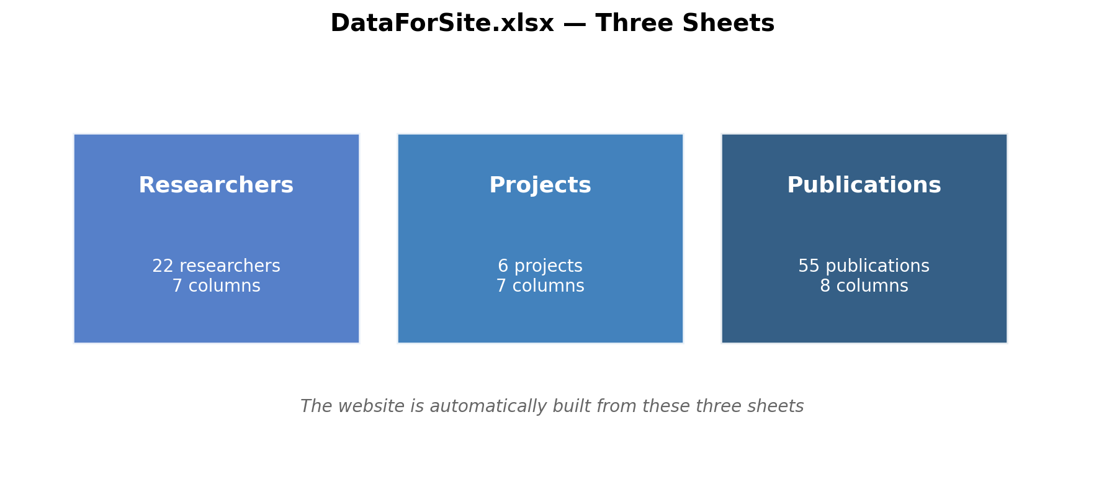
SECTION 01: UNDERSTANDING THE SPREADSHEET
The Spreadsheet Has Three Sheets
Every sheet has:
An ID column
(unique number for each entry)
A Name column
Cross-reference ID columns
(to link entries together)
An Image column
(for embedded pictures)
3 / 14

Slide 4
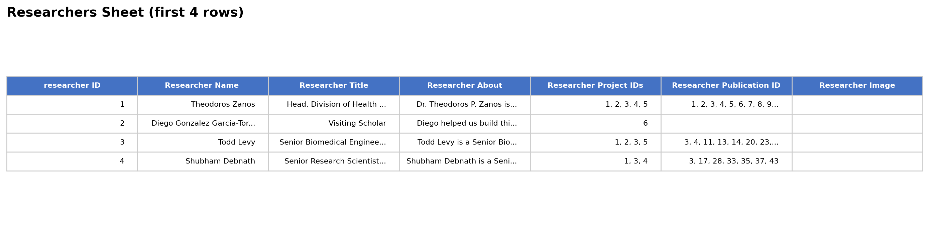
SECTION 01: UNDERSTANDING THE SPREADSHEET
Researchers Sheet — Columns
Column Name | What to Enter | Example
researcher ID | A unique number (next available) | 23
Researcher Name | Your full name with title | Dr. John Smith
Researcher Title | Your job title / role | Research Scientist, PhD
Researcher About | A paragraph describing your work | Dr. Smith studies neural...
Researcher Project IDs | Comma-separated project IDs | 1,3,5
Researcher Publication ID | Comma-separated publication IDs | 2,7,14,21
Researcher Image | Your photo (embedded in cell) | (see images section)
4 / 14

Slide 5

SECTION 02: ADDING YOURSELF AS A RESEARCHER
Step-by-Step: Add a New Researcher
1
Open the Researchers sheet
Tips
Click the "Researchers" tab at the bottom of the Excel window.
2
Find the next empty row
Always check the last ID before adding yours to avoid duplicates.
You can leave Project/Publication IDs blank and fill them in later.
Keep your "About" text to 2-3 sentences for the website.
Use a professional headshot for your image.
Scroll down past the last researcher. The current last row is ID 22.
3
Enter your ID
In the "researcher ID" column, type the next number (e.g. 23). This must be unique.
4
Fill in your details
Type your name, title, and about text in the corresponding columns.
5
Add cross-reference IDs
Enter comma-separated project/publication IDs (e.g. "1,3,5").
6
Insert your photo
Use Insert > Pictures > Place in Cell to embed your headshot.
5 / 14

Slide 6
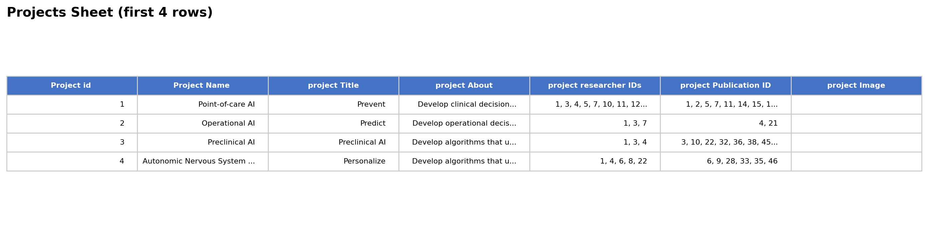
SECTION 03: ADDING A PROJECT
Projects Sheet — Columns
Column Name | What to Enter | Example
Project id | A unique number (next available) | 7
Project Name | Short project name | Surgical AI
project Title | Full descriptive title | AI-Assisted Surgical Planning
project About | Description of the project | This project explores the use...
project researcher IDs | Comma-separated researcher IDs | 1,3,7
project Publication ID | Comma-separated publication IDs | 4,21
project Image | Image embedded in cell | (see images section)
6 / 14

Slide 7
SECTION 03: ADDING A PROJECT
Step-by-Step: Add a New Project
1
Open the Projects sheet
Click the "Projects" tab at the bottom of Excel.
2
Go to the next empty row
The last project is currently ID 6. Your new project would be ID 7.
3
Enter a unique Project ID
Type the next number in the "Project id" column.
4
Fill in name, title, and about
Enter the project short name, full title, and a description.
5
Link researchers
In "project researcher IDs", enter the researcher ID numbers separated by commas.
6
Link publications
In "project Publication ID", enter publication IDs for related papers.
7 / 14

Slide 8
SECTION 04: ADDING A PUBLICATION
Publications Sheet — Columns
Column Name | What to Enter | Example
Publicatoin ID | Unique number (next available) | 56
publication Name | Full title of the paper | AI-Driven Diagnostics in...
publication journal | Journal name | Nature Communications
publication abstract | The paper's abstract text | In this study, we propose...
publication researcher IDs | Comma-separated researcher IDs | 1,5,10
publication project ID | The project ID this relates to | 1
publication Image | Image embedded in cell | (see images section)
publication url | Link to the paper (DOI preferred) | https://doi.org/10.1234/...
Note: The column header reads "Publicatoin ID" (with a typo). While this was initially unintentional, please do not rename it, as the website parser expects this exact name.
8 / 14

Slide 9
SECTION 04: ADDING A PUBLICATION
Step-by-Step: Add a New Publication
1
Open the Publications sheet
Click the "Publications" tab at the bottom of Excel.
2
Find the next empty row
The last publication is currently ID 55. Your new entry would be ID 56.
3
Enter a unique publication ID
Type the next number in the "Publicatoin ID" column.
4
Fill in the publication details
Enter the paper title, journal name, and abstract.
5
Link to researchers and project
Enter researcher IDs (comma-separated) and the project ID.
6
Add the URL
Paste the DOI link or direct URL to the paper.
9 / 14

Slide 10
SECTION 05: UPDATING YOUR BIO / ABOUT TEXT
How to Update Your Information
1
Go to the Researchers sheet
If you are not currently in the sheet, you can add yourself but do NOT change your Existing researcher ID — other entries depend on it.
2
Find your row using your name or ID
3
Click the cell you want to edit
4
Type your updated text and press Enter
Fields you can update:
Researcher Name — your displayed name
Researcher Title — your role/position
Researcher About — your biography paragraph
Researcher Image — replace with a new photo
Project/Publication IDs — add new links
10 / 14

Slide 11
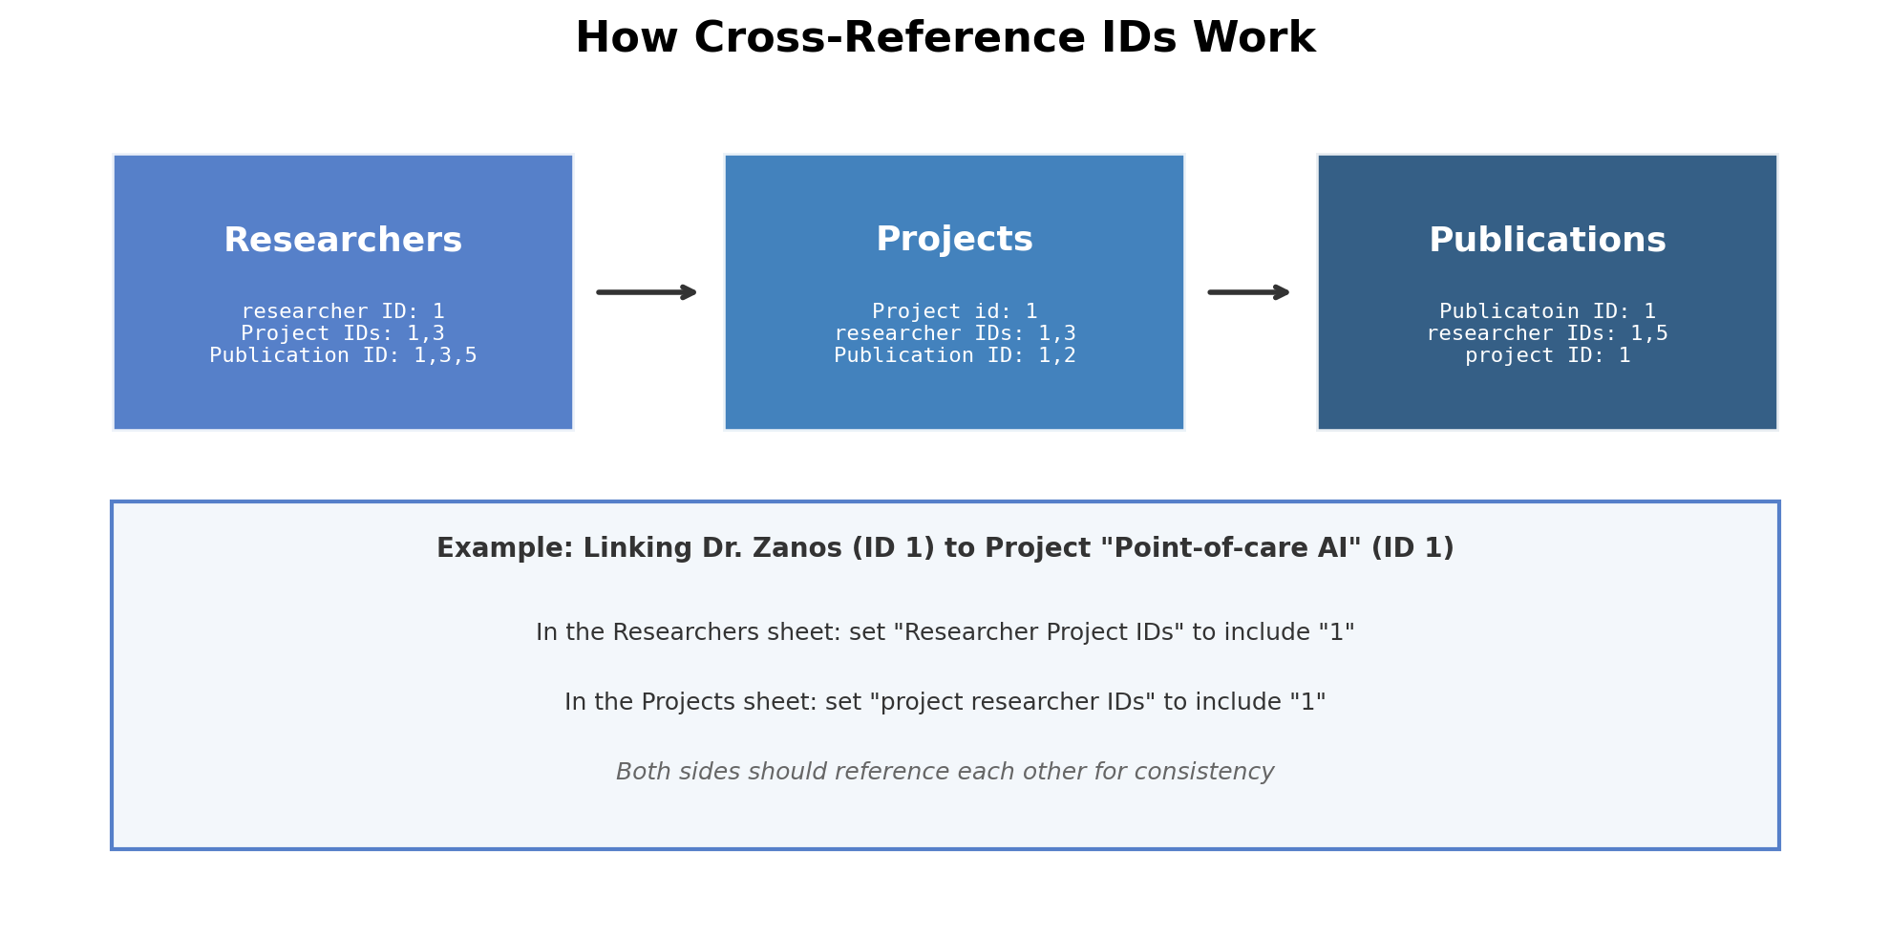
SECTION 06: HOW CROSS-REFERENCE IDS WORK
11 / 14

Slide 12


SECTION 06: HOW CROSS-REFERENCE IDS WORK
Rules for Cross-Reference IDs
DO
DON'T
Use simple numbers: 1, 2, 3
Separate multiple IDs with commas: 1,3,5
Update both sides: if you add project 2 to a researcher, also add that researcher's ID to project 2
Keep IDs sequential: the next ID is always last + 1
Spaces after commas are OK: "1, 3, 5"
Use names instead of numbers
Reuse an existing ID number
Use semicolons, slashes, or other separators (only commas)
Skip numbers (use 23 after 22, not 25)
Change someone else's ID number
12 / 14

Slide 13
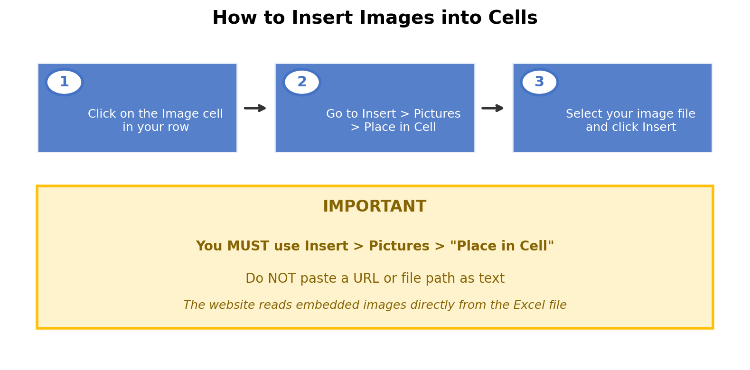
SECTION 07: INSERTING IMAGES
13 / 14

Slide 14
Quick Reference Cheat Sheet
Add Researcher
Add Project
Add Publication
Go to Researchers sheet
Next row, new unique ID
Fill name, title, about
Link project/pub IDs
Embed headshot image
Go to Projects sheet
Next row, new unique ID
Fill name, title, about
Link researcher/pub IDs
Embed project image
Go to Publications sheet
Next row, new unique ID
Fill title, journal, abstract
Link researcher/project IDs
Add DOI URL
Remember
IDs are simple numbers (1, 2, 3). Use commas to list multiple IDs. Always update both sides of a link. Embed images with Insert > Pictures > Place in Cell.
14 / 14

