Slide 1
Team 218 — Global-Therma
Infrared thermography-enabled NICU monitoring for early detection of circulatory deterioration
✅ InterSystems Prize

Slide 2
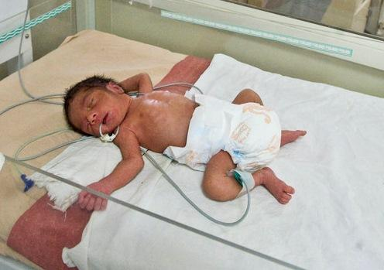
Look at him. Just days old, and already fighting for his life.

Slide 3
GLOBAL NEONATAL DEATHS FROM CIRCULATORY FAILURE
Late-onset sepsis 34%
NEC 22%
680,000
Early-onset sepsis 18%
deaths per year
Cardiogenic shock 12%
PDA / other 14%
NeoTherm detects the thermal signature common to all five.

Slide 4
THE PROBLEM
Current diagnostics are nonspecific, variable, or late.
⏱ Too Late
⚠ Too Invasive
◉ Too Nonspecific
Blood cultures take 24–72 hours. Clinical signs appear only after deterioration. Spot checks every 1–4 hours miss what happens between readings.
Adhesive probes damage premature skin. Blood draws for CRP / procalcitonin. 78% of NICU devices used off-label.
Single-point probes can’t detect spatial gradients. Capillary refill unreliable on dark skin. qSOFA designed for adults.
The gap: No continuous, non-contact, automated screening.
$2.1B / yr

Slide 5
What if we could see the warning signs 5 hours earlier?
But what if…
[ Claude GIF / Demo Animation here ]
Replace in Google Slides

Slide 6
THE SCIENCE
One camera. The body tells us everything.
CPTD = T_core − T_peripheral
Core-to-peripheral temperature difference (CPTD) is a validated marker of circulatory compromise. A rising CPTD indicates peripheral vasoconstriction — the body’s earliest autonomic response to infection or shock.
33.1°C
CORE 36.8°C
33.6°C
5 hrs
83%
0.3°C
All tones
earlier than clinical signs
sensitivity (Leante-Castellanos)
resolution FLIR Lepton 3.5
works on every skin tone
Leante-Castellanos et al., 2015; Knobel-Dail et al., 2017; Ussat et al., 2018 — see Appendix A5
31.5°C
32.1°C

Slide 7
HOW IT WORKS
Four components. Existing infrastructure.
No new network. No cloud. No custom EHR development.
Incubator Module
On-Device AI
InterSystems Health Connect
EHR Flowsheet
Custom-built device Mounts in incubator lid FLIR Lepton + compute <$1,000 / bed
Built into the module YOLOv8-Pose + CPTD 24h local buffer No separate hardware
HL7v2 ↔ FHIR R4 Message queue + audit Routes to any EHR Already at Northwell
CPTD as vitals BPA alerts Where clinicians look Epic Wave 2: May 2026
NeoTherm deploys once. Health Connect routes everywhere.

Slide 8
INTERSYSTEMS INTEGRATION
Health Connect is the backbone. FHIR R4 is the language.
Phase 1 — HL7v2 via Capsule
{
Edge box emits HL7v2 ORU. Capsule receives. Health Connect routes to EHR. Zero custom development.
"resourceType": "Observation",
"status": "final",
"code": {
"coding": [{
"system": "http://neotherm.io",
Phase 2–3 — FHIR R4 Direct
"code": "cptd",
Observations to Health Connect FHIR endpoint. IRIS repository. SMART on FHIR widget in Epic.
"display": "Core-Peripheral
Temperature Difference"
}]
},
"valueQuantity": {
EHR Migration Bridge
"value": 2.7,
Cohen Children’s Epic go-live May 30, 2026. Health Connect routes to legacy before, Epic after. Deploy once.
"unit": "degC"
},
"interpretation": [{
"coding": [{"code": "H"}]
}]
}

Slide 9
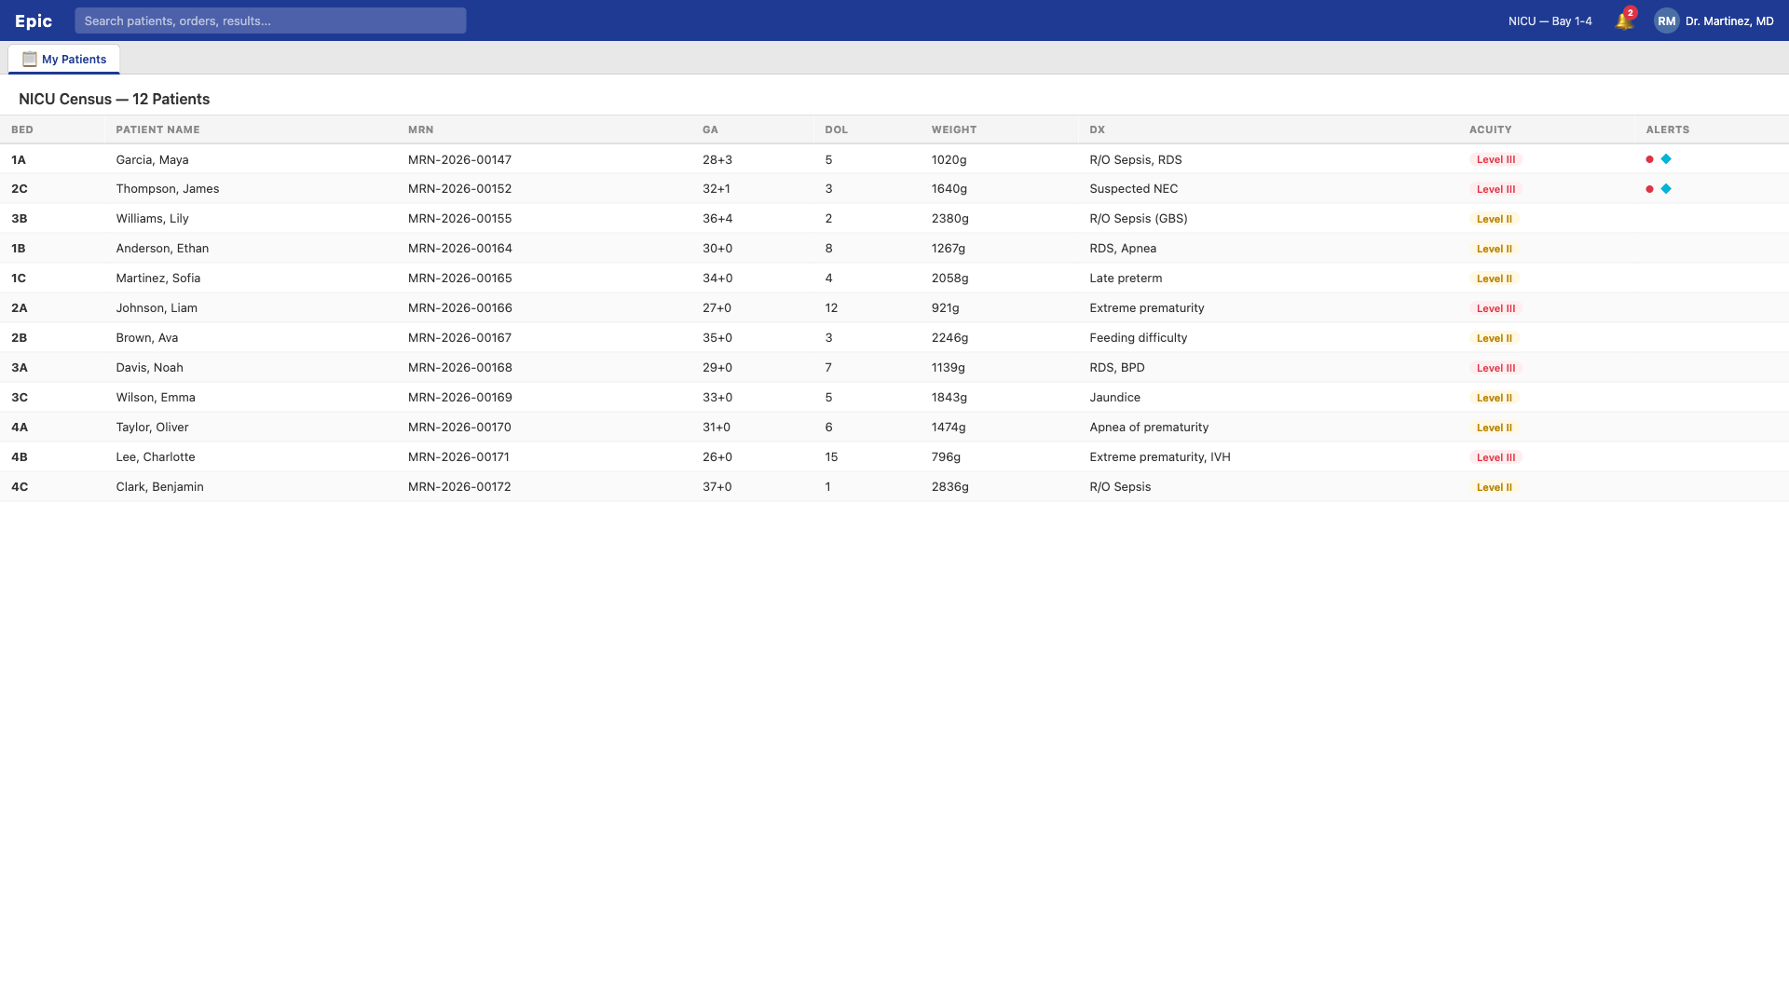
LIVE DEMO — NICU CENSUS
12 patients. NeoTherm flags visible at a glance.
Fully interactive Epic Hyperdrive replica. Built this weekend.

Slide 10
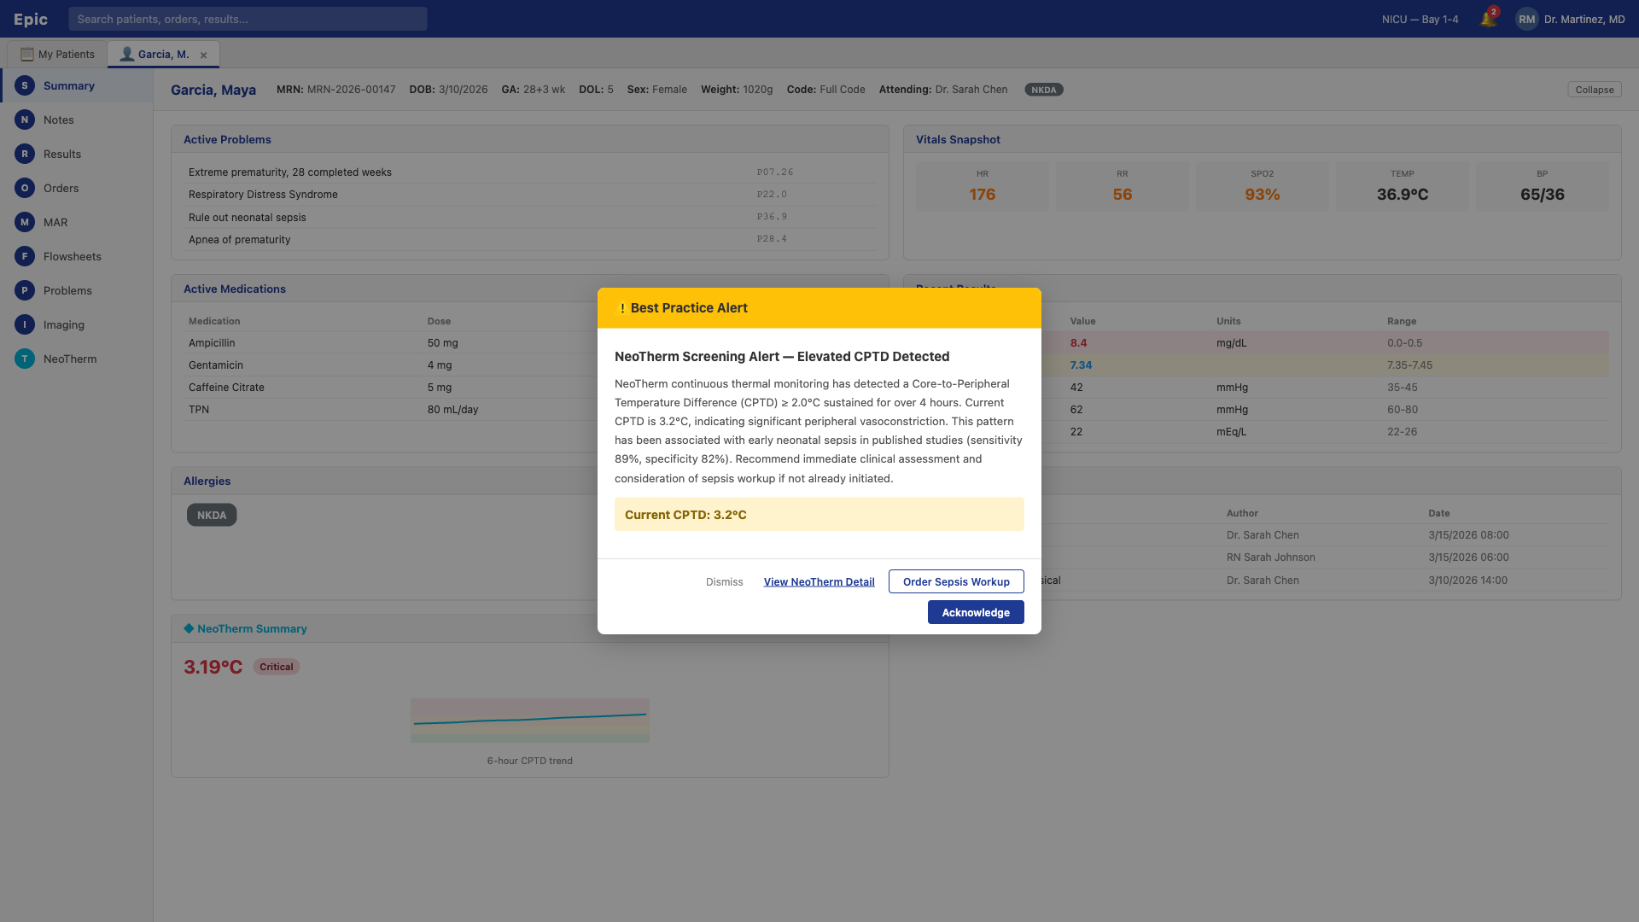
LIVE DEMO — BESTPRACTICE ALERT
CPTD crosses threshold. Alert fires on chart open.
Hospital-configured Epic BPA rule — no NeoTherm software generates the alert. No FDA clearance needed.

Slide 11
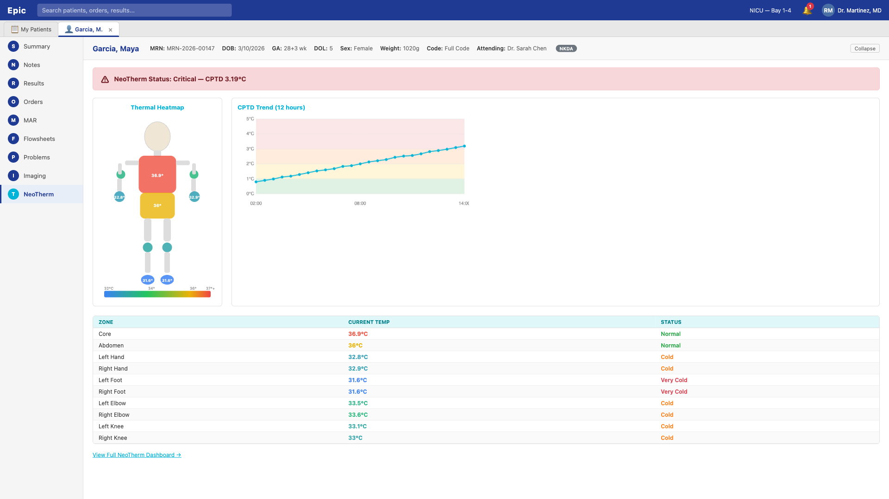
LIVE DEMO — NEOTHERM WIDGET
Dedicated tab. Trend data. Zone breakdown.
SMART on FHIR app queries InterSystems IRIS for Health. Deployed via Epic App Market.

Slide 12
GO-TO-MARKET
Built-out path to market.
Cohen Children’s Pilot
Q4 2026
1–2 beds. Display-only thermal + zone temps in Epic Flowsheet. IRB study with Dr. Barry Weinberger as Clinical PI. 200+ neonates target.
Silent Validation
Q1–Q2 2027
Expand to 6–10 beds. CPTD runs silently — data recorded but alerts NOT shown to clinicians. Builds unbiased prospective dataset.
Randomized Controlled Trial
Q3 2027 – Q1 2028
Full RCT: intervention arm gets alerts, control arm standard monitoring. Primary endpoint: time-to-antibiotic. Powers FDA De Novo.
Commercial Launch
2028+
FDA clearance with RCT data. GPO contracts (Vizient, Premier). 20 → 100+ hospitals. Adult ICU expansion ($6–8B TAM).

Slide 13
THE BUSINESS CASE
13.2x return. Pays for itself in 30 days.
$82,500
Pays (subscription)
$82,500 / yr
annual subscription per unit
Gets (CMS RPM)
+$31,987 / yr
Gets (sepsis savings)
+$1,140,000 / yr
$1.14M
sepsis cost savings per unit
Net benefit
$1,089,487 / yr
$65K
CMS RPM reimbursement
13.2x
30 days
82%
ROI
payback period
gross margin

Slide 14
MARKET
$2.1 billion problem. Zero competitors. We are first.
$2.14B
0
Annual US Cost Burden
TAM $1.6B
commercial thermal camera products for NICU
All US NICU beds (16,000+)
SAM $400M
“No commercial system exists for continuous non-contact thermal monitoring in the NICU.” — Frontiers in Pediatrics, 2023
Level III–IV NICUs (4,800 beds)
SOM $33M
First 400 beds by 2030
Adult ICU expansion $6–8B TAM

Slide 15
NORTHWELL PARTNERSHIP
Champions. Infrastructure. Ready.
Clinical Champion
Infrastructure Already In Place
Barry Weinberger, MD
InterSystems Health Connect
Message broker (live)
Assoc. Director, Neonatology — Cohen Children’s
Capsule MDI
Device integration (live)
NICU access · Clinical PI · IRB
Epic Hyperdrive
Go-live May 30, 2026
FHIR R4 Endpoint
Via Health Connect
Network / Wi-Fi
Existing NICU infra
Innovation Champion
Theodoros Zanos, PhD
AVP, Exploration & Innovation — Health AI
16-person team · IT approvals · Health Connect
Fully reversible: NeoTherm adds to existing infrastructure. Unplug and the NICU returns to normal.

Slide 16
REGULATORY ROADMAP
Phase 1 needs no FDA. We start now.
Phase 1: Display & Record
Phase 2: CPTD Trending
Phase 3: AI Sepsis Warning
NO FDA SUBMISSION
ENFORCEMENT DISCRETION
510(k) / DE NOVO
• Thermal image + zone temps only
• Calculated CPTD metric
• ML-based risk prediction
• Displayed as “adjunctive” data
• Threshold-based alerting
• Autonomous alert generation
• No diagnostic claim
• Clinical Decision Support
• Requires clinical trial data
• Clinician interprets all data
• FDA CDS exclusion criteria
• RCT powers submission
• IRB oversight only
• Transparent algorithm
• Predicate: InSightIQ (De Novo)
NOW
2027
2028+

Slide 17
THE INTERSYSTEMS CHALLENGE
Why Global-Therma wins.
Real Interoperability
HL7v2 + FHIR R4
✓ Health Connect
Not a wrapper. Health Connect is the production message broker at Northwell — 17,000+ clinicians, 23 hospitals.
Day-one HL7v2 via Capsule for immediate deployment. FHIR R4 for modern EHR integration. Both through Health Connect.
✓ FHIR R4 Facade
✓ IRIS for Health
✓ SMART on FHIR
EHR Migration Ready
IRIS Repository
✓ Message queuing
Cohen Children’s transitions from Allscripts Sunrise to Epic May 2026. Health Connect routes messages to either. Deploy once.
CPTD history stored in InterSystems IRIS for Health. Powers trend analysis, ML training, and SMART on FHIR queries.
✓ Multi-EHR routing
Not a prototype. Production architecture at the largest US health system.

Slide 18
680,000 newborns die from circulatory failure every year…
We just need to plug it in.
5 hrs
13.2x
$0 infra
0
earlier detection
ROI
new infrastructure
competitors
One camera. InterSystems Health Connect. Every NICU in America.
Global-Therma. Early detection saves lives.

Slide 19
TEAM 218
Global-Therma
Diego Pedregal
CEO / Product
Marcos Rodriguez
CTO / Engineering
Rida Baquai
Clinical / Neonatology
Michael Meehan
Business Dev
Taylir Speer
Regulatory / Strategy
Jedd Horowitz
InterSystems / Infra
✓ InterSystems Prize

