Slide 1
Business Data Analytics
TELECOM CHURN PREDICTION
18MCMI05, Delton M Antony
18MCMI14, Garima Jain

Slide 2
Problem Description
We are given a dataset by a telecommunications company
Dataset contains
Demographics Data
Company’s products opted by the customers
Billing options chosen by the customer
Amount paid/to be paid by the customer
The company is experiencing a high churn ratio
We need to identify why this churn is happening
We need to build a predictive solution to predict churn

Slide 3
Data Mining Task Identification
We need to identify customers which might churn
This is a binary classification problem
The positive class is Churn

Slide 4
Dataset Description
7043 records x 21 features
csv format with headers
Churn column is our target variable
Contains both categorical and continuous variables
The categorical columns are Gender, SeniorCitizen, Partner, Dependents, PhoneService, MultipleLines, InternetService, OnlineSecurity, OnlineBackup, DeviceProtection, TechSupport, StreamingTV, StreamingMovies, Contract, PaperlessBilling, PaymentMethod
The numerical ones are TotalCharges, MonthlyCharges, Tenure
The primary key is CustomerId

Slide 5
Exploratory Data Analysis

Slide 6
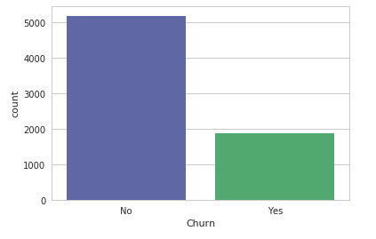
Exploratory Data Analysis
This shows the churn ratio

Slide 7
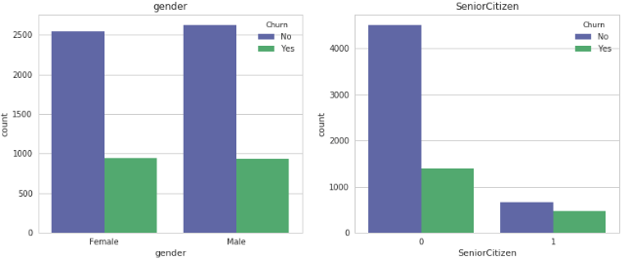
Exploratory Data Analysis
Gender does not matter in customer attrition in this case
Senior Citizens are more likely to churn

Slide 8
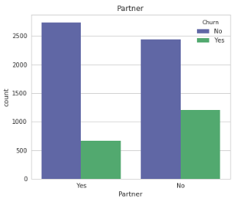
Exploratory Data Analysis
If a customer has a partner, then he/she is less likely to churn.

Slide 9
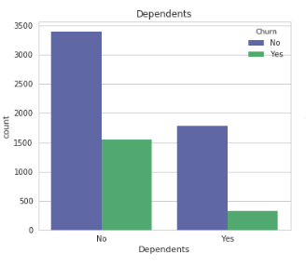
Exploratory Data Analysis
Customers without dependents are more likely to churn than settled people with dependents.

Slide 10
Exploratory Data Analysis
Similarly, the other insights we drew were
Customers with an Optical Fibre Internet Connection are highly probable to Churn. Will need to check this for possible reasons.
Customers without Online Security is highly likely to churn. Possible reason could be security breaches and frequent connectivity issues due to it.
Customers without online backup are also likely to Churn.
Customers without device protection are likely to Churn.
Customers without Tech Support are likely to Churn.
Customers with a month-to-month contract are the most frequent churners.
Customers using paperless billing churn more that those who transact in cash.
Customers paying their bills using electronic checks are highly likely to churn.

Slide 11
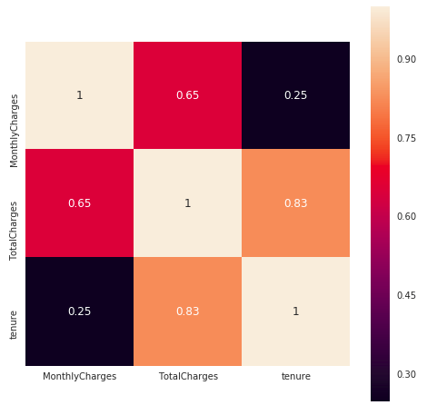
Exploratory Data Analysis
This is the correlation matrix for the numerical variables

Slide 12
Data Preprocessing
Imputing Missing Values
After converting TotalCharges as a numerical type, we got eleven missing values.
We imputed them with zeroes
The reason is that their tenure was also zero.
Which means that they had not been billed yet.
So logically TotalCharges is zero

Slide 13
One Hot Encoding
Here, all of the categorical variables are nominal as opposed to ordinal.
The categorical values of the variables are represented as “Yes”, “No”, “No internet service”. That is, they are represented as character strings.
We did one hot encoding on them.
After one hot encoding, we got multiple variables in place of one

Slide 14
Feature Selection
We used the Chi square value to perform feature selection.
We discarded features like PhoneService, Gender, StreamingTV, StreamingMovies, MultipleLines and InternetService.
Each of their chiSquare values were less than 9.821

Slide 15
Feature Selection
Feature | X^2
Contract | 1115.78
Tenure | 710.611
OnlineSecurity | 551.612
TechSupport | 523.304
TotalCharges | 298.738
OnlineBackp | 230.087
MonthllyCharges | 227.130
DeviceProtection | 191.303
SeniorCitizen | 134.532
Dependants | 133.036
PaperlessBilling | 105.681
Partner | 82.412
PaymentMethod | 58.492

Slide 16
Feature Scaling
Feature scaling can be used to standardize the range of input variables.
Some classifiers uses Euclidean distance which requires the data to be scaled. This is highly sensitive to the magnitude of the data.
methods like Gradient Descent converges much faster with scaled data.
x_{stand}=x_{i}-mean(f)/std(f)

Slide 17
Data Partitioning
Data partitioning means how we are splitting the data into training set and testing set
We are doing
regular hold out method
10 fold cross validation

Slide 18
METHODS AND TECHNIQUES APPLIED

Slide 19
Principal Component Analysis
Method to reduce the input dimensions without performing feature selection
It performs a linear transformation of the input data from one form to another
selecting the first few principal components after doing PCA will essentially result in dimension reduction without feature selection.
Here, we selected the first 3 components which accounts for 80% of the variance.

Slide 20
Grid Search
For selecting the hyperparameters
Grid search is a brute force based technique where you initialize a list with all the parameter values you want to try out for your model instances
Then you pass that to the function that calls the models with different permutations of all the parameters you chose
Note that you should keep the seed or random_state as a constant value
It finds a tuple of optimal parameters for you to fit on the model.
Grid search can be considered as a kind of methodical trial and error
in some cases, the best results were given by the default parameters itself

Slide 21

Logistic Regression
uses the logistic function to model a binary dependent variable
Logistic Regression is a discriminative classifier.
For a single input variable, the Logistic Regression function looks like this

Slide 22
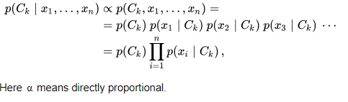
Naïve Bayes Classifier
classifiers based on applying Bayes' Theorem with strong (naive) independence assumptions between the features
Naive Bayes is a popular method for text classification
Naive Bayes is preferred on smaller datasets
It is a generative classifier

Slide 23
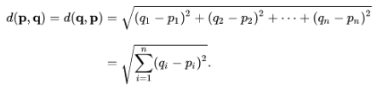
K - Nearest Neighbors Classifier
The input consists of the k closest training examples in the feature space
The output is a class membership
An object is classified by a majority vote of its neighbors
Nearness is calculated by using distance measure like Euclidean distance as shown below

Slide 24
Support Vector Classifiers
Unlike other models, SVC does not use the entire dataset to train itself.
It uses the tipping points - also known as support vectors
These are those points that define the boundary of the two classes
This is a rare case of dimension reduction with respect to the records as opposed to features
Records of the separate categories are divided by a clear gap that is as wide as possible.

Slide 25

Kernel Support Vector Machines
Kernel Support Vector Machine will introduce the data to a higher dimension and then try to classify them
The procedure is to make a non-linearly-separable data linearly separable
the kernel function used is set as rbf which is "Radial Basis Function". The function is as follows: Here, |x - x’|^2 is the squared Euclidean distance.

Slide 26

Decision Tree Classifier
Decision Tree is the go to method if you want clear insights on how the classifier predicts and under what criteria
This gives clear rules followed by the classifier
We are using information gain as the criteria ie criteria = entropy

Slide 27
Random Forest Classifier
Random forest comes under a category called ensemble algorithms
instead of one single decision tree, an army of decision trees are used and the results learned by them are then converged together to create the model.

Slide 28
Xtreme Gradient Boosting
produces a prediction model in the form of an ensemble of weak prediction models, typically decision trees
It builds the model in a stage-wise fashion and it generalizes them by allowing optimization of an arbitrary differentiable loss function
This is done sequentially
as the number of iterations goes by, the error will steadily decrease

Slide 29
Multi Layer Perceptron
An MLP consists of, at least, three layers of nodes: an input layer, a hidden layer and an output layer
Each node is a neuron that uses a nonlinear activation function
MLP utilizes a supervised learning technique called backpropagation for training
MLP can work with non-linearly-separable data

Slide 30
RESULTS AND DISCUSSIONS

Slide 31
Best Parameters Returned by Grid Search
SlNo | Model | Non default Parameters
1. | K - Nearest Neighbors | 20 Neighbors, Minkowski with p = 2
2. | Linear Support Vector Classifier | Default
3. | Kernel Support Vector Classifier | rbf kernel, degree 3
4. | Decision Tree | max_depth = 5, criteria= information_gain
5. | Random Forest | n_estimators = 10, max_depth = 5, criteria = information_gain
6. | XGBoost | max_depth = 4, learning_rate = 0.1
7. | Multi Layer Perceptron | solver=sgd, actFunction=relu, maxIter=85, learning_rate=0.001, momentum=0.9, hidden_nodes = (100,)

Slide 32

Model Evaluation Methods
confusion matrix
True positives (TP): These are cases in which we predicted a churn, and they do churn. True negatives (TN): We predicted a non-churn, and they don't churn. False positives (FP): We predicted a churn, but they don't actually churn. False negatives (FN): We predicted a no-Churn, but they actually do churn.
10 - fold cross validation
Area under Receiver Operating Characteristic Curve:
The ROC curve is created by plotting the true positive rate (TPR) against the false positive rate (FPR) at a single or various threshold settings
AUC, the Area Under receiver operating characteristic Curve. The higher the area, the better the classifier is
Model Comparison is done by t-stat test
Predicted
Actual

Slide 33
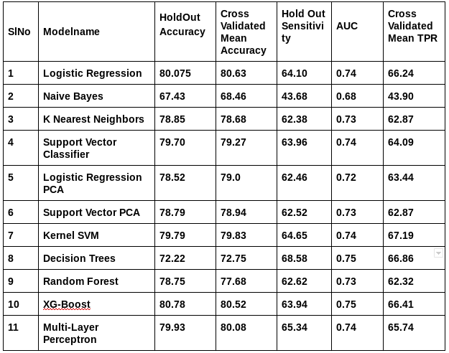

Slide 34
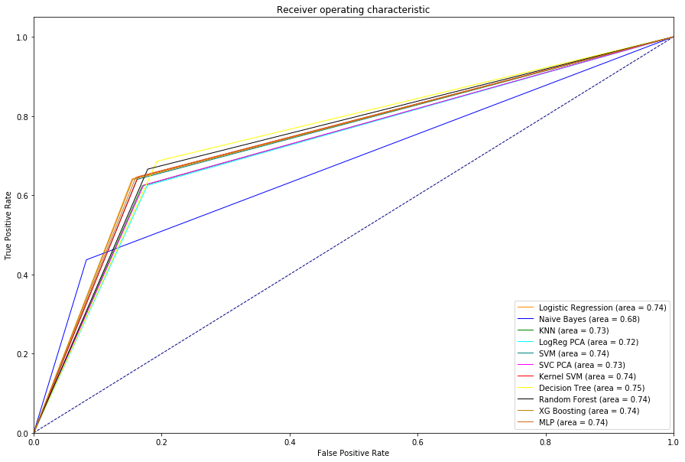

Slide 35
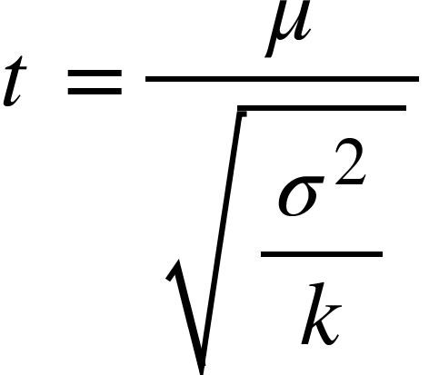
Model Selection
Student’s t-test
A method of testing hypotheses about the mean of a small sample drawn from a normally distributed population when the population standard deviation is unknown.
If we have the mean and the variance of a list, in this case, the list of ten sensitivities from 10 fold cross validation, then t is given as

Slide 36
Model Selection
Here, the k value is set as 10 as we are doing 10 fold cross validation
For a 1 % test, we use the threshold value of 3.25 - corresponding to 0.5% value with 9 degrees of freedom. It’s two tailed test, as we do not know whether the mean of one classifier’s list of TPRs is greater than that of another’s or vice-versa
So, if the t-test returns a value greater than 3.25, it means for that confidence level of 1%, the two classifiers we are comparing are different.

Slide 37
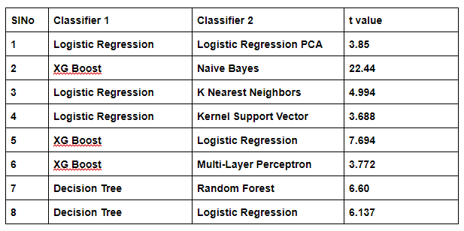
Model Selection

Slide 38
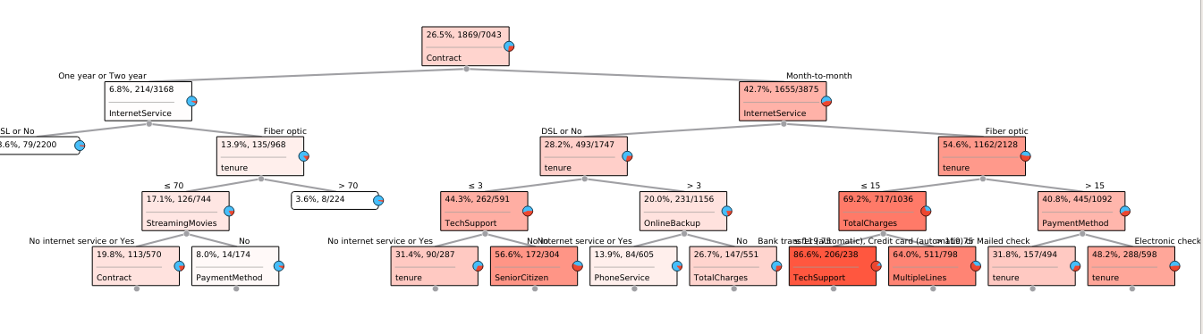
Model Selection
From t test, we found out how the models are different from each other
The most promising models are Logistic Regression, XG Boost and Decision tree
we decided to choose Decision tree classifier for the final build
decision trees will give you clear knowledge
Once the model is fixed as Decision Tree with max_depth=4 and criterion=entropy, we train it on the entire dataset.
Now it is ready to predict for unseen data

Slide 39
Monitoring
On a final note to the company, it is necessary to monitor the model to check that it does not get outdated.

Slide 40
CONCLUSIONS

Slide 41
Guidelines from Exploratory Data Analysis
Give senior citizens more incentive to stay on as customers.
For customers without dependents, they might move places often. Make connection relocation cheaper and easier.
Reduce the cost of Optical Fibre Internet Connection.
Make online security a default feature. It will reduce churn and will make customers more secure.
Similarly make online backup also accessible to customers.
Device Protection should be a default feature as damaged devices will lead to a possible churn.
Make Tech Support available to each customer.
Try to convert month-to-month contract customers to yearly contract customers. Provide more year-based payment plans and offers.
Find out the reason why the customers who opt for paperless billing and electronic checks churn more. Maybe a fault in the company's online billing process.

Slide 42
Conclusions from predictive Analytics
Built a total of eleven models
Performing PCA reduced the accuracy
Feature Selection did not really impact the accuracy
Naïve Bayes performed poorly
Decision tree was chosen as the final model.
Other models like Logistic Regression and xgboost also performed well

Slide 43
REFERENCES
[1] http://scikit-learn.org/stable/documentation.html
[2] https://matplotlib.org/contents.html
[3] https://xgboost.readthedocs.io/en/latest/parameter.html
[4] https://docs.anaconda.com/anaconda/install/linux/
[5] https://docs.python.org/3/library/statistics.html
[6] https://www.youtube.com/watch?v=ErDgauqnTHk
[7] https://en.wikipedia.org/wiki/Stochastic_gradient_descent
[8] http://scikit-learn.org/stable/modules/grid_search.html

