Slide 1


Blue Sky City:
Community livability Assessment for Calgary
Figure 1 Calgary peace bridge (2026)
BGIS Final Project
Group 1:
Teng Zhang, 998796
Apram Singh, 998547
Delu Maduekwe, 861782
April 20, 2026
Notes:
Morning everyone! We are Group 1, my name is teng and this is Apram and our project manager Delu. today we are excited to share with u the final findings of our project named blue sky city: community livability assessment for Calgary.

Slide 2

Agenda
1.Project Introduction
2.Geospatial Project Management
3.Geospatial Technology Introduction
4.Project Analysis
5.Concluding Remarks
Figure 2 View of Downtown Calgary from the Calgary Tower
Notes:
Here’s the agenda for today. We will be covering these five topic for the project.

Slide 3




Rationale & Geographic Question
The Problem
The Solution
Geographic Question
Rapid population growth has created an infrastructure lag in new communities residents lack objective data to evaluate neighbourhoods.
A 0–40 Livability Index using GIS to objectively rank 200+ residential neighbourhoods across four evidence-based pillars.
Where in Calgary, are the most livable communities?
Figure 3 The Peace Bridge in Calgary Note. This photograph shows the Santiago Calatrava-designed bridge spanning the Bow River. From Peace Bridge, by Mindtrip, n.d.,
Notes:
Calgary is growing at a historic pace, leading to an 'infrastructure lag' in new areas. This is why our project is important: right now, homebuyers and city planners are often making major decisions without objective data. They need a way to evaluate neighborhoods based on actual quality of life, not just real estate prices. We answered this by creating a standardized 0–40 Index to rank over 200 neighborhoods. This brings us to our core geographic question: Where in Calgary, are the most livable communities?"

Slide 4

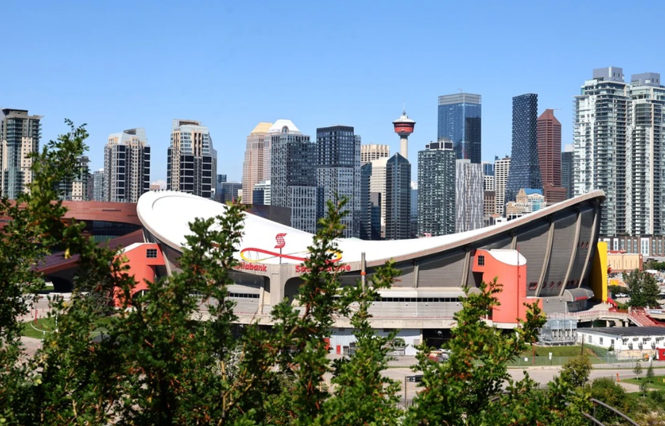
Geospatial Project Management
PROJECT TOOLS
PROJECT TIMELINE
MS Project / Gantt Chart
Phase 1
Phase 2
Phase 3
Work Breakdown Structure (WBS)
Data Capture
Data Manipulation
Analysis & Output
ESRI ArcGIS Pro
Feb 2026
Mar 2026
Apr 2026
bluesky.gdb (File Geodatabase)
RISK MITIGATION
Shared Version Control Folder
Standardized coordinate system: NAD 1983 3TM 114W across all layers
Topology rules enforced (No Gaps / No Overlaps/ Must Cover By) on Study Area
QA/QC audits at each phase; version-controlled BlueSky.gdb packaging
Figure 5 Scotiabank Saddledome in Calgary
Notes:
To manage this complex workflow, we acted as a functional GIS firm. We utilized a Work Breakdown Structure to divide the four pillars. A critical technique was our Centralized Data Management; by using a shared Geodatabase with a NAD 1983 3TM 114 projection standard and we audit data with QA/QC checklist at each phase, we ensured that our individual analyses could be combined into the final index without spatial errors.

Slide 5
Methodology:
Data Capture & Geodatabase
B&E Rate
B&E Crime Statistics (CPS) /
Calgary Police Service
Transportation
10-Min Walk Service Areas / City Of Calgary Open Data
BlueSky.gdb
Four Pillars
Housing Price
HPI: Housing Price-to-Income /
Pillar 9 (2025 MLS Data)
Park Space
Park Density per Community Area / City of Calgary Open Data
Notes:
"The foundation of our project rests on four critical pillars:
We tracked break-and-enter rates, because physical security is the first requirement of any stable neighborhood.
We mapped 10-minute transit walk service area, ensuring residents are efficiently linked to jobs and essential services.
We analyzed housing-to-income ratios, as financial accessibility is the baseline for realistic livability.
We measured park density, recognizing that green space is essential for environmental and personal health.

Slide 6

Methodology:
Data Cleaning & Topology
STUDY AREA REFINEMENT
TOPOLOGY RULES: Communities_Final
Filtered to residential communities only using Select Layer By Attribute
Rule: Must Not Have Gaps (Area)
Ensures continuous spatial coverage across Calgary no unmapped voids in analysis area.
Removed communities with population < 100 (statistical outliers)
Excluded industrial zones, institutional campuses (e.g., University of Calgary)
Rule: Must Not Overlap (Area)
Prevents double-counting in area-based calculations like park density and crime rates.
Final study area: 212 residential communities
Rule: Must Be Covered By City_Boundary
Guarantees all community polygons remain within Calgary municipal limits.
Figure 6 The Calgary Tower and Surrounding Downtown Infrastructure
Notes:
Looking back at our methodology, this slide shows how carefully we cleaned and prepared our data. We focused only on true residential communities, removing industrial areas, campuses, and any neighbourhood with less than 100 people after used enrichment. This left us with a clean set of 212 communities in Calgary. We then applied clear topology rules: must not have gaps / overlaps, Must be covered by city boundary.
That careful work gave us a trustworthy foundation for the whole project.

Slide 7





Why Geospatial Technology Is Important?
Advanced Spatial Statistics
Vector Analysis
Spatial Joins
GIS is the best tool because it enables
Multicriteria
Decision
Analysis
Enables Moran's I spatial autocorrelation and Getis-Ord Gi* hot spot analysis to prove results are statistically significant and not random.
The "glue" of the project : attached crime points, park polygons, and housing prices to a single community boundary layer.
Spatial Relationships
Multi-Source Integration
Network Analysis
Data Enrichment
10-Minute Walk
GeoEnrichment
Calculated actual pedestrian travel time via Network Analyst : accounting for real barriers like the Bow River and Deerfoot Trail.
Pulled 2025 demographic & income data to normalize livability scores against current population density.
Figure 4 Night Skyline of Calgary, Alberta, in Winter
Notes:
Our methodology came down to one core idea: don't just look at the numbers - look at where those numbers live.
We used Spatial Joins to pull together crime data, park coverage, and housing prices into one unified map of Calgary. Every community got a single, comparable livability score. But what made GIS essential was how it handled distance. Instead of drawing a simple circle on a map, we used Network Analysis to calculate actual service area. That's something a spreadsheet will never do.
Finally, we ran a Global Moran's I test to prove our results weren't random. Livable communities in Calgary genuinely cluster together -and we have the statistics to back that up.
With that, I’m happy to pass it over to Delu, who will take us through the key analytical findings.

Slide 8
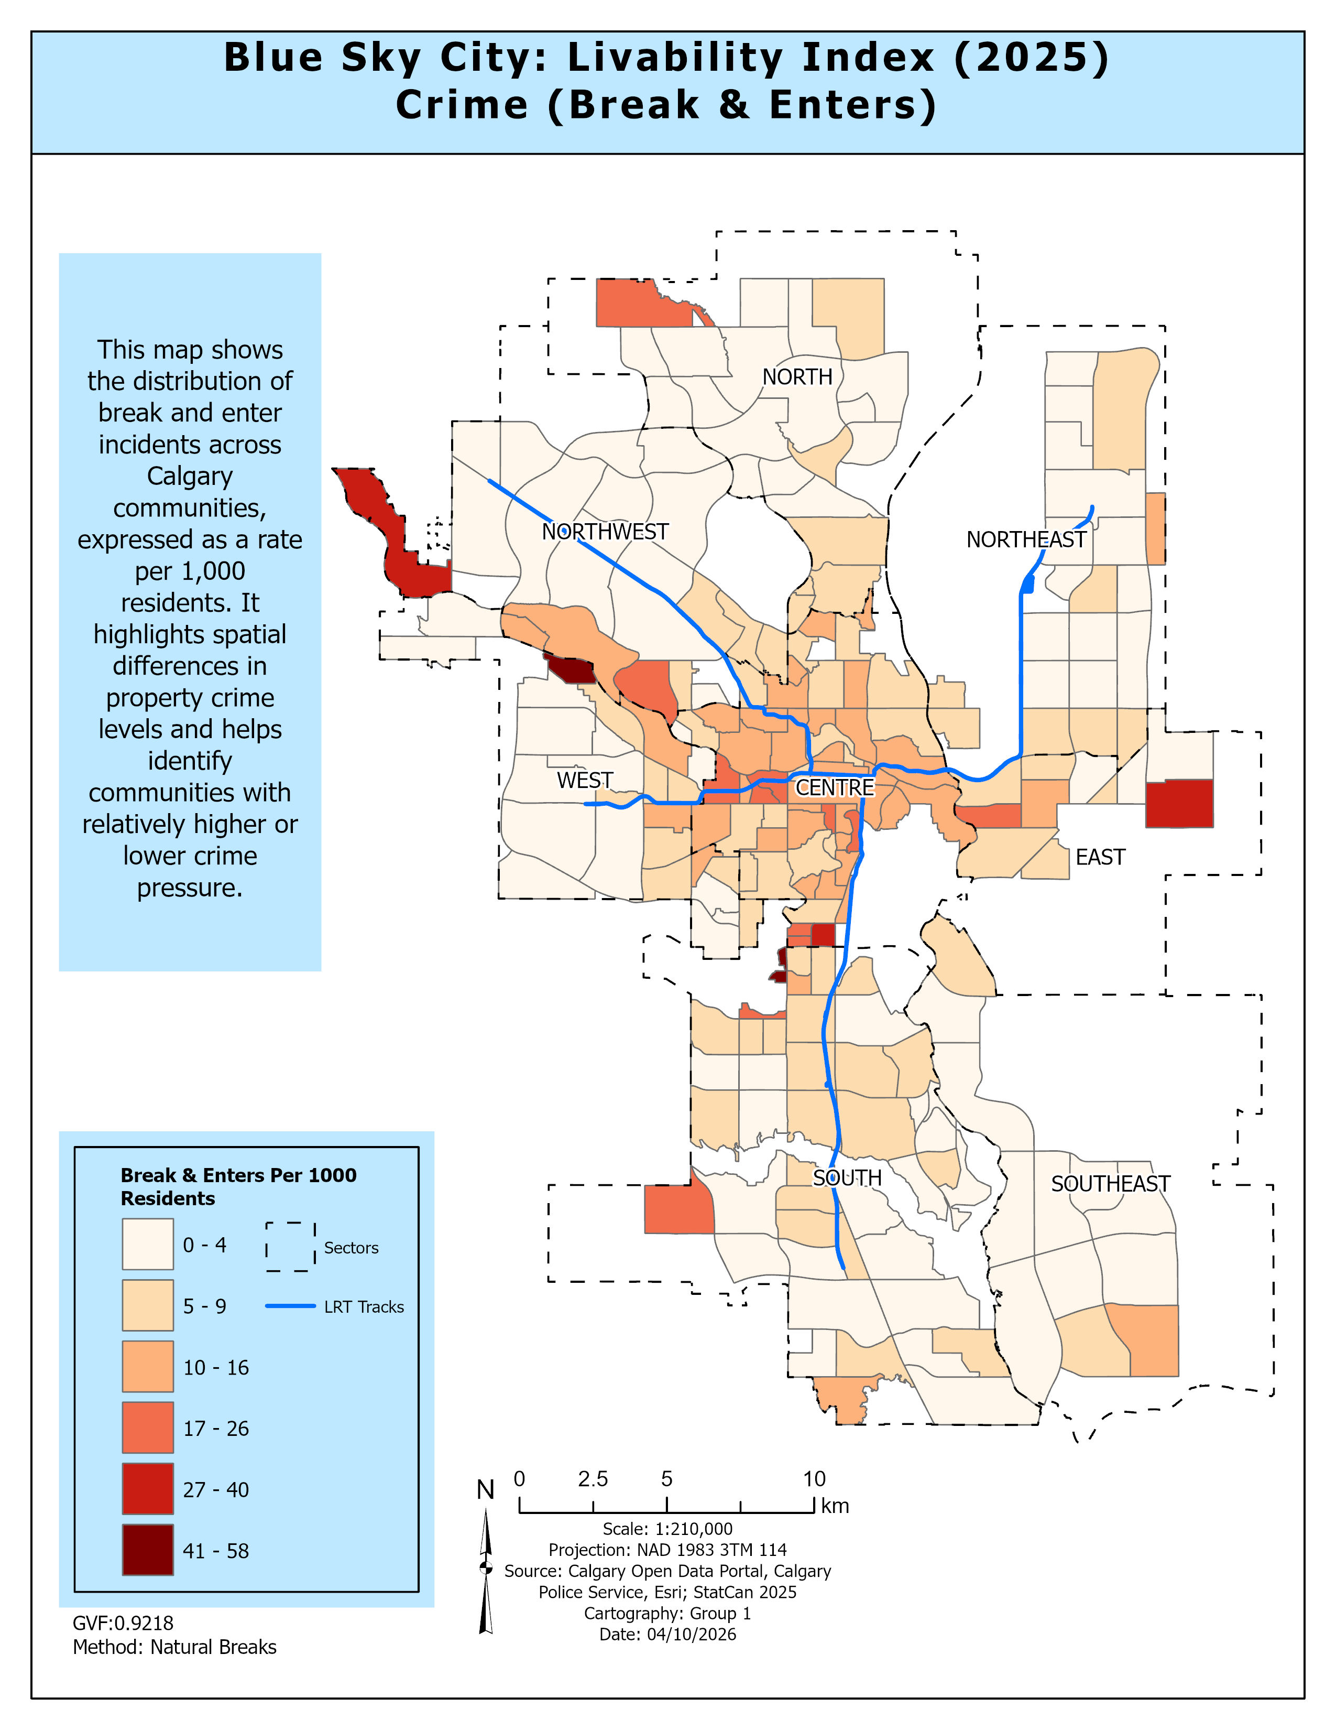


Pillar Analysis: Crime B&E
PILLAR 01 - Crime B&E
Metric:
Break & Enter rate per 1,000 residents
Why Normalize?
Raw counts favour dense areas per-capita rates reveal true risk
Finding:
Higher B&E counts concentrated in Centre sector (2,794 incidents) leading to higher rates
Trend:
Lower rates more common in North and Southeast sectors
Index Impact:
Lower B&E rate = higher safety sub-score (0–10 pts)
Notes:
The first pillar we looked at was safety.
Instead of using total break and enter counts, we used the rate per 1,000 residents.
That was important because raw counts can make denser communities look worse than they actually are.
What we found was that higher break and enter rates were concentrated mainly in the Centre sector.
Lower rates were more common in the North and Southeast.
This pattern also generally followed the LRT corridor, suggesting that LRT-connected areas may create greater opportunity and mobility for crime.
In the final index, lower crime meant a higher safety score.

Slide 9
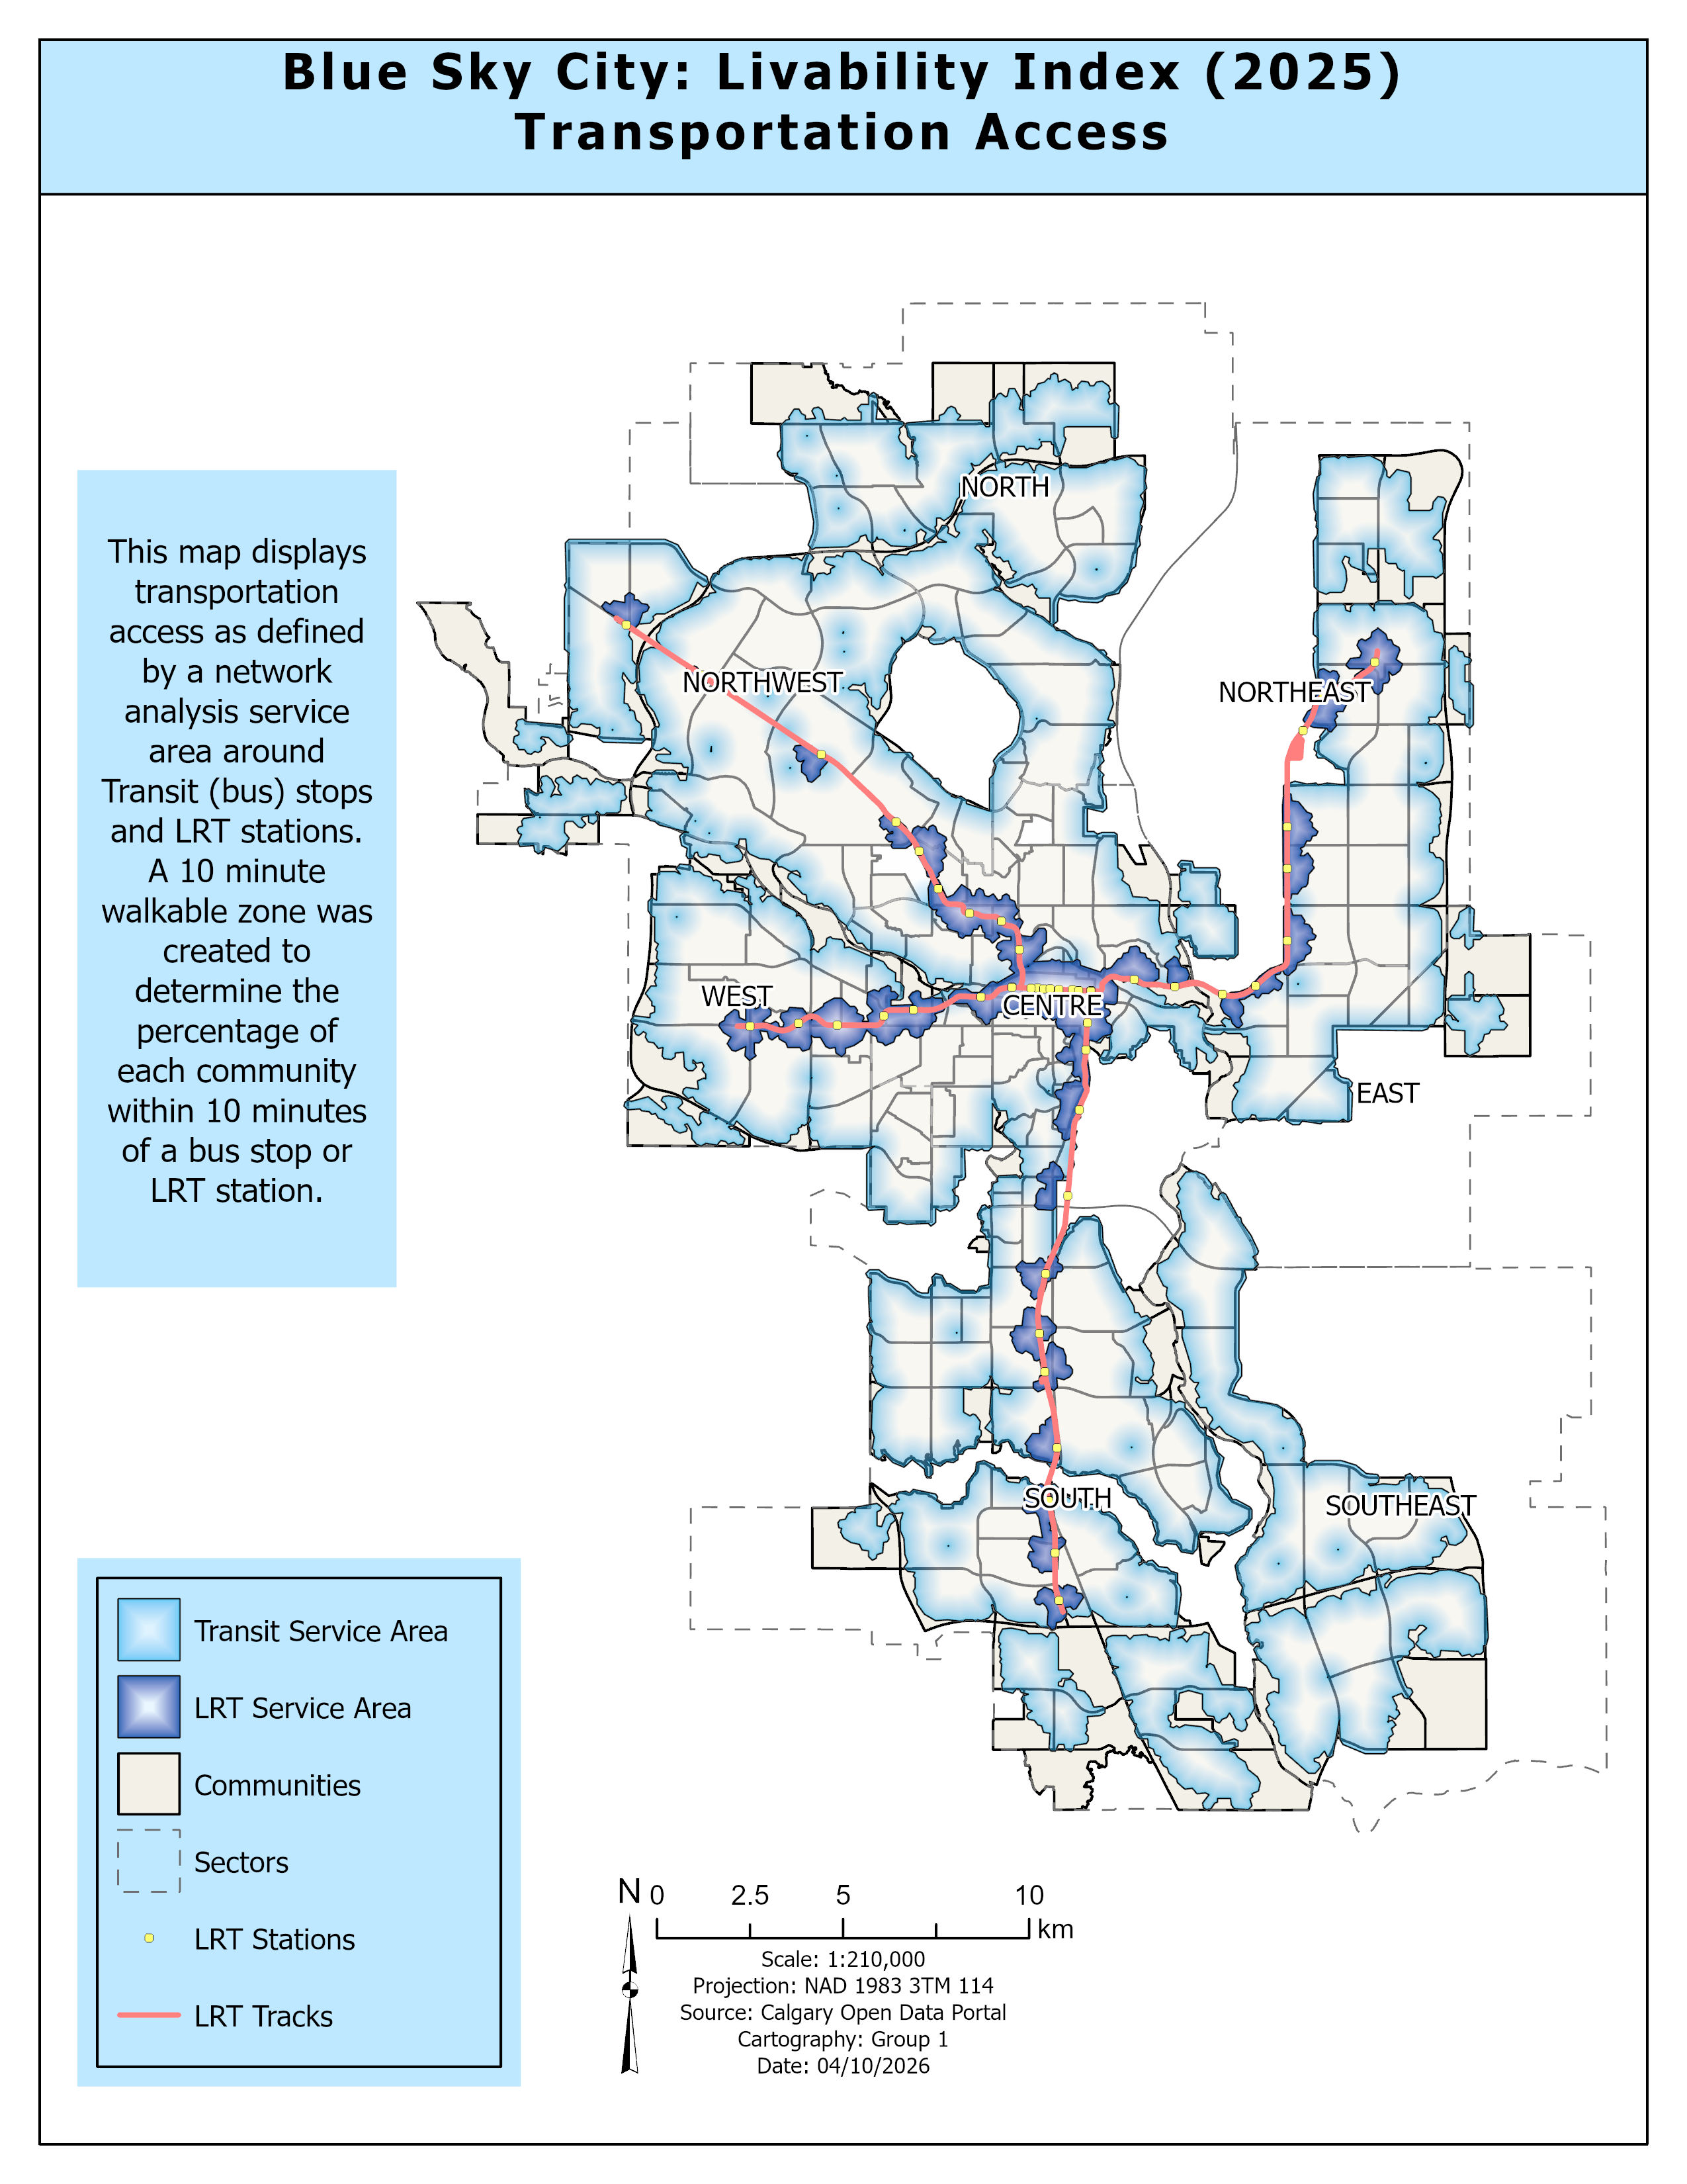

Pillar Analysis: Transportation
Moraine
PILLAR 02 -Transportation Access
Metric:
% of community within 10-min walk of transit/LRT
Method:
Network Analyst service areas 5 km/h, major roads as barriers
Finding:
64% of communities (135/212) have > 90% transit coverage
Weak Spots:
Pine Creek, Rangeview, Moraine peripheral, limited infrastructure
LRT Access:
Only 76 communities have LRT coverage; 6 have > 80% coverage
Pine Creek
Rangeview
Notes:
The second pillar is transportation access.
Here, we measured how much of each community falls within a 10-minute walk of transit stops and LRT stations.
We used Network Analysis instead of simple buffers so the results reflected actual walking paths and barriers.
The results showed that transit coverage is quite strong in many established communities.
About 64 percent of communities had over 90 percent coverage.
In contrast, developing edge communities like Pine Creek, Rangeview, and Moraine had much weaker coverage.
In the livability index, better transit access meant a higher score.

Slide 10
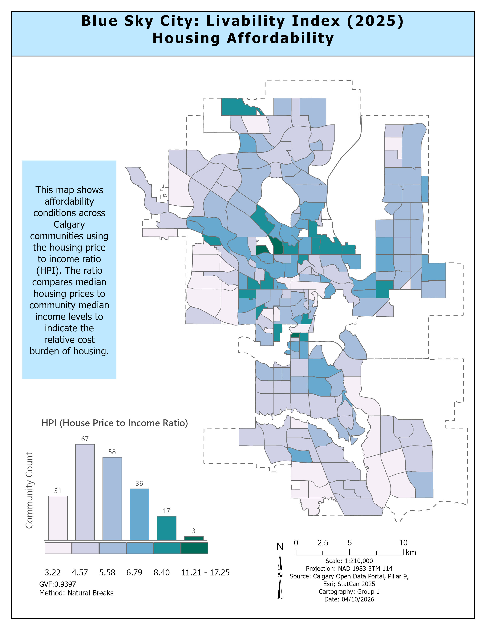

Pillar Analysis: Affordability
PILLAR 03 -AFFORDABILITY (HPI)
Metric:
Housing Price-to-Income Ratio (HPI)
Formula:
Median House Price ÷ Median Household Income (2025)
Spatial:
Low affordability clusters in central city and outward pockets
West/SE:
Peripheral communities show more favourable HPI values
Index:
Lower HPI = reverse-scored to give higher livability points
Notes:
This slide focuses on housing affordability.
We measured that using the housing price to income ratio, or HPI.
A lower HPI means housing is more affordable relative to income.
A higher HPI means a greater housing cost burden.
Spatially, lower affordability appeared in parts of the central city and some connected outward pockets.
Some western and southeastern peripheral communities showed more favourable affordability values.
Because affordability works in the opposite direction, lower HPI values were reverse scored in the final index.

Slide 11
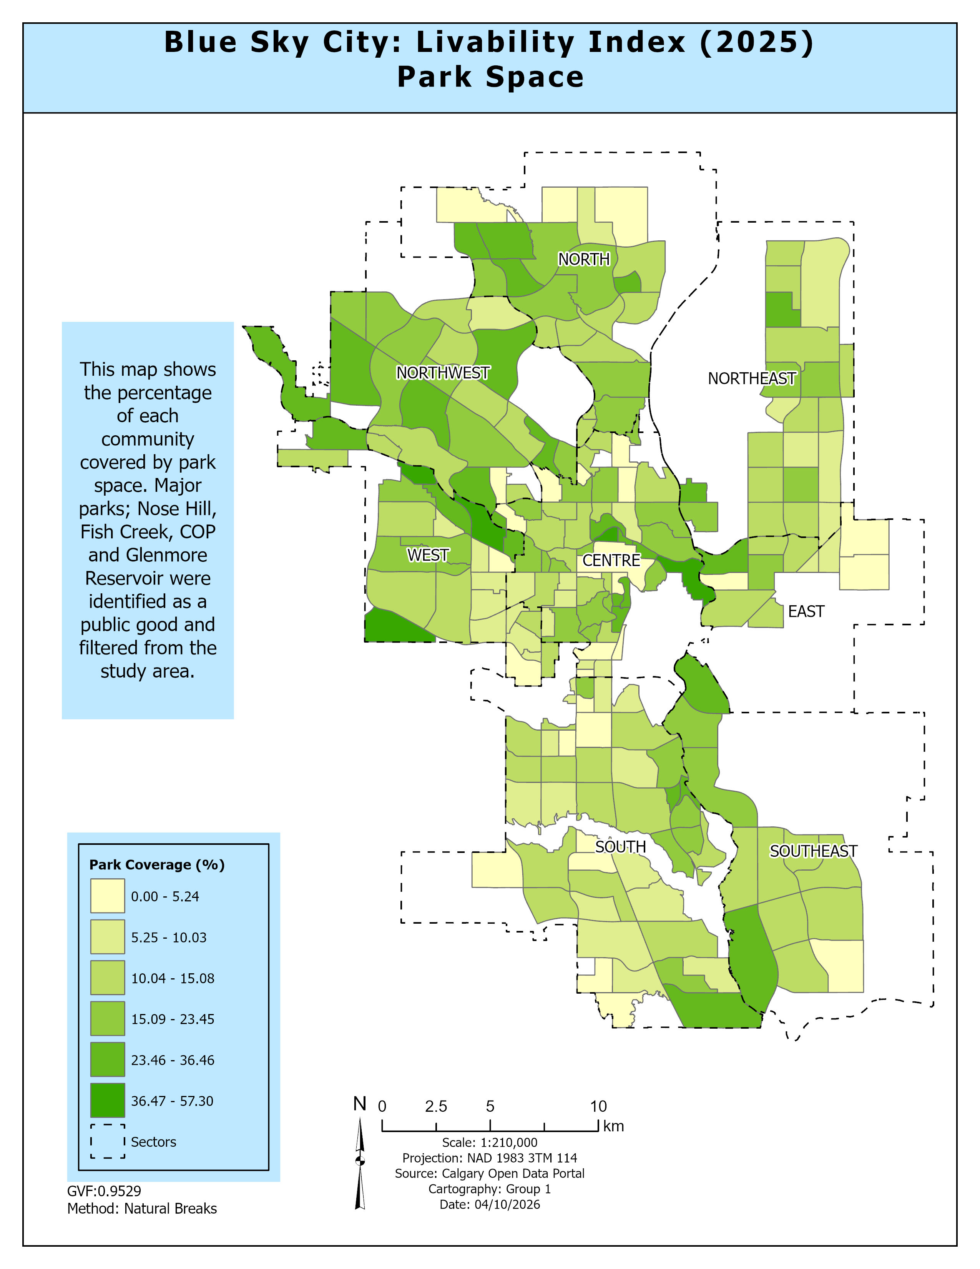

Pillar Analysis: Park Space
PILLAR 04 – PARK SPACE
(Park Coverage)
Metric:
Park area as % of total community polygon area
Filtered:
Removed major destination parks (Nose Hill, Fish Creek, etc.)
Pattern:
Higher coverage in western, central, and southern communities
Low Areas:
Eastern and outer-edge communities have fewer park assets
Trade-off:
High-density core communities trade space for park proximity
Notes:
The fourth pillar was usable park space.
We looked at the distribution of parks and calculated park area as a percentage of total community area.
We removed major destination parks like Nose Hill and Fish Creek because they do not reflect neighbourhood-level park access for a single community.
The results showed stronger park coverage in many western, central, and southern communities.
Lower park coverage was more common in eastern and outer-edge areas.
In the livability model, higher park coverage was considered more favourable.

Slide 12
The 0–40 Livability Scoring Formula
Index = Score(Safety) + Score(Transit) + Score(Affordability) + Score(Green Space)
[each 0–10 pts]
23.83
5.77
Min-Max Normalization Formula
For each variable X:
/ 40
Score = (X − X_min) / (X_max − X_min) × 10
City Mean Score
Std Deviation
• Converts diverse units (km², CAD, incidents) to a common 0–10 scale
• Crime/HPI are reverse-scored (lower = better = higher points)
• Prevents any single pillar from dominating the final result
24.31
115/212
/ 40
City Median Score
Above Average Communities
Notes:
After calculating all four pillars, we standardized them using min-max normalization.
That allowed us to compare everything on the same scale.
Each pillar was scored from 0 to 10, and then combined into a final livability index out of 40.
Crime and affordability were reverse scored, so lower crime and more affordable housing produced higher scores.
Because the mean and median are so close, the scores are fairly balanced overall and are not being pulled too much by a few extreme communities.
The mean of 23.83 gives us a city-wide benchmark to compare communities against.
54% of viable communities ranked above average, supporting a normal distribution of livability scores
And the standard deviation shows there is still enough variation to clearly separate the stronger and weaker communities

Slide 13
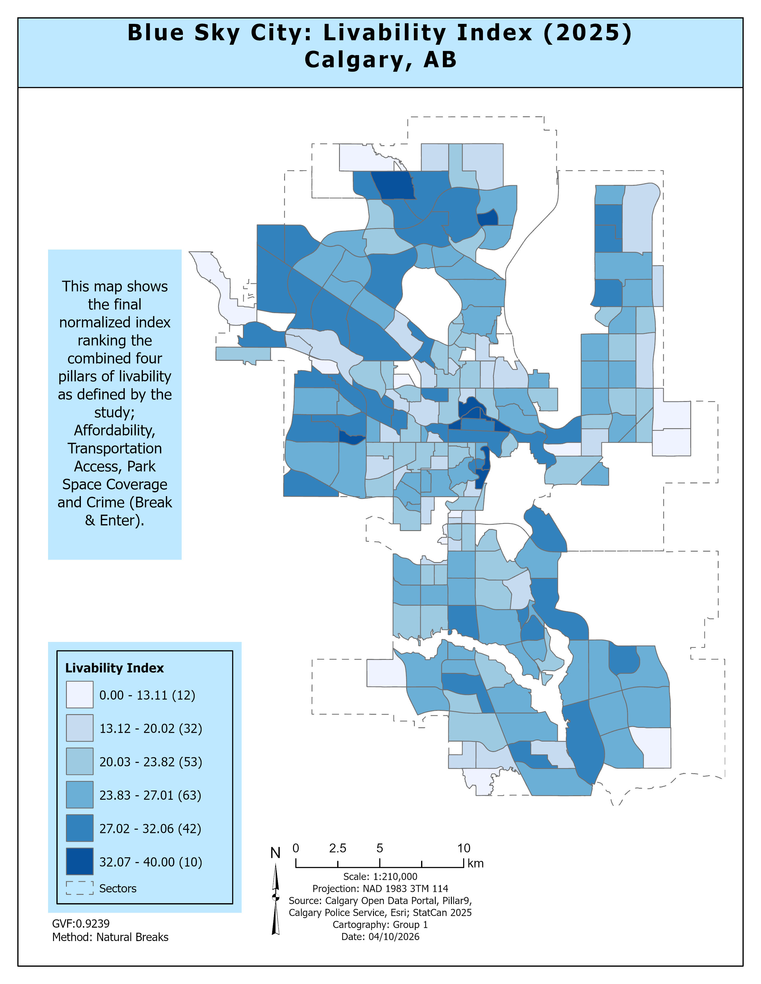
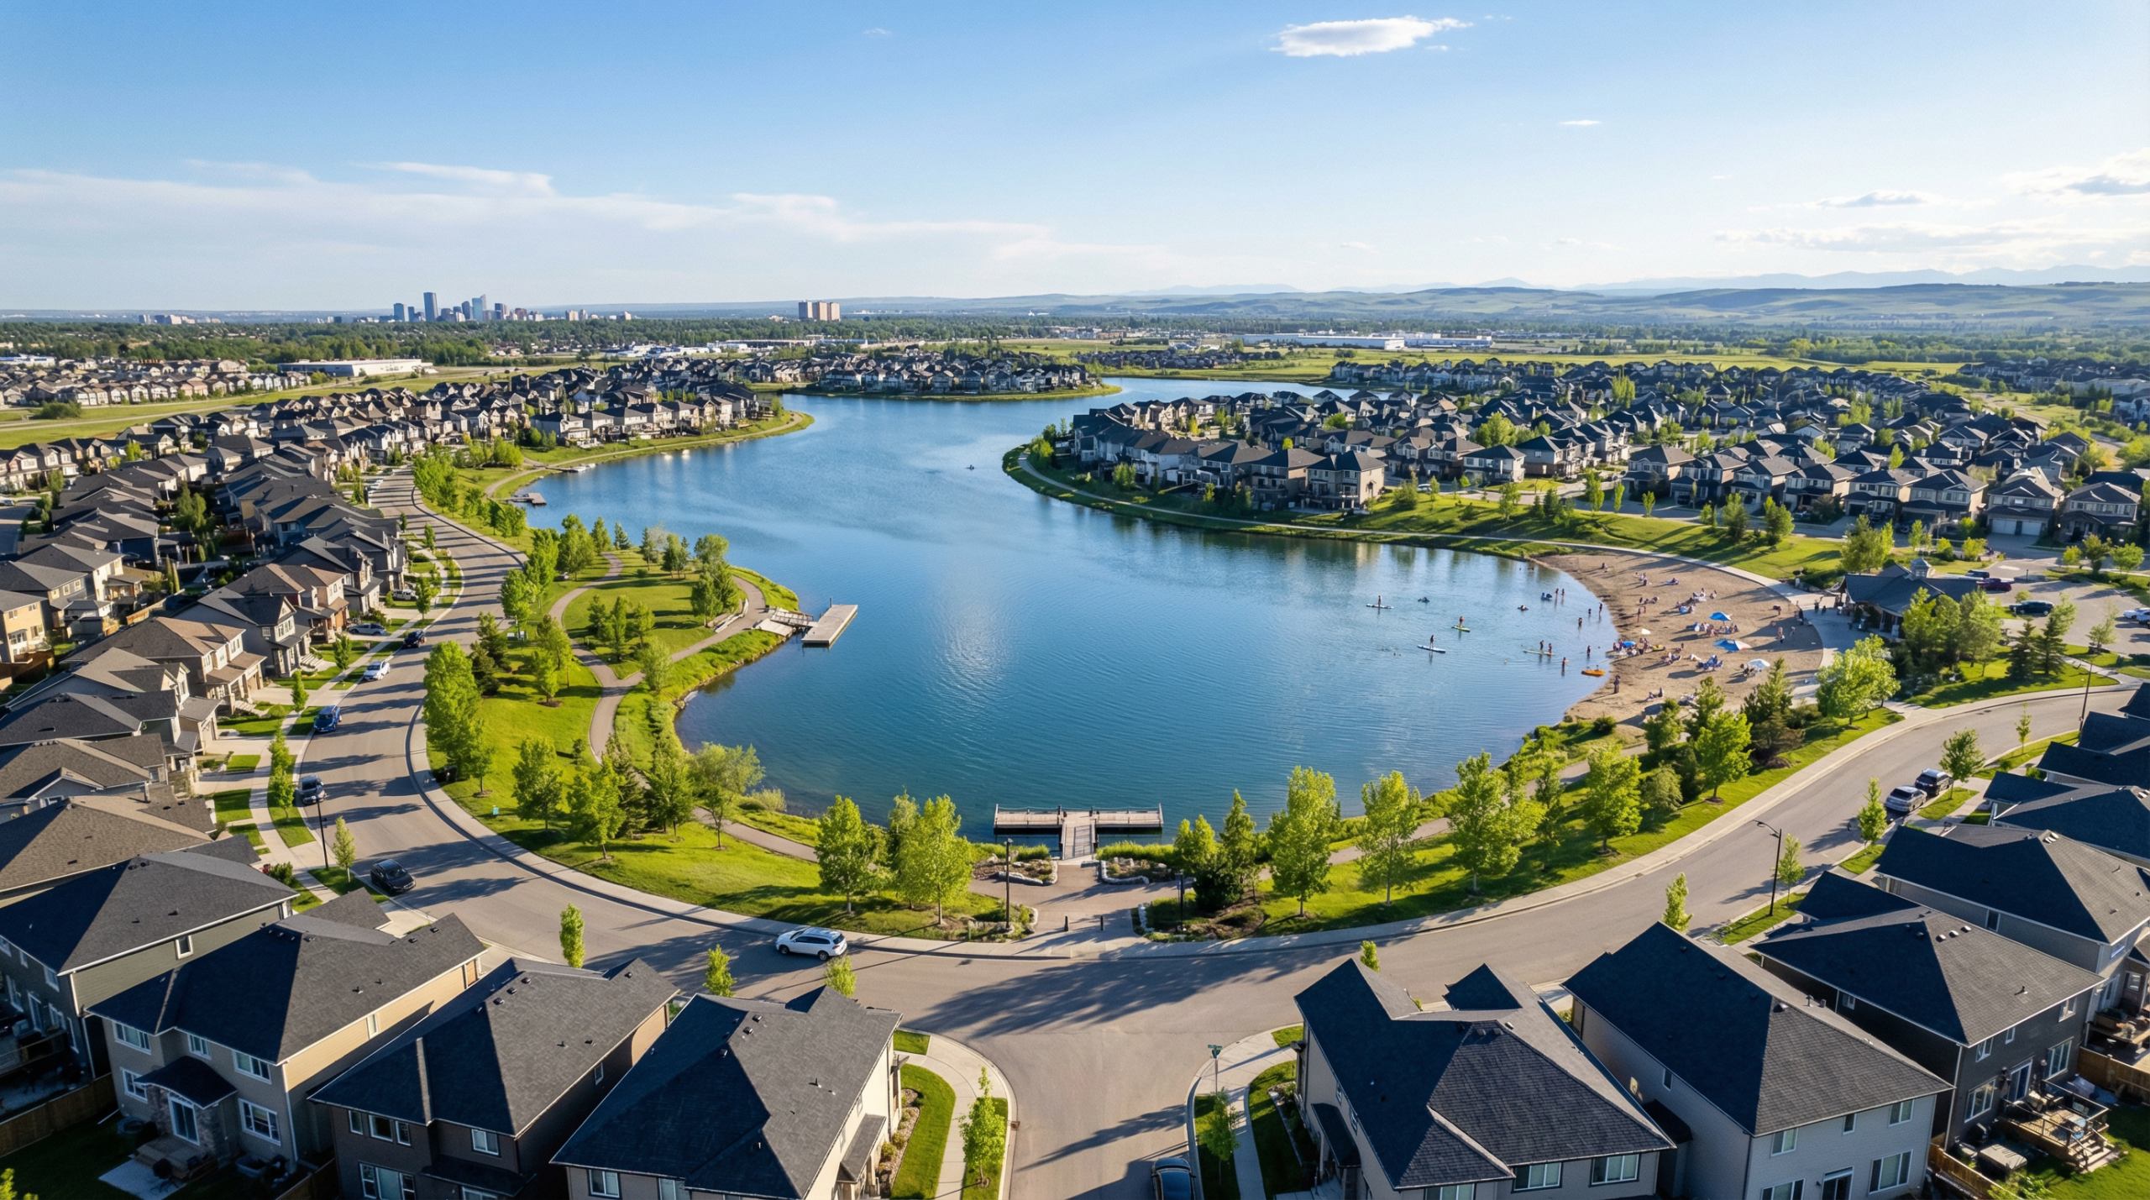
Final Results:
Calgary Livability Index
Figure 7 Recreational Amenities in a Calgary Lake Community
Notes:
This final index map brings all four pillars together into one overall livability score.
The main pattern is that livability is not evenly distributed across Calgary.
Higher scores are concentrated mainly in the central city, with additional clusters in the northwest, west, and parts of the south.
Lower scores are more common in peripheral communities, especially along the east, northeast, and far south edges.
Overall, taken together this map and the others indicate that the most livable communities tend to be more established, greener, and better connected.
Once we identified the overall city-wide pattern, the next step was to look at which individual communities ranked the highest.

Slide 14

Final Results:
Top 10 Community Rankings
RANK COMMUNITY SECTOR
RANK COMMUNITY SECTOR
#1
Eau Claire
Centre
#6
Erlton
Centre
#2
Downtown West End
Centre
#7
SunnySide
Centre
#3
China Town
Centre
#8
Downtown East Village
Centre
#4
Park Hill
Centre
#9
Country Hill
North
#5
Christie Park
West
#10
Sage Hill
North
Key Finding: Top communities are where residents can live, work, and play without a vehicle, high transit connectivity + infrastructure maturity.
Figure 7 Recreational Amenities in a Calgary Lake Community
Notes:
What stands out here is that many of the highest scoring communities are located in the Centre sector.
Eau Claire, Downtown West End, and Chinatown made up the top three.
A few high-ranking communities in the North and West also show that strong livability is not limited only to the urban core.
More broadly, the highest scoring communities tend to be well connected and infrastructure-mature neighbourhoods.
Many of these communities performed well because they combined strong transit access with relatively favourable housing conditions.
In some cases, higher crime pressure was also present, but this appears to be offset by the benefits of established infrastructure, mobility, and access to amenities that strengthen overall livability.
At this point, I’ll pass it over to Apram, who will take us through the significance of these results, along with our conclusions and recommendations.

Slide 15
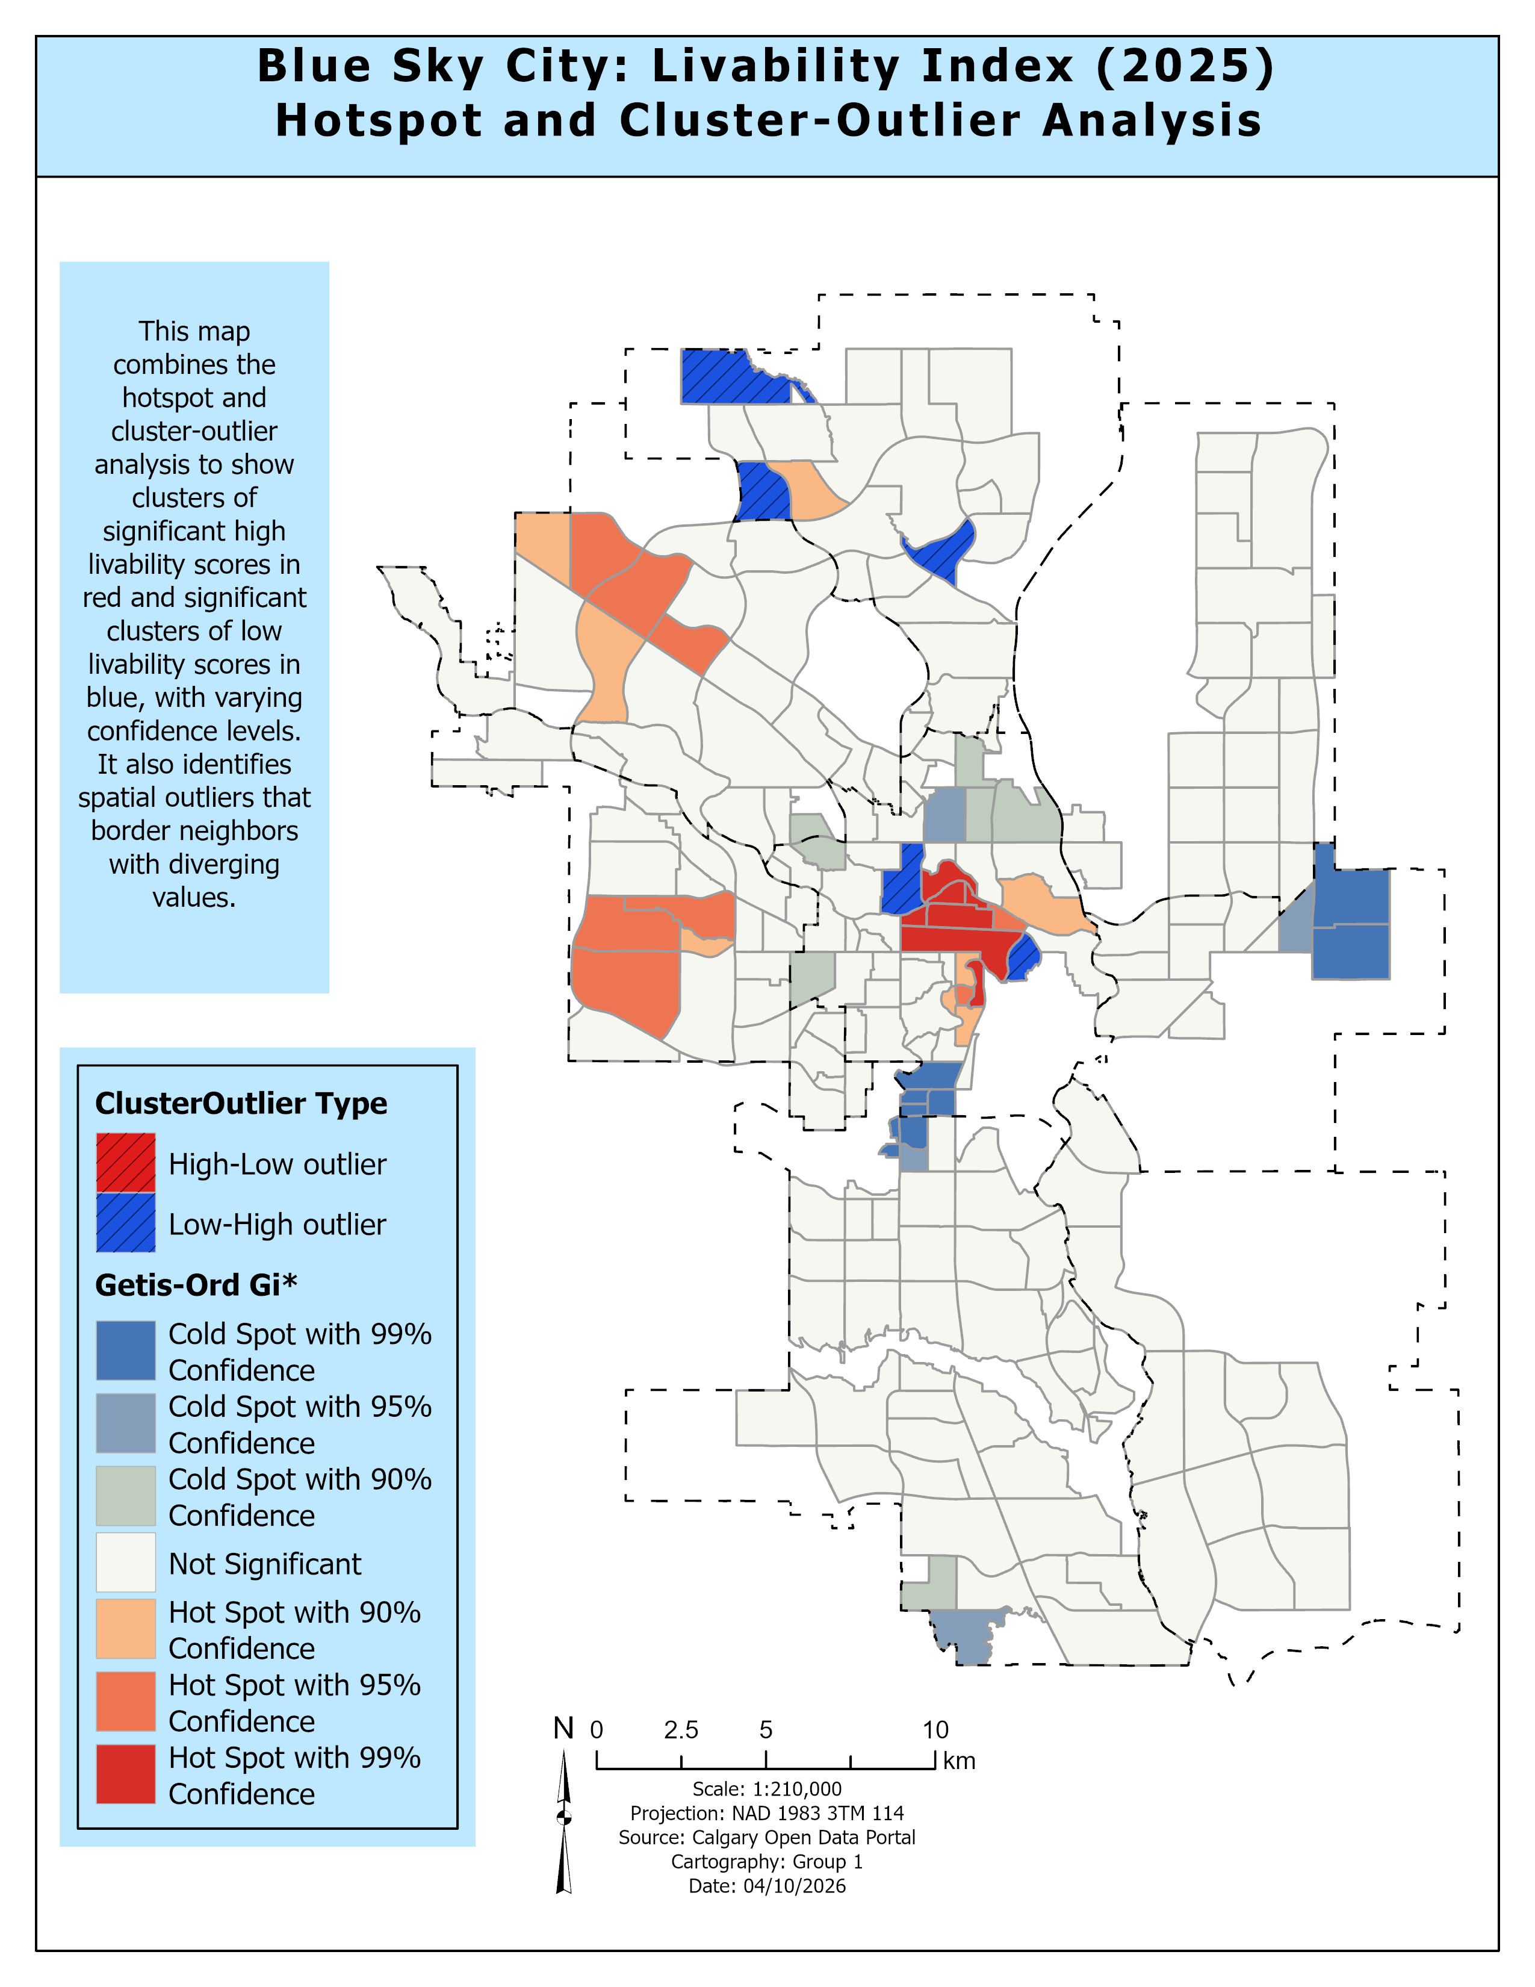
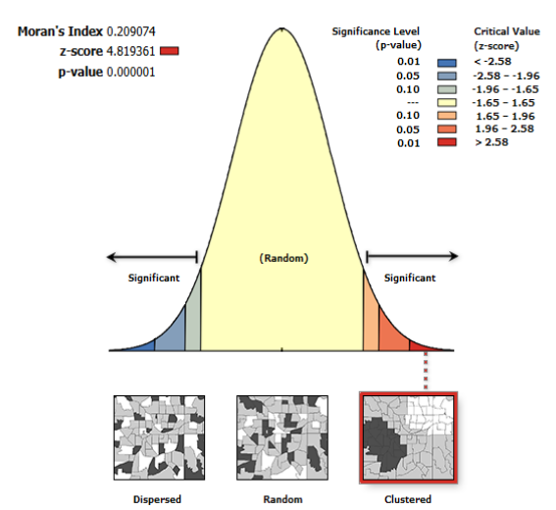
Advanced Results: Spatial Autocorrelation, Hotspots & Outliers
Moran's I
0.2091
Z-Score
4.82
P-Value
< 0.0001
Given the Z-score of 4.82, there’s a less than 1% likelihood that this clustered pattern could be the result of random chance.
Notes:
HOT SPOTS (High Livability): Concentrated in City Centre, with secondary clusters in the Northwest and West sectors. Communities here benefit from mature transit, established parks, and managed crime levels.
COLD SPOTS (Low Livability): Statistically significant clusters of low scores identified in eastern industrial corridors and some southern peripheral areas associated with limited services and infrastructure.
LOCAL OUTLIERS: Cluster and Outlier Analysis (Anselin Local Moran's I) identified individual communities that perform differently from their neighbors important local exceptions for targeted planning.
Apram – Thank you Delu, Now let’s discuss the advanced results, where we tested whether our livability pattern is statistically meaningful.
We used Global Moran’s I, which measures whether values are clustered or random.
The result is 0.209, with a z-score of 4.82 and a p-value near zero.
This confirms a significant clustered pattern, meaning livability across Calgary is not random.
Hot Spot Analysis shows where these clusters occur:
High livability areas are concentrated in the City Centre, and parts of the Northwest and West, where transit, parks, and services are well established.
Low livability areas appear in eastern and southern peripheral regions, where infrastructure and services are more limited.
We also used Cluster and Outlier Analysis to identify communities that perform differently from their neighbors.
These local outliers highlight important exceptions within the overall pattern.
Overall, livability in Calgary is clearly spatially structured, influenced by factors like transit access, green space, and safety.

Slide 16


Conclusions & Recommendations
Livability in Calgary directly reflects infrastructure maturity not random chance. Established communities with mature transit, walkable parks, and managed crime consistently outperform newer peripheral developments.
Transit-First Policy
Pedestrian Network Investment
Equitable Green Space Access
Accelerate transit expansion in peripheral SE/NE communities (Pine Creek, Rangeview, Moraine) to bridge the mobility score gap the largest driver of low livability rankings.
Improve pedestrian connectivity in Cold Spot areas not just transit stops. Physical walking barriers (highways, gaps) are the hidden cause of poor Network Analyst scores.
Mandate park density requirements for new community approvals in eastern sectors. High-density development does not automatically include quality public green space.
Notes:
Our project proves that a data-driven approach can demystify urban quality of life.
From these results, we conclude that livability is driven by infrastructure and service access, not chance.
Established communities with strong transit, accessible parks, and managed crime consistently perform better than newer peripheral areas.
Lower livability scores are more common in outer-edge communities, especially in eastern and southern parts of the city.
On the basis of this we make three key recommendations :
Transit-First Policy
Expand transit in underserved southeast and northeast communities to improve access and mobility.
Pedestrian Network Investment
Improve walkability by reducing barriers such as disconnected pathways and major roads.
Equitable Green Space Access
Ensure new developments include sufficient parks and green spaces, especially in eastern sectors.
These recommendations focus on targeted improvements to reduce livability gaps between communities

Slide 17

Lessons Learned & QA/QC
Normalization Matters
Extreme house prices can mask other livability benefits. Min-Max scaling prevents any single variable from distorting the overall community score.
Natural Breaks (Jenks) Classification
Validated with GVF index > 0.92 confirms classification accurately reflects real-world data distribution, not arbitrary breaks.
Data Source Diversity
Combining three independent data sources (CPS, City of Calgary, Pillar 9) strengthened the validity of results and reduced single-source bias.
Notes:
Now lets discuss Some of the Lessons we Learned –
First we realized, normalization was essential.
We used min-max scaling to ensure all variables contributed equally to the index.
Second, Natural Breaks (Jenks) classification was used and validated with a GVF above 0.92, confirming meaningful grouping.
Third, data source diversity improved reliability, combining data from multiple trusted sources.
Finally, strong QA/QC practices ensured data quality, including:
consistent coordinate systems
accurate joins
and topology checks
These steps ensured the analysis was clean, accurate, and reliable.

Slide 18

Thanks
Figure 8 New "Blue Sky City" Welcome Sign in Calgary
Notes:
Thank you for your time.

Slide 19
References
Azad, A. K. (2011). *Assessment of crime at C-Train stations* [Master’s thesis, University of Calgary]. PRISM. [https://prism.ucalgary.ca](https://prism.ucalgary.ca)
Bochman, A. (2016). Abstract dialectical argumentation among close relatives. In P. Baroni, T. F. Gordon, T. Scheffler, & M. Stede (Eds.), *Computational models of argument: Proceedings of COMMA 2016* (pp. 127–138). IOS Press. [https://doi.org/10.3233/978-1-61499-686-6-127](https://doi.org/10.3233/978-1-61499-686-6-127)
Calgary Police Service. (n.d.). *Community crime statistics*. [https://www.calgarypolice.ca/transparency-and-accountability/crime-statistics.html](https://www.calgarypolice.ca/transparency-and-accountability/crime-statistics.html)
CalgaryHomes.ca. (2024, January 10). *Best Calgary lake communities*. [https://calgaryhomes.ca/blog/best-calgary-lake-communities.html](https://calgaryhomes.ca/blog/best-calgary-lake-communities.html)
City of Calgary. (n.d.). *Open data portal*. [https://data.calgary.ca](https://data.calgary.ca)
Department of Justice Canada. (2022). *Exploring the link between crime and socio-economic status in Ottawa and Saskatoon: A small-area geographical analysis*. [https://www.justice.gc.ca/eng/rp-pr/csj-sjc/crime/rr06_6/p5.html](https://www.justice.gc.ca/eng/rp-pr/csj-sjc/crime/rr06_6/p5.html)
Depositphotos. (n.d.). *Beautiful night skyline of Calgary, Alberta, Canada in winter* [Photograph]. [https://depositphotos.com/editorial/beautiful-night-skyline-calgary-alberta-canada-winter-225996230.html](https://depositphotos.com/editorial/beautiful-night-skyline-calgary-alberta-canada-winter-225996230.html)
Esri. (n.d.). *How Calculate Composite Index works*. ArcGIS Pro. [https://pro.arcgis.com/en/pro-app/latest/tool-reference/spatial-statistics/how-calculate-composite-index-works.htm](https://pro.arcgis.com/en/pro-app/latest/tool-reference/spatial-statistics/how-calculate-composite-index-works.htm)
Laidback Trip. (2023, August 23). *15 best things to do at Calgary Tower (Alberta)*. [https://www.laidbacktrip.com/posts/things-to-do-calgary-tower](https://www.laidbacktrip.com/posts/things-to-do-calgary-tower)
Mindtrip. (n.d.). *The Peace Bridge in Calgary* [Photograph]. [https://mindtrip.ai/attraction/calgary-alberta/peace-bridge/at-2kWcZ6UP](https://mindtrip.ai/attraction/calgary-alberta/peace-bridge/at-2kWcZ6UP)
Pillar 9. (2025). *Calgary median housing prices by community*. [https://matrix.pillarnine.com/Matrix/Stats](https://matrix.pillarnine.com/Matrix/Stats)
Sheikh, M. A., & Biswas, S. (2022). Exploring urban liveability: Frameworks and approaches for sustainable cities. *Quest Journals Journal of Research in Humanities and Social Science*, 10(3), 13–20.
Shutterstock. (n.d.). *View of downtown Calgary from the Calgary Tower* [Photograph]. [https://www.shutterstock.com/search/calgary-tower](https://www.shutterstock.com/search/calgary-tower)
Simes, J. (2025, March 24). *Blue Sky City signs replace 'Be Part of the Energy'*. LiveWire Calgary. [https://livewirecalgary.com/2025/03/24/blue-sky-city-signs-replace-be-part-of-the-energy/](https://livewirecalgary.com/2025/03/24/blue-sky-city-signs-replace-be-part-of-the-energy/)
Statistics Canada. (2023). *How far is the nearest transit stop?* [https://www.statcan.gc.ca/o1/en/plus/7921-how-far-nearest-transit-stop](https://www.statcan.gc.ca/o1/en/plus/7921-how-far-nearest-transit-stop)
Via Transportation. (n.d.). *Long walking distance prevents people from using transit: Here’s how to change that*. [https://ridewithvia.com/resources/long-walking-distance-prevents-people-from-using-transit-heres-how-to-change-that](https://ridewithvia.com/resources/long-walking-distance-prevents-people-from-using-transit-heres-how-to-change-that)
Wikipedia. (2024, March 15). *Scotiabank Saddledome*. [https://en.wikipedia.org/wiki/Scotiabank_Saddledome](https://en.wikipedia.org/wiki/Scotiabank_Saddledome)
Zhang, T., Singh, A., & Maduekwe, D. (2026). *Blue Sky City: Community livability assessment for Calgary* [Unpublished manuscript]. Southern Alberta Institute of Technology.

