Slide 1
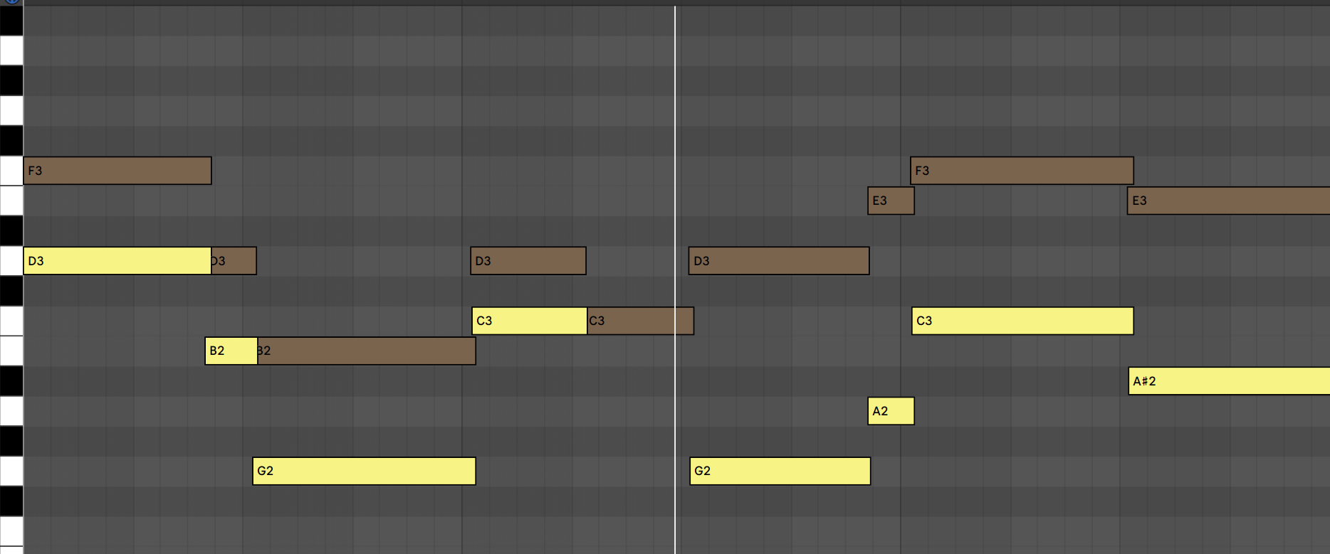

Titolo presentazione sottotitolo
MELPODY:
A Java assistant to melody creation Music and Acoustic Engineering
Giorgio De Luca 875598
A.A. 2018/2019
Milano, XX mese 20XX

Slide 2
Melpody – A Java assistant for melody creation
Overview
Introduction
Artistic needs as general idea of the project
Goals of Melpody
Fundamental concepts
Harmony
Melody Abstraction
Assumptions and errors handling
Software architecture
Components and functionalities
Phases
Scale compatibility process
Possible notes filtering process
Note selection criteria
Definitions and reasons of the choice
Output result: comments and correctness control
Possible improvements

Slide 3
Introduction
Melpody – A Java assistant for melody creation
Artistic needs as general idea of the project
Goals of Melpody
The general idea of the project is based on the difficulties that an artist can run into during the composition of a song: the rhythmic and harmonic parts are completely done but the melodic part (that is usually the most important) is not «artistically» perfect or not created at all.
Given a harmony and a rhythm, the missing element is the idea of a melody that, in some ways, is present in the artist’s mind, but not clearly defined, in terms of notes (C,D,E,…), rests, contour, etc.
The goal of Melpody is to create a link between this idea of melody (that will be called Melody Abstraction) and the harmony and rhythm parts, that are already artistically linked.

Slide 4
Introduction
Melpody – A Java assistant for melody creation
Fundamental concepts
Melpody is based on two fundamental elements that help the software select which are the appropriate notes that can be chosen as elements for the final melody:
Harmony
Harmony is the study of the chords and scales within a musical piece, aimed to create harmonic progressions that lead to musical resolutions. In this specific case, Melpody takes as input a MIDI file where chords are described (with initial assumptions): the one-to-many association between chord and scales allows the software to calculate different «compatible scales» related to the same chord. In that way, in each moment we know all the possible notes that can be played.
Melody Abstraction
The melody abstraction is the description of the contour of the melody: it’s characterized by the distance between a note and the next one and the duration of the note at a given point. Defining a Melody Abstraction is the equivalent to creating a mental idea of the melody without writing it or knowing the notes that compose it. Melpody will use Melody Abstraction as a reference for the distances between notes, their durations and their intensity.

Slide 5
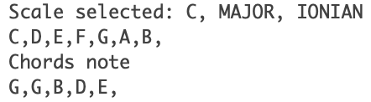
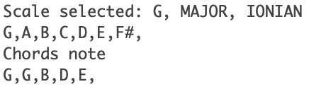
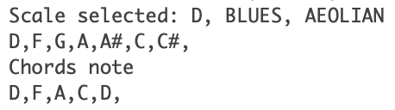
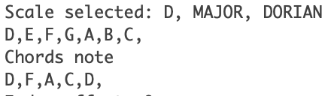
Introduction
Melpody – A Java assistant for melody creation
Harmony in Melpody
Common notes
Melpody’s aim is to create a variety of melodies all restricted to the same constraints set by the
harmony:
Each chord is compared to all possible modal scales applied to a specific list of scales, in order to define the set of scales (type of scale, mode of the scale)
The set of scales calculated by Melpody represents all the possible scales that contain the notes in the chord.
To provide a local reference in the chord progression without adding complex logic in the code, the lowest note is considered as root of the chord played in input (acting as a bass guitar note).
G,B,D,E
D,F,A,C
= root note, type of scale, mode of the scale

Slide 6
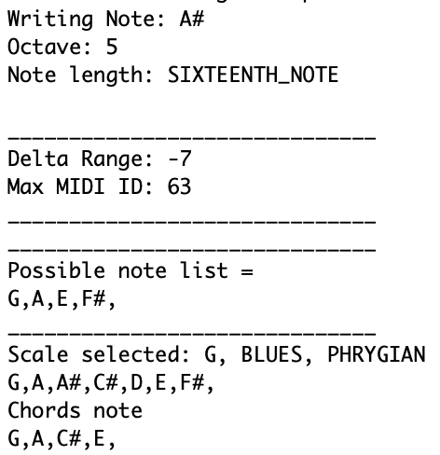
Introduction
Melpody – A Java assistant for melody creation
Melody Abstraction in Melpody
Melpody creates each single note of the melody considering the harmony and the melody abstraction in a specific time instant.
Constraints are time-dependent and affect possible notes that can be chosen.
Melody abstraction in particular, after the creation of the first note, deals with the tonal distance between the new note and the previous one, considering the sign of the difference. All notes can be enumerated in ascending order from the lowest to the highest, so for example, if the difference is negative, all the notes within the range that has an index lower than the current note’s one are selected, like in the image.
A# (5° octave) value is 70 in MIDI representation.
The delta expressed by the melody abstraction is -7: it means that the next possible notes are all the notes included from 63 to 69 - respectively from E (5° octave) to A (5° octave).
The common notes between (1) the notes found through the previous note and the melody abstraction step distance and (2) the note list of the scale to be used (in the example, G Blues Phrygian) are the possible note list, that represents the final set where the output note will be chosen.

Slide 7
Introduction
Melpody – A Java assistant for melody creation
Assumptions
Melpody is intended as a software able to provide an immediate ready to use melody created in accordance with the constraints set by the artist.
For this to happen, a general rule is required for the selection of the notes. Musical correctness of a note into a melody is difficult to be modeled. Melpody is not designed to «substitute» the figure of the musician, but should be used as «explorer» of an idea of melody or as «decorator»
to add colour to an already existing melody (just using as melody abstraction the melody in object).
In this project selection criteria are developed on following assumptions:
There’s no correlation between chord progression of the harmony and the selection of notes described in the melody abstraction – transitions can appear strongly distinct.
Novelty feature is based on a random value and a threshold, responsible for the activation of the feature.
In case of error or exception, checkpoint setting is used (based on the last correct note processed).

Slide 8
Introduction
Melpody – A Java assistant for melody creation
Error handling
The execution of the program, in case of errors, has different behaviours:
Execution ends with error
Problems related to the MIDI files (notes close to bounds of the track or different length of tracks)
No compatible scale found (Harmony MIDI file must be checked or “end of the path” is reached )
Unexpected generic error is raised
Execution continues handling errors and restoring the stack
Compatibility between the possible scale selected and the range of notes defined in the melody abstraction has in result an empty set: in this case Melpody tries to complete the output melody anyway, using another scale (for the same chord of the first possible scale selected) and deletes the first one. In case of different roots between the two selected possible scales, the final result may not be artistically pleasant.
In these first phases of the project, error handling has been developed only for known errors.

Slide 9
Melpody – A Java assistant for melody creation
Software Architecture
Components and functionalities
Note selection criteria
Output result

Slide 10
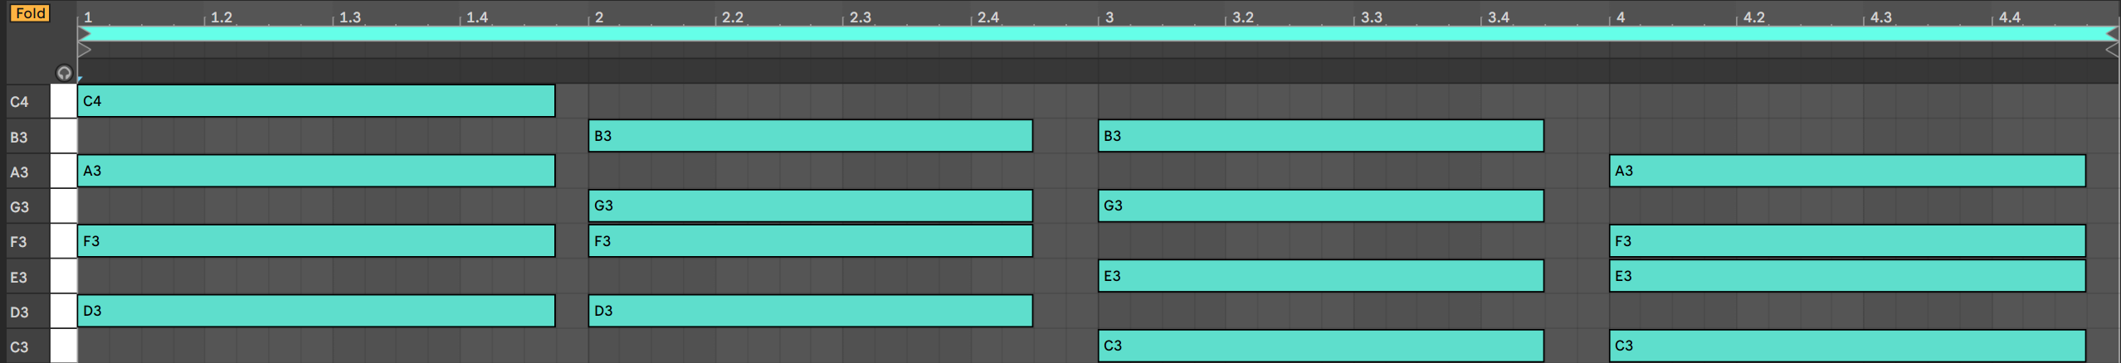
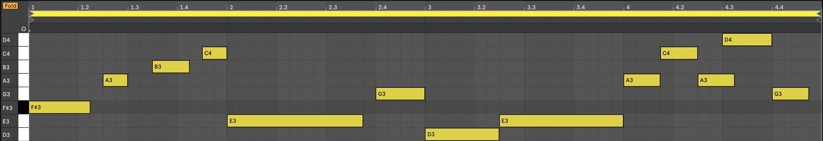
Software Architecture
Melpody – A Java assistant for melody creation
Components and functionalities
Melpody is a software that requires two MIDI files in input to create an output MIDI file:
MIDI file for Harmony: contains the chord progression
MIDI file for Melody Abstraction: contains the note played as idea of the contour of the final melody; duration and intensity of the notes are preserved; range of distance is based on tonal distance
Harmony MIDI file example
Melody Abstraction MIDI file example

Slide 11




Software Architecture
Melpody – A Java assistant for melody creation
1. Reading of files and mapping of information about notes
2. Calculation of compatible scales according to chords in Harmony file
4. Choose the note to be played in accordance with selection criteria
3. Retrieving possible notes that can be played in each specific time instant according to notes of Melody Abstraction
Harmony MIDI file
Melody Abstraction MIDI file
Phases

Slide 12
Software Architecture
Melpody – A Java assistant for melody creation
Scale compatibility process
Given a chord from the Harmony MIDI file, the count of common notes between all the possible scales (combining a set of definition of scales, a set of modes) and the notes played in the chords, is used as meter of compatibility.
The root note (the lower in the chord sequence of the harmony, for assumption) can be used as filter to exclude all scales with different roots to restrict the set of possible compatible scales: in that way the result is the set of all possible compatible scales each one different from the others only for the type of scale and mode; filtering the possible type of scale definitions (Major, Minor, etc), the software limits the compatibilities only on the modal scales.
Parameters of scale definition:
Type of scale, defined as list of step distance in tonal reference;
Mode of the scale, defined as an offset from the root note of the heptatonic scale;
Root note, as starting point of the scale;
Phase 2 in detail
Only heptatonic scales are considered valid as definition of types of scale

Slide 13
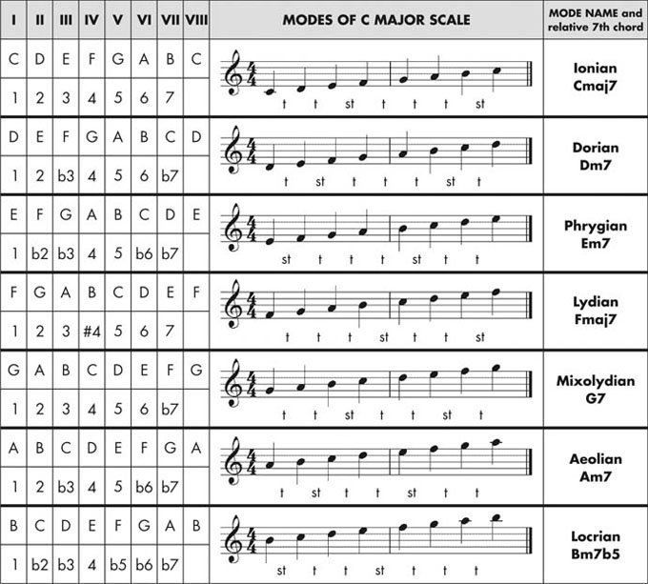
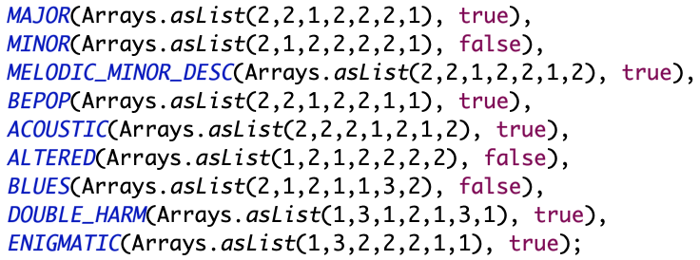
Software Architecture
Melpody – A Java assistant for melody creation
Scale compatibility process – Color in modes and types of scale
Modes color
Type of scales color
The integer list represents the step distance in terms of tonal distance from lower to highest grade of an heptatonic scale (Ionian mode).
Scales can be added to the program, defining the list of integers.
The scale definition is combined with modes of scales to create possible scales.
Phase 2 in detail
= 3rd major
= 3rd minor

Slide 14
Software Architecture
Melpody – A Java assistant for melody creation
Possible notes filtering process
Phase 3 involves Melody Abstraction where one possible scale from phase 2 is chosen among all the possible in a random way (since all of them have the same number of common notes with the related chord of the harmony), considering the presence of the 3rd (min/maj) as filter for the sub-selection of modes of scale (based on their colours).
Given that the scale is a list of notes and considering the previous note (the first is selected on the basis of its duration – stability/duration relationship in the next slide) and its MIDI representation as integer, Melpody calculates the possible notes included in a given range (relative value).
Phase 3 in detail
In case of range = 0, the previous note is directly used.
If there’s no compatible notes (which could happen during a chord change or if range difference is too small) the root note of the scale is used as the output note.
Legend
Range from Melody Abstraction
Notes of the scale
Possible notes compatible in range

Slide 15
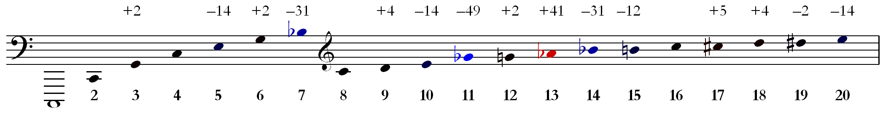
Software Architecture
Melpody – A Java assistant for melody creation
Note selection criteria
Note selection criteria are defined in phase 4. This process selects, among the possible notes selected in the phase 3, one note used to build the output melody.
The output melody is a perfect transposition, when required, in semi-tone of the melody abstraction: Melpody «corrects» the notes it finds in the melody abstraction.
Selection criteria depends on the following parameters:
Novelty, on/off
Possible notes
Duration of the note
Duration of note is directly linked with the stability of a note: the term «stability» refers to the occurrences of a grade (in an heptatonic scale) in the harmonic series. The occurrence of a grade on the total sum of the occurrences of all them is considered as the percentage of probability.
Harmonics in C

Slide 16
Software Architecture
Melpody – A Java assistant for melody creation
Note selection criteria
Duration – Stability relationship
«Stable» notes correspond to high probability grades
«Hybrid» length notes correspond to medium probability grades
«Unstable» notes correspond to low probability grades
The association note length – {«slow», «medium», «fast»} is customizable and its definition can considerably affect the output melody.
Possible notes passed as parameter are scanned to be identified as grades of the scale (with as reference the root note of the harmony - assumption). The presence of a grade is not always guaranteed: in that case the highest probability, among the remaining ones, is considered (next slide).
The novelty boolean should introduce, when active, sense of surprise, considering the probability from the lowest to the highest, so from the most unstable to the most stable notes (according to harmonic series – stability relationship). Novelty value is triggered by a random value on a predefined threshold (from 0 to 1.0) of the status change.

Slide 17
Software Architecture
Melpody – A Java assistant for melody creation
Note selection criteria
Duration – Stability relationship: definitions
Note selection criteria is based on the compatibility of the grades on the possible note list according to the scale selected as source: for instance, if the notes of possible note list are {C#, D, D#} and the scale selected is (D, Minor, Ionian), the compatible grades in the possible note list are {7, 1} corresponding respectively to C# and D; D# doesn’t belong to the selected scale, so it’s not a compatible grade.
Duration – Stability: default value conditions + condition on empty set
Long notes are considered as stable notes
grade 1°, 5° of the scale (root note, type, mode)
Medium length notes are considered as color notes
grades 3°,7° of the scale (root note, type, mode)
Fast notes are considered as passing notes or tension notes
grades 2°, 4°, 6° of the scale (root note, type, mode)
If the intersection between possible notes and notes of the scale (intended as grades) has no results, the scale selected is removed and another scale chosen.

Slide 18
Software Architecture
Melpody – A Java assistant for melody creation
Note selection criteria
Duration – Stability relationship: reasons of the choice and comments
The duration – stability relationship is a static association between duration of a note and its colour in the melody. Usually notes with considerable duration are intended to lead to a musical resolution, since they cover the biggest part of a melody, if we consider the time required for the play of that particular sound. For that reason Melpody uses the value of probability explained in the previous slide to define the grade (note) it will write in the output.
The selection of the note is always guaranteed by the highest probability (in case of novelty feature on, the lowest probability): if the note is slow and there’s no compatible grade with high stability, the scanned set of grades becomes the stability/tension set of grades, and so on till tension notes set.
Output melody can sound weird when the scale selected has particular grades in its definition (enigmatic scale for example, considering its altered grades) or if novelty feature is activated, since tension notes are preferred to stable ones and considered first.

Slide 19
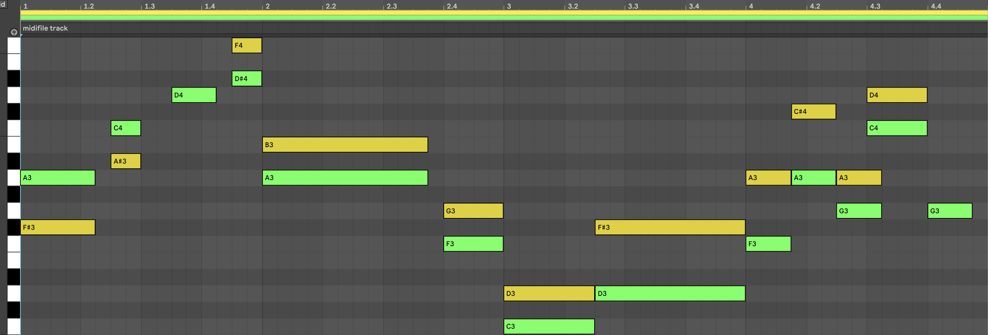
Software Architecture
Melpody – A Java assistant for melody creation
Output results: comments and correctness control
Melpody creates the output melody applying the phase 3 for each note of the melody abstraction.
Phase 2 is chord-dependent: it means that if the note of the melody abstraction is played onto the same chord (in its length) of a previous note, the same scale is considered to achieve a better musical sense (locality of the scale).
From the image, the melody output respects all the constraints set by the melody abstraction: it can be easily stated analysing the distances between consecutive yellow notes compared with the green ones.
Output melody
Melody Abstraction
Harmony MIDI file

Slide 20
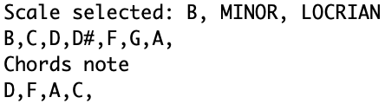
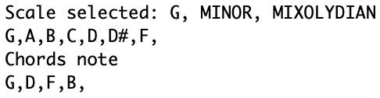
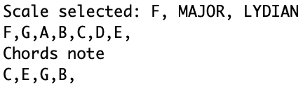
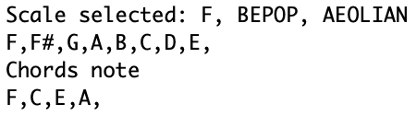
Software Architecture
Melpody – A Java assistant for melody creation
Output results: comments and correctness control
1st measure scale
2nd measure scale
Output melody
Melody Abstraction
3rd measure scale
4th measure scale
Harmony MIDI file
Root of scale selected can be restricted to the root of the harmony, the lowest note of the chord

Slide 21
Software Architecture
Melpody – A Java assistant for melody creation
Output results: comments and correctness control
Melpody behaviour, considering the final status of the executions, is strictly dependent from all the parameters used to generate notes: to be more specific, since the melody abstraction describes a range of distance and the note is chosen by the selection criteria, it’s not possible to guarantee the presence of a compatible grade. In this case a change of scale occurs and so on till a compatible grade in a possible scale is found.
If the 3rd grade of the chord is present in the chord definitions in the MIDI file (considering the modular distance from the root note of the chord), the program in the worst case may not conclude the execution but shows an alert on unavailability of possible scales (since possible scales are filtered on the colour of the mode).
In other words, even if the input files and the possible scales selected are the same, the execution of the program could end with error caused by the selection of different grades (of heptatonic scale).

Slide 22
Possible improvements
Melpody – A Java assistant for melody creation
Possible improvements
Melpody improvements can affect different areas:
Area of interest | Possible improvements
Rhythm | 1. Pattern recognition 2. Accent recognition
Harmony | 1. Reverse process – Melpody as a harmonizer of a melody 2. Chord progression recognition 3. Substitution chords as method to infer chord progression
Melody | 1. Note selection based on the melodic consonances and dissonances
Pattern recognition: improves the accuracy of selection of the notes belonging to a pattern, described in the melody abstraction;
Accent recognition: improves the accuracy of selection of notes in relation with the prosody of the meter;
Reverse process: the same process and concepts in Melpody can be used as an inverse function (with the required modifications) to create a chord progression (the input is only the series of an instant time sequence corresponding to the start of the new chord);
Chord progression recognition: improves the selection of the scale used in the specific chord of the chord progression;
Substitution chords as method to infer chord progression: improves the chord progression recognition, analysing each chord in all possible form;
Note selection based on the melodic consonances and dissonances: improves the quality of output melody, selecting the notes in accordance with the consonance and dissonance principles of melody (evaluation of the interval between notes);

Slide 23
Melpody – A Java assistant for melody creation
Thank you for the attention

