Slide 1


Complementary Segmentation : En route towards “Quasi-Perfect” Segmentation

Slide 2
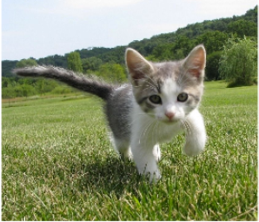
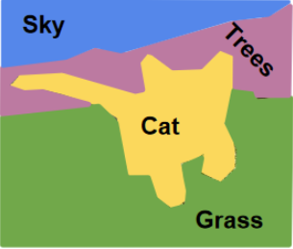
What is segmentation?
Segmentation + Classification

Slide 3
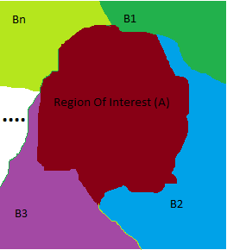
What is segmentation
Given an image extract out the region of interest

Slide 4
U-Nets
Conceived at Miccai 2015
Dr Olaf Ronneberger
Best solution to date for medical image segmentation
Overcomes –
Lack of a large amount of dataset (Performs well with as low as 30 training images)
Touching objects of the same class (Can still segment them out properly)

Slide 5
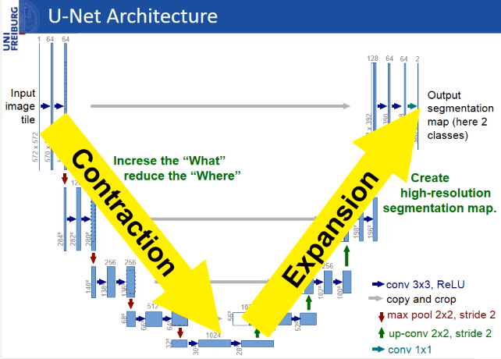
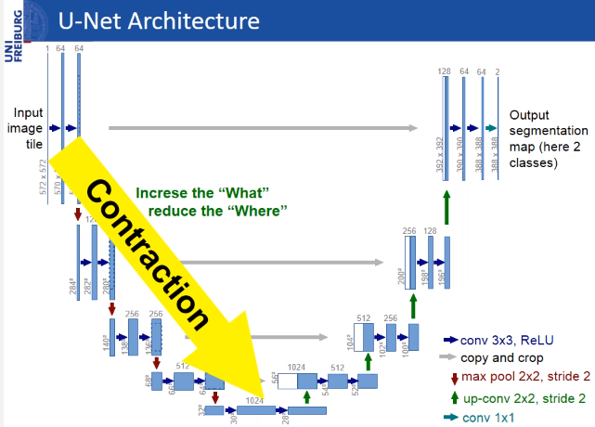
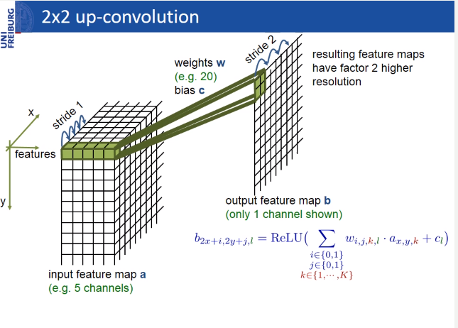
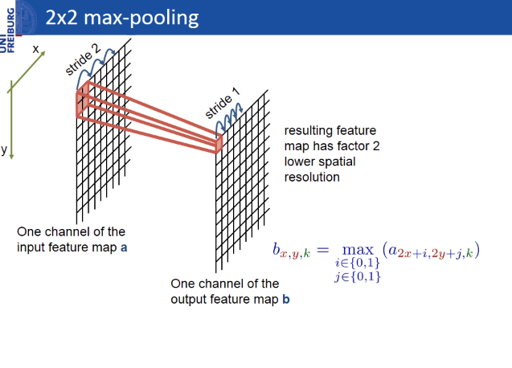
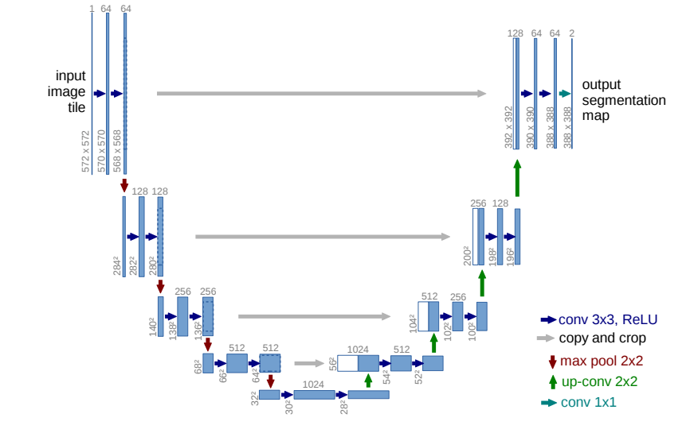
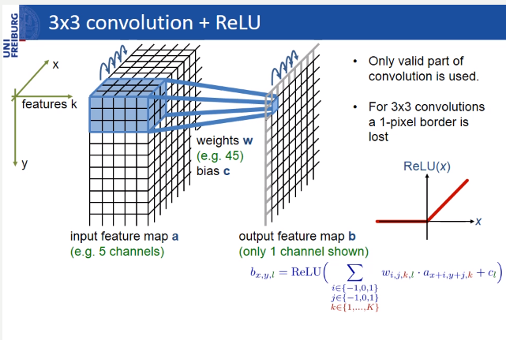
U-Nets
Slides borrowed from Dr Ronneberger’s Homepage
“Photocopies and downloads of web pages for personal, academic and non-commercial use are permitted. ”

Slide 6
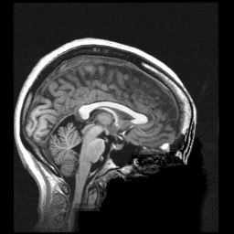

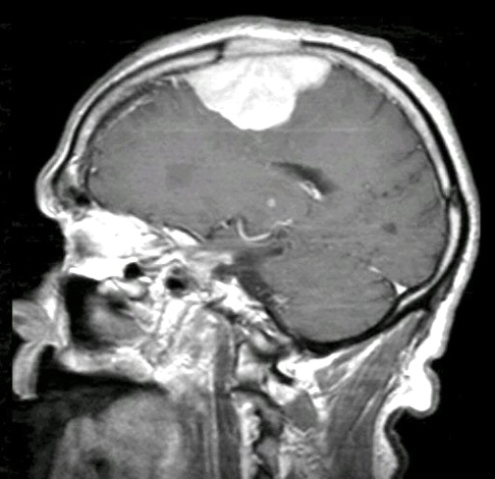
Image Preprocessing: Brain Extraction
Slide borrowed from Dr Yi Hong
Consistent in normal and pathological images
Challenge:
Lack of pathological image scans with skull for learning

Slide 7
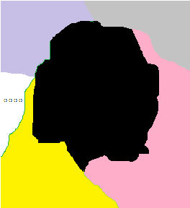
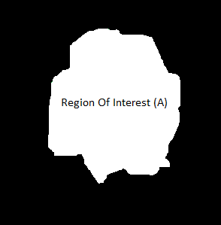
Solution – Comp Net

Slide 8
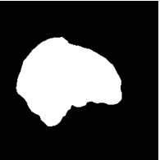
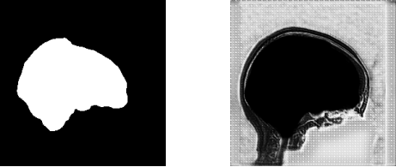
U-Net and CompNet
U-Net
Assuming ROI remains relatively uniform in training and testing aka training set adequately represents the ROI space, U-Net identifies it and draws a mask over it [Fig 1]
Comp-Net
Assuming ROI remains relatively uniform in training and testing aka training set adequately represents the ROI space, SO branch identifies it and draws a mask over it
Assuming Non-ROI remains relatively uniform the CO branch identifies it. There is no requirement to provide us a mask here [Fig 2]
Fig 1
Fig 2

Slide 9
Types of Distortions tested
Input Image -

Slide 10
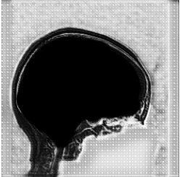
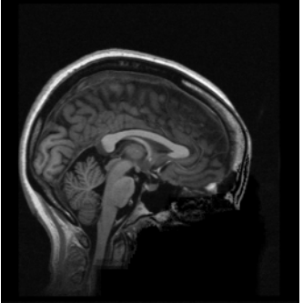
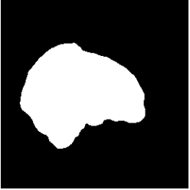
Types of Distortions tested
Input Image -

Slide 11
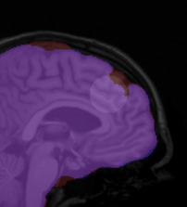
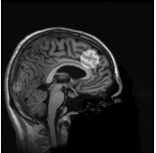
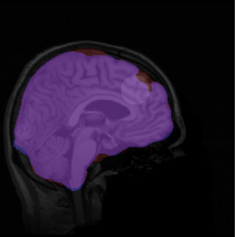
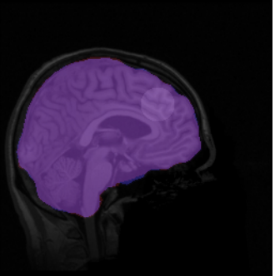
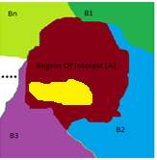
Types of Distortions tested
Distortion inside the ROI section
U-Net Undersegments
U-Net Segmentation
Comp-Net Segmentation

Slide 12
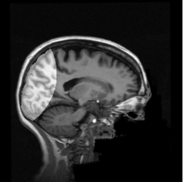
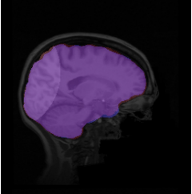
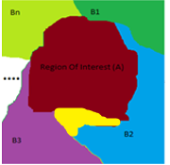
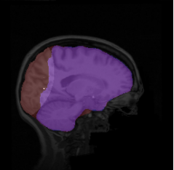
Types of Distortions tested
Distortion at the boundary of ROI region
U-Net Segmentation
Comp-Net Segmentation

Slide 13
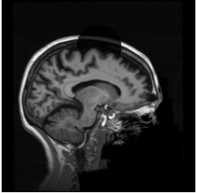
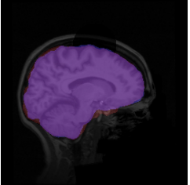
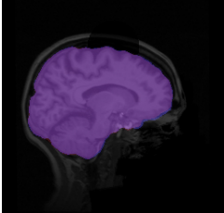
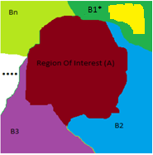
Types of Distortions tested
Distortion at Non - ROI region
U-Net Segmentation
Comp-Net Segmentation

Slide 14



Experimental Results
 | (Apparently) Normal Images Dice Sensitivity Specificity | Pathological Images Dice Dice Sensitivity Specificity
Kleesiek et al | 95.77±0.01 94.25±0.03 99.36±0.003 | - - -
Plain U-Net | 92.30±6.20 95.60±1.48 96.20±0.09 | 79.90±8.10 93.80±5.10 95.20±2.15
Dense U-Net | 96.40±4.10 97.50±0.70 96.90±0.01 | 85.43±5.80 96.13±3.20 97.10±1.27
Prob. CompNet | 95.10±0.19 96.73±0.90 96.03±0.02 | 92.10±5.23 96.32±1.90 98.86±0.50
Plain CompNet | 96.70±0.22 97.93±0.62 98.57±0.06 | 95.21±3.75 96.32±1.03 99.21±0.10
Opti. CompNet | 98.27±0.30 98.26±0.58 99.80±0.05 | 97.62±2.21 97.84±0.80 99.76±0.12
$$2$$
($+$ )

Slide 15
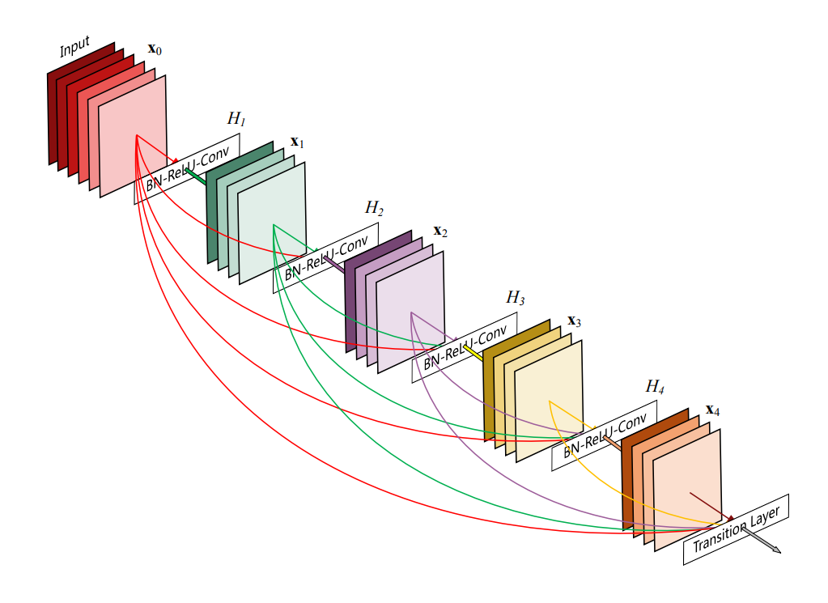
Useful techniques - Dense Nets
https://arxiv.org/pdf/1608.06993.pdf

Slide 16
Dense Nets
Allows for deeper networks
Translates the fanning as we go deeper policy as temporary connections
Removes the need for huge matrix storage and multiplication between layers
512*512 vs 12*12 or 512*12
https://arxiv.org/abs/1608.06993

Slide 17
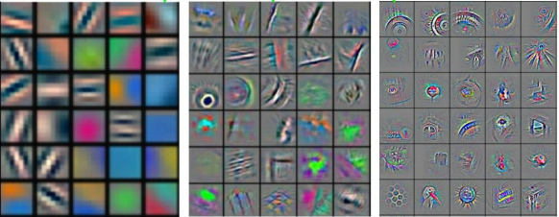
https://arxiv.org/abs/1311.2901

Slide 18
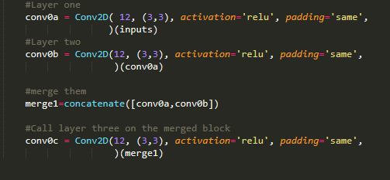
Dense Net blocks in keras

Slide 19
Multi-Outputs
Useful when training large networks
Enables implicit ensemble learning
Lets the network be evaluated at stages as if there were no other layers after it
Faster optimization time
https://arxiv.org/abs/1803.07192

Slide 20
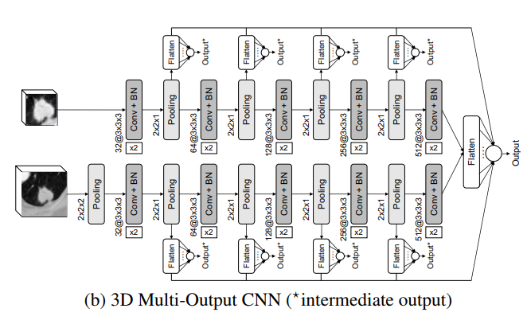
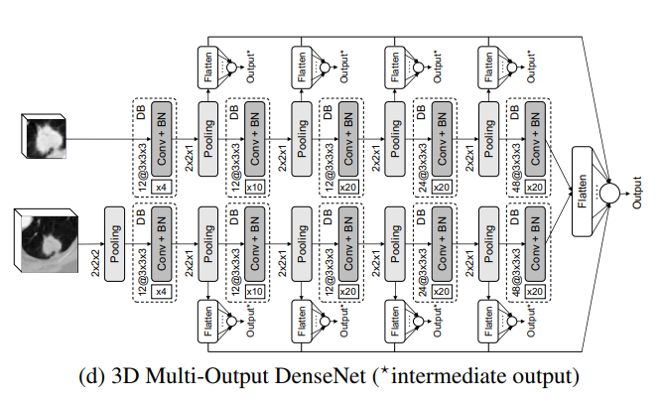
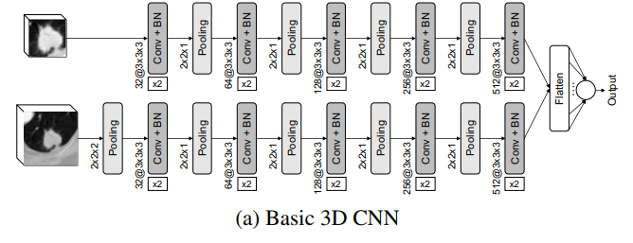
Multi - Outputs
https://arxiv.org/abs/1803.07192

Slide 21
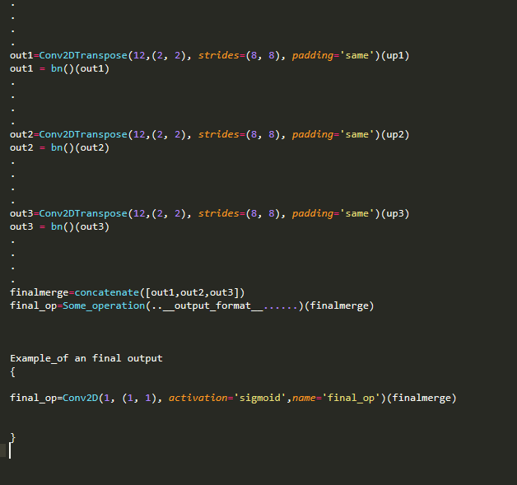
Multi-Output in Keras

Slide 22
Things to be careful about
The shapes of image states you are merging
May need to upsample-downsample
Efficient optimization in terms of performance not speed
Best if coupled with dense blocks

Slide 23
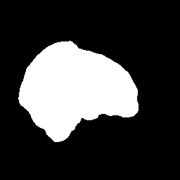
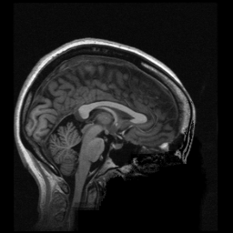

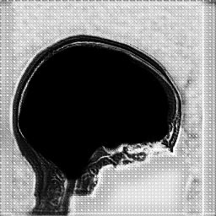
CompNet: Complementary Segmentation Network
Slide borrowed from Dr Yi Hong
Brain Mask
Decoder
x2
Encoder
Brain Scan
x8
x4
x2
Reconstruction
Encoder
x2
x8
x2
x8
x4
x2
x4
Decoder
x2
Decoder
Complement
[Dey and Hong, Accepted to MICCAI 2018]
Concatenation
Sigmoid
Notes:
This is the common encoder which feeds into the Segmentation and Complementary branches
THis is the Segmentation branch the output here is negative dice score with the Ground truth mask since we want the network to give us a mask
THis is the Complementary branch and here the loss is positive dice with the brain mask, I.e. it can do whatever it wants except for producing the ROI mask
THis is the Reconstruction branch. Since we don’t make the Complementary Branch predict anything in particular, the trivial case it can do is produce nothing. But that doesn’t help us so we use this MSE reconstruction loss which says the sum of Complementary and Segmentation branch needs to give us the original Input. It is basically a restrain preventing the Complementary branch from going crazy and predicting absurdities if you want.
A note about these dense blocks, they have x 12 layer feature maps connected in a dense net manner. But the final layer has a larger filter number. This is because every other branch except for the starting layer of a block gets a temporary summary of all the previous layers, but the first layer of a block only gets the immediately connected branch before it. To ensure enough information is passed on we increase the number of feature maps in the final layers of a dense block. In this case we have 4 dense block of 12 nodes and finally we have the final block with 32 feature map to help the next layer.

Slide 24
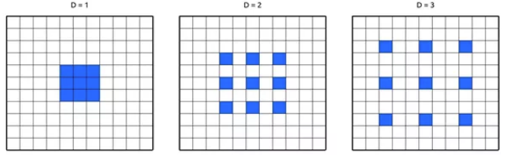
Deformable Convolutions and Dialations
Another useful concept is deformable convolutions –
Please look into it
Useful if you need relations between global arrangement of pixels

Slide 25
Thank You for coming! Questions :?

