Slide 1



By Team Krypton

Slide 2
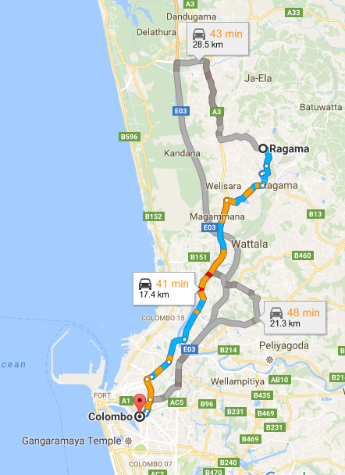
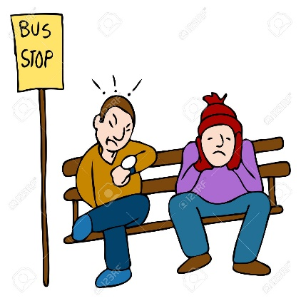

Problem
Passengers might wait long time for buses.
Passengers don’t know whether the bus comes or not.
Passengers don’t have any idea about the bus routes and bus fares.
Travelers don’t know how long it takes for the next bus.
Travelers are not aware of the buses and routes of new places.

Slide 3



Solution
Mobile Application
Web Application

Slide 4

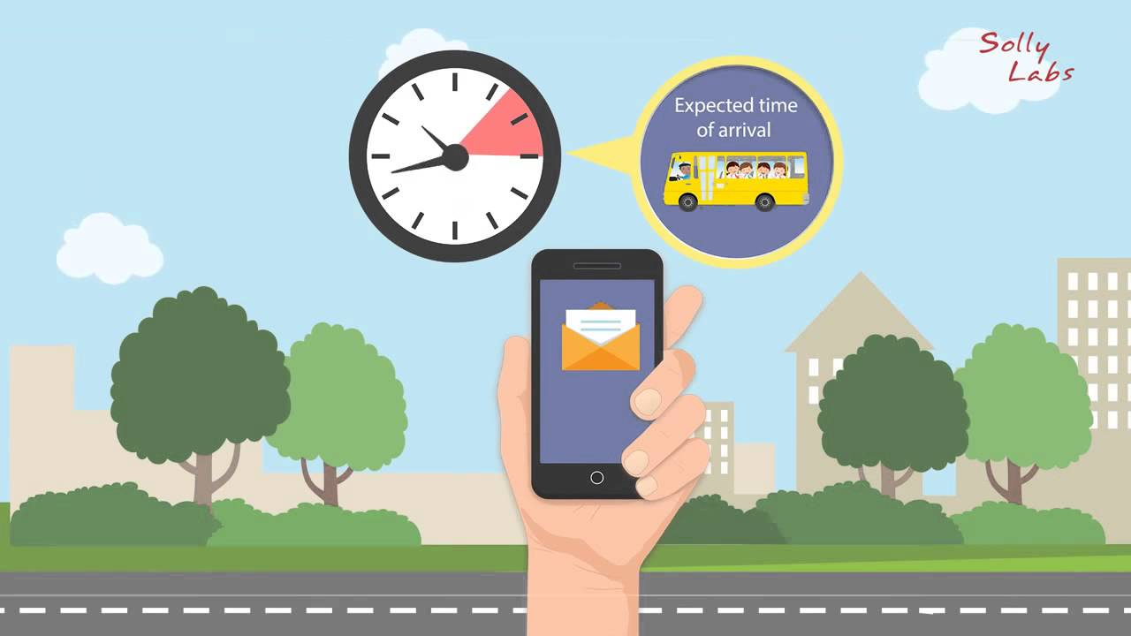
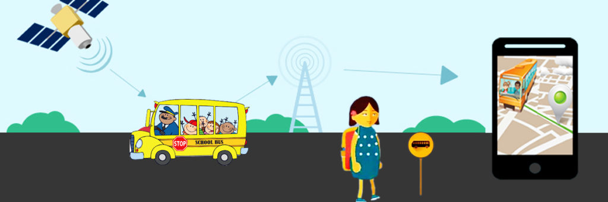
Pros
Saves time.
Can plan for the route which costs less.
Avoid waiting for late or missed buses.
Bus department will get a total control over buses.
Increases the efficiency of bus drivers and conductors.
Increase the number of public transport travelers.

Slide 5
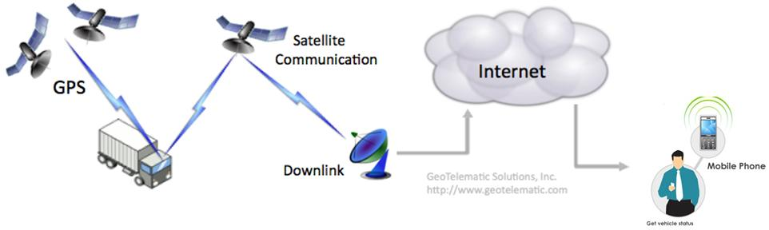

Architecture of the system

Slide 6









Underlying the magic

Slide 7

Q & A

Slide 8
THANK YOU

