Slide 1

LUNAR LANDER
Implementation of a Genetic Algorithm in the Gymnasium Lunar Lander environment using the PyGAD library.
Michał Figołuszka | Karol Bieżuński

Slide 2
Goals and objectives
The main goal is to develop a genetic algorithm that, through an evolutionary process, learns to safely land on the lunar surface.

Slide 3

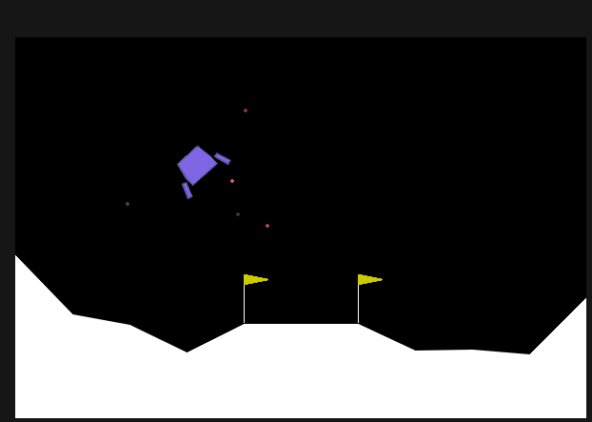
ENVIRONMENT: LUNAR LANDER
PHYSICAL CHALLENGES
8-dimensional state vector (position, velocity, angle).
4 discrete actions for engines steering

Slide 4






WHY GENETIC ALGORITHM?
GLOBAL OPTIMIZATION
GRADIENT FREE
LOGICAL SIMPLICITY
Ability to avoid local minima through mutation mechanism
GAs do not require a differentiable loss function, making them ideal for environments with sparse rewards
Nature-inspired approach allows for intuitive modeling of the learning process through “survival of the fittest”

Slide 5




IMPLEMENTATION STRATEGY
REPRESENTATION
Each individual (chromosome) consists of a vector of floating-point numbers. These values act as direct control parameters (gains) for the lander’s engines based on its current state (coordinates, velocity, angle)
FITNESS FUNCTION
The performance of each controller is measured by the Total Reward from the Gymnasium Env.
Positive Fitness: Awarded for a soft landing between the flags and stabilizing the aircraft.
Negative Fitness: Penalties for crashing or flying out of bounds

Slide 6
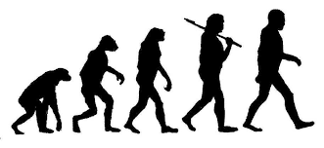
IMPLEMENTATION STRATEGY
EVOLUTIONARY PROCESS
We would use PyGAD to manage the life cycle of the population:
Selection: Identifying the top-performing “pilots” to act as parents
Crossover: Combining parameters form two successful individuals to produce offspring.
Mutation: Introducing random variations to the parameters to explore new landing maneuvers and prevent stagnation

Slide 7
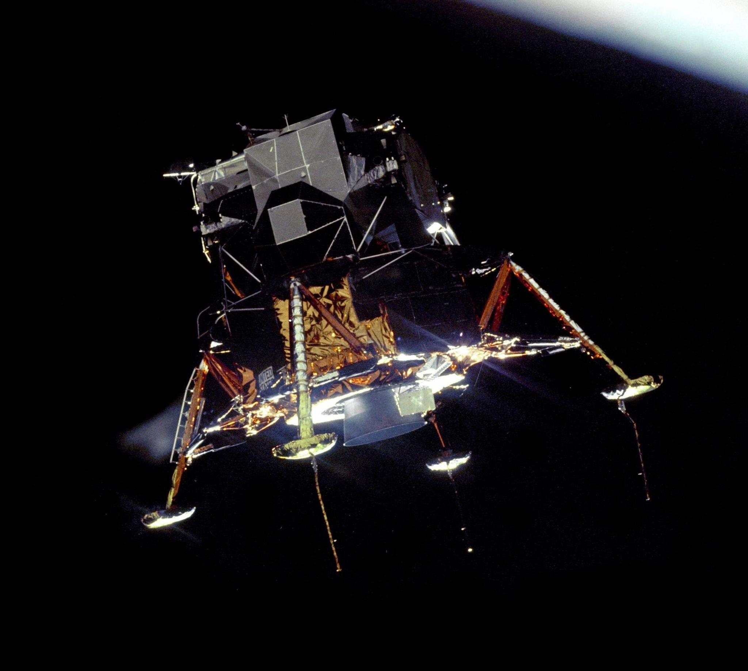
ENVIRONMENT INTEGRATION
The key challenge lies in integrating the PyGAD engine with the Gymnasium simulation loop. Each individual in the population will be evaluated based on the total reward accumulated during a single simulation run.
The final product will be a script demonstrating real-time landing using the evolved parameters.

Slide 8








TECH STACK
PYTHON 3.X
PYGAD
MATPLOTLIB
GITHUB
Base language providing flexibility and a rich ecosystem of scientific libraries.
Optimization framework, offering ready-to-use genetic algorithm modules and support dor neural networks.
Visualization tool for tracking evolutionary progress (fitness over generations).
Version control system for hosting the project code and managing changes.

Slide 9
EVOLUTION MECHANICS IN PYGAD
Fitness Function: Defined as the sum of rewards from Gymnasium. The higher the score, the better the “individual.”.
Selection: Choosing the best population for reproduction.
Crossover: The exchange of gens from fittest population
Mutation: A random change genes, introducing new genetic information and preventing population stagnation.

Slide 10

Thank you!
github.com/delux444/ genetic-lunar-landing

