Slide 1
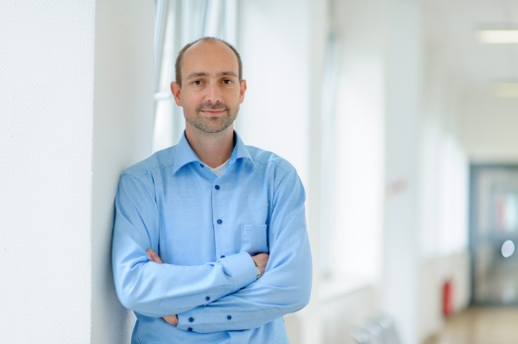
Chapter 2.3
Transform Methods
Performance Evaluation of the Internet of Things (IoT)
Module Course: Performance Evaluation of Distributed Systems
Prof. Tobias Hoßfeld, Summer Semester 2022

Slide 2
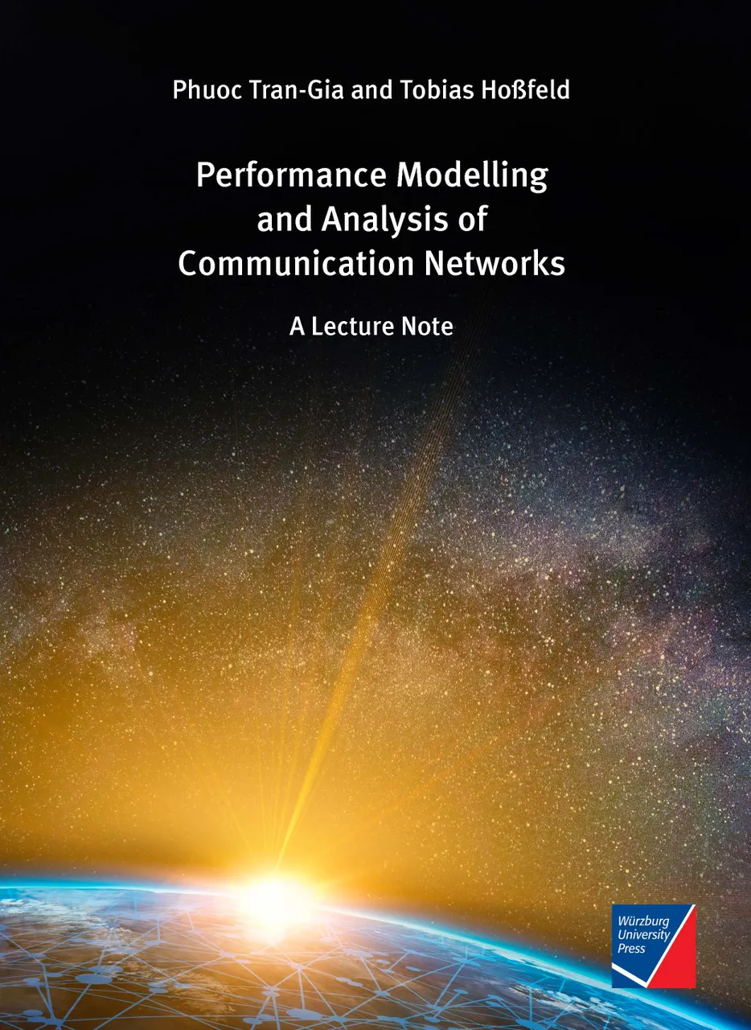
Disclaimer and Copyright Notice
Lecture slides, figures, and scripts are based on the open access text book “Performance Modeling and Analysis of Communication Networks”. The book and scripts are licensed under the Creative Commons License Attribution-ShareAlike 4.0 International (CC BY-SA 4.0). If you remix, transform, or build upon the material, you must distribute your contributions under the same license as the original.
The book must be cited and the disclaimer attached when using lectures slides or scripts.
Tran-Gia, P. & Hossfeld, T. (2021). Performance Modeling and Analysis of Communication Networks - A Lecture Note. Würzburg University Press. https://doi.org/10.25972/WUP-978-3-95826-153-2
Website to download book, exercises, slides and scripts: https://modeling.systems/

Slide 3
Chapter 2
2 Fundamentals and Prerequisites
2.1 Little’s Theorem and General Results
2.1.1 Little’s Law in Finite Systems with Blocking
2.1.2 Example: Multiclass Systems
2.1.3 Example: Balking
2.1.4 The Utilization Law
2.1.5 Assumptions and Limits of Little’s Law
2.1.6 General Results for GI/GI/n Delay Systems
2.1.7 Loss Formula for GI/GI/n-S Loss Systems
2.2 Probabilities and Random Variables
2.2.1 Random Experiments and Probabilities
2.2.2 Other Terms and Properties
2.2.3 Random Variable, Distribution, Distribution Function
2.2.4 Expected Value and Moments
2.2.5 Functions of Random Variables and Inequalities
2.2.6 Functions of Two Random Variables
2.3 Transform Methods
2.3.1 Generating Function
2.3.2 Laplace and Laplace-Stieltjes Transforms
2.4 Some Important Distributions
2.4.1 Discrete Distributions
2.4.2 Continuous Distributions
2.4.3 Relationship between Continuous and Discrete Distribution

Slide 4
Transform Methods
Time Domain Transform Domain
Function Transform (or transformed function)
Transformation:
discrete r.v. PMF generating function
PMF Z-transform
continuous r.v.
PDF, Laplace transform of a(t), CDF Laplace-Stieltjes-transform of A(t)

Slide 5
Generating Function
Definition, example, convolution theorem

Slide 6
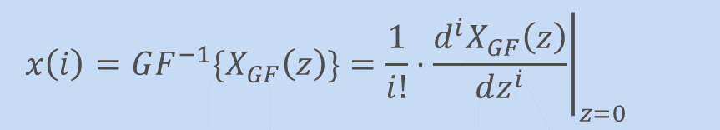
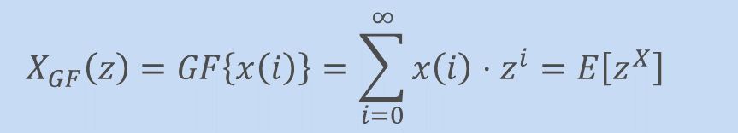
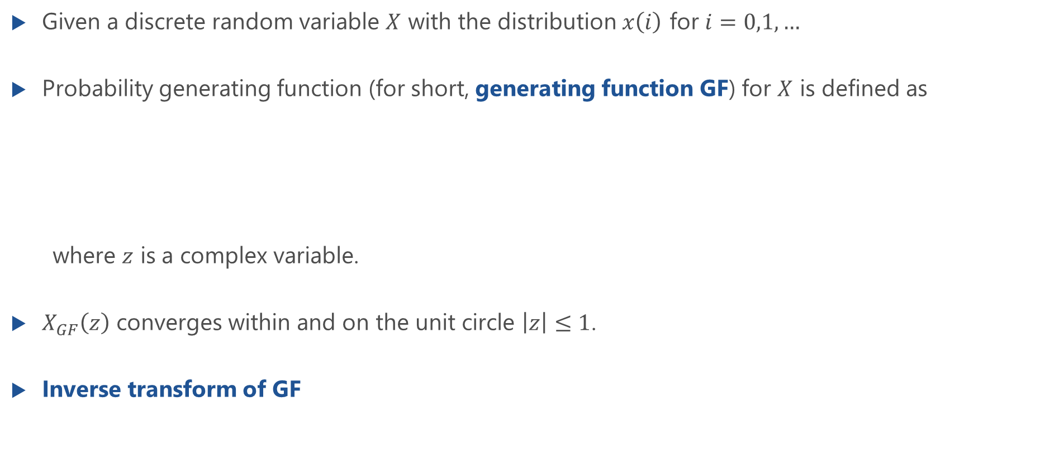
(Probability) Generating Function (GF)
Given a discrete random variable $X$ with the distribution $x\left(i\right)$ for $i=0,1,…$
Probability generating function (for short, generating function GF) for $X$ is defined as
where $z$ is a complex variable.
$X_{GF}\left(z\right)$ converges within and on the unit circle $\left|z\right|≤1$.
Inverse transform of GF
$$X_{GF}\left(z\right)=GF\left\{x\left(i\right)\right\}=\sum_{i=0}^{∞}{x\left(i\right)⋅z^{i}}=E\left[z^{X}\right]$$
$${x\left(i\right)=GF^{−1}\{X}_{GF}\left(z\right)\}={\left.\frac{1}{i!}⋅\frac{d^{i}X_{GF}\left(z\right)}{dz^{i}}\right|}_{z=0}$$

Slide 7
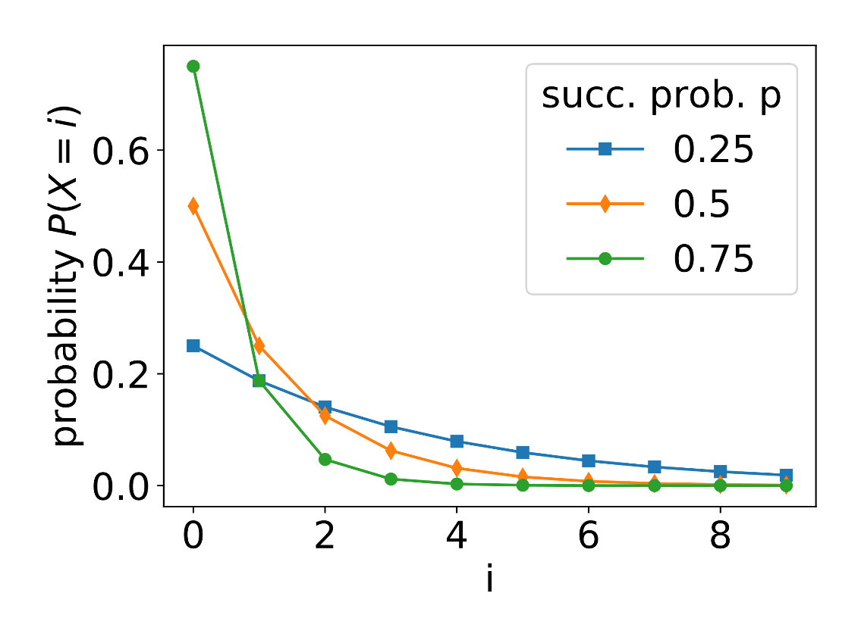
Example: Geometric Distribution
Lecture

Slide 8
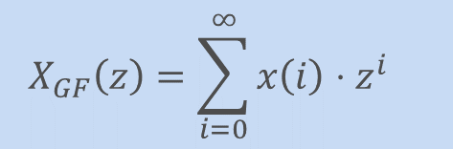

Properties of the Generating Function
$$X_{GF}\left(z\right)=\sum_{i=0}^{∞}{x\left(i\right)⋅z^{i}}$$
Moments of r.v. X can directly be determined in transform domain
$$X_{GF}\left(1\right)=\sum_{i=0}^{∞}{x(i)}⋅1^{i}=1$$
$$X_{GF}^{′}\left(1\right)={\left.\frac{dX_{GF}(z)}{dz}\right|}_{z=1}={\left.\sum_{i=0}^{∞}{x(i)}⋅i⋅z^{i−1}\right|}_{z=1}=E[X]$$
$$X_{GF}^{′′}\left(1\right)={\left.\frac{d^{2}X_{GF}(z)}{dz^{2}}\right|}_{z=1}=E\left[X^{2}\right]−E\left[X\right]$$
$$VAR\left[X\right]=E\left[X^{2}\right]−E{\left[X\right]}^{2}=X_{GF}^{′′}\left(1\right)+X_{GF}^{′}\left(1\right)−X_{GF}^{′}{\left(1\right)}^{2}$$

Slide 9
Example: Generating Function
Lecture

Slide 10


Convolution Theorem for Discrete Random Variables
Sum of two statistically independent discrete random variables $X_{1}$ and $X_{2}$ $X=X_{1}+X_{2}$
Convolution theorem
$$x\left(i\right) = x_{1}\left(i\right)∗x_{2}\left(i\right)$$
$$X_{GF}\left(z\right)=X_{1,GF}\left(z\right)⋅X_{2,GF}(z)$$

Slide 11
Convolution Theorem for Discrete Random Variables
Lecture

Slide 12
Example: Poisson Distribution
Lecture

Slide 13
Laplace- and Laplace-Stieltjes-Transformation
Definition, example, convolution theorem

Slide 14


Laplace and Laplace-Stieltjes Transforms
Non-negative continuous random variable $A$
cumulative distribution function $A(t)$
probability density function $a\left(t\right)=\frac{dA\left(t\right)}{dt}$
Definition
for a complex variable $s$ with non-negative real part $Re\left(s\right)≥0$
$$Φ_{A}\left(s\right)=LST\left\{A\left(t\right)\right\}=\int_{0}^{∞}{e^{−st} dA(t)}$$
$$=LT\left\{a\left(t\right)\right\}=\int_{0}^{∞}{e^{−st}a\left(t\right) dt}$$
$$=E\left[e^{−sA}\right]$$
Laplace-Stieltjes transform
Laplace transform

Slide 15
Example: Exponential Distribution
Lecture

Slide 16
Relation between Laplace and Laplace-Stieltjes Transforms

Slide 17
Properties of Laplace Transform
Computation of Moments using Laplace Transform
Laplace Transforms of Integral and Derivative
Laplace Transform Limit Theorems

Slide 18

Laplace Transform and Convolution Operation
Non-negative, statistically independent r.v.s $A_{1}$ and $A_{2}$
with PDFs $a_{1}(t)$ and $a_{2}(t)$
and Laplace transforms $Φ_{A_{1}}(s)$ and $Φ_{A_{2}}(s)$
The sum $A=A_{1}+A_{2}$ has the following PDF
Continuous convolution theorem: Laplace transform of $A=A_{1}+A_{2}$
LT
LT
LT

