Slide 1

Chapter 3.2
Renewal Processes
Performance Evaluation of the Internet of Things (IoT)
Module Course: Performance Evaluation of Distributed Systems
Prof. Tobias Hoßfeld, Summer Semester 2022

Slide 2
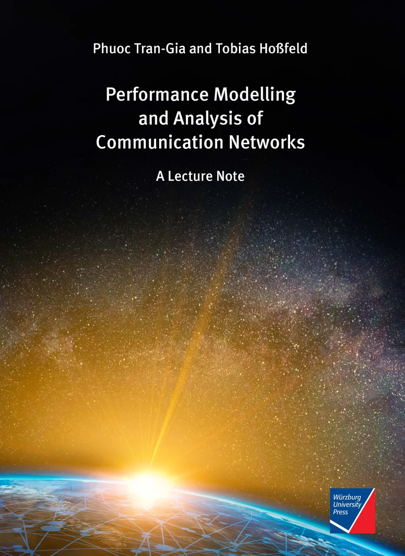
Disclaimer and Copyright Notice
Lecture slides, figures, and scripts are based on the open access text book “Performance Modeling and Analysis of Communication Networks”. The book and scripts are licensed under the Creative Commons License Attribution-ShareAlike 4.0 International (CC BY-SA 4.0). If you remix, transform, or build upon the material, you must distribute your contributions under the same license as the original.
The book must be cited and the disclaimer attached when using lectures slides or scripts.
Tran-Gia, P. & Hossfeld, T. (2021). Performance Modeling and Analysis of Communication Networks - A Lecture Note. Würzburg University Press. https://doi.org/10.25972/WUP-978-3-95826-153-2
Website to download book, exercises, slides and scripts: https://modeling.systems/

Slide 3
Chapter 3
3 Elementary Random Processes
3.1 Stochastic Processes
3.1.1 Definition
3.1.2 Markov Processes
3.1.3 Elementary Processes in Performance Models
3.2 Renewal Processes
3.2.1 Definition
3.2.2 Analysis of Recurrence Time
3.3 Poisson Process
3.3.1 Definition of a Poisson Process
3.3.2 Properties of the Poisson Process
3.3.3 Poisson Arrivals during Arbitrarily Distributed Interval
3.4 Superposition of Independent Renewal Processes
3.4.1 Superposition of Poisson Processes
3.4.2 Palm-Khintchine Theorem
3.5 Markov State Process
3.5.1 Definition of Continuous-Time Markov Chain
3.5.2 Transition Behavior of Markovian State Processes
3.5.3 State Equations and State Probabilities
3.5.4 Examples of Transition Probability Densities
3.5.5 Birth-and-Death Processes

Slide 4
Point Process and Renewal Process

Slide 5

Point Process
Finite or infinite sequence of random points in time or occurrences (arrival times of customers)
Interarrival times $A_{i}$ between customer arrivals $t_{i−1}$ and $t_{i}$ may follow different distributions $A_{i}$
Arrival process described by interarrival times or number of arrivals in intervals

Slide 6
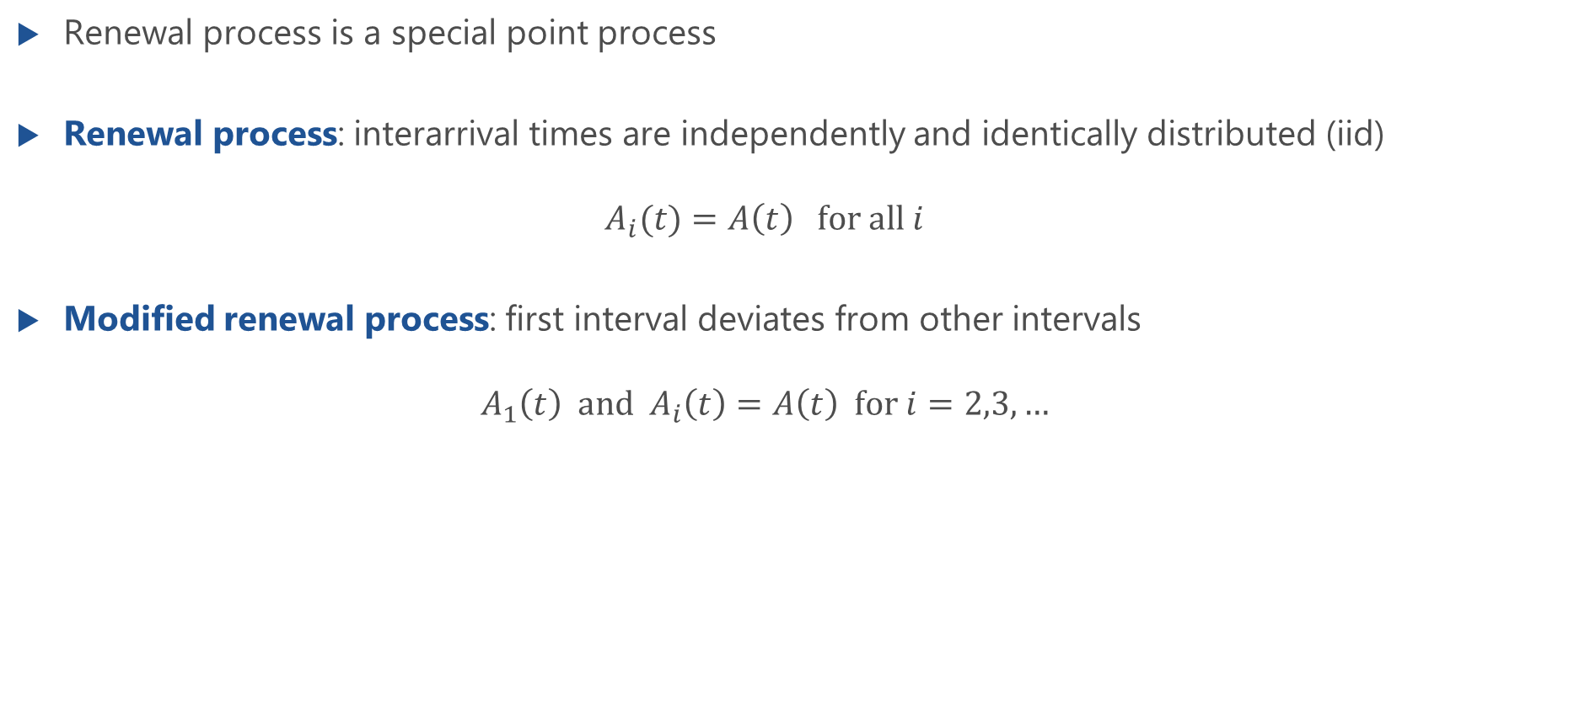
Renewal Process
Renewal process is a special point process
Renewal process: interarrival times are independently and identically distributed (iid) $A_{i}(t)=A\left(t\right) for all i$
Modified renewal process: first interval deviates from other intervals $A_{1}\left(t\right) and A_{i}\left(t\right)=A\left(t\right) for i=2,3,…$

Slide 7
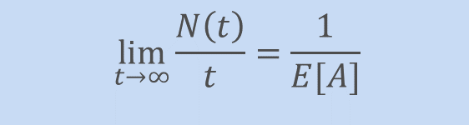
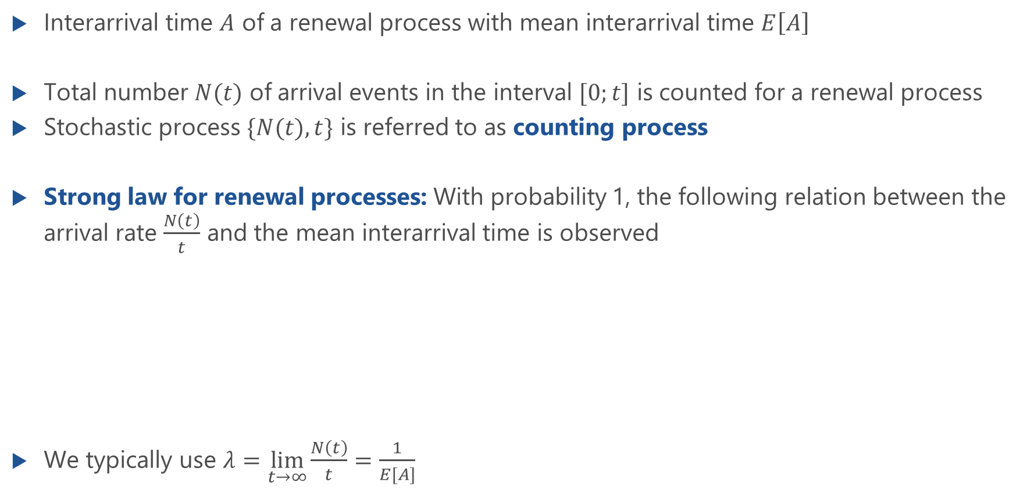
Recurrence Time
Interarrival time $A$ of a renewal process with mean interarrival time $E\left[A\right]$
Total number $N(t)$ of arrival events in the interval $[0;t]$ is counted for a renewal process
Stochastic process $\{N(t),t\}$ is referred to as counting process
Strong law for renewal processes: With probability 1, the following relation between the arrival rate $\frac{N\left(t\right)}{t}$ and the mean interarrival time is observed
We typically use $λ=\lim_{t→∞}{\frac{N\left(t\right)}{t}}=\frac{1}{E[A]}$
$$\lim_{t→∞}{\frac{N\left(t\right)}{t}}=\frac{1}{E[A]}$$

Slide 8

Recurrence Time
Process is observed by an independent outside observer at time $t^{∗}$
$R_{v}$ forward recurrence time; interval from the observation time to the next arrival;
$R_{r}$ backward recurrence time; interval from the last arrival to the observation time.
Random observation time can be at any time: forward and backward recurrence time have same statistical properties ➔ recurrence time is analyzed for given iat $A$

Slide 9
Analysis of Recurrence Time

Slide 10
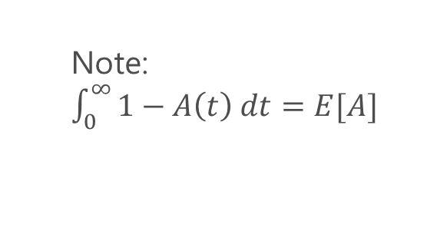

Cumulative Distribution Function of Recurrence Time
Recurrence time $R$ with $λ=\frac{1}{E[A]}$ and interarrival time $A$
Note
$a(t)$ or $A(t)$ known → $r(t)$ can be derived
$r(t)$and $E[A]$ known → $a(t)$ can be derived
Note: $\int_{0}^{∞}{1−A\left(t\right) dt=E[A]}$
Laplace transform (LT)

Slide 11
Recurrence Time: Proof
Lecture

Slide 12
Recurrence Time: Transform Domain
Lecture

Slide 13
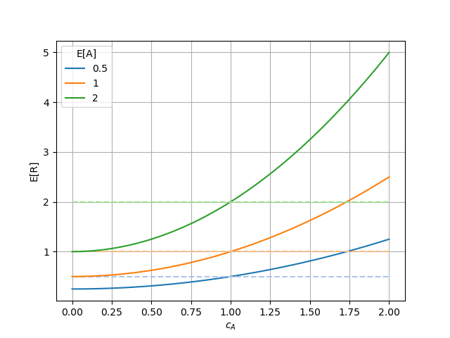

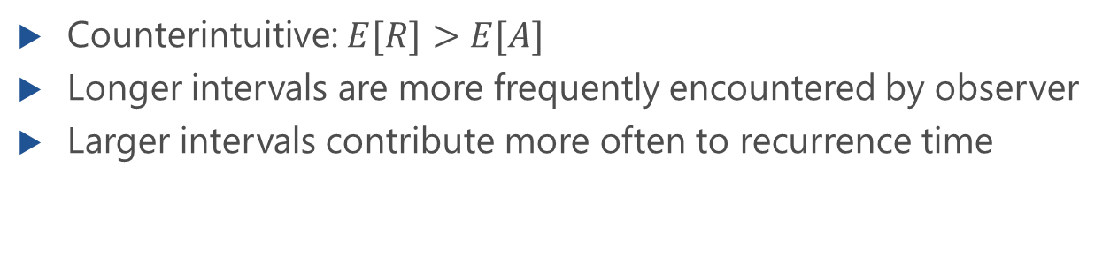
Moments of Recurrence Time
Ordinary moments of recurrence time
Mean recurrence time
$$c_{A}<1: E\left[R\right]<E\left[A\right]$$
$$c_{A}=1: E\left[R\right]=E\left[A\right]$$
$$c_{A}>1: E\left[R\right]>E\left[A\right]$$
Counterintuitive: $E[R]>E[A]$
Longer intervals are more frequently encountered by observer
Larger intervals contribute more often to recurrence time

Slide 14
Moments of Recurrence Time: Proof
Lecture

