Slide 1
Deep spell check
Delwende Eliane Birba

Slide 2
Introduction
Processing of electronic health records with artificial intelligence techniques to make them readable and understandable.
Problems
Poor understandability of the clinical notes taken by medical practitioners
Unintentional spelling mistakes
Lots of medical abbreviations used
Goal
Correct the spelling mistakes
Replace Abbreviations
Build a model which can work independently
Notes:
main topics in healthcare field is to develop artificial intelligence techniques to process the
Electronic Health Record

Slide 3

Spell-Check
Notes:
machine learning methods for correcting abbreviation and misspelling on medical text

Slide 4
Types of spelling mistakes
Non-word Errors: Missing a few keystrokes or putting an extra one leading to an unreal word. E.g. language laguage
Real Word Errors: A mistake which transforms one real word to another real word with a different meaning E.g. There Three
Cognitive Errors: Occurring due to confusion with similar sounding words E.g. Weather Whether
Short forms: Existing abbreviations we use while writing E.g. ltd. limited

Slide 5
Why do we need BI-LSTM?
Sequence to Sequence prediction
Take into account the context of the word
Good at holding long term memories
Sequences which have long term dependencies
Recognition of temporally extended patterns in noisy input sequences

Slide 6
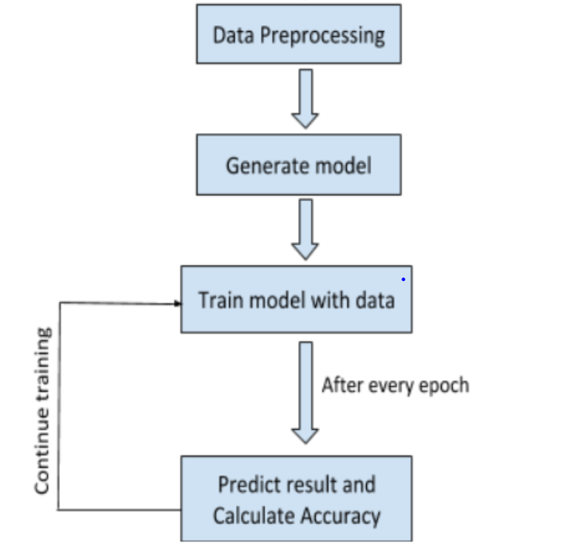
Spell-check Working Flowchart

Slide 7
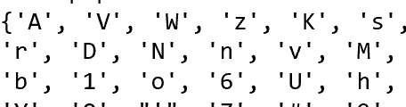
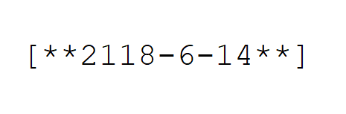
Data Preprocessing
Cleaning
Remove extra spaces
Remove unwanted characters
Most popular character
Takes 100 most frequent characters and stores it in a json file as dictionary
Data filter
If a line doesn't contain most popular chars those lines are removed

Slide 8
Data Preprocessing
Generating answers
Keeps the lines between 3 and 40 characters
If exceeds 40, it breaks the line into new lines based on the last space available
Generating questions
Takes the answers one by one and generate questions corresponding to each answer
Adds random noise
sixth-seeded Gilles Simon against Hugo..
and became unstable, the wing would.....
Contacts Tom Bergmann Telsima...........
...oguH tsniaga nomiS elliG dedees-htxis
......dluow gniw eht ,elbatsnu emacb dna
...........amisleT nnamgreB moT stcatnoC

Slide 9
Data Vectorization
Tuple(Question, Answer)
Vectorized tuple(Question, Answer)
One hot encoding
The technique used here is one hot encoding where each character is encoded in terms 0 and 1 based on the dictionary indices.
0,A
1,B
2,C
….
….
78,a
….
99,’
100,z
A 10000000000000000000000000000000000
B 01000000000000000000000000000000000
z 00000000000000000000000000000000001

Slide 10
Generate Model
Input
Dense
Softmax
Prediction
BI-LSTM
Encoder
Dropout 0.3
Dropout 0.3
Decoder
BI-LSTM
Output

Slide 11
Method
2 bidirectional LSTM layers
1 Encoder: first hidden layer
1 Decoder: second hidden layer
Architecture:
Character vocabulary: 100 Top character
Input string with max length 40
Vector:One hot encoding for each character

Slide 12
Training strategy
fed corrupted input strings and provided the original non corrupted string as output labels.
generate corrupted strings by randomly deleting, inserting , substituting and transpose one or two characters for a given string
a random number generator to determine if and which edit operations were selected.
Ratio noise is set to 0.005 or 0.003

Slide 13
Dataset
CURD corpus: The Carnegie Mellon University Recipe Database corpus
Combined with Recipe dataset from kaggle
This corpus look like real live medical report
Only the plain text are extracted for training.

Slide 14
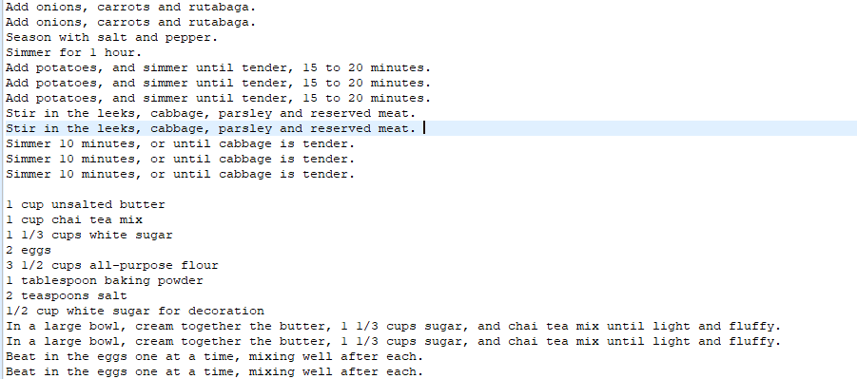
Overview of used corpora

Slide 15
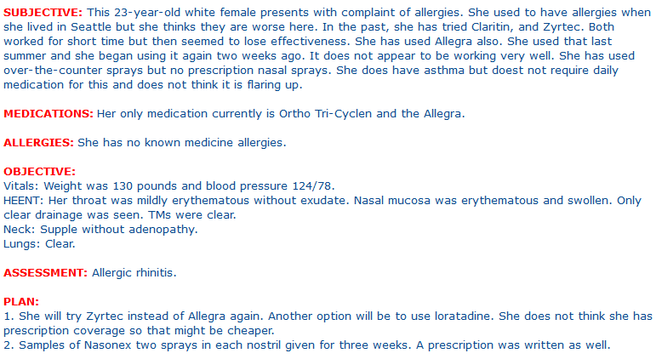
Dataset (cont°)
French News dataset: a billion word that Google released for Language Modeling research
English clinical notes: Collection of transcribed medical reports from www.mtsamples.com/

Slide 16
 | Text style / language | Domain | Train / VAL
Recipe dataset | Structured english | general | 460K/ 210K
Billion word | Free french text | general | 700M/300M
Clinical notes | Structured english | ALL domain | 7000k
Clinical notes | Structured french

Slide 17
Evaluation
Evaluation metrics:
CER : character error rate
Accuracy
Baseline model: Aspell’s default settings as a baseline
The first suggestion returned in Aspell’s suggestion list is used as the correction.
Notes:
Aspell generates possible corrections using the
Metaphone phonetic algorithm [23] and sorts them according to
their orthographic and phonetic edit distances.

Slide 18
Experiments and Discussion
Trained more than 15 times with different parametters

Slide 19
English clinical note

Slide 20
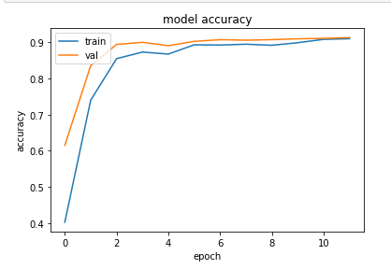
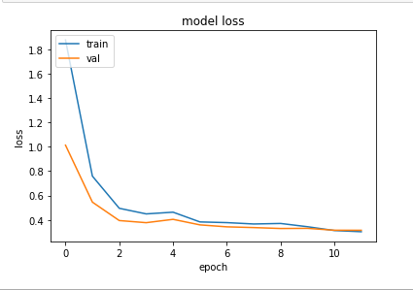
loss: 0.3030 - acc: 0.9105 - val_loss: 0.3148 - val_acc: 0.9136
Validation set =0.3
NUMBER_OF_EPOCHS = 100
INPUT_LAYERS = 1
OUTPUT_LAYERS = 1
AMOUNT_OF_DROPOUT = 0.5
BATCH_SIZE = 100
SAMPLES_PER_EPOCH = 1000
HIDDEN_SIZE = 500
Learn_rate=0.001
MAX_INPUT_LEN = 60
AMOUNT_OF_NOISE=0.003

Slide 21
French news dataset

Slide 22
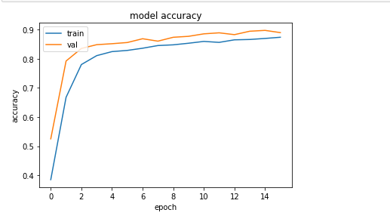
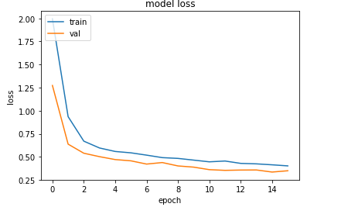
loss: 0.4299 - acc: 0.8647 - val_loss: 0.3577 - val_acc: 0.8825
Validation set =0.2
NUMBER_OF_EPOCHS = 16
INPUT_LAYERS = 1
OUTPUT_LAYERS = 1
AMOUNT_OF_DROPOUT = 0.5
BATCH_SIZE = 100
SAMPLES_PER_EPOCH = 1000
HIDDEN_SIZE = 700
Learn_rate=0.001
MAX_INPUT_LEN = 40
AMOUNT_OF_NOISE=0.005

Slide 23
English Recipe dataset

Slide 24
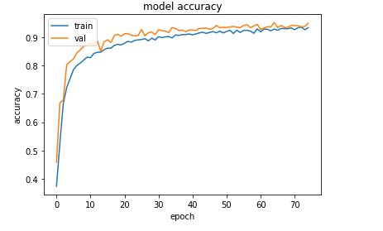
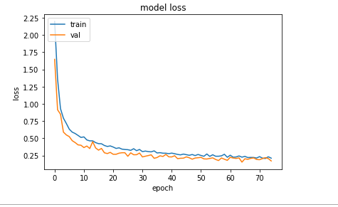
loss: 0.4299 - acc: 0.8647 - val_loss: 0.3577 - val_acc: 0.8825
Validation set =0.2
NUMBER_OF_EPOCHS = 75
INPUT_LAYERS = 1
OUTPUT_LAYERS = 1
AMOUNT_OF_DROPOUT = 0.5
BATCH_SIZE = 100
SAMPLES_PER_EPOCH = 1000
HIDDEN_SIZE = 500
Learn_rate=0.001
MAX_INPUT_LEN = 60
AMOUNT_OF_NOISE=0.003

Slide 25
Recipe example
Q Season both sides of chicken iwth.......
A Season both sides of chicken with.......
G Season woth sides of chicken with.......
Q for 18 to 20 minutest...................
A for 18 to 20 minutes....................
G for 20 to 20 minutes....................

Slide 26
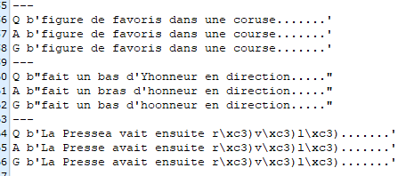
French news

Slide 27
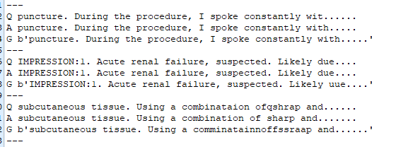
English clinical notes

Slide 28
Discussion
Validation accuracy is higher than the training accuracy. (still trying to figure out why)
I realized that using accuracy as metric is not always good to evaluate character level model.
Eg: If I deleted 1 character, all characters are shifted . If the model is not able to detect the error the accuracy should be zero but because of the padding I will not get 0.
Input: eat apple ……………….
correct: I eat apple………........
Predi: eat apple……………....
The solution is to use Levenshtein distance to get how many characters to modify to have the correct input.

Slide 29
Next
Solve evaluation metric problem using edit distance:
Name entity reconigtion:
I am trying to use Bi-directional LSTM-CNNs-CRF
To detect
Name: patient name , address
Drug:
FINDING :lung cancer; SOB; fever
PROCEDURE: chest X Ray;laparotomy
SUBSTANCE: Ceftriaxone; CO2; platelet
QUALIFIER: left; right;elective; mild
BODY: renal artery; LAD; diaphragm
BEHAVIOR: smoker; heavy drinker
ABNORMALITY: tumor; lesion; granuloma
ORGANISM :HCV; proteus; B streptococcus
OBJECT: epidural pump; larnygoscope
OCCUPATION: cardiologist; psychiatrist
OBSERVABLE: GCS; blood pressure

Slide 30
References:
EvaD’hondt : Generating a Training Corpus for OCR Post-Correction Using Encoder-Decoder Model
Kenneth H. Lai : Automated misspelling detection and correction in clinical free-text records
EvaD’hondt:Low resource OCR error detection and correction in French Clinical Texts
Annotating and Recognising Named Entities in Clinical Notes by Yefeng Wang
End-to-end Sequence Labeling via Bi-directional LSTM-CNNs-CRF

