Slide 1
Capstone 2: Wine Quality
Del Wester
3/24/2021

Slide 2
Overview
Many wine brands are seeking new ways to maximize the success of their wines. Before making any decisions, it might be helpful to know which features contribute to a wine's quality. Knowing these features can enable a brand to make more intelligent decisions when making it. But what exactly are these features? Using ML techniques with wine data retrieved from the following website, I plan to answer this question. https://archive.ics.uci.edu/ml/datasets/wine+quality

Slide 3
Data Wrangling
The dataset for this project was wrangled by another party prior to beginning this project.
Using red and white wine samples, inputs include objective tests (PH values) and the output is based on sensory data (wine tasting by experts). Using a median of at least 3 evaluations, each expert graded the wine quality between 0 (very bad) and 10 (very excellent). Several data mining methods were applied to model these datasets under a regression approach to determine wine quality.

Slide 4
Exploratory Data Analysis
Exploratory data analysis can be used to derive relationships between the wine quality and the various features available from the wine’s profile and suggest improvements to the profiles that would increase the wine’s quality. The quality feature of this set was the result of wine tasters opinions, ranging from 3 to 9, with the higher numbers being higher quality. The spread is shown below:
"quality" value counts:
 | 6 2836 5 2138 7 1079 4 216 8 193 3 30 9 5

Slide 5
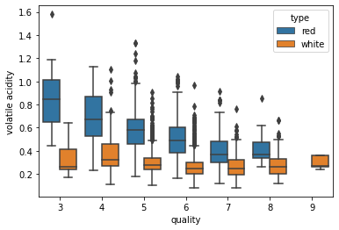

Slide 6
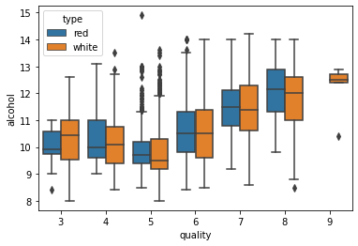

Slide 7
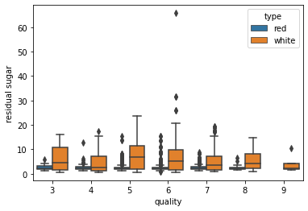

Slide 8
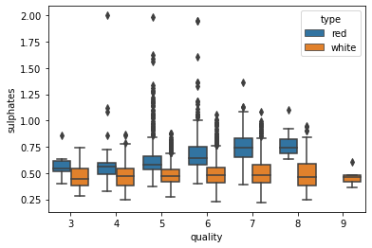

Slide 9
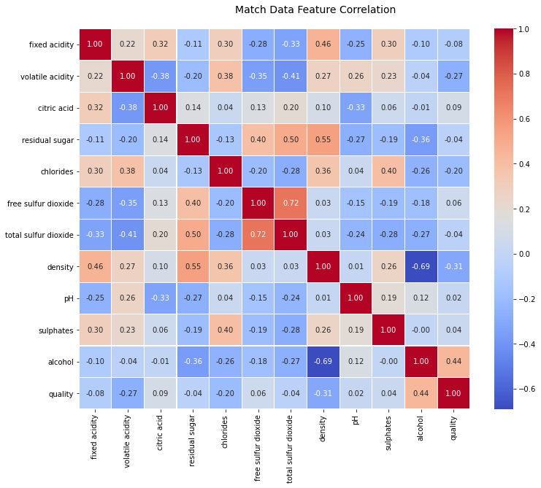
The Correlation Heatmap alcohol and density have a fairly high negative correlation free & total sulfur dioxide have a fairly high positive correlation

Slide 10
Preprocessing and Modeling
Split the data into high and low quality wines, as well as red and white, for a total of two subsets of data: Red and White.
The data was then scaled
I didn’t find any features to leave out due to high correlation

Slide 11

Quality Count – Red Wine
Approximately 15% of Red wines are high quality

Slide 12
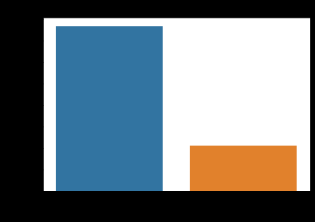
Quality Count – White Wine
Approximately 25% of white wines are high quality

Slide 13
Model Comparison
LogisticRegression
RandomForestClassifier
KNeighborsClassifier
Red: 0.84 White: 0.91
Red: 0.79 White: 0.75
Red: 0.38 White: 0.77

Slide 14
Feature Importance Red Wine
Alcohol
Volatile Acidity
Sulphates

Slide 15
Feature Importance White Wine
Alcohol
Volatile Acidity
Residual Sugar

Slide 16
GridsearchCV Hyperparameter Tuning
Logistic Regression
C=100, penalty='l1', solver='liblinear‘
RandomForest Classifier
max_depth=4, n_estimators=80
Kneighbors Classifier
algorithm='ball_tree', n_neighbors=100, weights='distance'

Slide 17
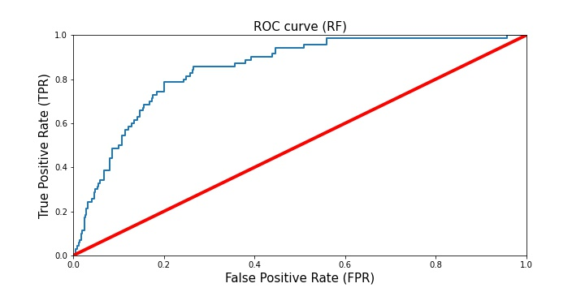
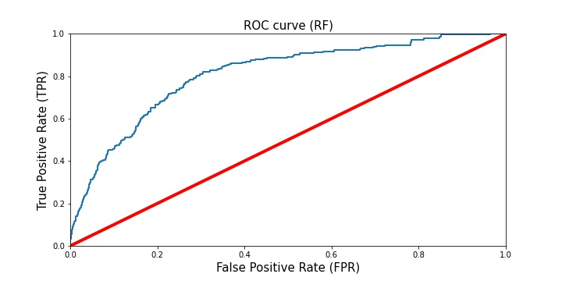
Red
White

Slide 18
Classification Reports

Slide 19
Conclusion
By analyzing the physicochemical data of red and white wines, I was able to create a model that can help industry producers, distributors, and sellers predict the quality of red wine products and have a better understanding of each critical feature. I found the Logistic Regression model performed better than the other two models. I determined three features most influential for both red and white wines. Red: volatile acidity, sulphates, and alcohol content. White: volatile acidity, residual sugars, and alcohol content. To be more specific, high-quality red wines seem to have lower volatile acidity, higher alcohol, and medium-to-high sulphates. Meanwhile, higher quality white wines also have low volatile acidity and high alcohol content, but differ in due to lower residual sugars.
This analysis comes with some limitations. First, the data set is unbalanced. A majority of the quality values were 5 and 6, which makes no significant contribution to finding an optimal model. These values make it harder to identify each features exact influence on a “high” or “low” quality of the wine, which was the main focus of this analysis. In order to improve the predictive model, more balanced data is needed. Another limitation worth mentioning is that the dataset only has 12 attributes, which reduces the accuracy of the predictive models. The solution for this is to include more relevant data features, such as the year of harvest, amount of brew time, or grape type. Different performance measures and/or machine learning techniques could also be utilized to find better performance and model comparisons.

