Slide 1
Capstone 3: Breast Cancer
Del Wester
4/06/2021

Slide 2
Overview
Most types of breast cancer are easy to diagnose by microscopic analysis of a sample - or biopsy - of the affected area of the breast. The two most commonly used screening methods, physical examination of the breasts by a healthcare provider and mammography, can offer an approximate likelihood that a lump is cancer, and may also detect some other lesions, such as a simple cyst. When these examinations are inconclusive, a healthcare provider can remove a sample of the fluid in the lump for microscopic analysis (a procedure known as fine needle aspiration, or fine needle aspiration and cytology, FNAC) to help establish the diagnosis. A needle aspiration can be performed in a healthcare provider's office or clinic. Together, physical examination of the breasts, mammography, and FNAC can be used to diagnose breast cancer with a good degree of accuracy.

Slide 3
Data Wrangling
I loaded the dataset into Excel and replaced the numbered columns with the column names. I then saved as a csv file and loaded into a pandas dataframe.
There are 699 records in this dataset.
Number of Attributes: 10 + output attribute
Attribute information: except for ID and Class, all columns had values ranging from 1 – 10.

Slide 4
Input variables
1 - ID
2 – Clump_Thickness
3 - Uniformity_of_Cell_Size
4 - Uniformity_of_Cell_Shape
5 - Marginal_Adhesion
6 - Single_Epithelial_Cell_Size
7 - Bare_Nuclei
8 - Bland_Chromatin
9 - Normal_Nucleoli
10 - Mitoses
11 - Class (2 for benign, 4 for malignant)
Missing Attribute Values: Bare_Nuclei was missing 16 values which I replaced with the mean.

Slide 5
Exploratory Data Analysis
The Breast Cancer data includes mostly continuous data with a single categorical column. . Exploratory data analysis was used to derive relationships between the class and the various features available from the data profile. The Class feature of this set was determined by the image of a fine needle aspirate (FNA) of a breast mass and takes into consideration the characteristics of the cell nuclei present in the image.

Slide 6
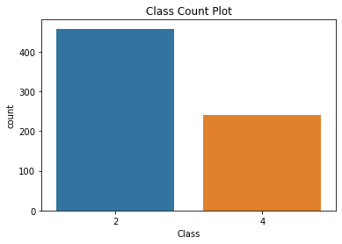
Class Distribution Benign(2): 458 Malignant(4): 241

Slide 7
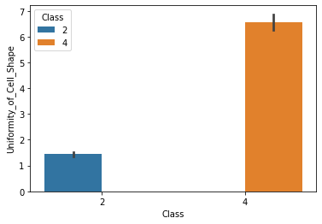
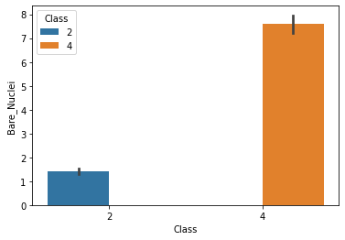
The plots for the output variable vs each of the features
Uniformity of Cell Shape
Bare Nuclei

Slide 8
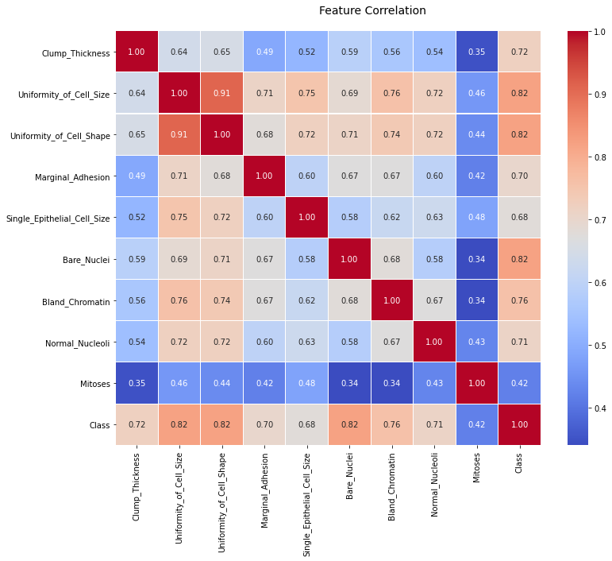
Correlation Matrix
Multicollinearity is a problem as it undermines the significance of independent variables. It can be fixed by removing the highly correlated features from the model.
Uniformity of Cell Size and Mitosis were both removed before modeling for this reason.

Slide 9
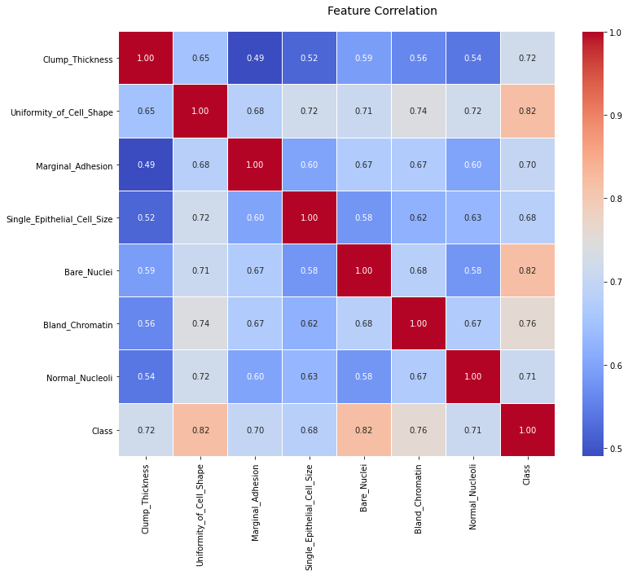
New Correlation Matrix

Slide 10
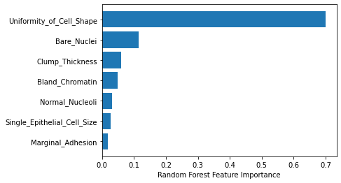
Preprocessing and Modeling
The data was scaled using a Robust Scaler and I ran a Random Forest Regressor to find the Feature Importance which is displayed below.

Slide 11
Modeling
I tested and scored the following models: RandomForestClassifier, KNeighborsClassifier, and Logistic Regression. I used GridsearchCV hyper parameter tuning for the models as well. I then ran the ROC_AUC scores/curve and Classification Reports. Logistic Regression scored higher than the others and was what I recommend for the final model.
With this model, we want a high TPR considering you don’t want to tell someone they don’t have cancer when they do.

Slide 12
Models With GridsearchCV hyper parameter Tuning
Logistic Regression | 99.6
C = 1, solver = 'liblinear'
Random Forest Classifier | 99.4
max_depth = 4, max_features = 'sqrt', n_estimators = 17
KNeighbors Classifier | 99.3
Algorithm = 'ball_tree', n_neighbors = 100, weights = 'distance'

Slide 13
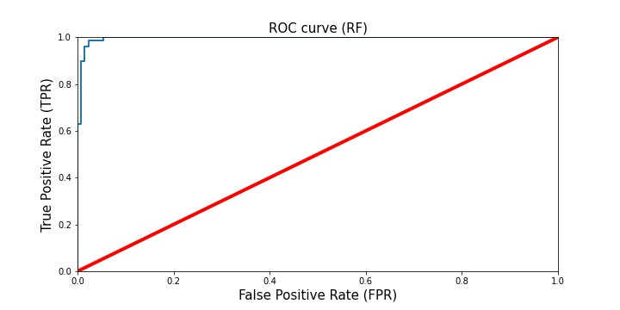
ROC-AUC Scores/Curve
Logistic Regression

Slide 14
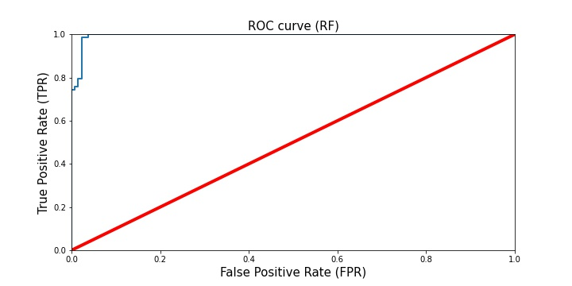
Random Forest Classifier

Slide 15
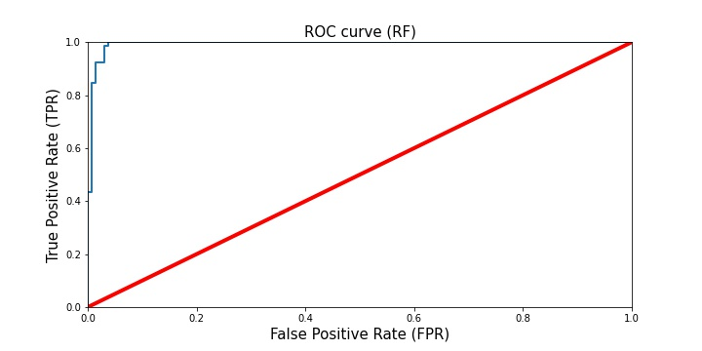
KNeighbors Classifier

Slide 16
Classification Reports

Slide 17
Conclusion
There are different techniques that can be used for the prediction of breast cancer. In this paper, I’ve analyzed breast cancer data using three classification techniques to predict the type of cancer and compared the results. They indicate that Logistic Regression is the best classifier with this dataset, followed by Random Forest and KNeighbors. Further studies could be conducted to improve performance of these classification techniques by identifying more features that could be used in the analysis.

