Slide 1
Capstone 3: Breast Cancer
Del Wester
3/16/2021

Slide 2
Overview
Most types of breast cancer are easy to diagnose by microscopic analysis of a sample - or biopsy - of the affected area of the breast. The two most commonly used screening methods, physical examination of the breasts by a healthcare provider and mammography, can offer an approximate likelihood that a lump is cancer, and may also detect some other lesions, such as a simple cyst. When these examinations are inconclusive, a healthcare provider can remove a sample of the fluid in the lump for microscopic analysis (a procedure known as fine needle aspiration, or fine needle aspiration and cytology, FNAC) to help establish the diagnosis. A needle aspiration can be performed in a healthcare provider's office or clinic. Together, physical examination of the breasts, mammography, and FNAC can be used to diagnose breast cancer with a good degree of accuracy.

Slide 3
Data Wrangling
I loaded the dataset into Excel and replaced the numbered columns with the column names. I then saved as a csv file and loaded into a pandas dataframe.
There are 699 records in this dataset.
Number of Attributes: 10 + output attribute
Attribute information: except for ID and Class, all columns had values ranging from 1 – 10.

Slide 4
Input variables
1 - ID
2 – Clump_Thickness
3 - Uniformity_of_Cell_Size
4 - Uniformity_of_Cell_Shape
5 - Marginal_Adhesion
6 - Single_Epithelial_Cell_Size
7 - Bare_Nuclei
8 - Bland_Chromatin
9 - Normal_Nucleoli
10 - Mitoses
11 - Class (2 for benign, 4 for malignant)
Missing Attribute Values: Bare_Nuclei was missing 16 values which I replaced with the mean.

Slide 5
Exploratory Data Analysis
The Breast Cancer data includes mostly continuous data with a single categorical column. . Exploratory data analysis was used to derive relationships between the class and the various features available from the data profile. The Class feature of this set was determined by the image of a fine needle aspirate (FNA) of a breast mass and takes into consideration the characteristics of the cell nuclei present in the image.
"Class" Distribution:
Benign: 458 Malignant: 241

Slide 6
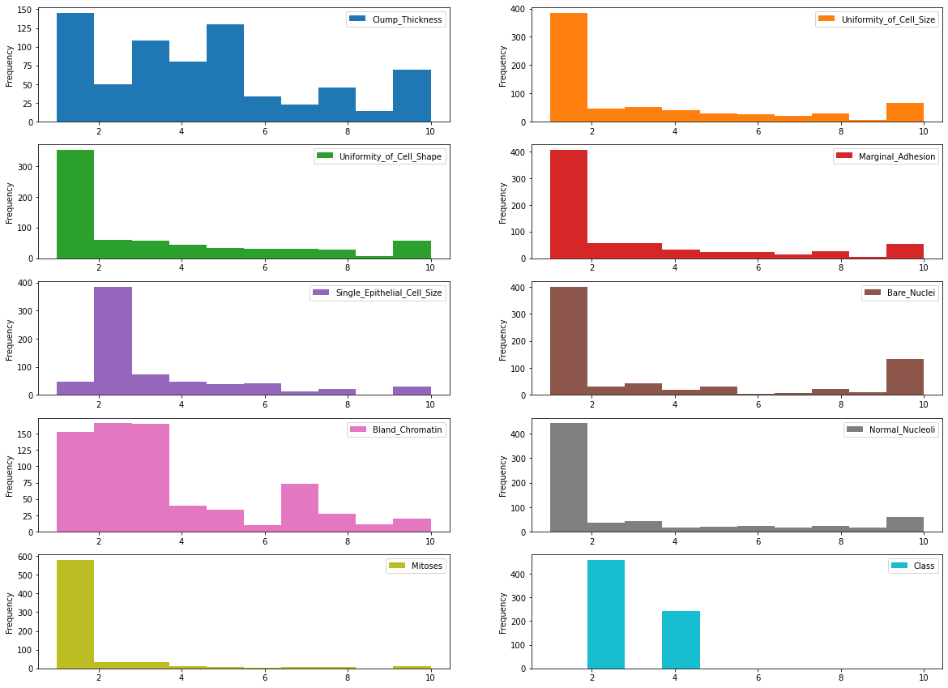
The plots for the output variable vs each of the features

Slide 7
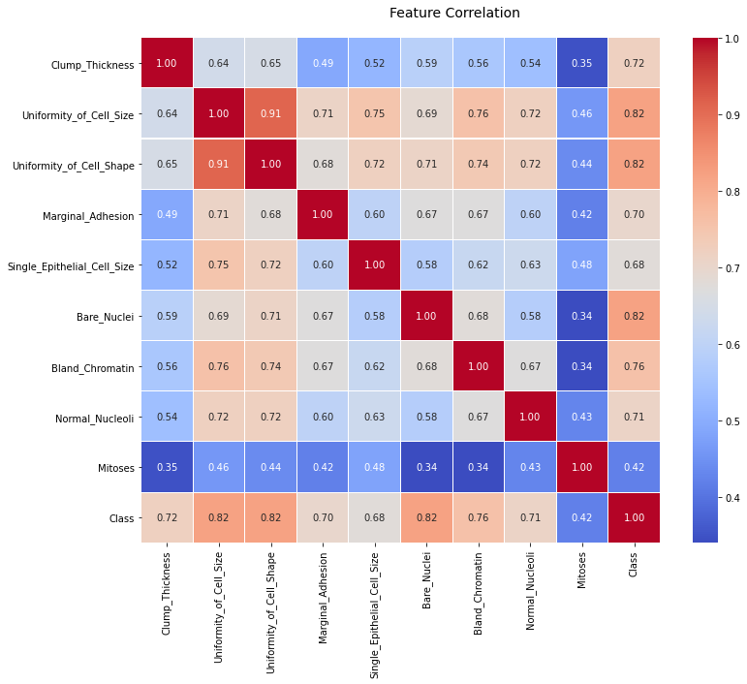
Correlation Matrix

Slide 8
Preprocessing and Modeling
The data was scaled using a Robust Scaler.
No features were dropped.
Random Forest Regressor was used to find the Feature Importance which is displayed below.

Slide 9
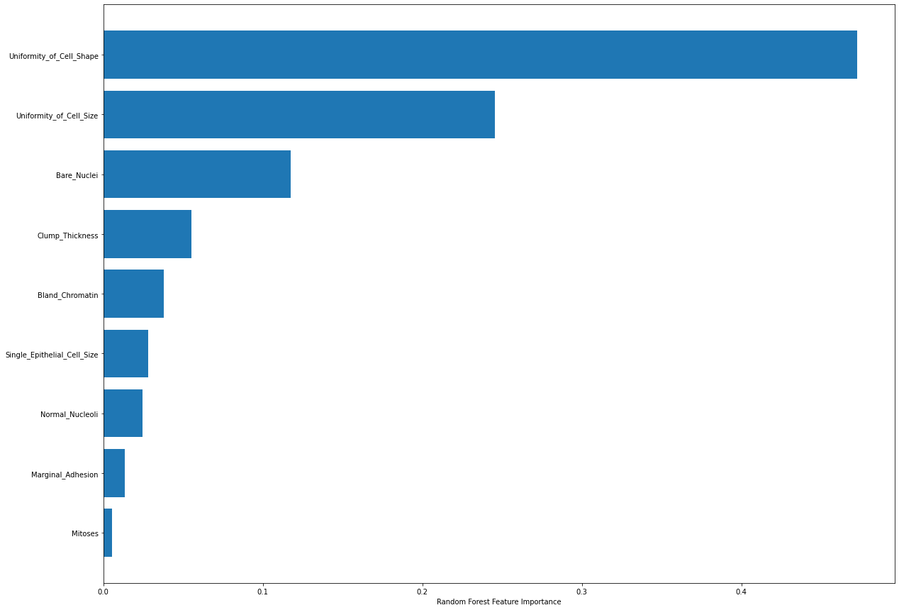
Top Three Features by Importance Uniformity_of_Cell_Shape Uniformity_of_Cell_Size Bare_Nuclei

Slide 10
Modeling
KNeighborsClassifier | 98.1
Decision Tree Classifier | 95.7
RandomForestClassifier | 97.6
GradientBoostingClassifier | 96.2
GaussianNB | 97.6
SVC | 97.1

Slide 11
Hyperparameter Tuning & ROC_AUC / ROC Curve
KNeighbors Model
Best Estimators:
n_neighbors = 150
weights = 'distance'
Best Score: 98.7
Accuracy Score: 94.3
CV Score: 99.0

Slide 12
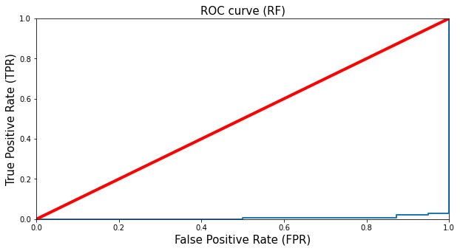

Slide 13
