Slide 1
Capstone 2: Wine Quality
Del Wester
2/1/2021

Slide 2
Overview
Many wine brands are seeking new ways to maximize the success of their wines. Before making any decisions, it might be helpful to know which features contribute to a wine's quality. Knowing these features can enable a brand to make more intelligent decisions when making it. But what exactly are these features? Using ML techniques with wine data retrieved from the following website, I plan to answer this question. https://archive.ics.uci.edu/ml/datasets/wine+quality

Slide 3
Data Wrangling
The dataset for this project was wrangled by another party prior to beginning this project.
Using red and white wine samples, inputs include objective tests (PH values) and the output is based on sensory data (wine tasting by experts). Using a median of at least 3 evaluations, each expert graded the wine quality between 0 (very bad) and 10 (very excellent). Several data mining methods were applied to model these datasets under a regression approach to determine wine quality. Data source: http://www3.dsi.uminho.pt/pcortez/winequality09.pdf

Slide 4
Exploratory Data Analysis
Exploratory data analysis can be used to derive relationships between the wine quality and the various features available from the wine’s profile and suggest improvements to the profiles that would increase the wine’s quality. The quality feature of this set was the result of wine tasters opinions, ranging from 3 to 9, with the higher numbers being higher quality. The spread is shown below:
"quality" value counts:
 | 6 2836 5 2138 7 1079 4 216 8 193 3 30 9 5

Slide 5
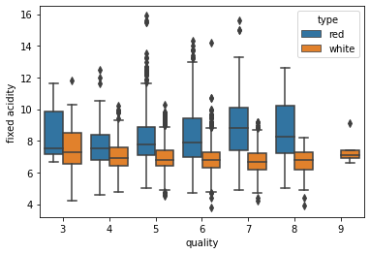
Output variable ‘quality’ vs each of the other features

Slide 6
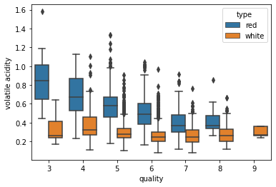

Slide 7
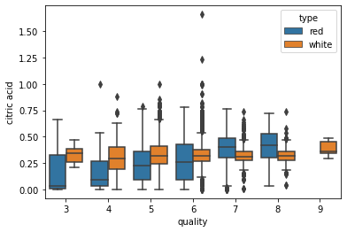

Slide 8
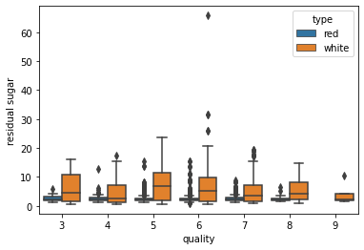

Slide 9
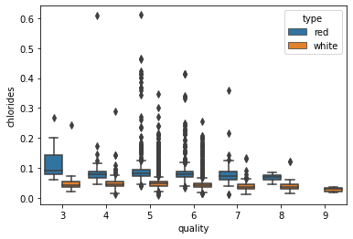

Slide 10
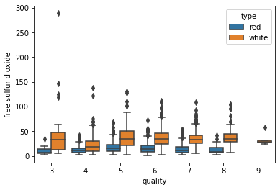

Slide 11
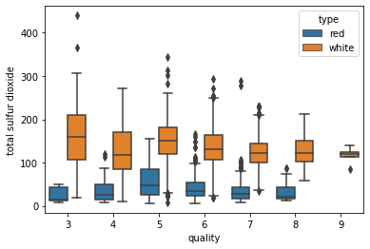

Slide 12
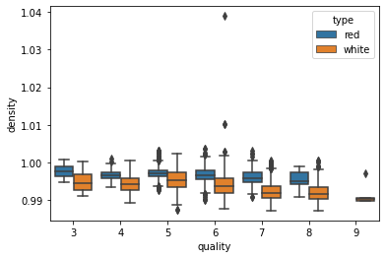

Slide 13
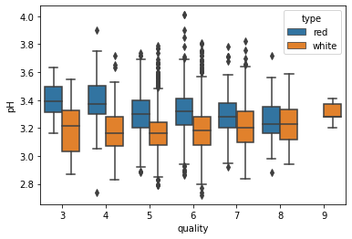

Slide 14
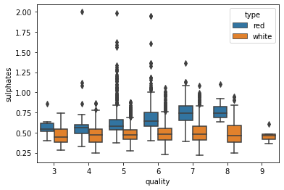

Slide 15
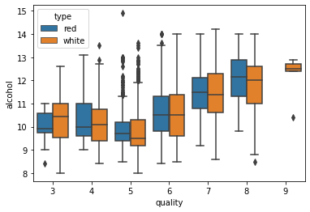

Slide 16
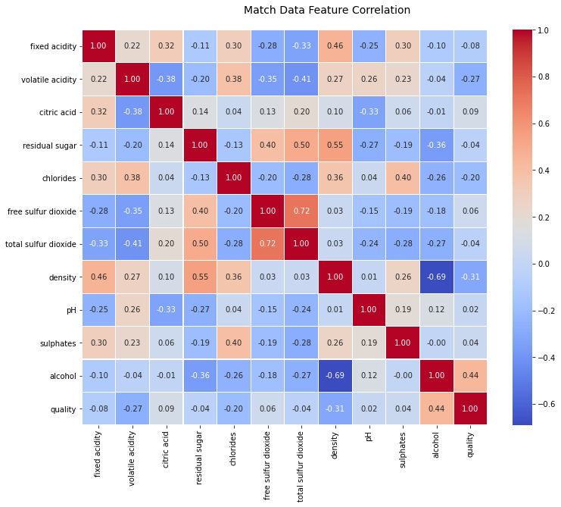
The Correlation Heatmap alcohol and density have a fairly high negative correlation free & total sulfur dioxide have a fairly high positive correlation

Slide 17
Preprocessing and Modeling
Split the data into high and low quality wines, as well as red and white, for a total of two subsets of data: Red and White.
The data was then scaled
I didn’t find any features to leave out due to high correlation
Feature Importance. alcohol, chlorides and density.

Slide 18
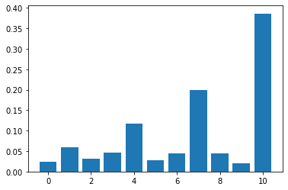
chlorides | density | alcohol

Slide 19
Models

Slide 20
Model Comparison
Red: 0.83 White: 0.80
Red: 0.89 White: 0.89
Red: 0.85 White: 0.83
Red: 0.87 White: 0.79
Red: 0.87 White: 0.84
Red: 0.84 White: 0.70
Red: 0.87 White: 0.83
DecisionTreeClassifier
RandomForestClassifier
GradientBoostingClassifier
LogisticRegression
KNeighborsClassifier
GaussianNB
SVC

Slide 21
Gridsearch Hyperparameter Tuning
Red:
RandomForestClassifier(max_depth=4, min_samples_leaf=2, n_estimators=72)
0.83
White:
RandomForestClassifier(max_depth=4, min_samples_leaf=2, n_estimators=72)
0.83

Slide 22
scored the Random Forest model with the new hyperparameters and ran the ROC AUC scores and curve
Red 0.87
White 0.80
Red ROC-AUC Score: 0.79
White ROC-AUC Score: 0.82

Slide 23
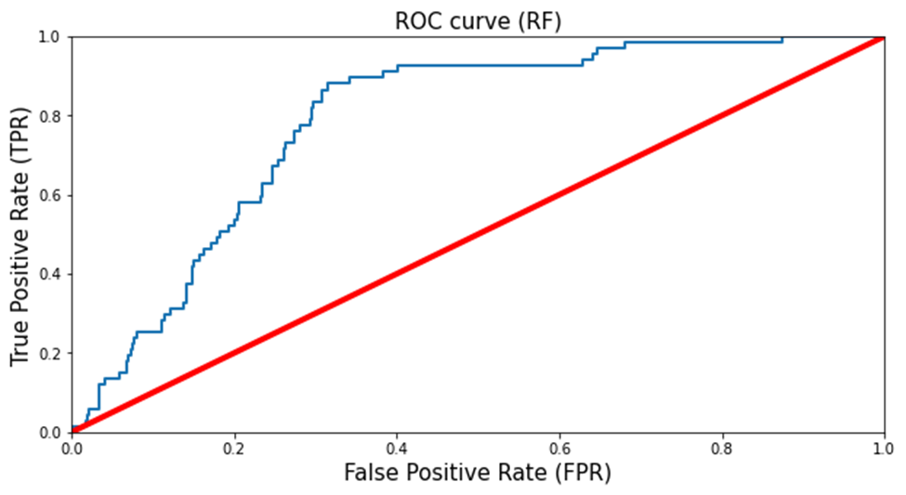
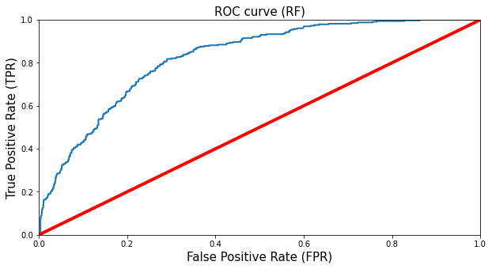
Red
White

