Slide 1
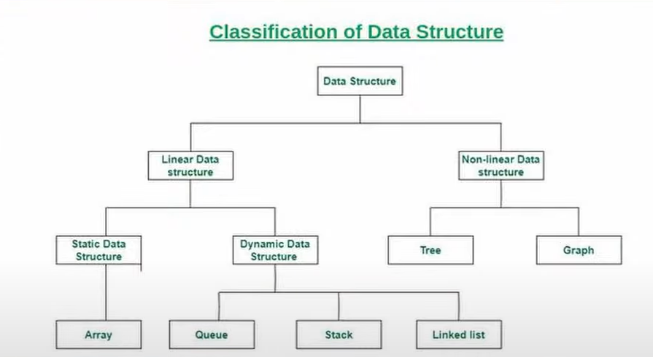

Slide 2
Read and understand the problem.
Think of all possible solutions. - think of edge cases/
Recall previous questions that are perhaps similar.
Know exactly code, if idea is done clearly.
Know time and space complexity of the solution.

Slide 3
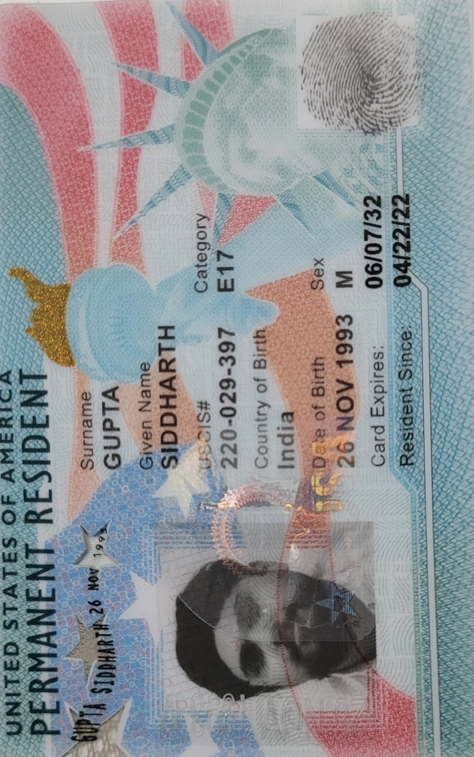
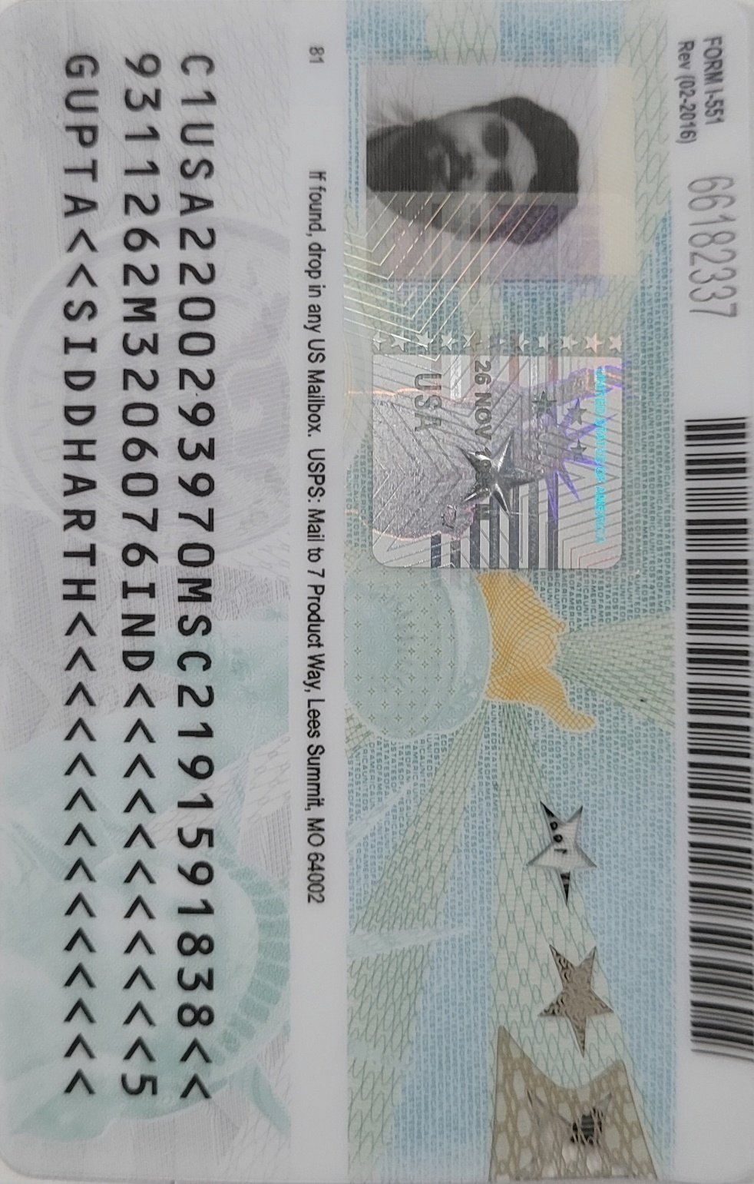

Slide 4
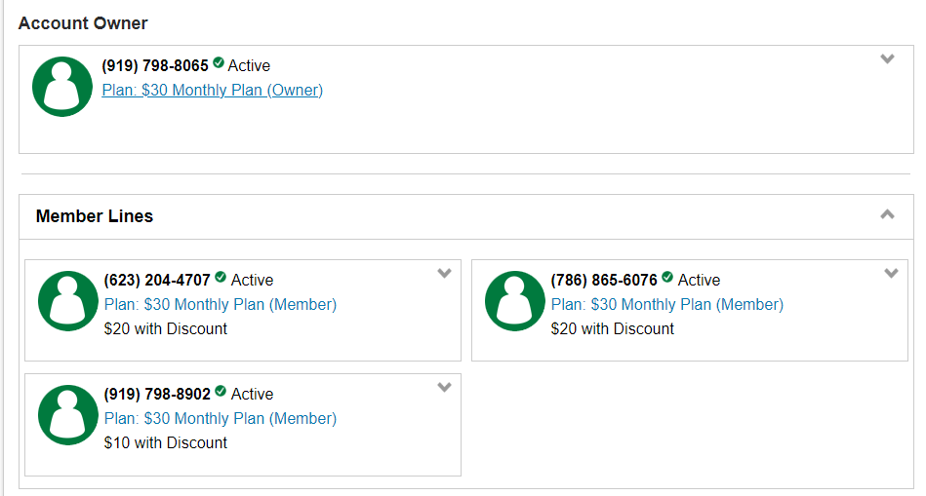
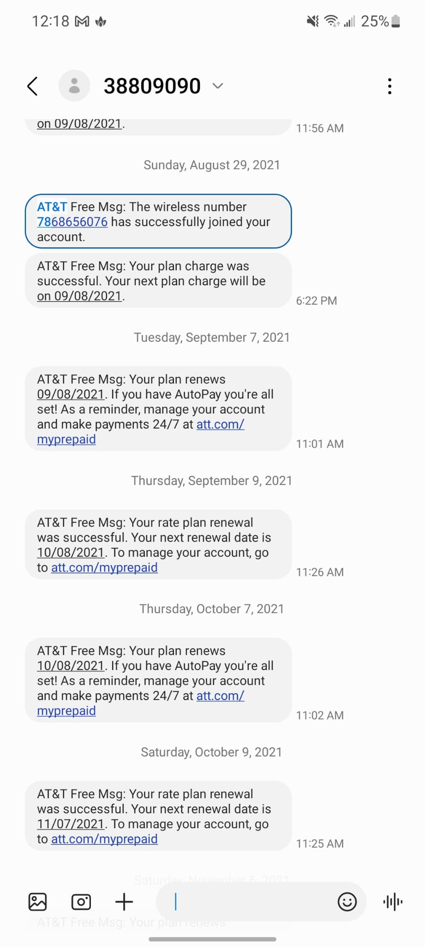
Siddharth Gupta
Arushi Gupta

