Slide 1
NS2 Tutorial
Aga Zhang
Dependable Computing Lab

Slide 2
Outline
Introduction
Fundamental Skills - Tcl and OTcl
Network Simulator - ns-2
Study Project - Mobile IP
Conclusions

Slide 3
Introduction
NS2 history
  Modified from REAL network simulator
  Developed through VINT project at UCB
  NS1 vs. NS2
NS version2 is a discrete-event driven and object-oriented network simulator
  Type of simulation: continuous, discrete event, and combined
Events → Packet and Timer
Retransmit timer start
R1
TCP Packet
R2
Ack
Retransmit

Slide 4
Fundamental Skills (I)
Scripting language is used to describe a high-level programming language with relatively transparent syntax
button .b text Hello! –command {puts hello} ---- tcl command
Scripting language—Unix shells(sh, csh, …), Tcl, Perl,VB, and JavaScript
All major computing platforms provide both system programming languages such as C or Java and scripting languages such as Tcl

Slide 5
Fundamental Skills (II)
NS2 is written in C++ and OTcl
  OTcl = Tcl + OO
  C++ implements the code that executed frequently
  OTcl configures the system
set ns [new Simulator]
set n1 [new Node]
set n2 [new Node]
$ns duplex-link $n1 $n2 5Mb 2ms DropTail
n1
n2

Slide 6
Tcl – Tool Command Language
Start: Typing “tclsh” in Unix shell
Instructions using in ns2:
proc add2 {a} {
set b [expr $a+1]
incr b
puts “a+2=$b”
}
add2 55 → 57
set ll [list a b c]
lappend $ll d → a b c d
lindex $ll 0 → a
llength $ll → 4
lsearch
linsert
lreplace
split a.b . →a b
source file→ include
foreach
info exists varNam
info tclversion

Slide 7
OTcl – MIT Object Tcl
Class son –superclass father
son instproc init {args} {
puts “no var_”
}
son ss → no var_
Class father
father instproc init {args} {
$self set var_ 0
puts “**var_=$var_”
eval $self next $args
}
Class son2 –superclass father
son instproc init {args} {
puts “no var_”
$self next $args
}
son2 ss → no var_
**var_=0
father ff → **var_=0
ff info vars → var_
ff set var_ → 0
ff info class → father
father info instances → ff

Slide 8
OTcl Linkage
set tcp [new Agent/TCP]
static class TcpClass : public TclClass {
public:
TcpClass() : TclClass("Agent/TCP") {}
TclObject* create(int, const char*const*) {
return (new TcpAgent);}
} class_tcp;
TclObject
Agent/TCP
Agent
Create C++ object
init
init
Create Otcl shadow object
OTcl
C++
TclObject (C++)
parent
TcpAgent
constructor
constructor
constructor

Slide 9
OTcl Linkage (II)
Command()
Otcl
$tcp advance 10
C++
int Agent::command(int argc, const char*const* argv)
{
if (argc == 3) {
if (strcmp(argv[1], “advance") == 0) {
int newswq = atoi(argv[2]);
return (TCL_OK);
}
}
return (Agent::command(argc, argv);
}

Slide 10
OTcl Linkage (III)
bind(): link C++ member variables to Otcl object variables
C++
TcpAgent::TcpAgent() {
bind(“window_”, &wnd_);
}
// bind_time(), bind_bool(), bind_bw()
Otcl
$tcp set window_ 200
You must setting the initial values of variants in ~ns/tcl/lib/ns-default.tcl

Slide 11
OTcl Linkage (IV)
Invoking Otcl procedure and obtaining its results
Tcl::instance().evalf("%s Lookup_CIP_RT %d", name(), iph->dst().addr_);
nextHop = Tcl::instance().result();
Classifier/Addr/Cip instproc Lookup_CIP_RT { m_addr }
{ return … }
Passing a results string to Otcl
Tcl::instance().result(“………”)
Buffer

Slide 12
Network Simulator - ns-2
After installing: Add the path of ns2 to your profile, and validate your ns2
Modifying *.cc or *.tcl file
  if add new one
    adding its path to makefile(.cc) or ~ns/tcl/lib/ns-lib.tcl(.tcl)
  Type: make depend→ make
  Or make clean→ configure –enable--debug→ make

Slide 13
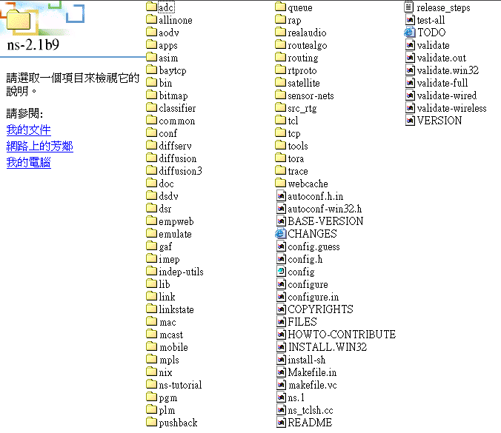
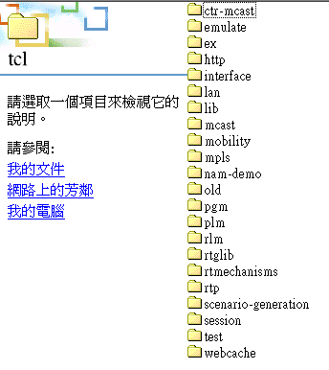
The directory of ns2

Slide 14
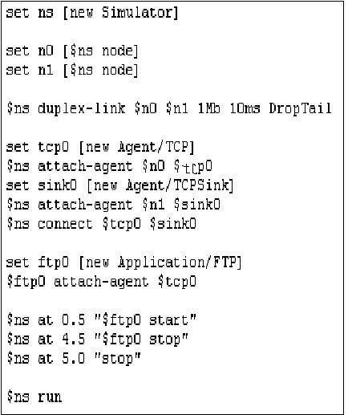
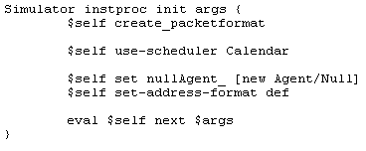
Simple code (I)
Run your program → % ns Simple.tcl
Simple.tcl

Slide 15
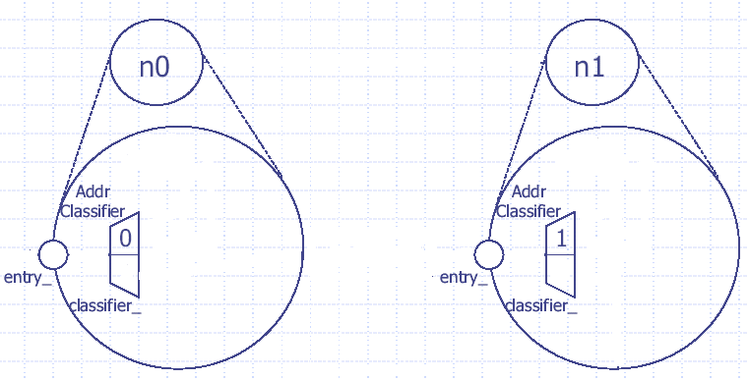
Simple code (II)

Slide 16
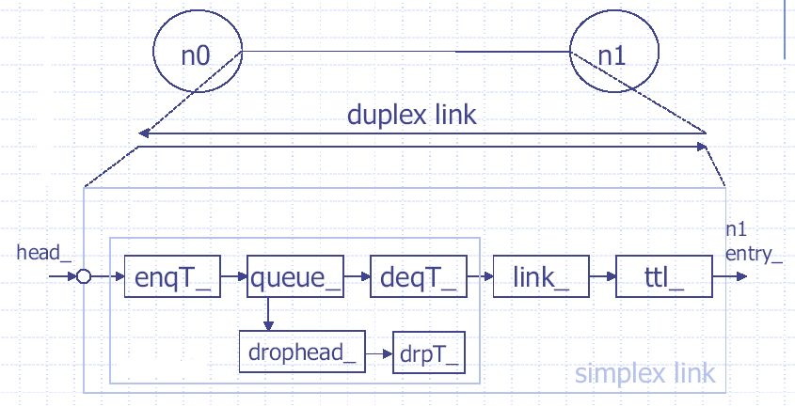
Simple code (III)

Slide 17
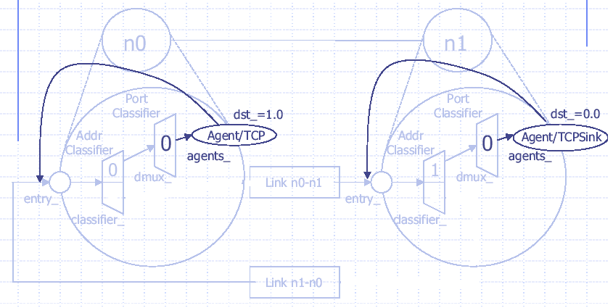
Simple code (IV)

Slide 18
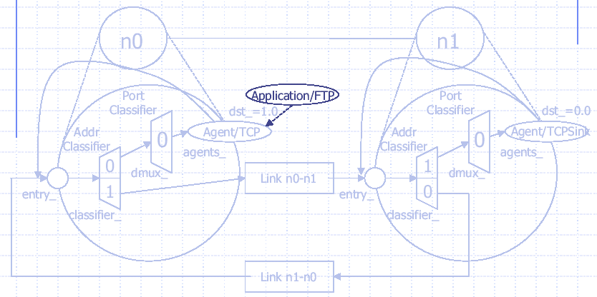
Simple code (V)

Slide 19
Study Project - Mobile IP
Configuring mobile node, HA, and FA
New packet header
Setting timer for advertisement and registration
Processing handoff

Slide 20
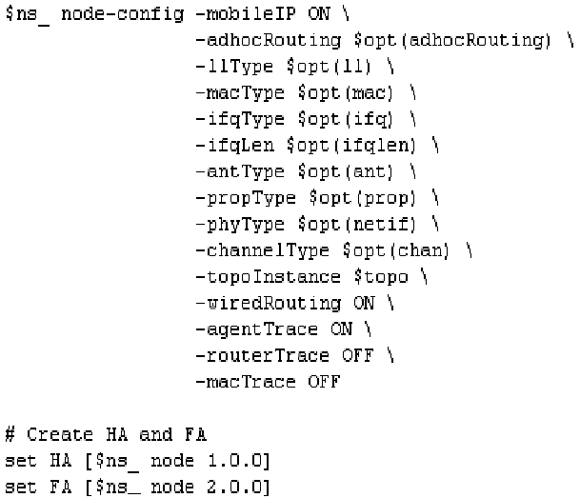
Configure mobile node, HA, and FA
routingAgent_
Wired node
  set node(0) [$ns_ node]
Wireless&wired node
OFF→MN

Slide 21
Motion
# Create HA and FA
set HA [$ns_ node 1.0.0]
set FA [$ns_ node 2.0.0]
$HA random-motion 0
$FA random-motion 0
# Position for base-station nodes (HA & FA).
$HA set X_ 1.000000000000
$HA set Y_ 2.000000000000
$HA set Z_ 0.000000000000
$FA set X_ 650.000000000000
$FA set Y_ 600.000000000000
$FA set Z_ 0.000000000000
# create a mobilenode
$ns_ node-config -wiredRouting OFF
set MH [$ns_ node 1.0.1]
set node_(0) $MH
set HAaddress [AddrParams addr2id [$HA node-addr]]
[$MH set regagent_] set home_agent_ $HAaddress
# movement of the MH
$MH set Z_ 0.000000000000
$MH set Y_ 2.000000000000
$MH set X_ 2.000000000000
# MH starts to move towards FA
$ns_ at 100.00 "$MH setdest 640.0 610.0 20.0"
# goes back to HA
$ns_ at 200.00 "$MH setdest 2.0 2.0 20.0"
Close random motion
destination
speed
Initial position

Slide 22
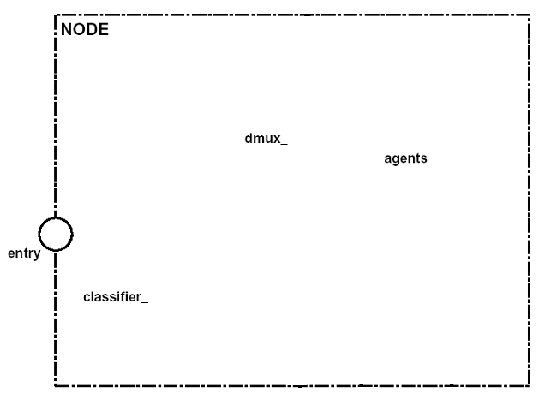
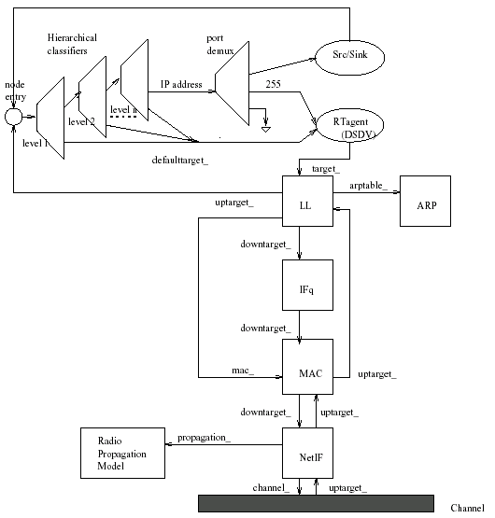
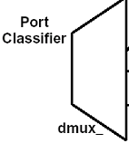
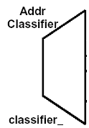

Mobile Node
Agent
0
1
Agent
Node

Slide 23
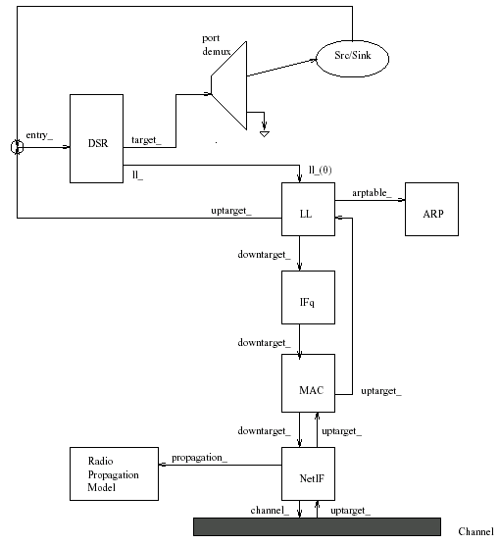
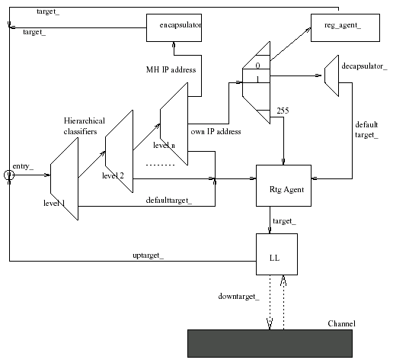
Base-Station

Slide 24
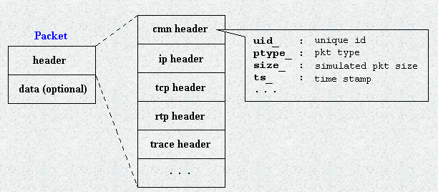
Packet header
offset_
struct hdr_ip {
………………….
static int offset_; // required by PacketHeaderManager
inline static hdr_ip* access(Packet* p) {
return (hdr_ip*) p->access(offset_);
}
Access packet header:
hdr_ip *iph = hdr_ip::access(p);
hdr_cmn *ch = hdr_cmn::access(p);
……………………
iph->dst() = iph->src();

Slide 25
New MIP packet header
static class MIPHeaderClass : public PacketHeaderClass {
public:
MIPHeaderClass() :
PacketHeaderClass("PacketHeader/MIP", sizeof(hdr_mip)) {
bind_offset(&hdr_mip::offset_);}
} class_miphdr;
Data-structure
struct hdr_mip {
int haddr_;
int ha_;
int coa_;
MipRegType type_;
//MIPT_REG_REQUEST, MIPT_REG_REPLY, MIPT_ADS, MIPT_SOL
double lifetime_;
int seqno_;
static int offset_;
inline static hdr_mip* access(const Packet* p) {
return (hdr_mip*) p->access(offset_);
}
};
Setting:
~ns/comm/packet.h and ~ns/tcl/lib/ns-packet.tcl
Access:
hdr_mip *miph = hdr_mip::access(p)

Slide 26
New Agent
New Agent for sending registration packet periodically
Data-structure
class MIPMHAgent : public Agent {
public:
MIPMHAgent();
void recv(Packet *, Handler *);
void timeout(int);
protected:
void reg();
int ha_; /* home agent address */
int coa_; /* care-of-address */
double reg_rtx_; /* retransmitting time */
SimpleTimer rtx_timer_;
RegTimer reg_timer_;
double reglftm_; /* registration lifetime */
double adlftm_; /* current ads lifetime */
};
class SimpleTimer : public TimerHandler {
public:
SimpleTimer(Agent *a) : TimerHandler() { a_ = a; }
protected:
inline void expire(Event*){
a_>timeout(MIP_TIMER_SIMPLE); }
Agent *a_; };
class RegTimer : public TimerHandler {
public:
RegTimer(MIPMHAgent *a) : TimerHandler() { a_ = a; }
protected:
Inline void expire(Event *) {
a_->timeout(MIP_TIMER_REG);}
MIPMHAgent *a_;};

Slide 27
New Agent (II)
Time-out
void MIPMHAgent::timeout(int tno){
switch (tno) {
case MIP_TIMER_SIMPLE:
reg(); break;
case MIP_TIMER_REG:
seqno_++;
reg(); break;
default: break;
}
}
Receiving reply
void MIPMHAgent::recv(Packet* p, Handler *){
Tcl& tcl = Tcl::instance();
hdr_mip *miph = hdr_mip::access(p);
switch (miph->type_) {
case MIPT_REG_REPLY:
tcl.evalf("%s update-reg %d", name_, coa_);
if (rtx_timer_.status() == TIMER_PENDING)
rtx_timer_.cancel();
reg_timer_.resched(miph->lifetime_-0.5);
break;
case MIPT_ADS: reg(); break;
default: Packet::free(p); break;
}
}

Slide 28
New Agent (III)
void MIPMHAgent::recv(Packet* p, Handler *){
hdr_mip *miph = hdr_mip::access(p);
switch (miph->type_) {
case MIPT_REG_REPLY:
tcl.evalf("%s update-reg %d", name_, coa_);
break;
case MIPT_ADS: reg(); break;
default: Packet::free(p); break;
}
}
class MIPMHAgent : public Agent {
public:
MIPMHAgent();
void recv(Packet *, Handler *);
………………………..
SimpleTimer rtx_timer_;
RegTimer reg_timer_;
};
static class MIPMHAgentClass : public TclClass {
MIPMHAgentClass() : TclClass("Agent/MIPMH") {}
TclObject* create(int, const char*const*) {
return (new MIPMHAgent());
}
} class_mipmhagent;
MIPMHAgent::MIPMHAgent() {
bind("adSize_", &size_);
}
~ns/tcl/lib/ns-default.tcl

Slide 29
recv()
Class
Class
Class
………..
………..
………..
recv(Packet* p, Handler *)
recv(Packet* p, Handler *)
recv(Packet* p, Handler *)

Slide 30
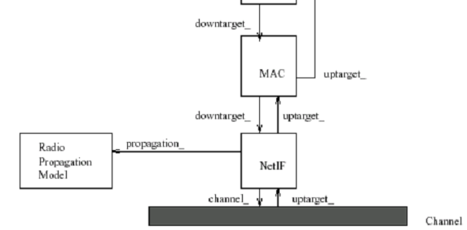
Processing handoff
$ns_ node-config -propType Propagation/TwoRayGround \
-phyType Phy/WirelessPhy \
-channelType Channel/WirelessChannel \
………………………………………
Free space model
Two-ray ground reflection model
Shadowing model
~ns/mac/wireless-phy.cc
RXThresh_

Slide 31
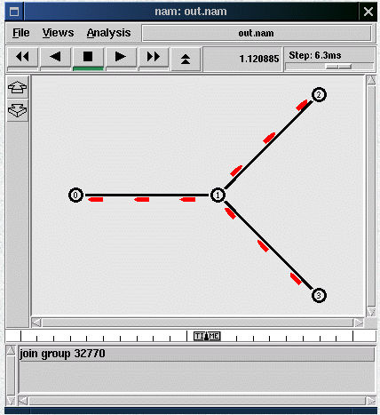
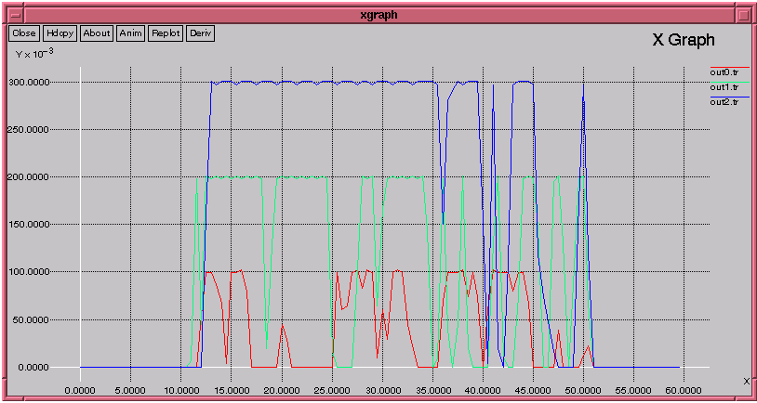
Conclusions
Tcl/Tk
NAM
Xgraph
New node
Node instproc init args {
eval $self next $args
……………………..
$self mk-default-classifier
……………………..
}
foreach modname [Node set module_list_] {
$self register-module [new RtModule/$modname]
}
Simulator instproc set-address-format {opt args} {…}

Slide 32
References
Tcl/Tk – http://www.tcl.tk/software/tcltk/
Nsnam web pages – http://www.isi.edu/nsnam/
NS by example – http://nile.wpi.edu/NS/
Tutorial – Marc Greis's tutorial
Discrete-event simulation software – http://www.topology.org/soft/sim.html

