Slide 1
🔭
WEEK 1
Sampling Period
Explore: The Sampling Period
Try everything. AI tools, design patterns, problem spaces. Don't specialise yet — the breadth you build now is your unfair advantage later.
🔨 AI-Powered Micro-Tool
Vibe Building Academy · Cohort 1
marcovanhout.com

Slide 2
WEEK 1 · EXPLORE
Sampling Period
🤖
Meet Your AI Co-Builder
First contact with Claude, ChatGPT, and Cursor — find your favourite collaborator.
📖 Self-study · 30 min
💬 Prompt 📡 Trends
Vibe Building Academy · Cohort 1
marcovanhout.com

Slide 3
🏗️ What is Vibe Building?
Vibe building is the practice of using AI tools to build complete digital products — not just code, but experiences that consider design, ethics, user needs, and real-world impact.
It goes beyond ‘vibe coding’ (typing prompts to generate code) by embracing the full breadth of what makes a product great: problem framing, design sense, storytelling, and the discipline to ship.
Vibe Building Academy · Cohort 1
marcovanhout.com

Slide 4
📚 The Range Advantage
David Epstein’s ‘Range’ shows generalists often outperform specialists in complex, uncertain domains
The ‘sampling period’ — trying many things before committing — builds creative problem-solving
AI building is exactly this kind of domain: fast-changing, interdisciplinary, rewarding breadth
Your diverse background is your superpower, not a weakness
Vibe Building Academy · Cohort 1
marcovanhout.com

Slide 5
Two Mindsets
🚀 Vibe Builder
💻 Vibe Coder
Sees the whole picture. Considers who it’s for, why it matters, how it feels. Uses AI as a creative partner to build things that work for real people.
Focuses on the code. Prompts AI to generate functions, fix bugs, ship features. Technically capable but often misses the human side of building.
Vibe Building Academy · Cohort 1
marcovanhout.com

Slide 6
💬 Prompt Craft
The new literacy. Communicating intent to AI in ways that produce what you actually mean.
🚀 Vibe Builder
💻 Vibe Coder
direct collaborators.
type commands
“Can I direct AI like a film director — not just ask it questions?”
Vibe Building Academy · Cohort 1
marcovanhout.com

Slide 7
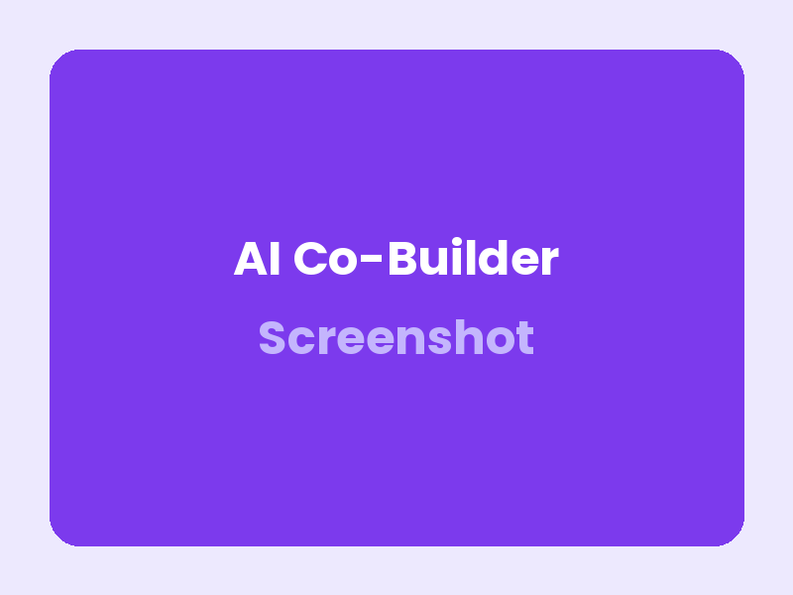
Your First Prompt
Start with something real. Not “Hello world” but a genuine problem you care about.
The best first prompts come from your own domain — your work, your hobby, your frustration. AI tools respond differently when you bring real context.
Try: “I’m a [your role] and I need to build [specific thing] for [specific audience].”
Claude generating a landing page from a domain-specific prompt
Vibe Building Academy · Cohort 1
marcovanhout.com

Slide 8
Design Sense in Action
Does the layout guide the eye naturally?
Is there enough whitespace to breathe?
Would someone enjoy using this — not just tolerate it?
Test with real people, not just yourself
Before and after applying design principles
Vibe Building Academy · Cohort 1
marcovanhout.com

Slide 9
AI Tool Speed Dating
Activity 1
Try three
AI tools
in 30 minutes
Open Claude (claude.ai), ChatGPT, and one other AI tool of your choice
Give each the same prompt: ‘Help me build a landing page for [your idea]’
Notice: How does each tool respond? Which feels more like a collaborator?
Write down 3 observations about the differences between tools
Pick your favourite — this is your co-builder for the rest of the week
Vibe Building Academy · Cohort 1
marcovanhout.com

Slide 10
Which AI tool felt most like a creative partner — and why?
What surprised you about the differences between tools?
Where in your life or work could AI building create the most impact?
REFLECTION
Vibe Building Academy · Cohort 1
marcovanhout.com

Slide 11
You don’t need to specialise —
you need to explore.
— Inspired by David Epstein, Range
Vibe Building Academy · Cohort 1
marcovanhout.com

Slide 12
🎯 Your Range Wheel
10 competencies that make a vibe builder.
🎯 Problem Framing See the right problem before jumping to solut…
🎨 Design Sense Does this feel right? Layout, hierarchy, acce…
💬 Prompt Craft Communicating intent to AI effectively.
🔗 Systems Thinking How things connect. Data flows, feedback loop…
⚖️ Ethical Awareness AI bias, privacy, inclusion, sustainability.
📡 Trend Literacy Knowing which wave to ride.
📖 Storytelling Your build is only as good as your narrative.
🌉 Domain Bridging Your unique background is your superpower.
⚡ Experimentation How fast you try, fail, learn, try again.
🚀 Ship Discipline The gap between idea and live URL.
Vibe Building Academy · Cohort 1
marcovanhout.com

Slide 13
☕
Take a break
15 minutes — stretch, grab a coffee, let it sink in.
Vibe Building Academy · Cohort 1
marcovanhout.com

Slide 14
Vibe Building
Academy
Explore. Embrace. Experiment. Evolve.
marcovanhout.com
Vibe Building Academy · Cohort 1
marcovanhout.com

