Slide 1
Our AI Builder approach
Building the bridge to enterprise AI value

Slide 2
$4.5 trillion in labor value is exposed to AI — six years ahead of schedule
of jobs impacted by AI in some way
93%
vs. 90% forecast for 2032
of jobs facing existential change
30%
"The pace of change in work is now inextricably tied to the acceleration of AI itself. What we forecast would take a decade has arrived in three years."
vs. 15% originally forecast
Faster annual exposure growth rate
+4x
From 2% annually to 9%
US labor value exposed to AI shift
$4.5T
Bureau of Labor Statistics
Cognizant Research · New Work New World 2026 · Reassessment of 18,000 tasks across ~1,000 professions
2
© 2026 Cognizant. All Rights reserved. | 2026
Notes:
To put a number on it: $4.5 trillion in U.S. labor value is now exposed to AI-led automation.
Ninety-three percent of jobs are touched in some way; this means that at least some tasks within a job could be automated with AI.
Thirty percent face existential change – the role itself needs to be reinvented, not just augmented. These roles have a high AI-assisted automation exposure score , and reimagination here means humans have to be moved away from those tasks and into "higher-order thinking"—things like empathy, complex strategy, and creative agility that AI still cannot automate.
For example: A Financial Manager (now at 84% exposure) doesn't disappear, but their job "reinvention" means they stop doing analysis and start doing "AI orchestration" and "ethical oversight."
And the rate of exposure has accelerated more than 4x.

Slide 3

To realize tangible value, focus is shifting to AI industrialization and agentification
Enabling Hyperproductivity
Earliest use case for AI, fueling the SDLC
Current shift: from synchronous to asynchronous agentic software development
Industrializing AI
Moving from pilots to scaled production, including process and workflow reimagination
Agentifying the Enterprise
Shift towards autonomous, unlocking new value pools
3
© 2026 Cognizant. All Rights reserved. | 2026
3
Notes:
So where does the path forward lie? We see the enterprise opportunity to transform with AI as three strategic streams or vectors, and they fuel each other.
We are helping clients take advantage of these opportunities in parallel, vs. sequentially.
First, one of the earliest and most mature opportunities for AI-led transformation is achieving hyperproductivity in software engineering. Enterprises are using AI to accelerate development, modernize legacy estates, reduce technical debt, and improve productivity across the software development lifecycle. More recently, this has evolved from interactive, real-time AI assistance toward supervised agentic development: instead of prompting an assistant step by step, teams can now assign work to one or more agents that operate asynchronously, often in parallel, and return code, tests, or pull requests for human review.
Second, what we call “Industrializing AI,” means achieving enterprise scale, moving from pilots and experiments to enterprise-grade systems, including reimagining the processes those systems will power.
Lastly, agentifying the enterprise is shifting towards autonomous operations that unlock entirely new pools of value.
These transformations are interconnected.
Productivity gains fund scaled AI. Industrialization enables a foundational cognitive layer and scaled returns. Agentification generates returns from new areas and builds enterprise confidence for the next cycle.

Slide 4
Three vectors of AI-Led transformation for enterprises
A virtuous flywheel — each vector reinforces the other, yet transformation occurs in parallel along all three
01
02
03
→
→
AI-Led Productivity
Scale AI including agentic AI
Agentifying the Enterprise
VECTOR 01
VECTOR 02
VECTOR 03
Accelerate software development, reduce $2T in enterprise tech debt, lower deployment costs. Embed AI across the full SDLC.
Move AI from experiments to enterprise-grade operating systems. Build full stack AI systems, operationalize responsibly, adopt ADLC alongside SDLC.
End-to-end process agentification. New digital-labor-powered workflows. Services-as-software pricing. A fully hybrid human-agent workforce.
LEGACY MODERNIZATION, FASTER INNOVATION
EXAMPLE results from specific client work:
BUSINESS REINVENTION, SCALED AGENTIFICATION
EXAMPLE results from specific client work:
LARGE SCALE AGENTIFICATION, NEW VALUE SOURCES
EXAMPLE results from specific client work:
• 20–50% engineering productivity gains
• 400+ platform deployments
• Near-zero call abandonment
• 70+ enterprise clients deployed
• Context engineering at scale
• 90s order response (from 5 days)
• 1.6× AI investment returns
4
© 2026 Cognizant. All Rights reserved. | 2026

Slide 5


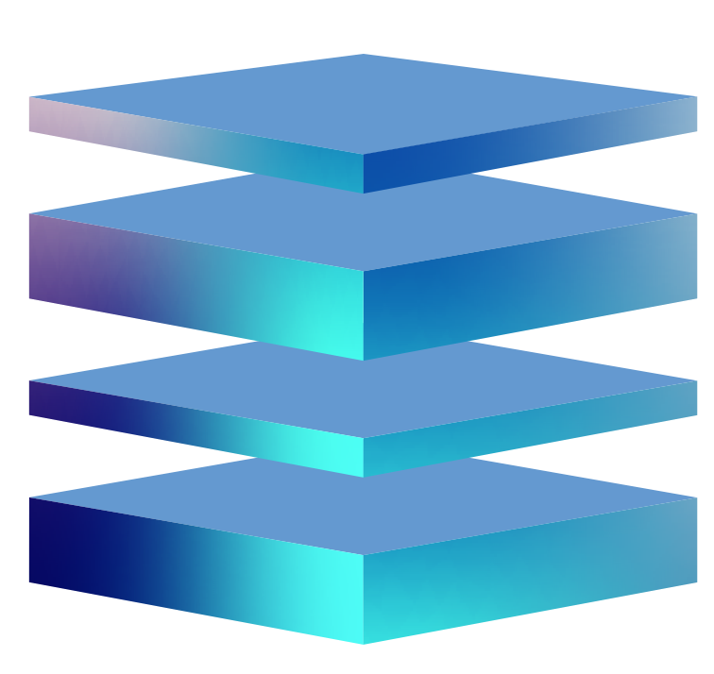




We defined the ‘AI Builder’ category
System builder
Technology focus
System integrator
Tech-enabled business outcome
AI Builder
AI-powered business value
IT and business operations
Business operations
System integrators
Application management
Agent
orchestration
Applications and middleware
Context
applications
Software
companies
Infrastructure and hardware
AI infrastructure
ROI
Linear model
Non-linear model
5
© 2026 Cognizant. All Rights reserved. | 2026
5
Notes:
The value we deliver delivers has always depended on what clients need most at a given moment.
In the 1990s, enterprises needed custom systems built from scratch, and Cognizant created value by building those systems with exceptional engineering strength, and owning the outcomes.
When enterprise software matured, clients needed help configuring and integrating packaged products at speed, and so we adapted and brough our engineering, domain and process expertise to bear to do that well.
AI has shifted the gap again. Probabilistic, contextual technology can't be configured off the shelf. It has to be built, tailored to each enterprise's context, processes, and data. We recognized this early and defined the AI Builder category - creating value by helping our clients reimagine processes and workflows, building full-stack, custom agentic journeys, and taking responsibility for the outcomes those journeys deliver.
That's the work that simplifies complexity, reduces risk, and accelerates value realization for clients, and we’ve invested here.

Slide 6

Core elements that strengthen our AI Builder stack
BASIS Framework
Context Engineering
Platforms & Products
AI Lab Innovation
Partner Ecosystem
Business-Led Autonomous Systems Integration Services — strategy, operating model, and change management for enterprise AI adoption.
Encoding enterprise workflows, domain knowledge, and tribal wisdom into AI systems. The connective tissue between models and outcomes.
Neuro® AI platforms, SLM Factory, Cognizant Flowsource™, Cognizant Ignition™ — modular, scalable, context-first.
65+ patents, 90+ peer-reviewed publications, 8 global research labs. Continuous innovation pipeline feeding directly into client solutions.
A broad and diverse ecosystem of partners ranging from established hyperscalers and infrastructure providers to startups that bring outsized value.
6
© 2026 Cognizant. All Rights reserved. | 2026
6
Notes:
Here are some of the core elements that strengthen our AI solutions.
BASIS is how we help you reimagine your processes and operating model.
Context engineering is how we make AI actually understand and amplify your business. That means your workflows, business rules, domain expertise, regulatory constraints, tribal knowledge, and institutional memory, all engineered into the AI system so it reasons with the specificity your business requires. We’ve already spoken about how Cognizant is leading here with an established Context Engineering discipline and specialization tracks within the company.
Our proprietary platforms (Neuro AI, Flowsource, SLM Factory, Ignition) are modular and already deployed at scale across 400+ client environments.
Our AI Lab, with 65+ patents and 8 global research labs, turns frontier research into capabilities you can use today.
And our board and diverse partner ecosystem – spanning hyperscalers, domain specialists and AI startups - means you get best-of-breed at every layer without being locked into any single vendor.

Slide 7
01 The AI Inflection Point
02 The New Complexity
03 The AI ROI Gap
04 Three Vectors of Transformation
05 Cognizant as AI Builder
06 What’s Next
We build the bridge from generic AI to AI that works for your business
AI INVESTMENTS
ENTERPRISE VALUE
Foundation models
GPT, Claude, Gemini, Llama
Business reinvention
New agentic capacity
Silicon & compute
GPUs, TPUs, custom accelerators
Hyperproductivity
AI-led SDLC, tech debt liberation
AI Factories
Hyperscale data centers
COGNIZANT as AI BUILDER
Innovation & growth
New products, services & revenue
Data infrastructure
Structured + unstructured at scale
Competitive advantage
Durable differentiation & growth
Reducing complexity & risk and accelerating time to value
Business
reimagination
Enterprise grade AI guardrails & trust
Full stack, contextual AI solutions
Economic AI optimization at scale
Workforce transformation
Outcome-based
services
Cognizant BASIS consulting methodology and process re-engineering .
Guardrails; responsible AI frameworks; agent development lifecycle methodology; agentic testing methodologies.
Custom, integrated, full stack solutions; Context engineering discipline with certification levels.
Small Language Models (SLMs), token usage predictability, inference cost governance.
BASIS consulting methodology, work-graphs / context, Cognizant Skillspring talent transformation platform.
Flexible commercial constructs delivering business operations outcomes.
7
© 2026 Cognizant. All Rights reserved. | 2026
Notes:
Plug-and-play AI is a myth. We’re hearing it every day from clients, and our Chief AI Officer Babak Hodjat put it simply: AI does not work out of the box.
Almost every client we work with has tried. They've experimented with agents, deployed copilots, run pilots.
And they've come back saying: we need someone to engineer this into our systems, govern it at enterprise scale, and make it deliver returns. That mapping between what AI can do generically and what it needs to do inside your specific business, with your data, your processes, your regulatory constraints, is the hardest and most valuable work in the AI era.
That's what this slide represents.
On the left is where capital is going: foundation models, silicon, compute, data infrastructure. Over $600 billion in 2025 alone, potentially a trillion this year. On the right is where you need to get: business reimagination, hyperproductivity, new revenue, competitive advantage. The gap in the middle is where value gets lost, and that’s where Cognizant’s solutions build a bridge.
We close this gap by partnering closely with your teams for:
Business reimagination - AI bolted onto legacy processes does not realize the full potential this technology holds.
Enterprise-grade guardrails and trust, because probabilistic systems need governance, auditability, and human oversight engineered in from day one.
Full-stack contextual AI solutions – “Full stack” to reduce complexity and provide efficiencies. And contextual because context is what converts a generic model into enterprise-specific intelligence. Cognizant is leading here with an established Context Engineering discipline and specialization tracks within the company.
Economic AI optimization – because scaling AI affordably requires disciplined token management, right-sized models, and inference cost governance.
Workforce transformation, because skilling is not a peripheral HR initiative, it is core AI infrastructure; your people need to evolve in lockstep with the technology.
And lastly, outcome-based commercial models. Clients want accountability for business results, and we can underwrite them.

Slide 8
01 The AI Inflection Point
02 The New Complexity
03 The AI ROI Gap
04 Three Vectors of Transformation
05 Cognizant as AI Builder
06 What’s Next
Industry value plays: custom industry AI stacks supporting agentic journeys
Transforming end-to-end journeys to drive efficiencies, higher profit and increased revenue
Financial Services
Healthcare
Retail & Consumer
Key Pain Points:
Key Pain Points:
Key Pain Points:
KYC delays, compliance burden, fraud loss, manual regulatory reporting
Grievance resolution taking days. High-quality talent tied up in triage and routing of cases.
Order management latency, inventory inaccuracy, fulfillment speed, low agent capacity
Smart picker routing with AI agents
Order management via Agentforce
Digital sales agents (inbound + outbound)
Context-aware product substitution AI
Process reimagination + AI Builder Stack:
Process reimagination + AI Builder Stack:
Process reimagination + AI Builder Stack:
KYC + compliance agents
Neuro AI for fraud detection
Context-engineered regulatory reasoning
Audit trails + human-in-the-loop built in
Multimodal agents for diagnostic assist
Contact center agentification (donor, patient)
Medical billing + claims AI agents
Grievance resolution automation
Outcome:
Outcome:
Outcome:
50% faster KYC turnaround · First-time approval: 20% → 80%
90%+ triage accuracy · 75% talent redeployed · Near-zero abandonment
20–45% faster fulfillment · 5 days → 90 sec order response
8
© 2026 Cognizant. All Rights reserved. | 2026
8
Notes:
Here are some examples of agentic journeys we’ve built, that are industry-specific:
In financial services, that means KYC turnaround cut by half and first-time approvals jumping from 20% to 80%.
In healthcare, 90%+ triage accuracy and 75% of clinical talent freed for complex strategic work.
In retail, order response times collapsing from five days to ninety seconds. Each of these started with process reimagination, understanding the workflow deeply before applying AI, and each creates patterns we can replicate across similar organizations.

