Slide 1
Design Patterns
GoF Patterns
TypeScript
Demchyna Mykola
SoftServe IT Academy

Slide 2

Agenda
Introduction to GoF Design Patterns
Conclusions
References and Sources
Behavioral Design Patterns
Structural Design Patterns
Creational Design Pattern
Types of Design Pattern

Slide 3
Types of Design Pattern
Creational Design Pattern
Introduction to GoF Design Patterns
Structural Design Patterns
Behavioral Design Patterns
Conclusions
References and Sources

Slide 4

What is Design Pattern ?
Design pattern is a general reusable solution to a commonly occurring problem in software design.
A design pattern is not a finished design that can be transformed directly into code. It is a description or template for how to solve a problem that can be used in many different situations.

Slide 5
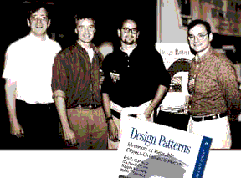
Why Design Patterns ?
Each pattern describes a problem which occurs over and over again in software programming environment and then describes the core of solution to that problem:
to design a new software system quickly and efficiently;
to understand a existing software system.
The authors Erich Gamma, Richard Helm, Ralph Johnson, and John Vlissides are often referred to as the GoF, or Gang of Four

Slide 6
Types of Design Pattern
Creational Design Pattern
Introduction to GoF Design Patterns
Structural Design Patterns
Behavioral Design Patterns
Conclusions
References and Sources

Slide 7
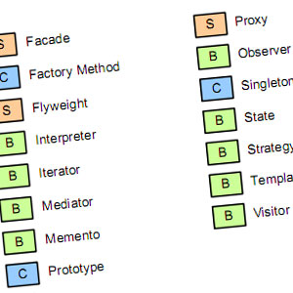
Types of Design Pattern
Creational Design pattern
Object creation.
Structural Design Pattern
Relationship between entities.
Behavioral Design Pattern
Communication between objects.

Slide 8
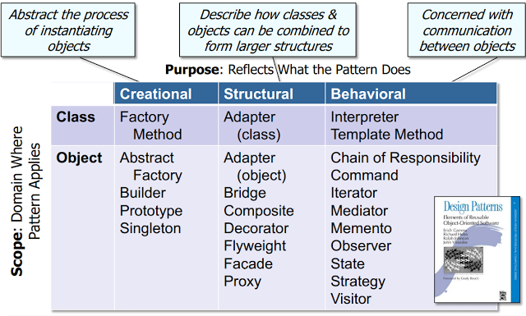
GoF Design Pattern Categories

Slide 9
Types of Design Pattern
Creational Design Pattern
Introduction to GoF Design Patterns
Structural Design Patterns
Behavioral Design Patterns
Conclusions
References and Sources

Slide 10
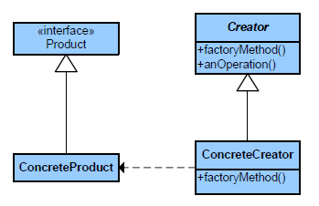
Creational ➔ Factory Method
What it is:
Define an interface for creating an object, but let subclasses decide which class to instantiate.
Notes:
Визначає інтерфейс для створення об'єкта, але залишає підкласам рішення про те, який саме клас інстанціювати. Фабричний метод дозволяє класу делегувати інстанціювання підкласам.

Slide 11
Factory Method (implementation)
We're going to create a Shape interface and concrete classes implementing the Shape interface. A factory class ShapeFactory is defined as a next step.
FactoryMethodDemo, our demo class will use ShapeFactory to get a Shape object. It will pass information (CIRCLE / RECTANGLE / SQUARE) to ShapeFactory to get the type of object it needs.

Slide 12
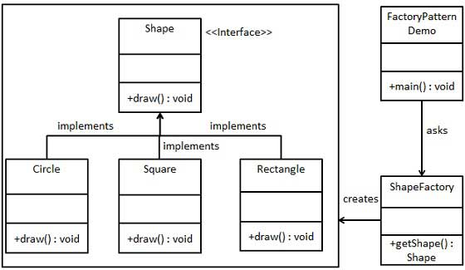
Factory Method (class diagram)

Slide 13
Factory Method (steps)
Create an interface.
interface Shape {
draw(): void;
}

Slide 14
Factory Method (steps)
Create concrete classes implementing the same interface.
class Circle implements Shape { draw(): void { console.log("Inside Circle::draw() method."); } }
class Rectangle implements Shape{ draw(): void { console.log("Inside Rectangle::draw() method."); } }
class Square implements Shape { draw(): void { console.log("Inside Square::draw() method."); } }

Slide 15
Factory Method (steps)
Create a Factory to generate object of concrete class based on given information.
class ShapeFactory {
getShape(shapeType: string): Shape { if(shapeType === "CIRCLE") return new Circle(); else if(shapeType === "RECTANGLE") return new Rectangle(); else if(shapeType === "SQUARE") return new Square(); else return null; } }

Slide 16
Factory Method (steps)
Use the Factory to get object of concrete class by passing an information such as type.
function main(): void { let shapeFactory = new ShapeFactory(); let shape1 = shapeFactory.getShape("CIRCLE"); shape1.draw(); let shape2 = shapeFactory.getShape("RECTANGLE"); shape2.draw(); let shape3 = shapeFactory.getShape("SQUARE"); shape3.draw(); }
Inside Circle::draw() method.
Inside Rectangle::draw() method.
Inside Square::draw() method.

Slide 17
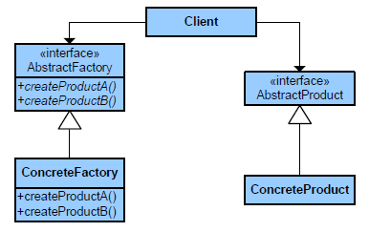
Creational ➔ Abstract Factory
What it is:
Provides an interface for creating families of related or dependent objects without specifying their concrete class.
Notes:
Подає інтерфейс для утворення родин взаємозв'язаних або взаємозалежних об'єктів, не специфікуючи їхніх конкретних класів.

Slide 18
Abstract Factory (implementation)
We are going to create a Shape and Color interfaces and concrete classes implementing these interfaces. We create an abstract factory class AbstractFactory as next step. Factory classes ShapeFactory and ColorFactory are defined where each factory extends AbstractFactory. A factory creator/generator class FactoryProducer is created.
AbstractFactoryDemo, our demo class uses FactoryProducer to get a AbstractFactory object. It will pass information (CIRCLE / RECTANGLE / SQUARE for Shape) to AbstractFactory to get the type of object it needs. It also passes information (RED / GREEN / BLUE for Color) to AbstractFactory to get the type of object it needs.

Slide 19
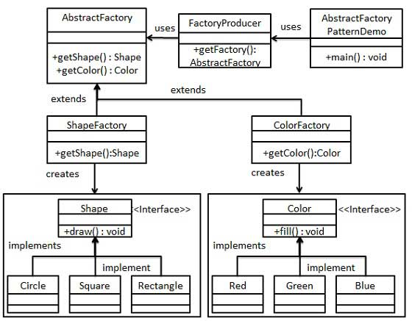
Abstract Factory (class diagram)

Slide 20
Abstract Factory (steps)
Create an interface for Shapes.
interface Shape {
draw(): void;
}

Slide 21
Abstract Factory (steps)
Create concrete classes implementing the same interface.
class Circle implements Shape { draw(): void { console.log("Inside Circle::draw() method."); } }
class Rectangle implements Shape{ draw(): void { console.log("Inside Rectangle::draw() method."); } }
class Square implements Shape { draw(): void { console.log("Inside Square::draw() method."); } }

Slide 22
Abstract Factory (steps)
Create an interface for Colors.
interface Color {
fill(): void;
}

Slide 23
Abstract Factory (steps)
Create concrete classes implementing the same interface.
class Red implements Color { fill(): void { console.log("Inside Red::fill() method."); } }
class Green implements Color { fill(): void { console.log("Inside Green::fill() method."); } }
class Blue implements Color { fill(): void { console.log("Inside Blue::fill() method."); } }

Slide 24
Abstract Factory (steps)
Create an Abstract class AbstractFactory to get factories for Color and Shape Objects.
abstract class AbstractFactory {
abstract getColor(color: string): Color;
abstract getShape(shape: string): Shape ;
}

Slide 25
Abstract Factory (steps)
Create Factory classes extending AbstractFactory to generate object of concrete class based on given information.
class ShapeFactory extends AbstractFactory{ getShape(shapeType: string): Shape { if(shapeType === "CIRCLE") return new Circle(); else if(shapeType === "RECTANGLE") return new Rectangle(); else if(shapeType === "SQUARE") return new Square(); else return null; } getColor(color: string): Color { return undefined; } }

Slide 26
Abstract Factory (steps)
Create Factory classes extending AbstractFactory to generate object of concrete class based on given information.
class ColorFactory extends AbstractFactory{ getShape(shapeType: string): Shape { return undefined; } getColor(color: string): Color { if(color === "RED") return new Red(); else if(color === "GREEN") return new Green(); else if(color === "BLUE") return new Blue(); else return null; } }

Slide 27
Abstract Factory (steps)
Create a Factory generator/producer class to get factories by passing an information such as Shape or Color
class FactoryProducer { static getFactory(choice: string): AbstractFactory { if (choice === "SHAPE") return new ShapeFactory(); else if (choice === "COLOR") return new ColorFactory(); else return null; } }

Slide 28
Abstract Factory (steps)
Use the FactoryProducer to get AbstractFactory in order to get factories of concrete classes by passing an information such as type.
function main(): void { let shapeFactory = FactoryProducer.getFactory("SHAPE"); let shape1 = shapeFactory.getShape("CIRCLE"); shape1.draw(); let shape2 = shapeFactory.getShape("RECTANGLE"); shape2.draw(); let colorFactory = FactoryProducer.getFactory("COLOR"); let color1 = colorFactory.getColor("RED"); color1.fill(); let color2 = colorFactory.getColor("GREEN"); color2.fill(); }
Inside Circle::draw() method.
Inside Rectangle::draw() method.
Inside Red::fill() method.
Inside Green::fill() method.

Slide 29
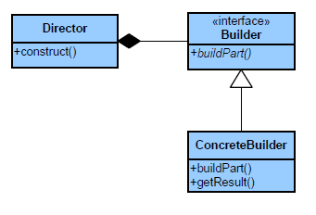
Creational ➔ Builder
What it is:
Separate the construction of a complex object from its representing so that the same construction process can create different representations.
Notes:
Відокремлює конструювання складного об'єкта від його подання, таким чином у результаті одного й того ж процесу конструювання можуть бути отримані різні подання.

Slide 30
Builder (example)
class User { private name: string; private age: number; private phone: string; private address: string; constructor(builder: UserBuilder) { this.name = builder.getName(); this.age = builder.getAge(); this.phone = builder.getPhone(); this.address = builder.getAddress() } getName() { return this.name; } getAge() { return this.age; } getPhone() { return this.phone; } getAddress() { return this.address; } }

Slide 31
Builder (example)
class UserBuilder { private userName: string; private userAge: number; private userPhone: string; private userAddress: string; constructor(name: string) { this.userName = name; } getName() { return this.userName; } age(value: number): UserBuilder { this.userAge = value; return this; } getAge() { return this.userAge; }
phone(value: string): UserBuilder { this.userPhone = value; return this; } getPhone() { return this.userPhone; } address(value: string): UserBuilder { this.userAddress = value; return this; } getAddress() { return this.userAddress; } build(): User { return new User(this); } }

Slide 32
Builder (example)
function main(): void { let user: User = new UserBuilder("Vasyl") .age(24) .phone("0845674195") .address("Shevchenka") .build(); console.log(user.getName() + " " + user.getAge() + " "
+ user.getPhone() + " " + user.getAddress()); }
Vasyl 24 0845674195 Shevchenka

Slide 33
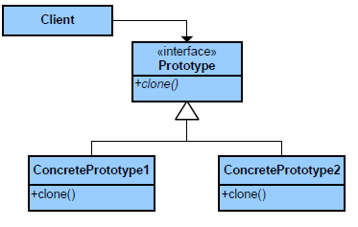
Creational ➔ Prototype
What it is:
Specify the kinds of objects to create
using a prototypical instance, and create new objects by copying this prototype.
Notes:
Задає види об'єктів, що створюються, за допомогою екземпляру-прототипу, та створює нові об'єкти шляхом копіювання цього прототипу.

Slide 34
Prototype (implementation)
We're going to create an abstract class Shape and concrete classes extending the Shape class. A class ShapeCache is defined as a next step which stores shape objects in a Hashtable and returns their clone when requested.
PrototypPatternDemo, our demo class will use ShapeCache class to get a Shape object.

Slide 35
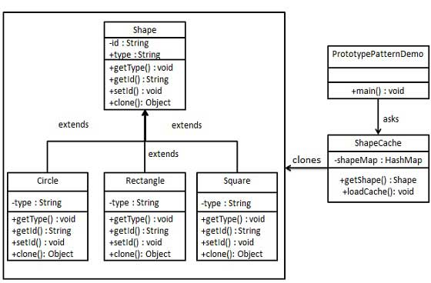
Prototype (class diagram)

Slide 36
Prototype (steps)
abstract class Shape { private id: number; private type: string; constructor(type: string) { this.type = type; } getType(): string{ return this.type; } getId(): number { return this.id; } setId(id: number): void { this.id = id; } abstract draw(): void; abstract clone(): Shape; }
Create an abstract class Shape.

Slide 37
Prototype (steps)
Create concrete classes extending the above class.
class Circle extends Shape { constructor() { super("Circle"); } draw(): void { console.log("Inside Circle::draw() method."); } clone(): Shape { return new Circle(); } }

Slide 38
Prototype (steps)
Create a class to get concrete classes from database and store them in a Hashtable.
class ShapeCache { private static shapeMap: { [id: number]: Shape; } = {}; static getShape(shapeId: number): Shape { let cachedShape = this.shapeMap[shapeId]; return cachedShape.clone(); } static loadCache(): void { let circle = new Circle(); circle.setId(1); this.shapeMap[circle.getId()] = circle; let square = new Square(); square.setId(2); this.shapeMap[square.getId()] = square; } }

Slide 39
Prototype (steps)
PrototypePatternDemo uses ShapeCache class to get clones of shapes stored in a Hashtable.
function main(): void { ShapeCache.loadCache(); let clonedShape1 = ShapeCache.getShape(1); console.log("Shape : " + clonedShape1.getType()); clonedShape1.draw(); let clonedShape2 = ShapeCache.getShape(2); console.log("Shape : " + clonedShape2.getType()); clonedShape2.draw(); }
Shape : Circle
Inside Circle::draw() method.
Shape : Square
Inside Square::draw() method.

Slide 40
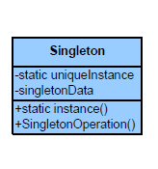
Creational ➔ Singleton
What it is:
Ensure a class only has one instance and provide a global point of access to it.
Notes:
Гарантує, що клас матиме тільки один екземпляр, і забезпечує глобальну точку доступу до цього екземпляра.

Slide 41
Singleton (implementation)
We're going to create a SingleObject class. SingleObject class have its constructor as private and have a static instance of itself.
SingleObject class provides a static method to get its static instance to outside world. SingletonPatternDemo, our demo class will use SingleObject class to get a SingleObject object.

Slide 42
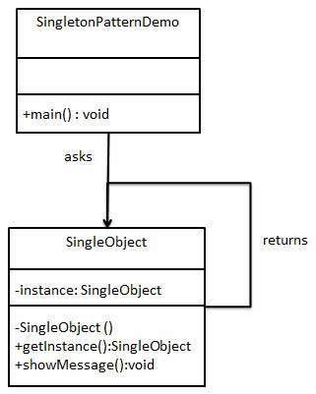
Singleton (class diagram)

Slide 43
Singleton (steps)
Create a Singleton Class.
class SingleObject { private static instance: SingleObject = null; private constructor() { } static getInstance(): SingleObject { if (this.instance == null) { this.instance = new SingleObject(); } return this.instance; } private message: string; setMessage(message: string): void { this.message = message; } getMessage(): string { return this.message; } }

Slide 44
Singleton (steps)
Get the only object from the singleton class.
function main(): void { let singleObject1 = SingleObject.getInstance(); let singleObject2 = SingleObject.getInstance(); singleObject1.setMessage("Hello first Single Object!"); singleObject2.setMessage("Hello second Single Object!"); console.log(singleObject1.getMessage()); console.log(singleObject2.getMessage()); }
Hello second Single Object!
Hello second Single Object!

Slide 45
Types of Design Pattern
Creational Design Pattern
Introduction to GoF Design Patterns
Structural Design Patterns
Behavioral Design Patterns
Conclusions
References and Sources

Slide 46
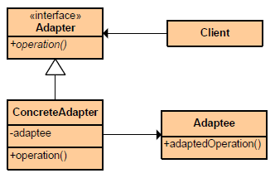
Structural ➔ Adapter (Wrapper)
What it is:
Convert the interface of a class into another interface clients expect. Lets classes work together that couldn't
otherwise because of incompatible interfaces.
Notes:
Адаптує інтерфейс одного класу в інший, очікуваний клієнтом. Адаптер забезпечує роботу класів з несумісними інтерфейсами, та найчастіше застосовується тоді, коли система підтримує необхідні дані і поведінку, але має невідповідний інтерфейс.

Slide 47
Adapter (implementation)
We have a MediaPlayer interface and a concrete class AudioPlayer implementing the MediaPlayer interface. AudioPlayer can play mp3 format audio files by default.
We are having another interface AdvancedMediaPlayer and concrete classes implementing the AdvancedMediaPlayer interface. These classes can play vlc and mp4 format files.
We want to make AudioPlayer to play other formats as well. To attain this, we have created an adapter class MediaAdapter which implements the MediaPlayer interface and uses AdvancedMediaPlayer objects to play the required format.
AudioPlayer uses the adapter class MediaAdapter passing it the desired audio type without knowing the actual class which can play the desired format. AdapterPatternDemo, our demo class will use AudioPlayer class to play various formats.

Slide 48
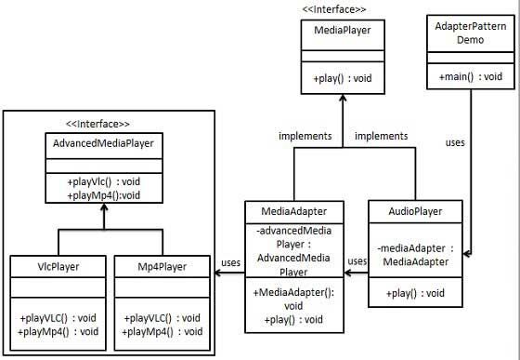
Adapter (class diagram)

Slide 49
Adapter (steps)
Create interfaces for Media Player and Advanced Media Player.
interface MediaPlayer { play(audioType: string, fileName: string): void; }
interface AdvancedMediaPlayer { playVlc(fileName: string): void; playMp4(fileName: string): void; }

Slide 50
Adapter (steps)
Create concrete classes implementing the AdvancedMediaPlayer interface.
class VlcPlayer implements AdvancedMediaPlayer { playVlc(fileName: string): void { console.log("Playing vlc file. Name: " + fileName); }
playMp4(fileName: string): void { } }
class Mp4Player implements AdvancedMediaPlayer { playVlc(fileName: string): void { } playMp4(fileName: string): void { console.log("Playing mp4 file. Name: " + fileName); } }

Slide 51
Adapter (steps)
Create adapter class implementing the MediaPlayer interface.
class MediaAdapter implements MediaPlayer { private advancedMusicPlayer: AdvancedMediaPlayer; MediaAdapter(audioType: string) { if(audioType === "vlc") { this.advancedMusicPlayer = new VlcPlayer(); } else if (audioType === "mp4") { this.advancedMusicPlayer = new Mp4Player(); } } play(audioType: string, fileName: string): void { if(audioType === "vlc") { this.advancedMusicPlayer.playVlc(fileName); } else if(audioType === "mp4") { this.advancedMusicPlayer.playMp4(fileName); } } }

Slide 52
Adapter (steps)
Create concrete class implementing the MediaPlayer interface.
class AudioPlayer implements MediaPlayer { private mediaAdapter: MediaAdapter; play(audioType: string, fileName: string): void { if(audioType === "mp3") { console.log("Playing mp3 file. Name: " + fileName); } else if(audioType === "vlc" || audioType === "mp4") { this.mediaAdapter = new MediaAdapter(audioType); this.mediaAdapter.play(audioType, fileName); } else { console.log("Invalid media. " + audioType
+ " format not supported"); } } }

Slide 53
Adapter (steps)
Use the AudioPlayer to play different types of audio formats.
function main(): void { let audioPlayer = new AudioPlayer(); audioPlayer.play("mp3", "beyond the horizon.mp3"); audioPlayer.play("mp4", "alone.mp4"); audioPlayer.play("vlc", "far far away.vlc"); audioPlayer.play("avi", "mind me.avi"); }
Playing mp3 file. Name: beyond the horizon.mp3
Playing mp4 file. Name: alone.mp4
Playing vlc file. Name: far far away.vlc
Invalid media. avi format not supported

Slide 54
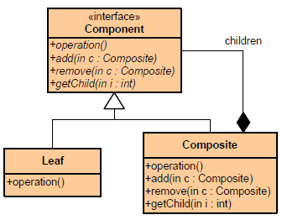
Structural ➔ Composite
What it is:
Compose objects into tree structures to represent part-whole hierarchies. Lets clients treat individual objects and compositions of objects uniformly.
Notes:
Об'єднує об'єкти в ієрархічну деревовидну структуру, і дозволяє уніфіковане звертання для кожного елемента дерева.
Дозволяє користувачам будувати складні структури з простіших компонентів. Проектувальник може згрупувати дрібні компоненти для формування більших, які, в свою чергу, можуть стати основою для створення ще більших.

Slide 55
Composite (implementation)
We have a class Employee which acts as composite pattern actor class.
CompositePatternDemo, our demo class will use Employee class to add department level hierarchy and print all employees.

Slide 56
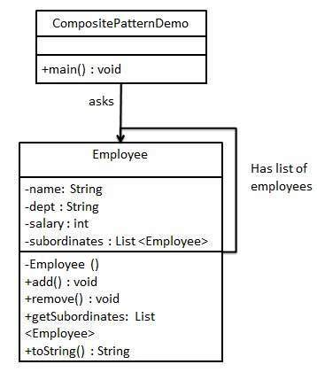
Composite (class diagram)

Slide 57
Composite (steps)
Create Employee class having list of Employee objects.
class Employee { private name: string; private department: string; private salary: number; private subordinates: Array<Employee> = []; constructor(name: string,department: string, salary: number) { ... }
add(e: Employee): void { this.subordinates.push(e); } remove(e: Employee): void { let index = this.subordinates.indexOf(e); if (index > -1) this.subordinates.splice(index, 1); } getSubordinates(): Array<Employee> { return this.subordinates; } toString(): string { return ("Employee : [ Name : " + this.name + ", department : "
+ this.department + ", salary : " + this.salary + " ]"); } }

Slide 58
Composite (steps)
Use the Employee class to create and print employee hierarchy.
function main(): void {
let CEO = new Employee("John", "CEO", 30000); let headSales = new Employee("Robert", "Head Sales", 20000); let headMarketing = new Employee("Michel", "Head Marketing", 20000); let clerk1 = new Employee("Laura", "Marketing", 10000); let clerk2 = new Employee("Bob", "Marketing", 10000); let salesExecutive1 = new Employee("Richard", "Sales", 10000); let salesExecutive2 = new Employee("Rob", "Sales", 10000); CEO.add(headSales); CEO.add(headMarketing); headSales.add(salesExecutive1); headSales.add(salesExecutive2); headMarketing.add(clerk1); headMarketing.add(clerk2);

Slide 59
Composite (steps)
Use the Employee class to create and print employee hierarchy.
console.log(CEO.toString()); for (let headEmployee of CEO.getSubordinates()) { console.log(headEmployee.toString()); for (let employee of headEmployee.getSubordinates()) { console.log(employee.toString()) } } }
Employee : [ Name : John, department : CEO, salary : 30000 ]
Employee : [ Name : Robert, department : Head Sales, salary : 20000 ]
Employee : [ Name : Richard, department : Sales, salary : 10000 ]
Employee : [ Name : Rob, department : Sales, salary : 10000 ]
Employee : [ Name : Michel, department : Head Marketing, salary : 20000 ]
Employee : [ Name : Laura, department : Marketing, salary : 10000 ]
Employee : [ Name : Bob, department : Marketing, salary : 10000 ]

Slide 60
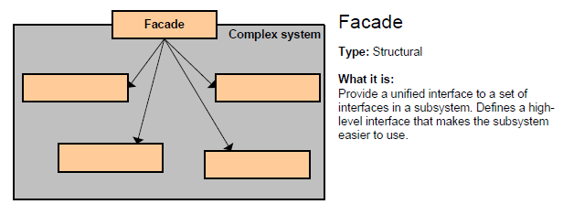
Structural ➔ Facade
What it is:
Provide a unified interface to a set of interfaces in a subsystem. Defines a highlevel interface that makes the subsystem easier to use.
Notes:
Призначений для об'єднання групи підсистем під один уніфікований інтерфейс, надаючи доступ до них через одну точку входу, що дяє змогу спростити роботу з підсистемами.

Slide 61
Facade (implementation)
We are going to create a Shape interface and concrete classes implementing the Shape interface. A facade class ShapeMaker is defined as a next step.
ShapeMaker class uses the concrete classes to delegate user calls to these classes.
FacadePatternDemo, our demo class, will use ShapeMaker class to show the results.

Slide 62
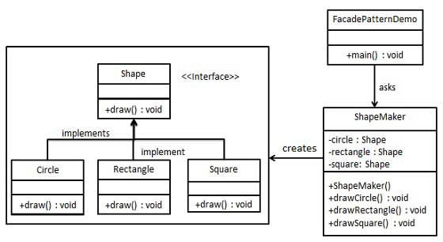
Facade (class diagram)

Slide 63
Facade (steps)
Create an interface.
interface Shape { draw(): void; }

Slide 64
Facade (steps)
Create concrete classes implementing the same interface.
class Circle implements Shape { draw(): void { console.log("Inside Circle::draw() method."); } }
class Rectangle implements Shape{ draw(): void { console.log("Inside Rectangle::draw() method."); } }
class Square implements Shape { draw(): void { console.log("Inside Square::draw() method."); } }

Slide 65
Facade (steps)
class ShapeMaker { private circle: Shape; private rectangle: Shape; private square: Shape; constructor() { this.circle = new Circle(); this.rectangle = new Rectangle(); this.square = new Square(); } drawCircle(): void { this.circle.draw(); } drawRectangle(): void { this.rectangle.draw(); } drawSquare(): void { this.square.draw(); } }
Create a facade class.

Slide 66
Facade (steps)
Use the facade to draw various types of shapes.
function main(): void { let shapeMaker = new ShapeMaker(); shapeMaker.drawCircle(); shapeMaker.drawRectangle(); shapeMaker.drawSquare(); }
Inside Circle::draw() method.
Inside Rectangle::draw() method.
Inside Square::draw() method.

Slide 67
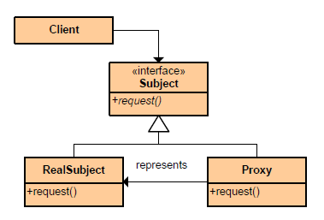
Structural ➔ Proxy
What it is:
Provide a surrogate or placeholder for another object to control access to it.
Notes:
Надає об'єкт, що контролює доступ, перехоплюючи всі виклики до нього.

Slide 68
Proxy (implementation)
We are going to create an Image interface and concrete classes implementing the Image interface.
ProxyImage is a proxy class to reduce memory footprint of RealImage object loading.
ProxyPatternDemo, our demo class, will use ProxyImage to get an Image object to load and display as it needs.

Slide 69
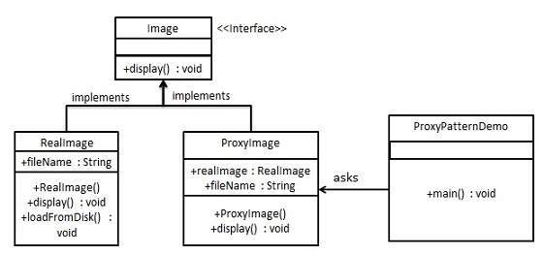
Proxy (class diagram)

Slide 70
Proxy (steps)
Create an interface.
interface Image { display(): void; }

Slide 71
Proxy (steps)
Create concrete classes implementing the same interface.
class RealImage implements Image { private fileName: string; display(): void { console.log("Displaying " + this.fileName); } loadFromDisk(fileName: string): void { this.fileName = fileName; console.log("Loading " + this.fileName); } }

Slide 72
Proxy (steps)
Create concrete classes implementing the same interface.
class ProxyImage implements Image { private realImage: RealImage; private fileName: string; constructor(fileName: string) { this.fileName = fileName; } display(): void { if (this.realImage == null) { this.realImage = new RealImage(); this.realImage.loadFromDisk(this.fileName); } this.realImage.display(); } }

Slide 73
Proxy (steps)
Use the ProxyImage to get object of RealImage class when required.
function main(): void { let image = new ProxyImage("test_01.dat"); //image will be loaded from disk image.display(); //image will not be loaded from disk image.display(); }
Loading test_01.dat
Displaying test_01.dat
Displaying test_01.dat

Slide 74
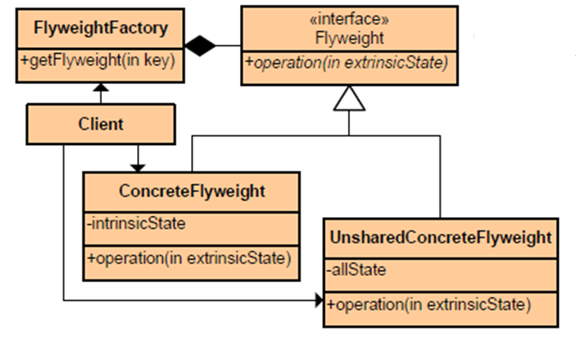
Structural ➔ Flyweight
What it is:
Use to support large numbers of fine grained objects efficiently.
Notes:
Використовується для ефективної підтримки (в першу чергу для зменшення затрат пам'яті) великої кількості дрібних об'єктів.

Slide 75
Flyweight (implementation)
We are going to create a Shape interface and concrete class Circle implementing the Shape interface. A factory class ShapeFactory is defined as a next step.
ShapeFactory has a HashMap of Circle having key as color of the Circle object. Whenever a request comes to create a circle of particular color to ShapeFactory, it checks the circle object in its HashMap, if object of Circle found, that object is returned otherwise a new object is created, stored in HashMap for future use, and returned to client.
FlyWeightPatternDemo, our demo class, will use ShapeFactory to get a Shape object. It will pass information (RED / GREEN / BLUE/ BLACK / WHITE) to ShapeFactory to get the circle of desired color it needs.

Slide 76
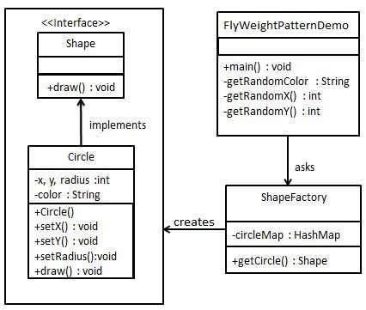
Flyweight (class diagram)

Slide 77
Flyweight (steps)
Create an interface.
interface Shape { draw(): void; }

Slide 78
Flyweight (steps)
Create concrete class implementing the same interface.
class Circle implements Shape { private color: string; private x: number; private y: number; private radius: number; constructor(color: string) {
this.color = color;
} setX(x: number): void { this.x = x; } setY(y: number): void { this.y = y; } setRadius(radius: number): void { this.radius = radius; } draw(): void { console.log("Circle: Draw() [Color : " + this.color + ", x : "
+ this.x + ", y : " + this.y + ", radius : " + this.radius); } }

Slide 79
Flyweight (steps)
Create a factory to generate object of concrete class based on given information.
class ShapeFactory { private static circleMap: { [color: string]: Shape; } = {}; static getCircle(color: string): Shape { let circle = this.circleMap[color]; if (circle == null) { circle = new Circle(color); this.circleMap[color] = circle; console.log("Creating circle of color : " + color); } return circle; } }

Slide 80
Flyweight (steps)
Use the factory to get object of concrete class by passing an information such as color.
let colors = [ "Red", "Green", "Blue", "White", "Black" ]; function main(): void { for(let i=0; i < 20; i++) { let circle = <Circle> ShapeFactory.getCircle(getRandomColor()); circle.setX(getRandomX()); circle.setY(getRandomY()); circle.setRadius(100); circle.draw(); } }
function getRandomColor():string { return colors[Math.floor(Math.random()*colors.length)]; }

Slide 81
Flyweight (steps)
Creating circle of color : Blue
Circle: Draw() [Color : Blue, x : 35, y : 1, radius : 100
Creating circle of color : Black
Circle: Draw() [Color : Black, x : 55, y : 46, radius : 100
Creating circle of color : Red
Circle: Draw() [Color : Red, x : 37, y : 8, radius : 100
Circle: Draw() [Color : Blue, x : 9, y : 68, radius : 100
Creating circle of color : Green
Circle: Draw() [Color : Green, x : 39, y : 30, radius : 100
Circle: Draw() [Color : Black, x : 80, y : 41, radius : 100
Creating circle of color : White
Circle: Draw() [Color : White, x : 32, y : 20, radius : 100
Circle: Draw() [Color : Green, x : 19, y : 2, radius : 100
Circle: Draw() [Color : Black, x : 51, y : 73, radius : 100
Circle: Draw() [Color : White, x : 67, y : 4, radius : 100
Circle: Draw() [Color : Blue, x : 85, y : 45, radius : 100
Circle: Draw() [Color : Green, x : 42, y : 77, radius : 100
Circle: Draw() [Color : Red, x : 3, y : 49, radius : 100
Circle: Draw() [Color : Green, x : 66, y : 6, radius : 100

Slide 82
Types of Design Pattern
Creational Design Pattern
Introduction to GoF Design Patterns
Structural Design Patterns
Behavioral Design Patterns
Conclusions
References and Sources

Slide 83
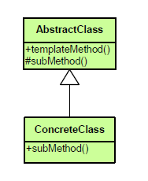
Behavioral ➔ Template Method
What it is:
Define the skeleton of an algorithm in an operation, deferring some steps to subclasses. Lets subclasses redefine certain steps of an algorithm without changing the algorithm's structure.
Notes:
Визначає основу алгоритму та дозволяє підкласам перевизначити деякі кроки алгоритму, не змінюючи структуру в цілому.

Slide 84
Template Method (implementation)
We are going to create a Game abstract class defining operations with a template method.
Cricket and Football are concrete classes that extend Game and override its methods.
TemplatePatternDemo, our demo class, will use Game to demonstrate use of template pattern.

Slide 85
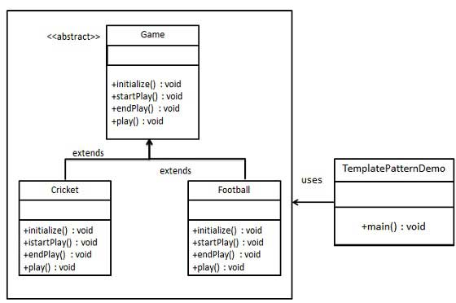
Template Method (class diagram)

Slide 86
Template Method (steps)
Create an abstract class with a template method being final.
abstract class Game { abstract initialize(): void; abstract startPlay(): void; abstract endPlay(): void; play(): void { this.initialize(); this.startPlay(); this.endPlay(); } }

Slide 87
Template Method (steps)
Create concrete classes extending the above class.
class Football extends Game { initialize(): void { console.log("Football Game Initialized! Start playing."); } startPlay(): void { console.log("Football Game Initialized! Start playing."); } endPlay(): void { console.log("Football Game Initialized! Start playing."); } }

Slide 88
Template Method (steps)
Use the Game's template method play() to demonstrate a defined way of playing game.
function main(): void { let game1 = new Cricket(); game1.play(); let game2 = new Football(); game2.play(); }

Slide 89
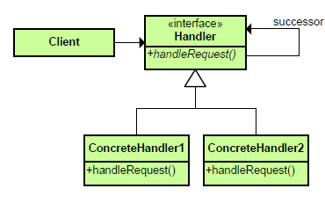
Behavioral ➔ Chain of Responsibility
What it is:
Avoid coupling the sender of a request to its receiver by giving more than one object a chance to handle the request. Chain the receiving objects and pass the request along the chain until an object handles it.
Notes:
Уникає зв’язування відправника запиту з його обробником, даючи більше ніж одному об'єкту можливість обробити запит. Ланцюг приймає об'єкти і передає запит по ланцюжку, поки об'єкт не обробить його.

Slide 90
Chain of Responsibility (implementation)
We have created an abstract class AbstractLogger with a level of logging.
Then we have created three types of loggers extending the AbstractLogger.
Each logger checks the level of message to its level and print accordingly otherwise does not print and pass the message to its next logger.

Slide 91
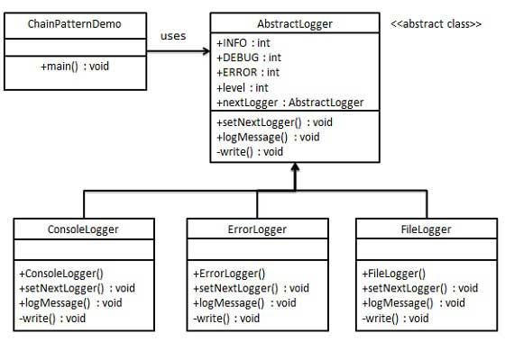
Chain of Responsibility (class diagram)

Slide 92
Chain of Responsibility (steps)
Create an abstract logger class.
abstract class AbstractLogger { static INFO: number = 1; static DEBUG: number = 2; static ERROR: number = 3; protected level: number; protected nextLogger: AbstractLogger; setNextLogger( nextLogger: AbstractLogger): void { this.nextLogger = nextLogger; } logMessage(level: number, message: string): void { if(this.level <= level) { this.write(message); } if(this.nextLogger != null){ this.nextLogger.logMessage(level, message); } } abstract write(message: string): void; }

Slide 93
Chain of Responsibility (steps)
Create concrete classes extending the logger.
class ConsoleLogger extends AbstractLogger { constructor(level: number) { super(); this.level = level; } write(message: string): void { console.log("Standard Console::Logger: " + message); } }
class FileLogger extends AbstractLogger { constructor(level: number) { super(); this.level = level; } write(message: string): void { console.log("File::Logger: " + message); } }

Slide 94
Chain of Responsibility (steps)
Create different types of loggers. Assign them error levels and set next logger in each logger.
function getChainOfLoggers(): AbstractLogger { let errorLogger = new ErrorLogger(AbstractLogger.ERROR); let fileLogger = new FileLogger(AbstractLogger.DEBUG); let consoleLogger = new ConsoleLogger(AbstractLogger.INFO); errorLogger.setNextLogger(fileLogger); fileLogger.setNextLogger(consoleLogger); return errorLogger; }

Slide 95
Chain of Responsibility (steps)
function main(): void { let loggerChain = getChainOfLoggers(); loggerChain.logMessage(AbstractLogger.INFO, "This is an information."); loggerChain.logMessage(AbstractLogger.DEBUG, "This is an debug level information."); loggerChain.logMessage(AbstractLogger.ERROR, "This is an error information."); }

Slide 96
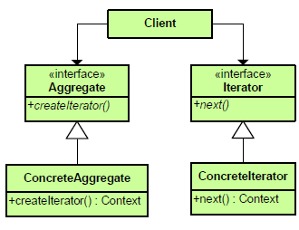
Behavioral ➔ Iterator
What it is:
Provide a way to access the elements of an aggregate object sequentially without exposing its underlying representation.
Notes:
Надає спосіб послідовного доступу до всіх елементів складеного об'єкта, не розкриваючи його внутрішнього представлення.

Slide 97
Iterator (implementation)
We're going to create a Iterator interface which narrates navigation method and a Container interface which returns the iterator.
Concrete classes implementing the Container interface will be responsible to implement Iterator interface and use it
IteratorPatternDemo, our demo class will use NamesRepository, a concrete class implementation to print a Names stored as a collection in NamesRepository.

Slide 98
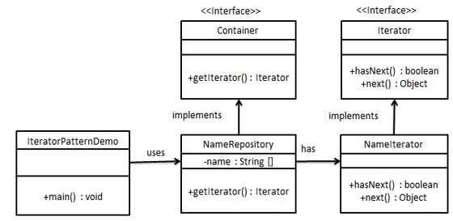
Iterator (class diagram)

Slide 99
Iterator (steps)
Create interfaces.
interface Iterator { hasNext(): boolean; next(): any; }
interface Container { getIterator(): Iterator; }

Slide 100
Iterator (steps)
Create concrete class implementing the Container interface. This class has inner class NameIterator implementing the Iterator interface.
class NameRepository implements Container { private names: Array<string> = ["Robert", "John", "Julie"]; getIterator(): Iterator { return new NameIterator(this.names); } }

Slide 101
Iterator (steps)
class NameIterator implements Iterator { private names: Array<string> private index: number; constructor(names: Array<string>) { this.names = names; } hasNext(): boolean { if(this.index < this.names.length) { return true; } return false; } next(): any { if(this.hasNext()){ return this.names[this.index++]; } return null; } }

Slide 102
Iterator (steps)
Use the NameRepository to get iterator and print names.
function main(): void { let namesRepository = new NameRepository(); for(let iterator = namesRepository.getIterator(); iterator.hasNext();) { let name = <String> iterator.next(); console.log("Name : " + name); } }

Slide 103
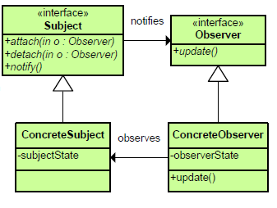
Behavioral ➔ Observer
What it is:
Define a one-to-many dependency between objects so that when one object changes state, all its dependents are notified and updated automatically.
Notes:
Визначає залежність типу «один до багатьох» між об'єктами таким чином, що при зміні стану одного об'єкта всіх залежних від нього сповіщають про цю подію.

Slide 104
Observer (implementation)
Observer pattern uses three actor classes. Subject, Observer and Client. Subject is an object having methods to attach and detach observers to a client object.
We have created an abstract class Observer and a concrete clients that are extending class Observer.
ObserverPatternDemo, our demo class, will use Subject and concrete class object to show observer pattern in action.

Slide 105
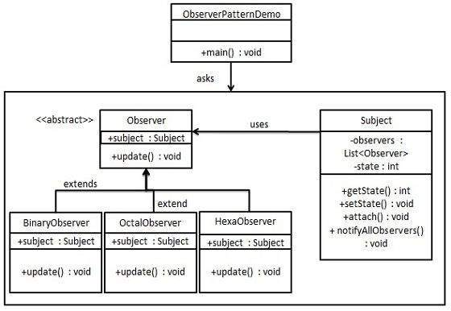
Observer (class diagram)

Slide 106
Observer (steps)
class Subject { private observers: Array<Observer> = []; private state: number; getState(): number { return this.state; } setState(state: number): void { this.state = state; this.notifyAllObservers(); } attach(observer: Observer): void { this.observers.push(observer); } notifyAllObservers(): void{ for (let observer of this.observers) { observer.update(); } } }
Create Subject class.

Slide 107
Observer (steps)
Create Observer class.
abstract class Observer { protected subject: Subject; abstract update(): void; }

Slide 108
Observer (steps)
Create concrete observer classes.
class BinaryObserver extends Observer { constructor(subject: Subject) { super(); this.subject = subject; this.subject.attach(this); } update(): void { console.log("Binary String: " + this.subject.getState().toString(2)); } }
class HexaObserver extends Observer { constructor(subject: Subject) { super(); this.subject = subject; this.subject.attach(this); } update(): void { console.log("Hex String: " + this.subject.getState().toString(16)); } }

Slide 109
Observer (steps)
Use Subject and concrete observer objects.
function main(): void { let subject = new Subject(); new HexaObserver(subject); new OctalObserver(subject); new BinaryObserver(subject); console.log("First state change: 15"); subject.setState(15); console.log("Second state change: 10"); subject.setState(10); }

Slide 110
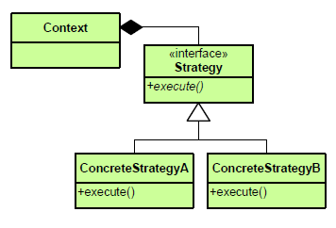
Behavioral ➔ Strategy
What it is:
Define a family of algorithms, encapsulate each one, and make them interchangeable. Lets the algorithm vary independently from clients that use it.
Notes:
Визначає сімейство алгоритмів, інкапсулює кожен з них і робить їх взаємозамінними. Дозволяє алгоритму змінюватися незалежно від клієнтів, які використовують його.

Slide 111
Strategy (implementation)
We are going to create a Strategy interface defining an action and concrete strategy classes implementing the Strategy interface. Context is a class which uses a Strategy.
StrategyPatternDemo, our demo class, will use Context and Strategy objects to demonstrate change in Context behaviour based on strategy it deploys or uses.

Slide 112
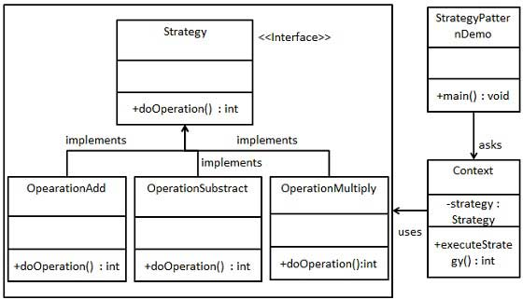
Strategy (class diagram)

Slide 113
Strategy (steps)
Create an interface.
interface Strategy { doOperation(num1: number, num2: number): number; }

Slide 114
Strategy (steps)
Create concrete classes implementing the same interface.
class OperationAdd implements Strategy { doOperation(num1: number, num2: number): number { return num1 + num2; } }
class OperationSubstract implements Strategy { doOperation(num1: number, num2: number): number { return num1 - num2; } }

Slide 115
Strategy (steps)
Create Context Class.
class Context { private strategy: Strategy; constructor(strategy: Strategy){ this.strategy = strategy; } executeStrategy(num1: number, num2: number): number { return this.strategy.doOperation(num1, num2); } }

Slide 116
Strategy (steps)
Use the Context to see change in behavior when it changes its Strategy.
function main(): void { let context = new Context(new OperationAdd()); console.log("10 + 5 = " + context.executeStrategy(10, 5)); context = new Context(new OperationSubstract()); console.log("10 - 5 = " + context.executeStrategy(10, 5)); context = new Context(new OperationMultiply()); console.log("10 * 5 = " + context.executeStrategy(10, 5)); }

Slide 117
Types of Design Pattern
Creational Design Pattern
Introduction to GoF Design Patterns
Structural Design Patterns
Behavioral Design Patterns
Conclusions
References and Sources

Slide 118
Conclusions
Design Patterns are generalized solutions for common problems.
Understanding design principles behind design patterns help understand how they work and how to use them in a particular problem.
Identifying your design objectives and priorities is essential for good design.
Patterns are not the “silver bullet” but are an important tool for designers practices.

Slide 119
Types of Design Pattern
Creational Design Pattern
Introduction to GoF Design Patterns
Structural Design Patterns
Behavioral Design Patterns
Conclusions
References and Sources

Slide 120
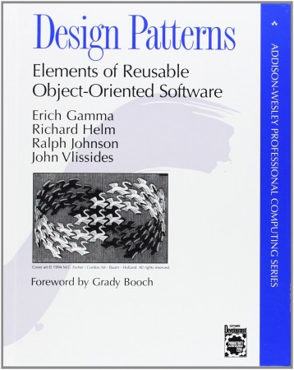
References and Sources
Design Patterns in Java Tutorial - TutorialsPoint: http://www.tutorialspoint.com/design_pattern/
Design Pattern Card - McDonaldLand: http://www.mcdonaldland.info/files/designpatterns/ designpatternscard.pdf
Design Patterns - DZone: https://dzone.com/refcardz/ design-patterns
Design Patterns illustrated – Herman Peeren (May 31st 2010): http://www.slideshare.net/ HermanPeeren/design-patterns- illustrated

Slide 121

Thank you!

