Slide 1
Tokyo: a Tourist's Guide
By Marina De Melo Letourneau

Slide 2
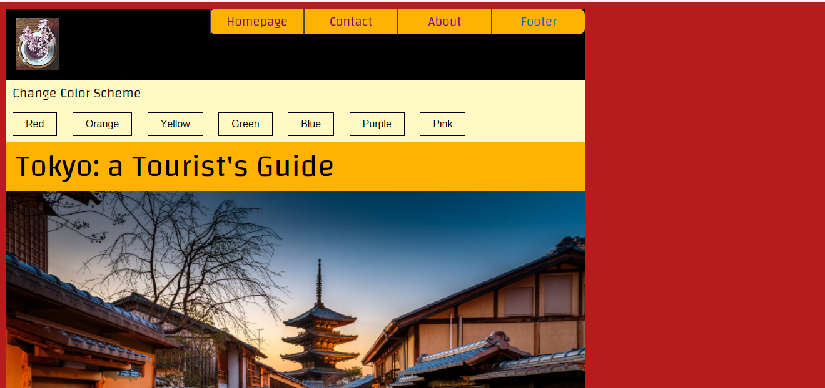
Site Topic
Historical and touristic information about Tokyo

Slide 3
Creative Direction
Color scheme
Reflects colors that are associated with Japan (i.e. red, gold, etc..)
Fonts
Used Changa for headings and navigation
Used Arimo Regular for paragraph text

Slide 4
Homepage
Features the website’s main article
Placed where it is highly visible and easy to access
Navigation at the top of the page
For ease of access

Slide 5
Responsiveness and Interactivity
Users can change the color layout of the page they are currently on
Users can submit a contact form on the contact page

