Slide 1
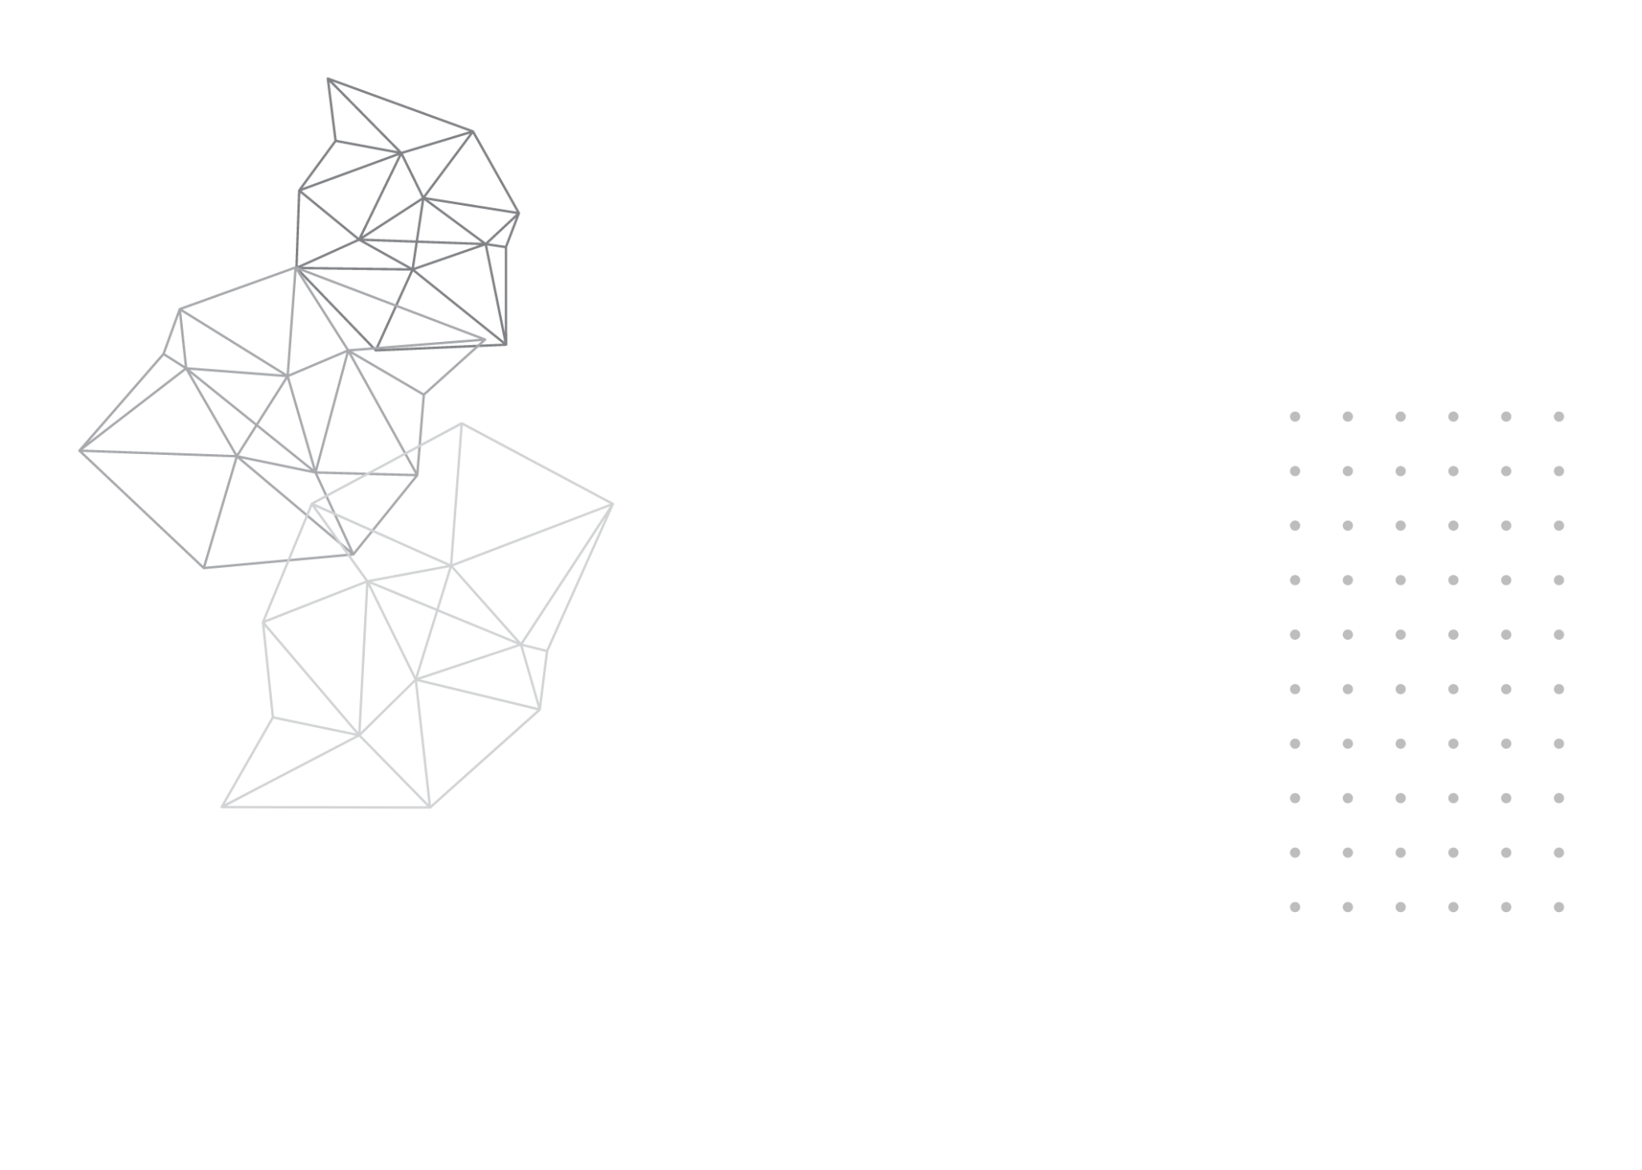

DeMedia
Decentralized Social Media Protocol
2023-234

Slide 2





DeMedia Team
Mr. Kavinga Abeywardena
Supervisor
Perera B.S.S.
Bandara A.M.C.A.
Dhananjani G.G.S.
Abeykoon A.W.Y.I.K.
IT20254698
IT20159726
IT20137496
IT20157432

Slide 3




Introduction
What is a social media platform?
According to the Tufts University[1],
“Social media refers to the means of interactions among people in which they create, share, and/or exchange information and ideas in virtual communities and networks.”

Slide 4
Research Problem
Existing social media platforms do not allow users to govern the data they upload or share on their platforms. This has resulted in numerous disagreements among users, and major social media corporations use this user information to gain revenue while compromising the confidentiality of the user data to third parties.
The current social media platforms have given rise to a number of issues that prompt the need for a new approach to decentralized social media.

Slide 5
Research Problem Contd.
In particular, the following issues have come to the fore:
How to implement decentralized protocol to support social media platforms?
How to ensure transparency in the flow of application data?
How to grant users true control over their own data?
How to provide a centralized application like user experience on a decentralized application?

Slide 6
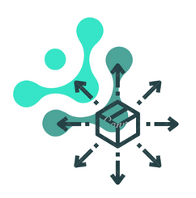


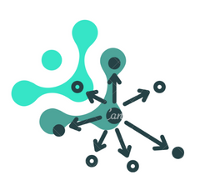
Solution
DeMedia - a protocol that facilitates the development of decentralized social media platforms.

Slide 7
Objectives
Implement a protocol that facilitates the development of decentralized social media platforms.
Implement a peer-to-peer
communication protocol
Implement user data
decentralization protocol
Implement a mechanism for
decentralized data integrity
Implement a mechanism for
decentralized
data caching

Slide 8
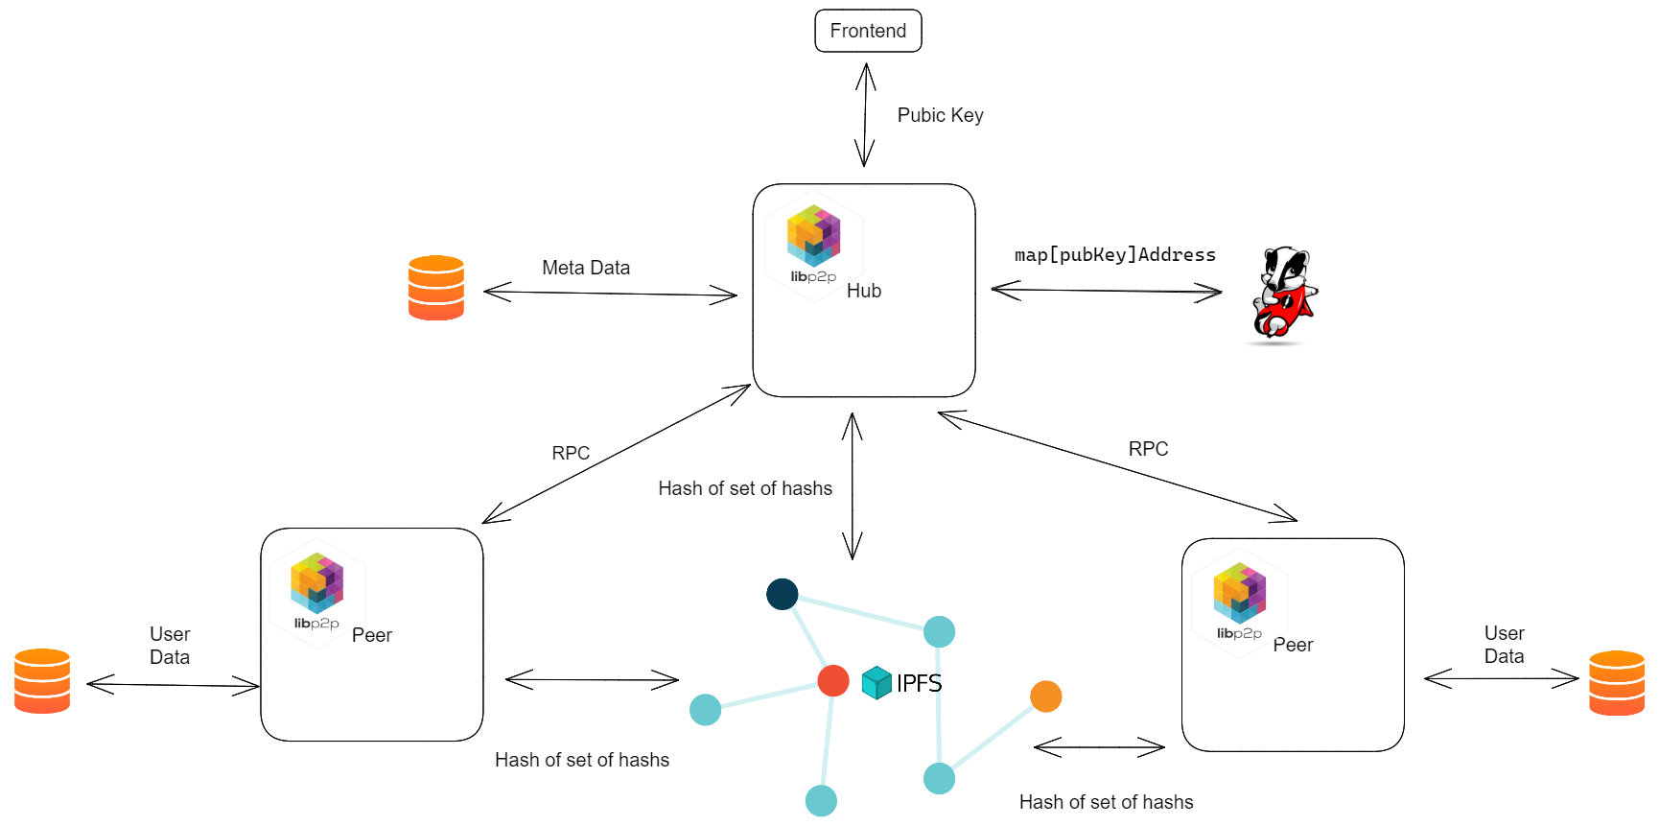
Overall System Architecture

Slide 9

System Integration
DeMedia protocol consist of following components and is integrated in to one protocol.
A demo social media platform is developed to demonstrate the implemented protocol.

Slide 10
PERERA B.S.S | IT20254698 | IT
PEER TO PEER COMMUNICATION
IT20254698 | Perera B.S.S. | 2023-234

Slide 11





Introduction
Successful projects in past
Skype [1]
Gnutella [2]
Kazaa [2]
eMule [3]
Torrent [4]
IT20254698 | Perera B.S.S. | 2023-234

Slide 12
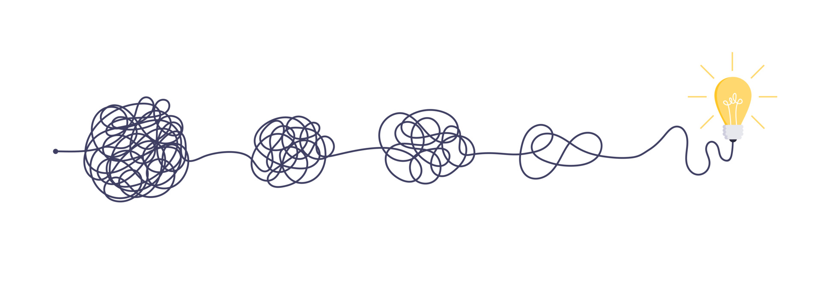
Research Problem
What is the best way to communicate in peer to peer network ?
How to scale peer to peer communication network ?
How to implement general purpose peer to peer protocol ?
IT20254698 | Perera B.S.S. | 2023-234

Slide 13

Sub Objectives
Design RPC style full duplex communication protocol
Use key-value store to keep track of peers
Utilizing third party storage providers for file sharing
Implement a protocol with flexibility for any kind of peer to peer communication
IT20254698 | Perera B.S.S. | 2023-234

Slide 14
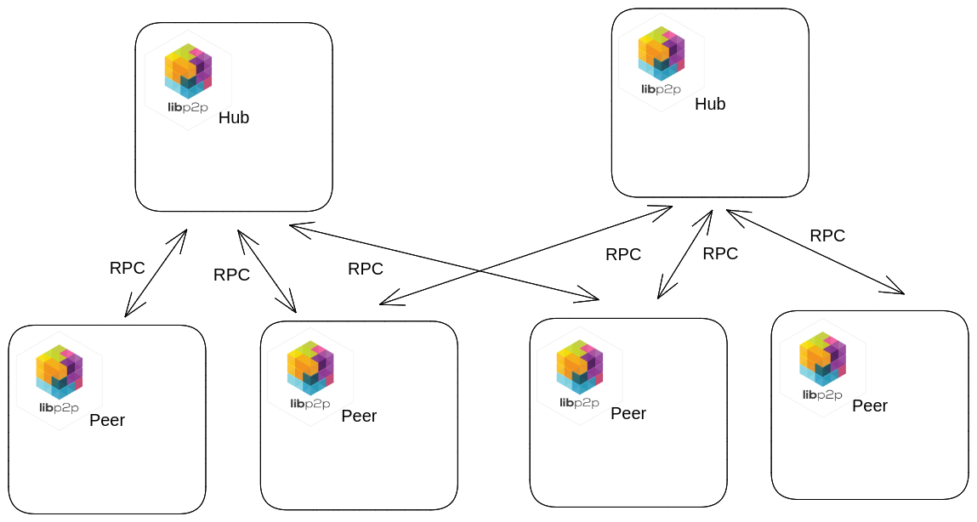
System Architecture
IT20254698 | Perera B.S.S. | 2023-234

Slide 15

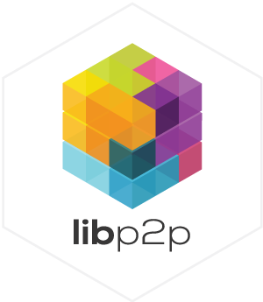

Technologies
IT20254698 | Perera B.S.S. | 2023-234

Slide 16
Current Progress Of The Component
Done | To-Do
Establish RPC connection between peers and hub DNS resolving for hubs and peers Integration with demo panel Comprehensive logging Tracing and Observability | System and load testing Integration with pricing model Performance improvements
IT20254698 | Perera B.S.S. | 2023-234

Slide 17
REFERENCES
[1] Y. A.-N. R. M. N. Mehdi Jahanirad*, "Security measures for VoIP application: A state of the art review" [Academic Journals, 2011].
[2] S. K. M. G. Leonidas Lymberopoulos, "Deliverable D.6.1: ARGUGRID Platform Design" [2007].
[3] D. B. Yoram Kulbak, "The eMule/eDonkey protocol," 2005 17 January. [Online]. Available: http://pages.di.unipi.it/ricci/e-mule-report.pdf. [Accessed: 24-Mar-2023].
[4] B. Cohen, 22 May 2003. [Online]. Available: https://stuker.com/wp-content/uploads/import/i-1fd3ae7c5502dfddfe8b2c7acdefaa5e-bittorrentecon.pdf.[Accessed: 24-Mar-2023].
IT20254698 | Perera B.S.S. | 2023-234

Slide 18
Bandara A.M.C.A. | IT20159726 | IT
USER DATA DECENTRALIZATION
IT20159726 | Bandara A.M.C.A. | 2023-234

Slide 19
Introduction
Presently, numerous decentralized social media platforms exist in the market[1].
A significant proportion of these platforms are blockchain-based[2].
While many researches have been done on decentralizing social media[3], Most of them are done using blockchain, which is not an optimal solution to store large binary objects[4].
IT20159726 | Bandara A.M.C.A. | 2023-234

Slide 20
Research Problem
What measures can be taken to provide users with complete ownership of their data?
What potential solutions exist for overcoming the limitations of blockchain when using it to store large quantities of data?
What enhancements can be made to current decentralized social media networks?
IT20159726 | Bandara A.M.C.A. | 2023-234

Slide 21
Sub Objectives
Enable user to control user data
Utilizing user device to store user data
Improving limitations in current decentralized social media platforms
Making user data highly available
IT20159726 | Bandara A.M.C.A. | 2023-234

Slide 22
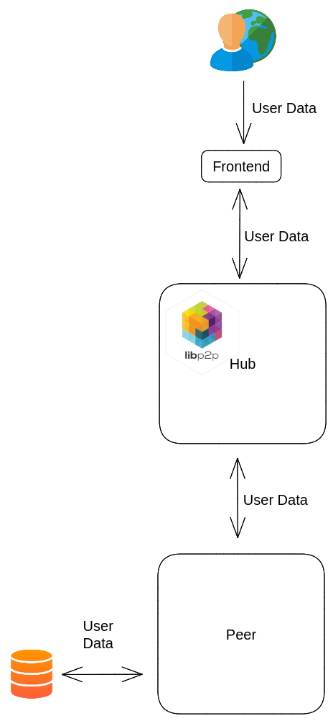
System Architecture
IT20159726 | Bandara A.M.C.A. | 2023-234

Slide 23

Technologies
IT20159726 | Bandara A.M.C.A. | 2023-234

Slide 24
Current Progress Of The Component
Done | To-Do
Establishment of connection with hubs Handling locally stored data Integration of local storage with IPFS Tracing & Observability Integration with demo panel | System and load testing Integration with pricing model Performance improvements
IT20159726 | Bandara A.M.C.A. | 2023-234

Slide 25
REFERENCES
[1]. C. Staff, “Blockchain social media and crypto social media,” Cryptopedia . [Online]. Available: https://www.gemini.com/cryptopedia/blockchain-social-media-decentralized-social-media#section-blockchain-and-social-media. [Accessed: 20-Mar-2023].
[2]. Sketchar, “What advantages does web 3.0 give to creators?,” Sketchar, 03-Mar-2023. [Online]. Available: https://blog.sketchar.io/what-advantages-does-web-3-0-give-to-creators/. [Accessed: 20-Mar-2023].
[3]. T. Cai, Z. Hong, S. Liu, W. Chen, Z. Zheng and Y. Yu, "SocialChain: Decoupling Social Data and Applications to Return Your Data Ownership," in IEEE Transactions on Services Computing, vol. 16, no. 1, pp. 600-614, 1 Jan.-Feb. 2023, doi: 10.1109/TSC.2021.3128959.
[4]. R. Nourmohammadi and K. Zhang, "An On-Chain Governance Model Based on Particle Swarm Optimization for Reducing Blockchain Forks," in IEEE Access, vol. 10, pp. 118965-118980, 2022, doi: 10.1109/ACCESS.2022.3221419.
IT20159726 | Bandara A.M.C.A. | 2023-234

Slide 26
Dhananjani G.G.S. | IT20137496 | IT
DECENTRALIZED DATA INTEGRITY
IT20137496 | Dhananjani G.G.S. | 2023-234

Slide 27
Introduction
Data integrity is a main aspect of any application. [1]
Currently, there are various mechanisms available to maintain the integrity of data in applications. [2] [3]
In here, the focus is on implementation of mechanism to ensure data integrity on a decentralized network.
IT20137496 | Dhananjani G.G.S. | 2023-234

Slide 28

Research Problem
How to maintain integrity of user data which saved on user device?
What is the best mechanism to achieve user data integrity?
IT20137496 | Dhananjani G.G.S. | 2023-234

Slide 29
Sub Objectives
Ensure consistency in preparation for hashing and signing
Ensures the data security distributed across multiple nodes
Verify the authenticity of the data
Ensure that the data has not been altered or tampered with during storage
IT20137496 | Dhananjani G.G.S. | 2023-234

Slide 30
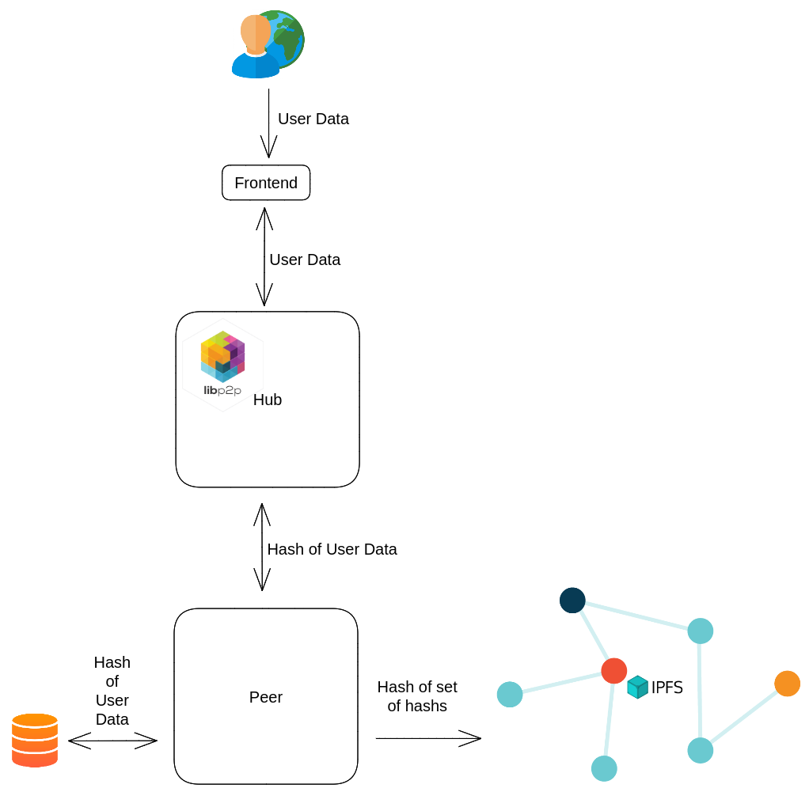
System Architecture
IT20137496 | Dhananjani G.G.S. | 2023-234

Slide 31

Technologies
IT20137496 | Dhananjani G.G.S. | 2023-234

Slide 32
Current Progress Of The Component
Done | To-Do
Implemented hashing of user data Implemented persist hashes on database Implemented verified flag Allow purge unverified content Integration with demo panel | System and load testing Integration with pricing model Performance improvements
IT20137496 | Dhananjani G.G.S. | 2023-234

Slide 33
REFERENCES
[1] Vishwanath G. Garagad, Nalini C. Iyer, Heera G. Wali, "Data Integrity: A security threat for Internet of Things and Cyber-Physical Systems", IEEE 2020.
[2] “Decentralized social media,” Mastodon. [Online]. Available: https://joinmastodon.org/. [Accessed: 20-Mar-2023].
[3] Bogdan Tiganoaia, "The use of social platforms and personal data protection — An exploratory study" IEEE, 2017.
IT20137496 | Dhananjani G.G.S. | 2023-234

Slide 34
ABEYKOON A.W.Y.I.K. | IT20157432 | IT
DECENTRALIZED DATA CACHING
IT20157432 | Abeykoon A.W.Y.I.K. | 2023-234

Slide 35
Introduction
Decentralized social media protocols that preserve data caching are essential for improving network performance, reducing traffic, and improving scalability, dependability, and cost effectiveness.[1]
They also increase storage optimization and reduce the cost of network operations. [2]
There are many kind of decentralized storage networks [3]
Ex : Storj, Filecon, Arware , BitTorrent, IPFs (InterPlanetary File System)
The primary goal is to implement a caching mechanism using IPFS [4]
IT20157432 | Abeykoon A.W.Y.I.K. | 2023-234

Slide 36

Research Problem
What is the most effective caching strategy for issues of caching mechanism?
What we can do for minimize resource usage?
Why we use IPFS to implement the caching mechanism?
IT20157432 | Abeykoon A.W.Y.I.K. | 2023-234

Slide 37
Sub Objectives
Integrating the caching mechanism with the IPFS
Reduce resource consumption in data storage
Improve Scalability, Efficiency, Flexibility, and Lower transaction fees
Evaluate the ease of integration and development efficiency with IPFS
IT20157432 | Abeykoon A.W.Y.I.K. | 2023-234

Slide 38
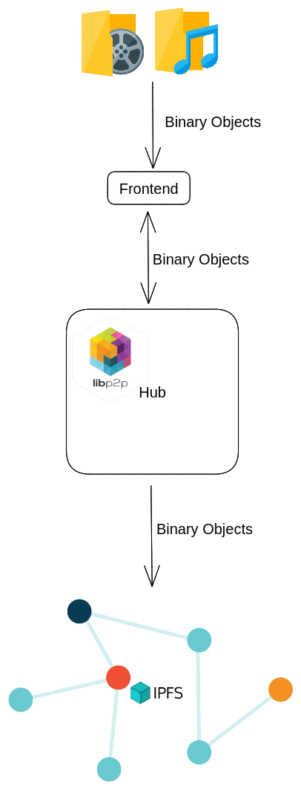
System Architecture
IT20157432 | Abeykoon A.W.Y.I.K. | 2023-234

Slide 39
Technologies
IT20157432 | Abeykoon A.W.Y.I.K. | 2023-234

Slide 40
Current Progress Of The Component
Done | To-Do
Upload binary objects to IPFS Binary object retrieval from IPFS Map binary objects content & peers Purging binary objects on IPFS Integration with demo panel | System and load testing Integration with pricing model Performance improvements
IT20157432 | Abeykoon A.W.Y.I.K. | 2023-234

Slide 41
REFERENCES
[1] B. Zhang and H. Wu, "A new distributed caching replacement strategy," IEEE, 2011.
[2] F. T. Erik Daniel, "IPFS and Friends: A Qualitative Comparison of Next Generation Peer-to-Peer Data Networks," IEEE, 2022.
[3] B. P. Robert Sheldon, "7 decentralized data storage networks compared," TechTarget, 05 June 2022. [Online]. Available: https://www.techtarget.com/searchstorage/tip/Comparing-4-decentralized-data-storage-offerings.
[4] "IPFS Docs," [Online]. Available: https://docs.ipfs.tech/.
IT20157432 | Abeykoon A.W.Y.I.K. | 2023-234

Slide 42
Commercialization Plan
DeMedia is to function as an open source protocol, facilitating the creation of decentralized social media platforms that are self-hosted.
DeMedia will provide
A base model which can be utilized for free of charge.
Additionally 2 paid models will also available:
A membership model based on subscription, which can be governed by the host
An advertising-based revenue model that can also be governed by the host

Slide 43
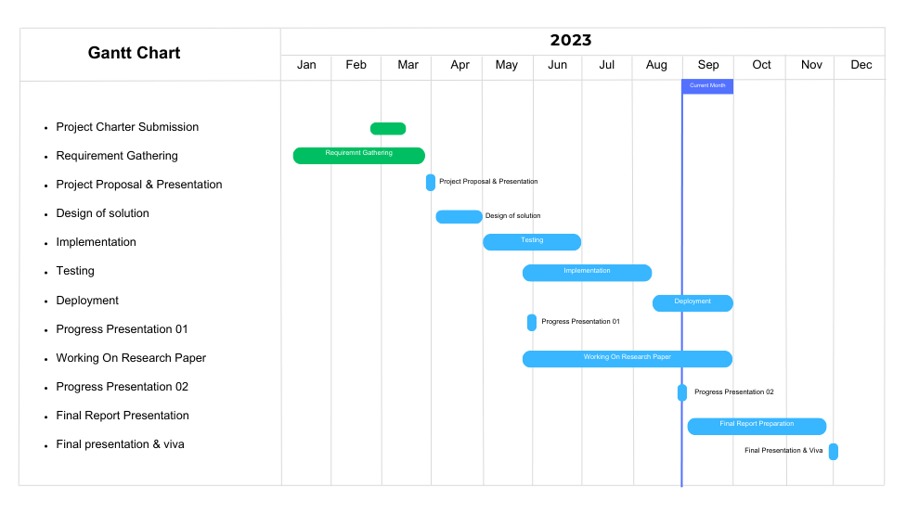
Current Progress Of The Project
IT20137496 | Dhananjani G.G.S. | 2023-234

Slide 44
Demo
2023-234

Slide 45

Q & A

Slide 46
Thank You!
2023-234

