Slide 1
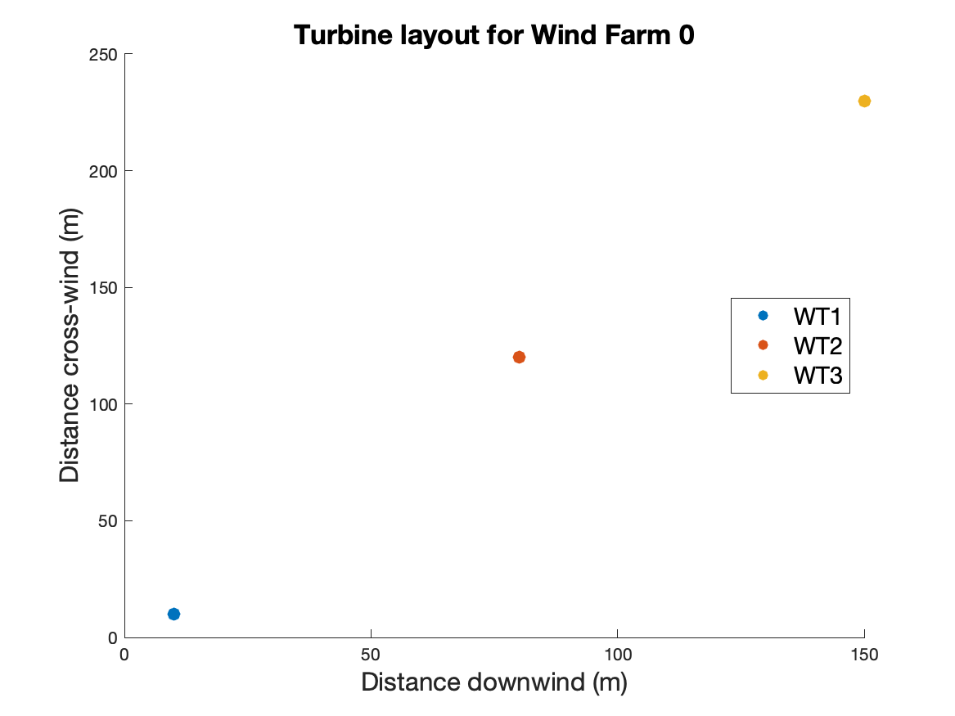
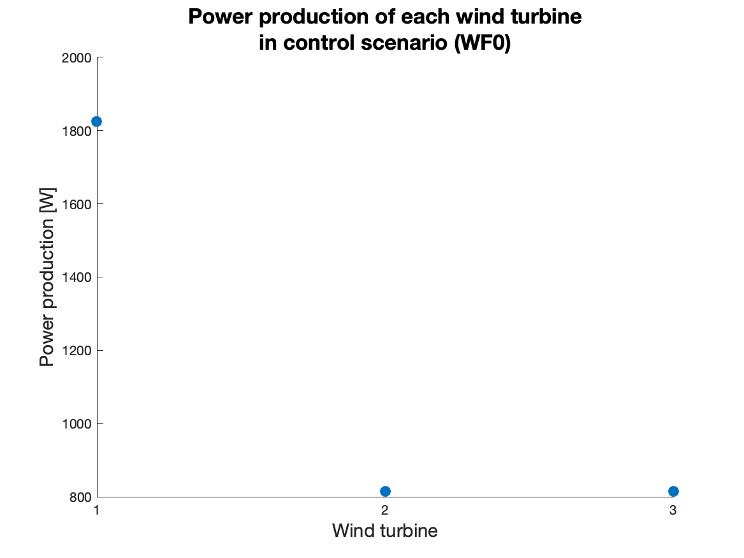
Control Scenario
Windfarm layout
Power production by each turbine
(a)
(b)

Slide 2
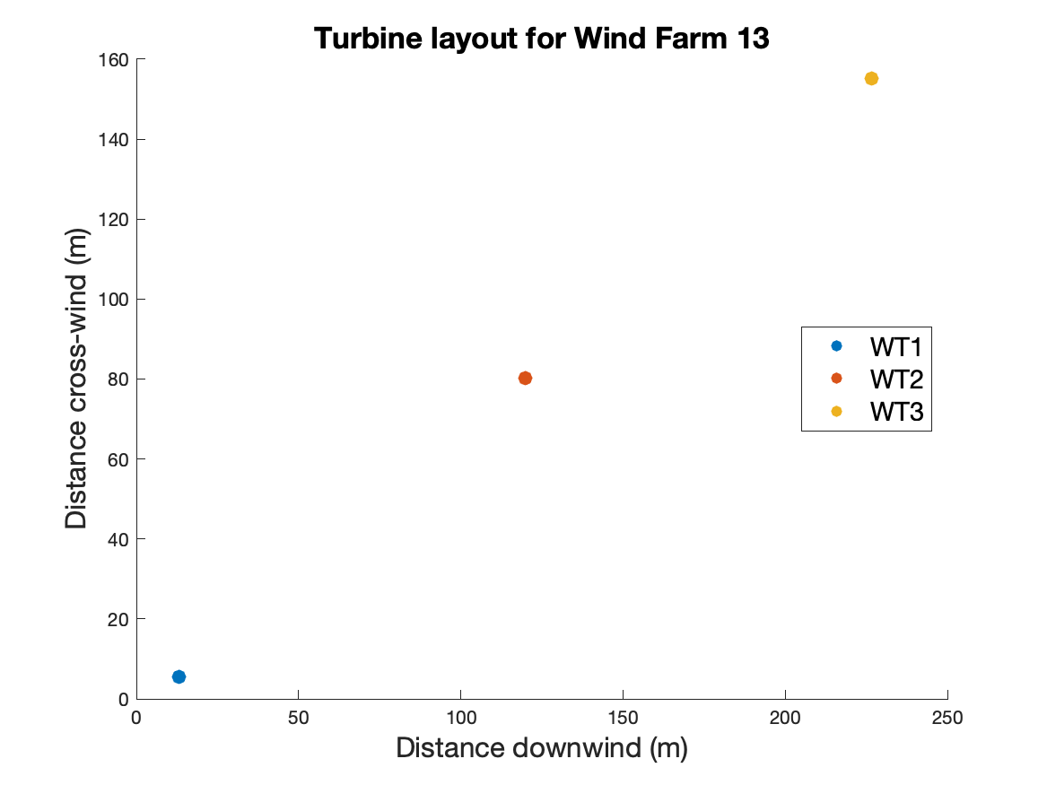
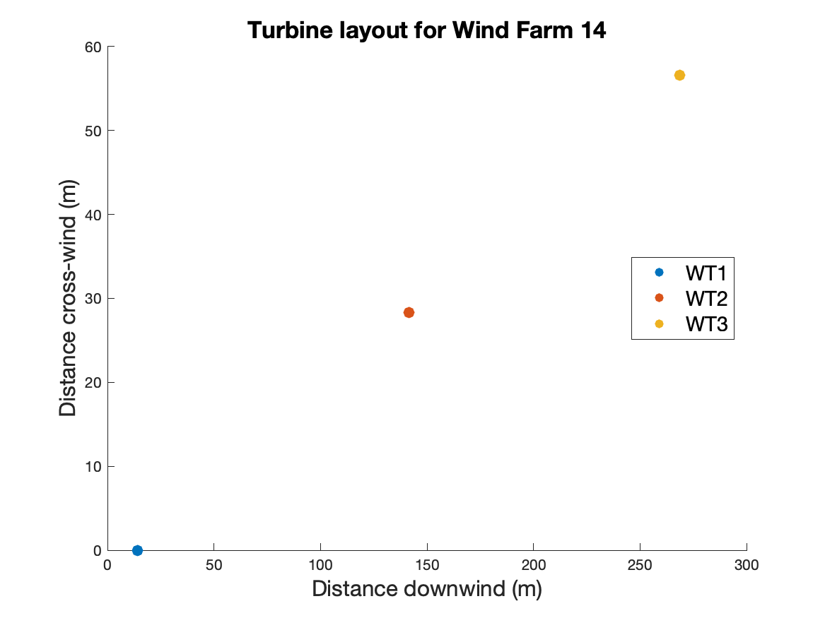
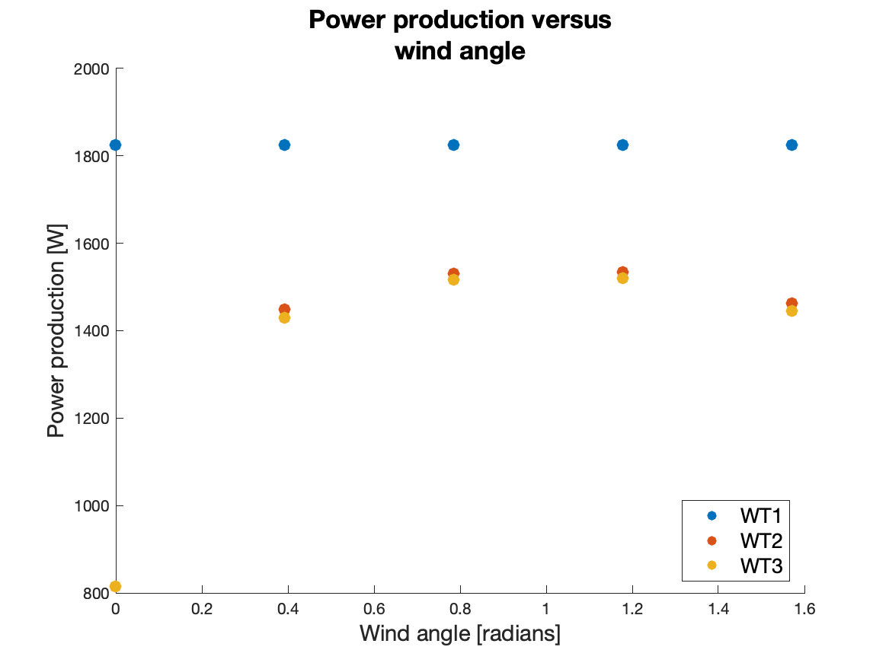
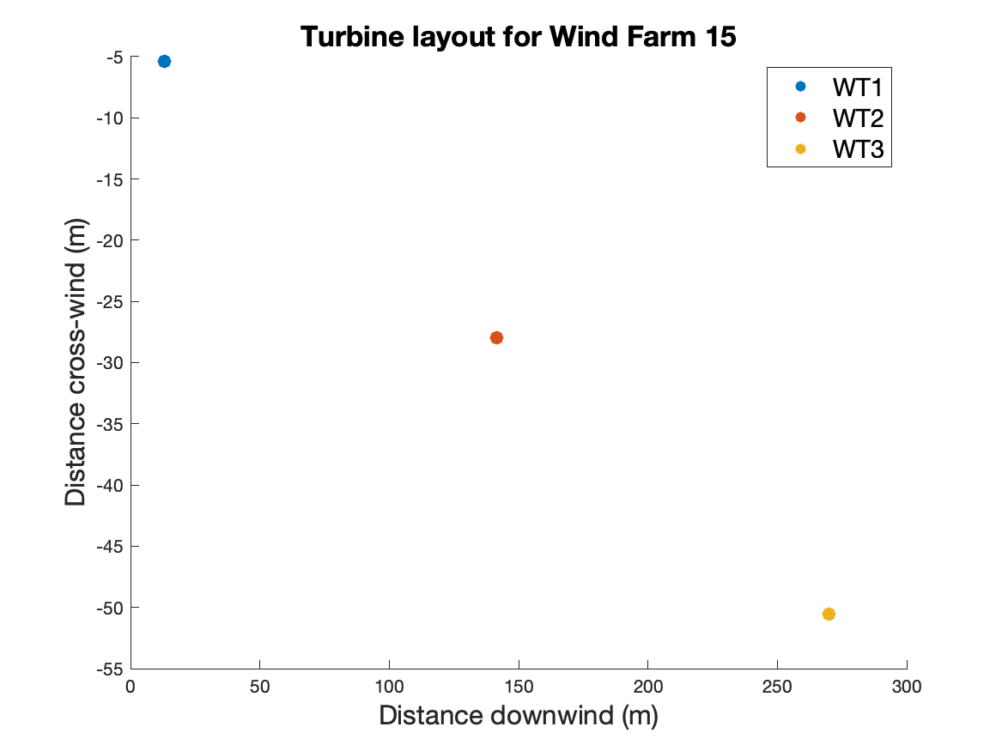
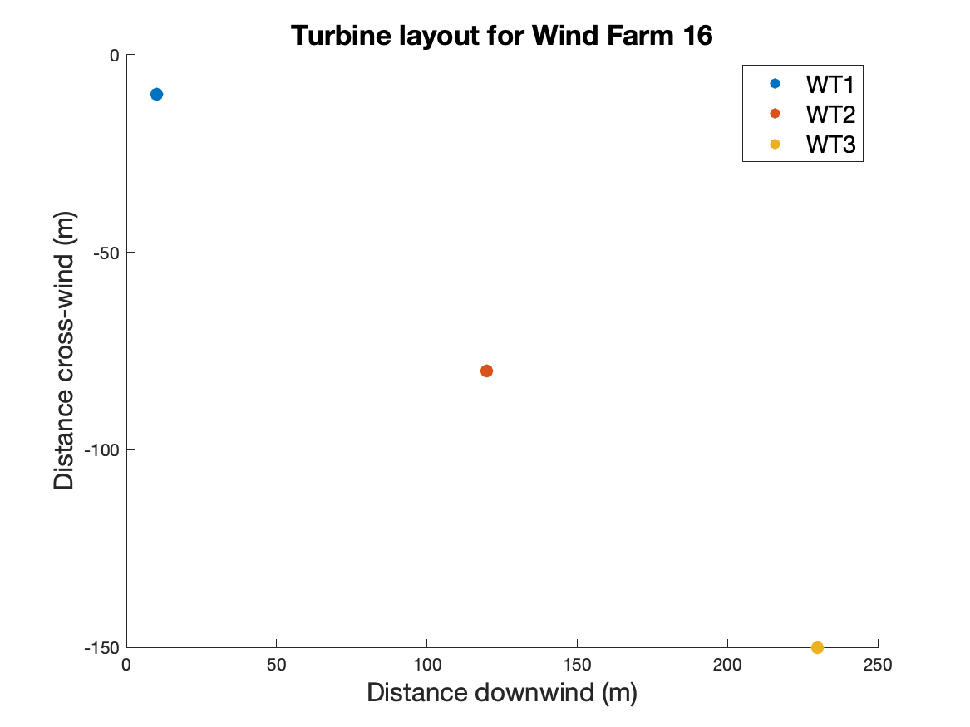
(b1)
(b2)
(a)
(b3)
(b4)

Slide 3
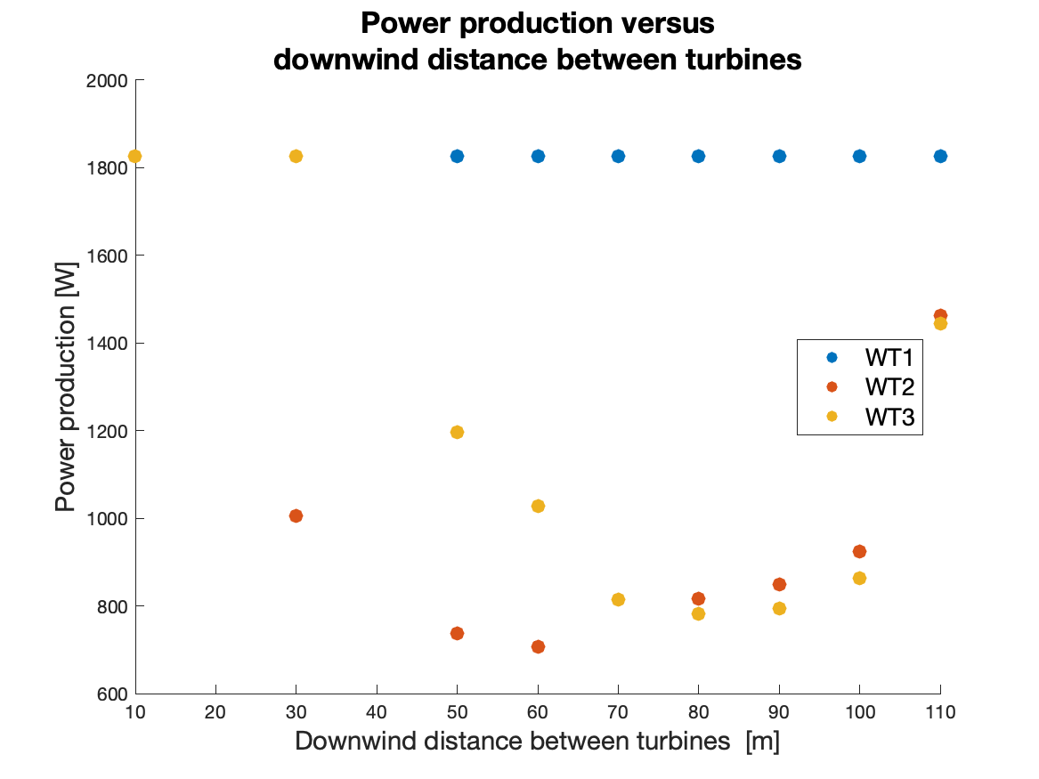
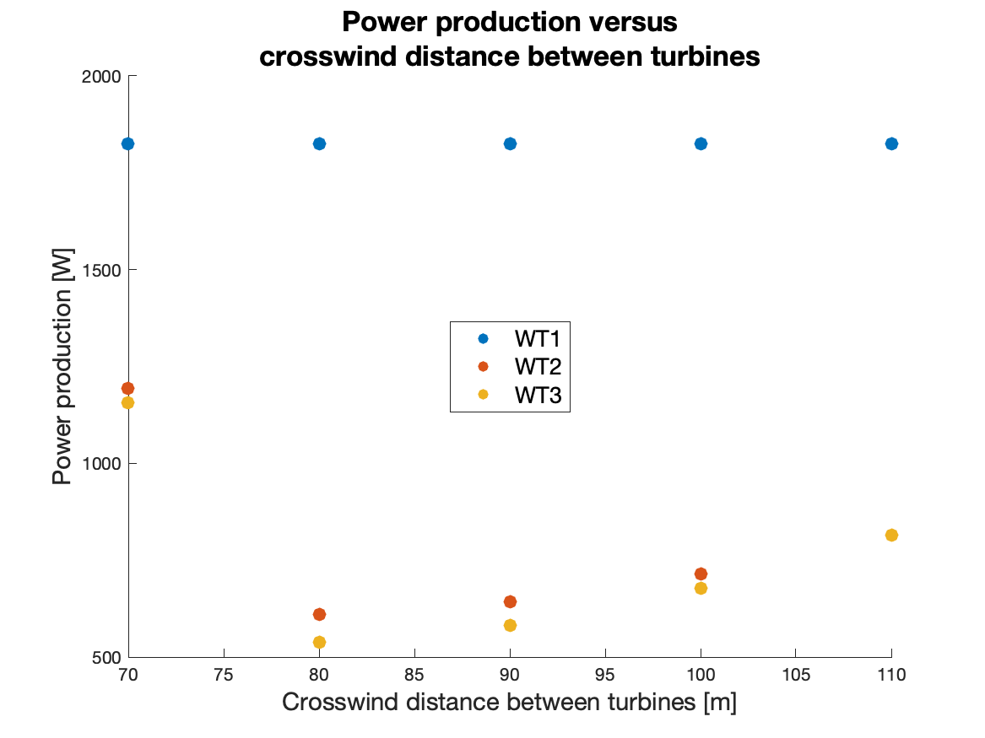
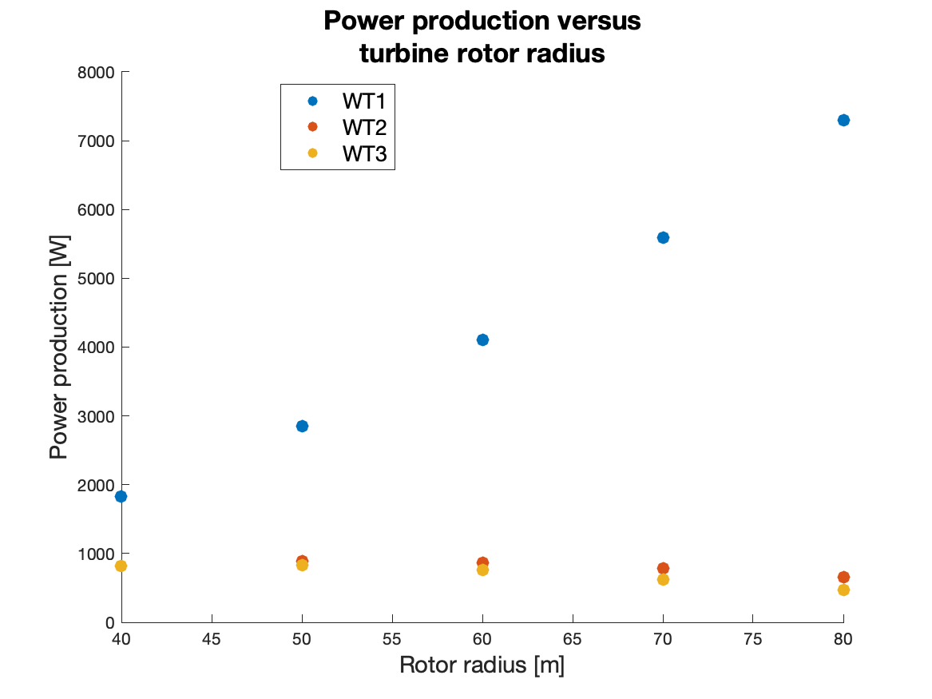
(a)
(b)
(c)

Slide 4
(a)
(b)

Slide 5
(a)
(b)

Slide 6
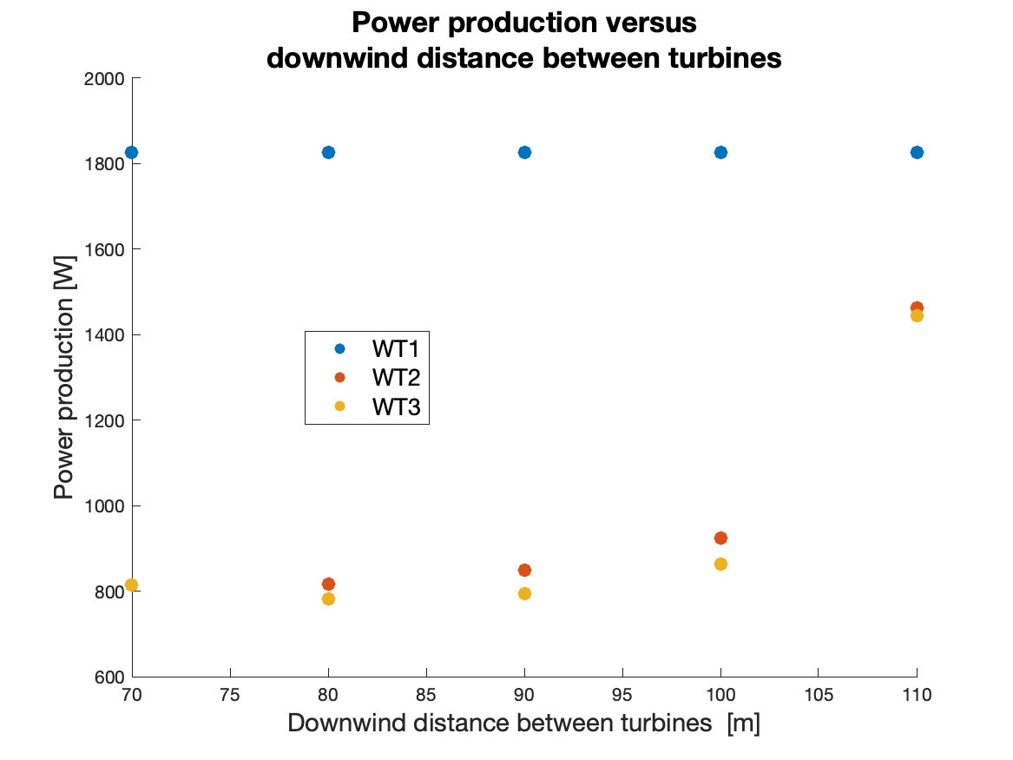

Slide 7

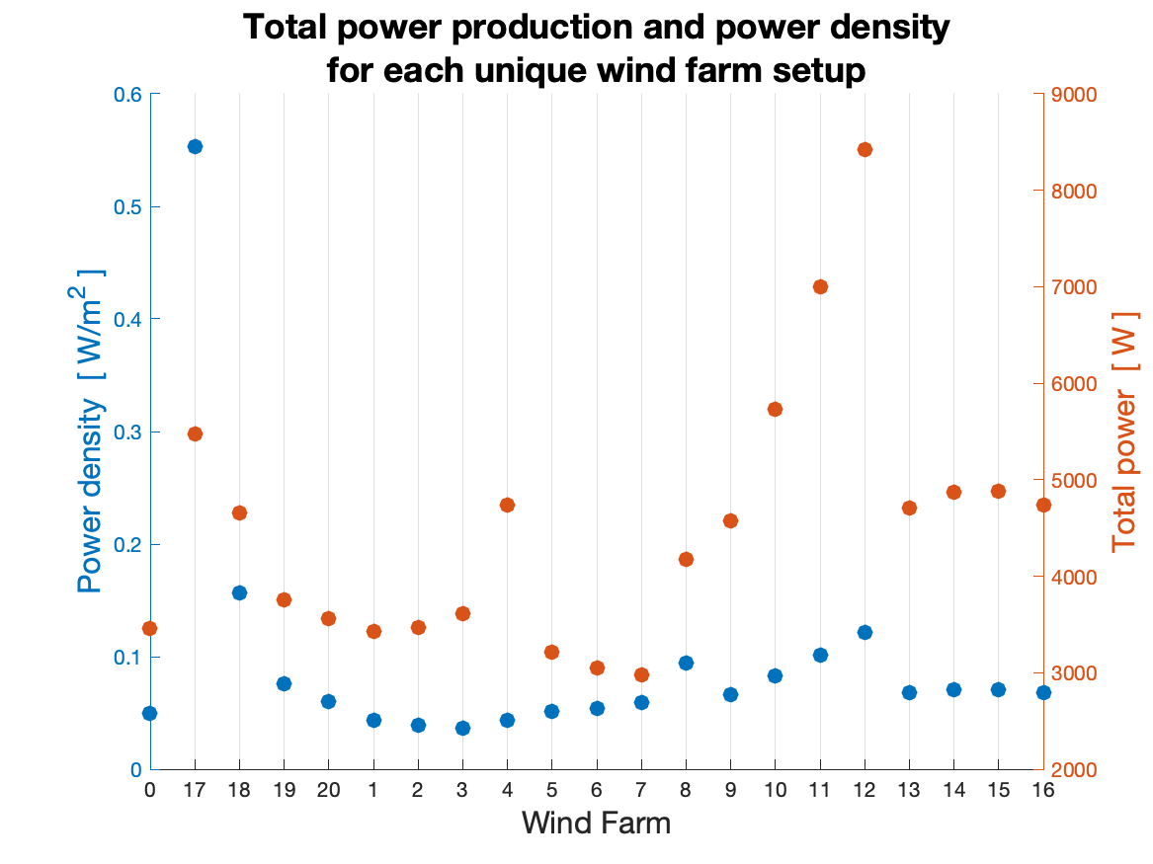


increasing x spacing
decreasing y spacing
Increasing $R_{r}$
Increasing $θ$

Slide 8
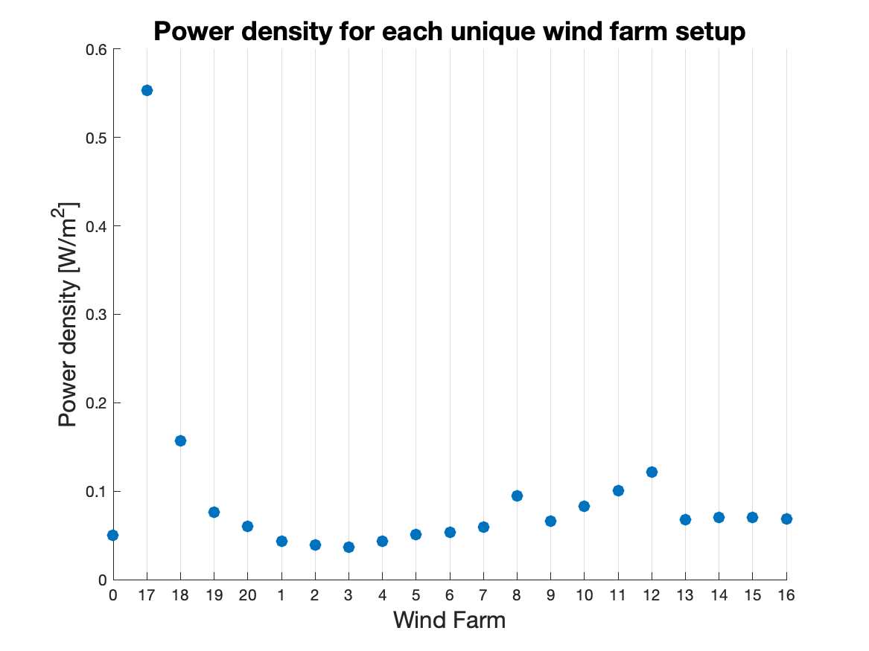


increasing x spacing
decreasing y spacing
Increasing $R_{r}$
Increasing $θ$

Slide 9
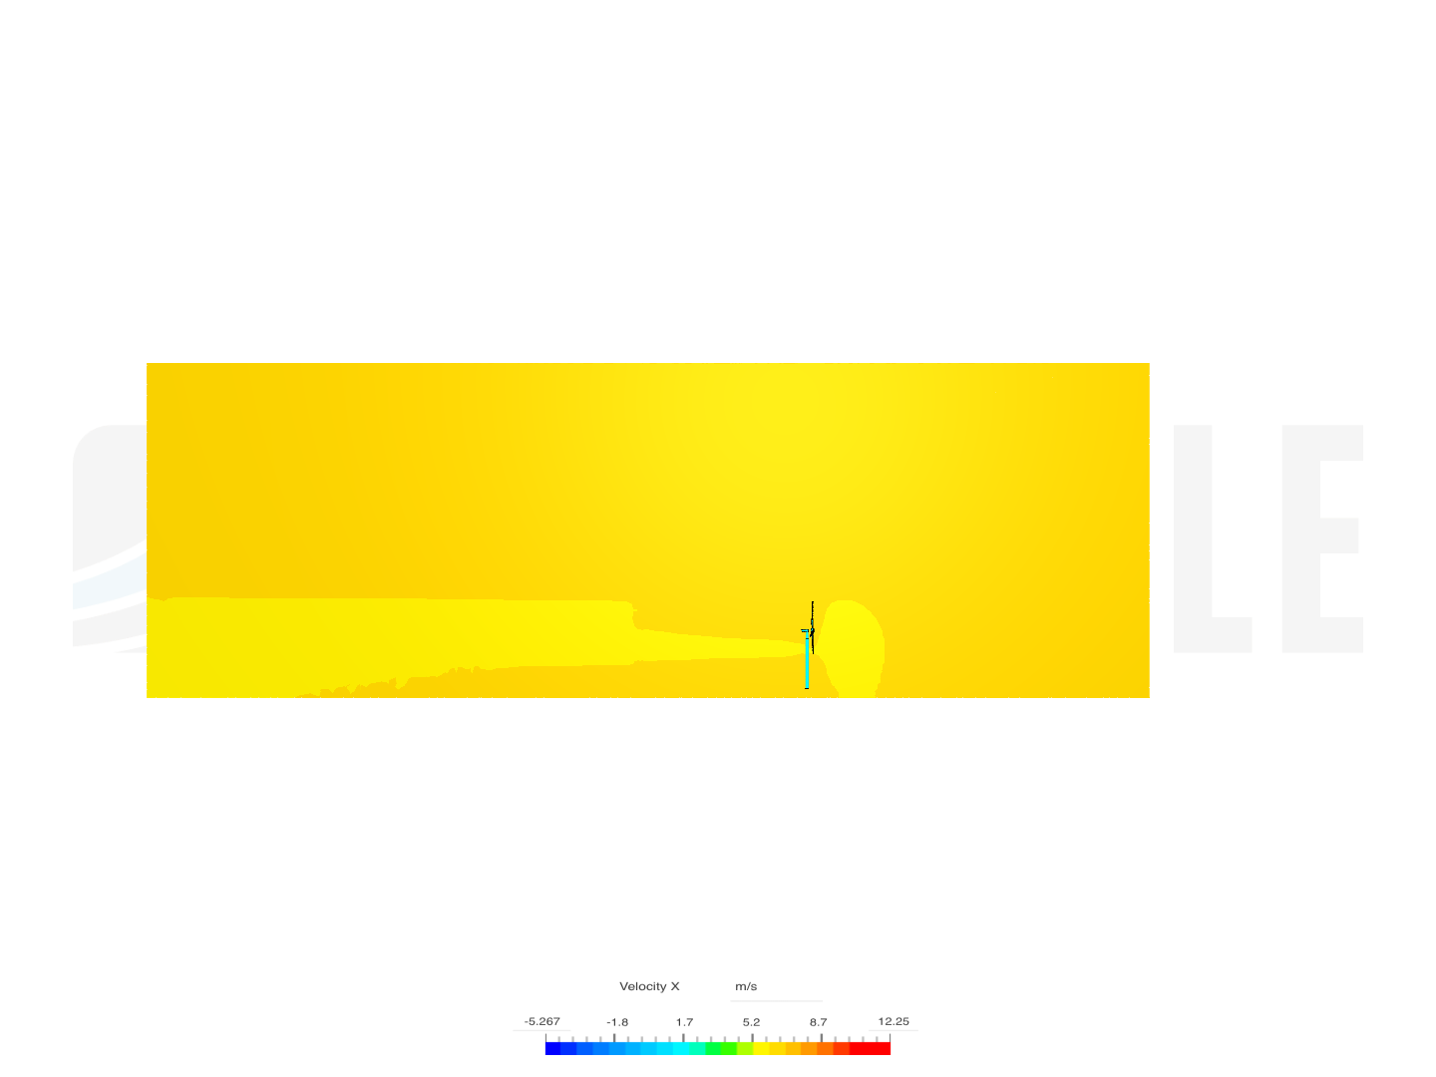
Single turbine wake field from SimScale simulation (Run 2)

Slide 10
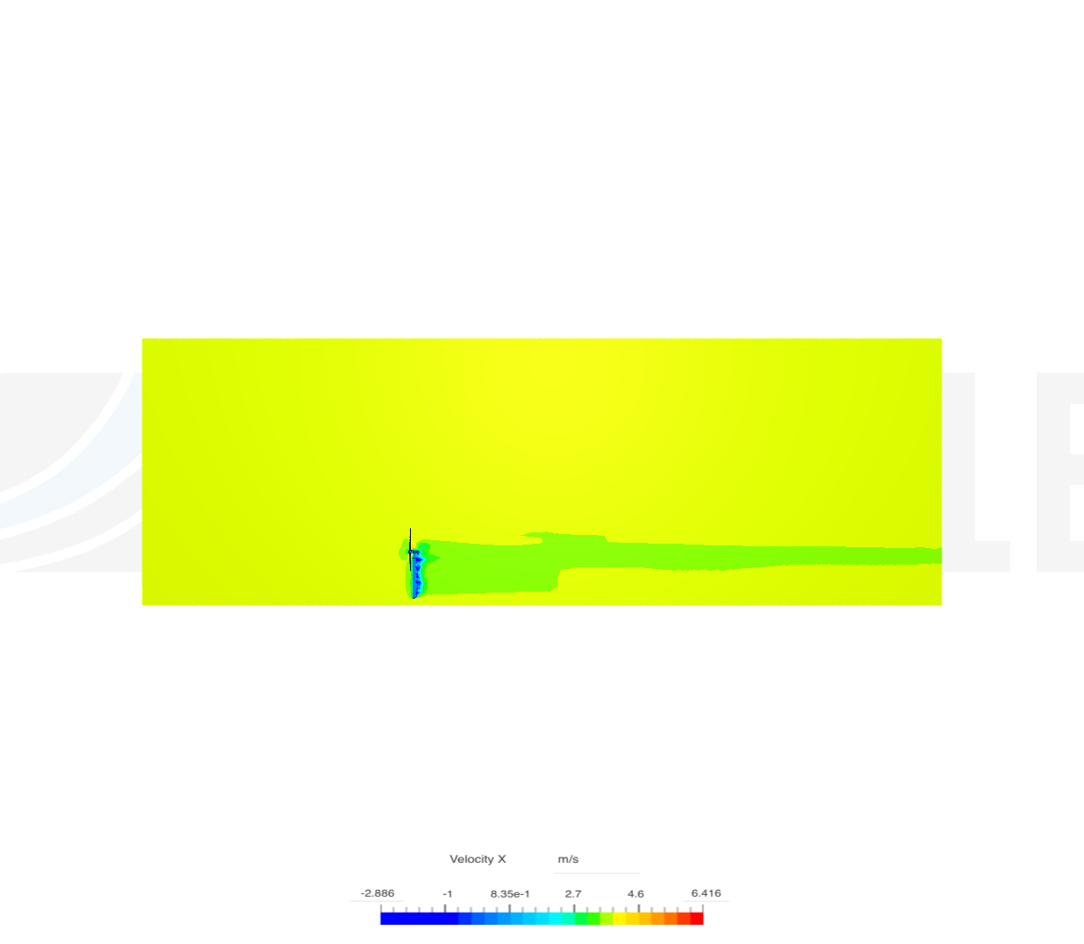
Single turbine wake field from SimScale simulation (Run 1)

