Slide 1
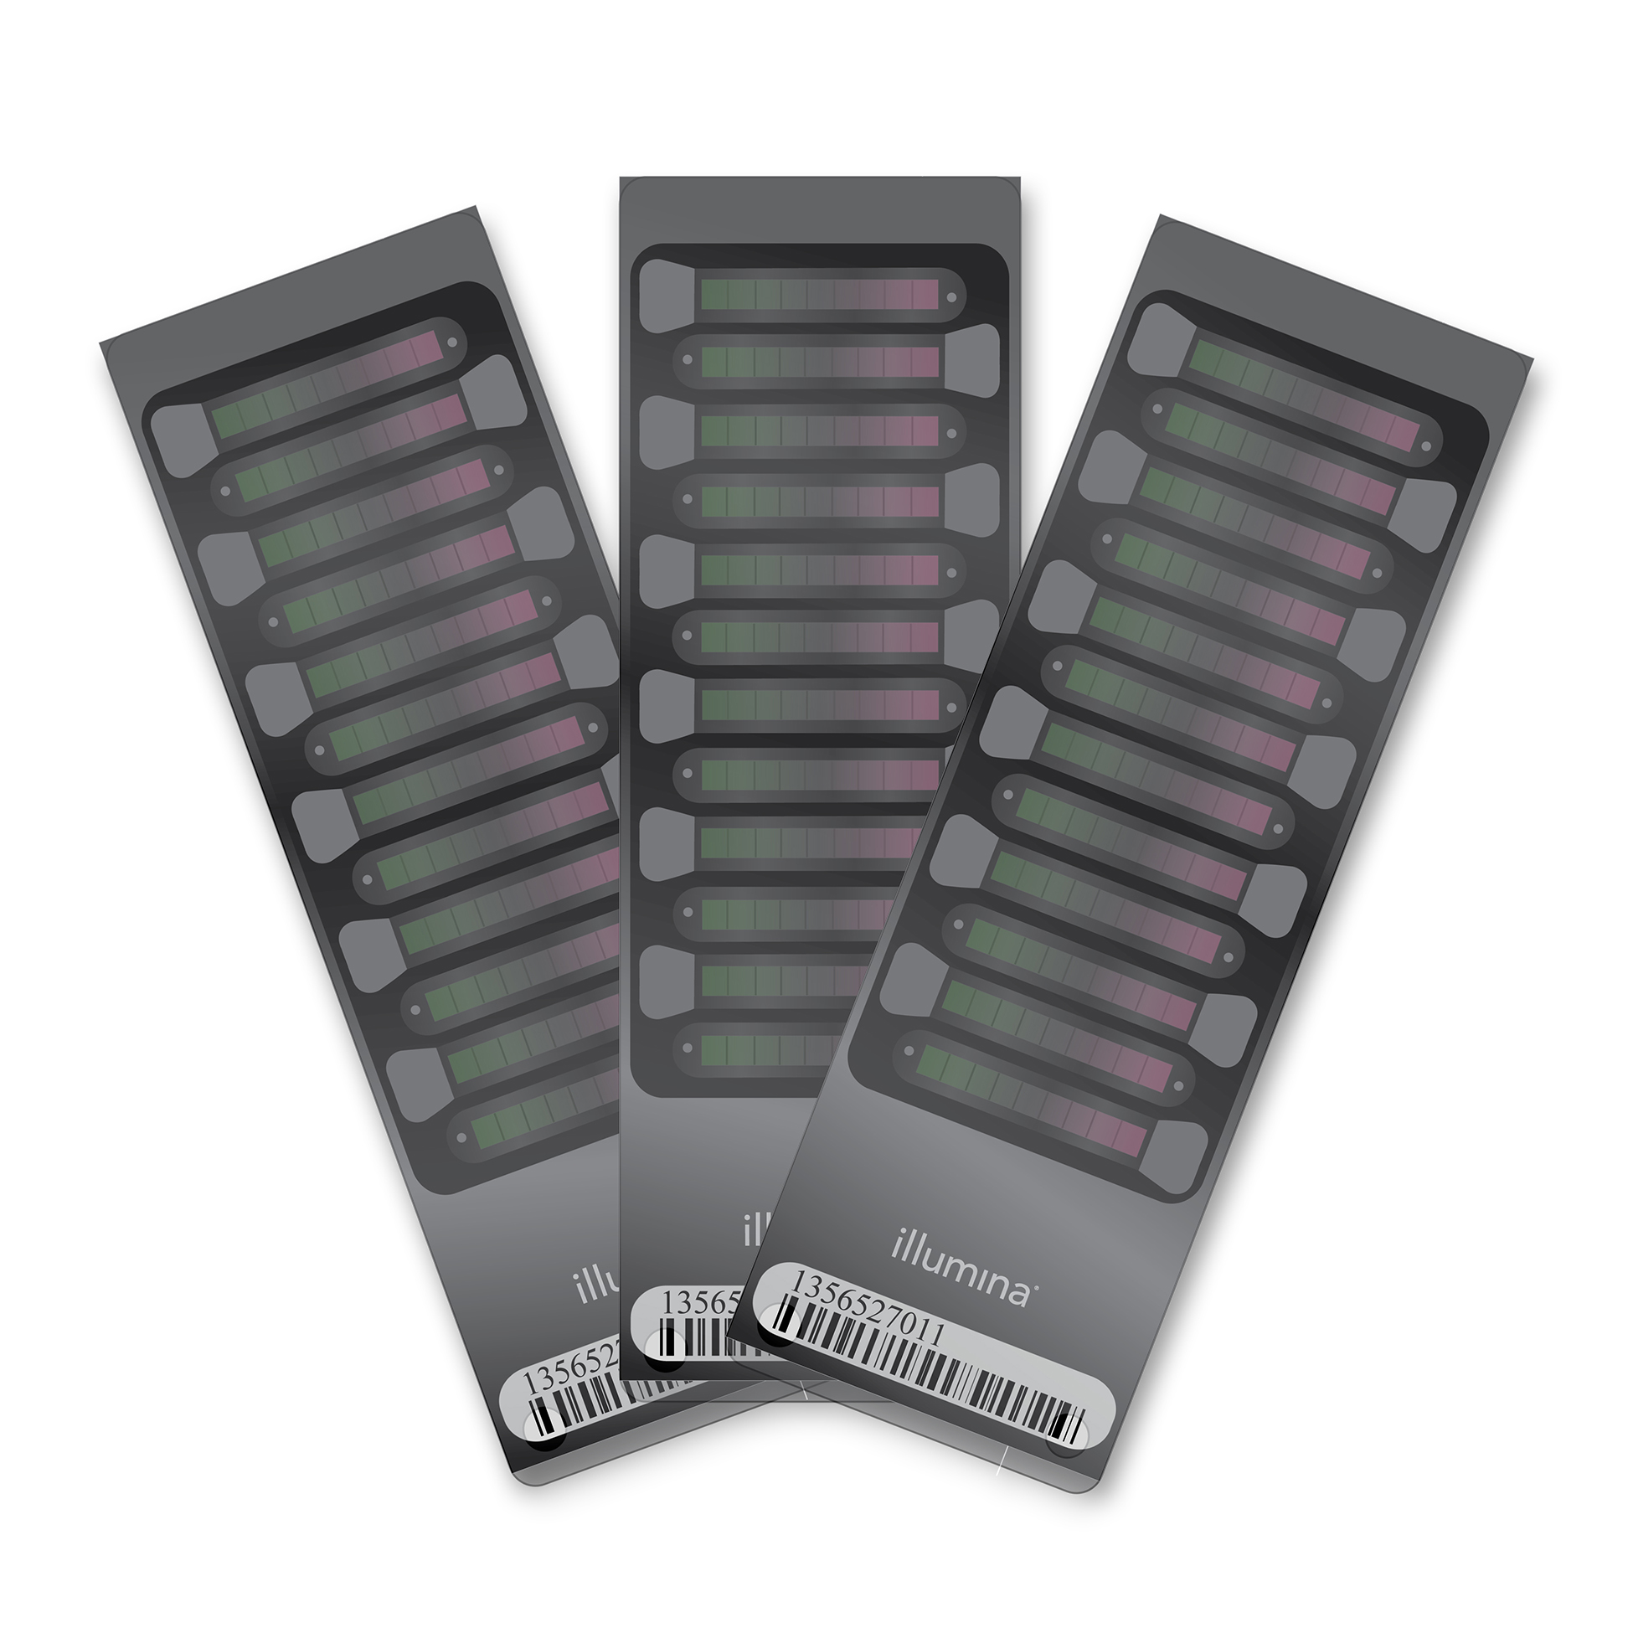
DNA methylation
data (IDAT files)
Background
correction (noob)
Healthy individuals
N_{samples} = 2325
N_{probes} = 485512
Quality control
Healthy individuals
N_{samples} = 2218
N_{probes} = 485512
Probe filtering
β-value
calculation
BMIQ normalisation
Healthy individuals
N_{samples} = 2218
N_{probes} = 428266

