Slide 1


Implementing a Multilingual Solution Using AWS
This presentation details a robust, scalable solution for multilingual audio transcription and translation leveraging the power of Amazon Web Services (AWS). We'll explore the architecture, technical intricacies, and implementation steps involved in automating the process of converting multimedia content for a global audience. This solution offers significant advantages for businesses seeking to expand their reach and engage with diverse linguistic communities, enhancing accessibility and communication effectiveness.
by Ahmed Moustafa

Slide 2




Project Overview and Architecture
Audio Input
Transcription (Amazon Transcribe)
Translation (Amazon Translate)
Speech Synthesis (Amazon Polly)
Clients upload diverse audio content, ranging from lectures and podcasts to customer service calls and marketing materials, in various languages and formats such as MP3, WAV, FLAC, and more. The system is designed to handle a wide range of audio qualities and sizes efficiently.
Amazon Transcribe employs advanced Automatic Speech Recognition (ASR) to convert the uploaded audio into text. Custom vocabularies and language models can be implemented to optimize accuracy and handle specific terminology, addressing challenges like accents, dialects, and background noise.
The transcribed text is then processed by Amazon Translate, leveraging Neural Machine Translation (NMT) to convert the source language text into the desired target language. Custom terminology further refines the translation quality, ensuring accuracy and consistency across various content types.
Finally, Amazon Polly synthesizes the translated text into natural-sounding speech. With a vast selection of voices, accents, and speech rates, Polly ensures high-quality audio output in various formats like MP3 and OGG, enhancing the user experience.

Slide 3
Deep Dive: Amazon Transcribe
Core Technology
Challenges and Solutions
Implementation
Amazon Transcribe uses Automatic Speech Recognition (ASR) to convert audio to text. Its robust algorithms handle various audio formats (MP3, WAV, FLAC) and can be optimized with custom vocabularies and language models for improved accuracy. This customization is crucial for specialized terminology and industry-specific jargon.
Challenges like background noise, accents, and varying audio quality are addressed through advanced noise reduction techniques and acoustic models. The service offers different options for handling these complexities, ensuring reliable transcriptions even in challenging audio environments.
Integration is straightforward using AWS SDKs. Developers can easily incorporate Transcribe into applications with simple API calls, enabling seamless audio processing within existing workflows.
aws transcribe start-transcription-job --media-file-uri "s3://example-bucket/example-audio.mp3" --language-code "en-US" --transcription-job-name "example-job"

Slide 4
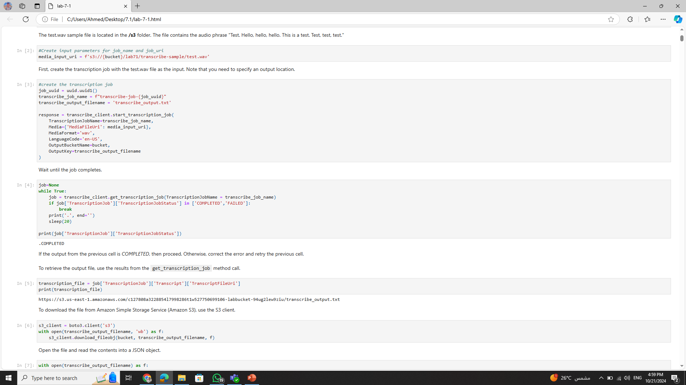

Slide 5
Deep Dive: Amazon Translate
1
Neural Machine Translation
2
Custom Terminology
3
Language Support and Performance
Accuracy is further enhanced with custom terminology support. By providing domain-specific dictionaries, businesses can ensure consistent translation of technical terms, product names, and other critical phrases. This feature is essential for maintaining brand consistency and clarity.
Amazon Translate uses Neural Machine Translation (NMT) to provide accurate and fluent translations across a wide range of languages. This technology allows for more nuanced and context-aware translations compared to traditional statistical methods.
Translate supports over 70 languages, catering to a global audience. The service is designed for both real-time and batch translation, offering flexibility for different use cases. Considerations for latency and throughput are crucial when designing high-volume translation workflows.

Slide 6
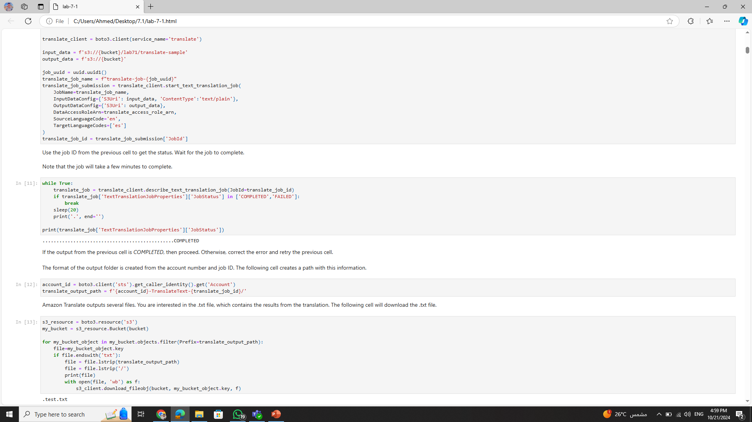

Slide 7




Deep Dive: Amazon Polly
Text-to-Speech (TTS)
Amazon Polly transforms text into lifelike speech using advanced deep learning technologies. It offers a diverse selection of voices, accents, and speaking styles, allowing developers to tailor the audio output to specific contexts and target audiences.
Voice Customization
Beyond pre-built voices, Polly provides options for customizing speech output. Developers can adjust parameters such as speaking rate, pitch, and volume, and even create custom lexicons to ensure accurate pronunciation of specific words or phrases.
Output Formats
Polly supports a range of audio output formats, including MP3, OGG, and PCM, offering flexibility for different playback devices and applications. This versatility allows for seamless integration with various multimedia platforms and content delivery systems.

Slide 8
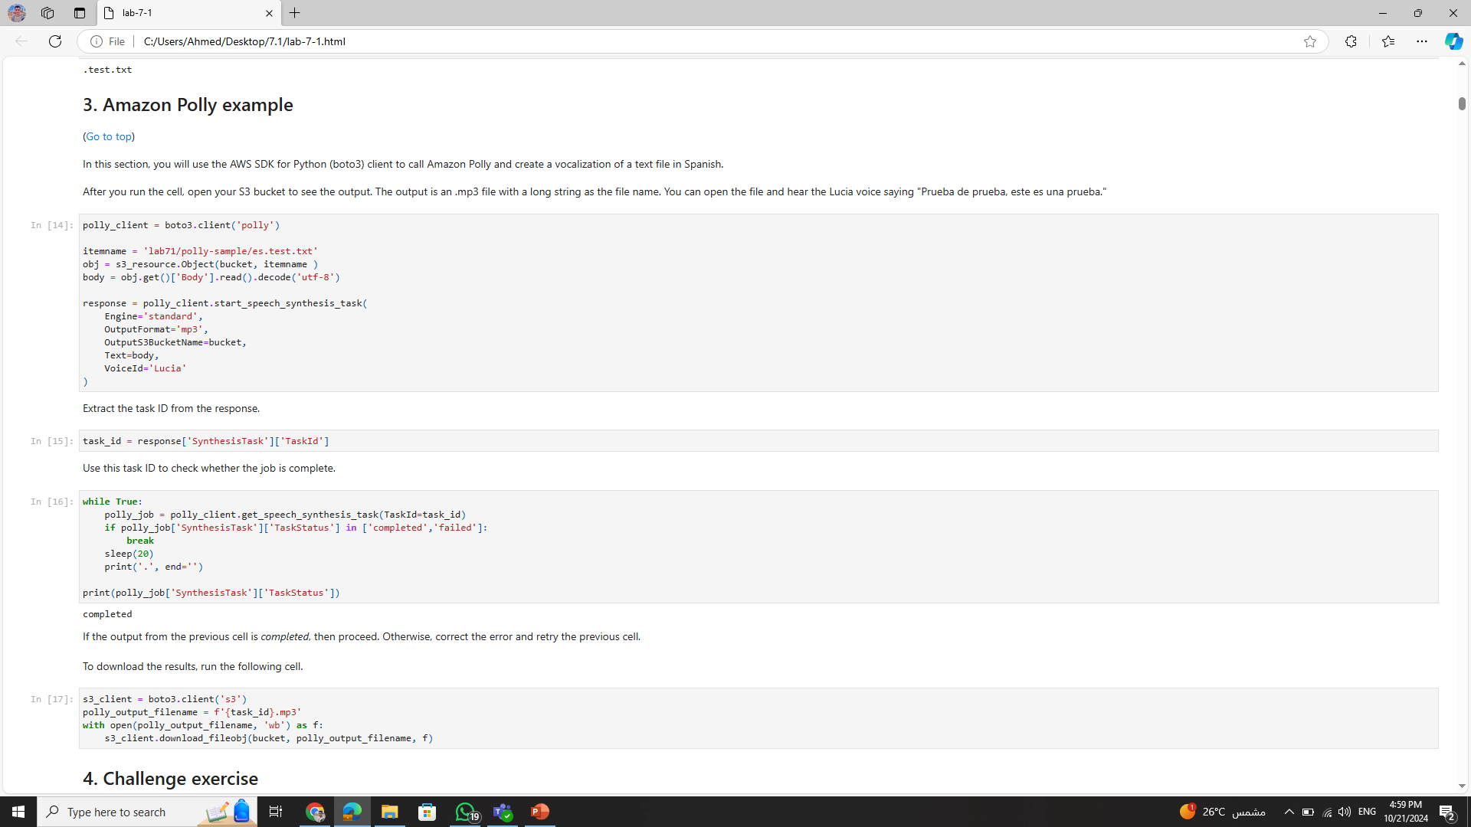

Slide 9
Code Walkthrough

Slide 10
Data Pipeline and Integration
1
API Gateway
The process begins with client requests via API Gateway, the entry point for external systems. API Gateway handles authentication, authorization, and request throttling, ensuring secure and controlled access to the translation pipeline.
2
AWS Lambda
AWS Lambda functions orchestrate the workflow, seamlessly connecting the different AWS services. Lambda triggers Transcribe for audio-to-text conversion, passes the output to Translate, and finally invokes Polly for text-to-speech synthesis, ensuring a smooth and automated process.
3
Amazon S3
Amazon S3 provides durable and scalable storage for audio files, transcripts, and translated text. S3's robust infrastructure ensures data availability and facilitates efficient data transfer between the different services involved in the pipeline.

Slide 11
Q&A

