Slide 1

Cluster and Cloud Computing Assignment 2 - #TheDeadlySins #2019
Presentation by team 52 :
Shreyas Walvekar - swalvekar@student.unimelb.edu.au
Nitish Mathur - nitishm@student.unimelb.edu.au
Nakia Silva - nakias@student.unimelb.edu.au
Yash Shinde - yshinde@student.unimelb.edu.au
Krishna Srinivas Sundararajan - ksundararaja@student.unimelb.edu.au

Slide 2
Overview
Cloud based social media data analytic system which will compute the correlation of twitter data with aurin and categorize that into one of the seven deadly sins(Wrath).
Hypothesis:
There is a correlation between the portrayal of violence in mass media like game of thrones and the amount of violence, aggression and the transpiration of germane crimes in the real-world

Slide 3
System Architecture

Slide 4
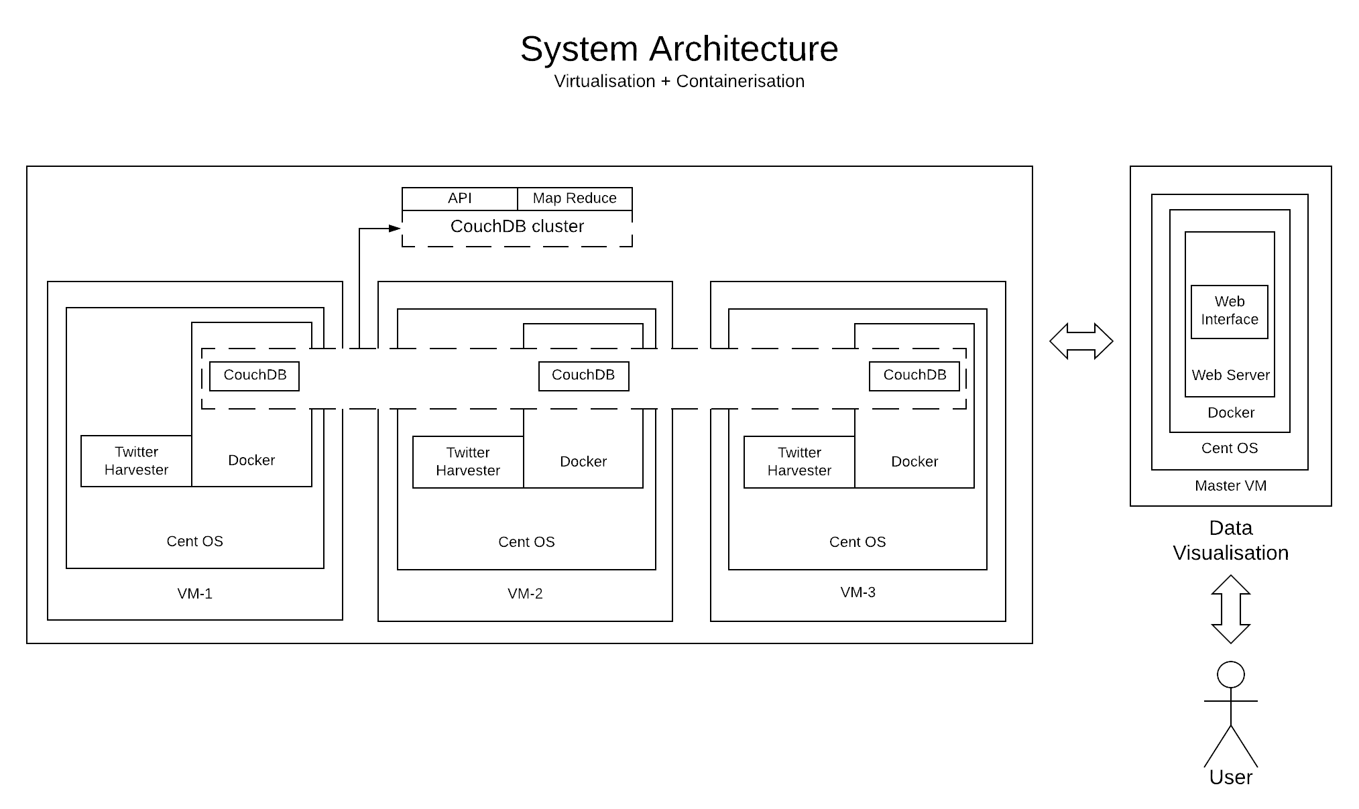

Slide 5
Conclusion

