Slide 1

SUPERSTORE SALES & PROFITABILITY DASHBOARD:

Slide 2
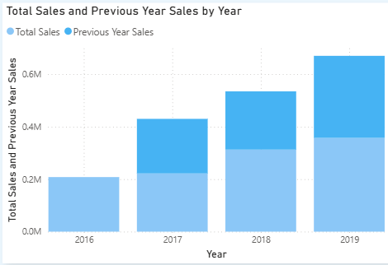
Q1. How has sales performance changed over the years?
Sales increased steadily over the analyzed years, with the strongest growth occurring between 2017 and 2018.
Recommendation:
The business should investigate the factors that contributed to the strong sales growth and replicate successful strategies in future years.

Slide 3
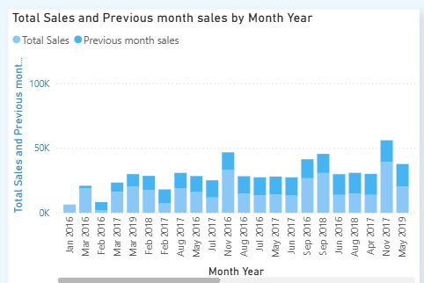
Q2. How does monthly sales performance compare with the previous month?
Monthly sales fluctuate throughout the year, with several months showing significant increases or decreases compared with the previous month.
Recommendation:
The business should analyze seasonal patterns and investigate the reasons behind significant monthly changes to improve sales forecasting and planning.

Slide 4
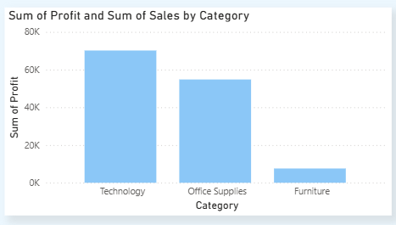
Q3. Which product categories contribute most to sales and profit?
Technology is the most profitable category, while Furniture generates significantly lower profit compared with Technology and Office Supplies.
Recommendation:
The business should continue investing in Technology while investigating pricing, costs, and discount strategies affecting Furniture profitability

Slide 5
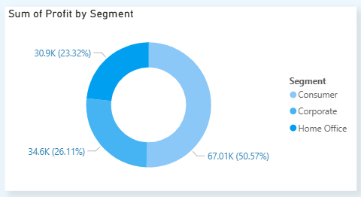
Q4 : Which customer segment generates the highest profit?
The Consumer segment is the most profitable, contributing approximately 50.57% of total profit
Recommendation:
The company should maintain strong engagement with Consumer customers while developing targeted strategies to increase profitability in the Corporate and Home Office segments.

Slide 6
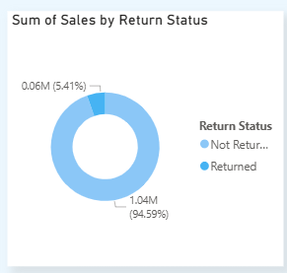
Q5: > What percentage of sales is associated with returned orders?
Approximately 5.41% of sales are associated with returned orders, while 94.59% are not returned.
Recommendation:
The company should investigate the main reasons for returns and identify products or categories with unusually high return rates to reduce potential revenue loss.

Slide 7
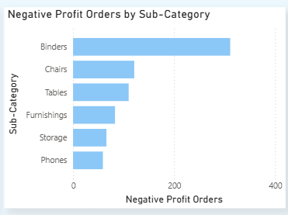
Q6: Which sub-categories have the highest number of negative-profit orders?
Binders have the highest number of negative-profit orders, followed by Chairs and Tables.
Recommendation:
The business should review pricing, costs, and discount levels for Binders, Chairs, and Tables to reduce loss-making orders..

