Slide 1

SEKE 2021
How MOOC Videos Affect Dropout? A
Lightweight Pipeline Making Student Dropout
Interpretable From Several Levels
Deming Sheng¹, Jingling Yuan^{1(✉️)}, Xin Zhang¹
School of Computer Science and Technology, Wuhan University of Technology,Wuhan 430070, China
Emails: yjl@whut.edu.cn, shengdeming@whut.edu.cn

Slide 2
1
Introduction
2
Proposed Model
3
Experiments
4
Conclusion

Slide 3


1
Introduction
We simplify the MOOC dropout problem and describe some preliminary to make the pipeline interpretable. After that, we explore data analysis, feature engineering, model selection, model metrics and visualization as design parameters in the context of our lightweight pipeline. In the end, our pipeline achieves 69.52% AUC, 0.744 R-squared and 0.553 -squared with 0.982s inference time on the 20238 sample student data.
We adopt two interpretable models to provide in-depth insights into students dropout at several levels. Besides, we visualize the probability estimation and change trend of predicted label linked to feature values to longitudinally interpret the sample student behaviours.
We devise a deterministic finite automaton to construct the complete student behaviours, which overcomes the inherent limitation of the student engagement time. Moreover, we find that shorter videos and instructors speak fast is more engaging, which enables instructors to adjust MOOC videos for future education.

Slide 4
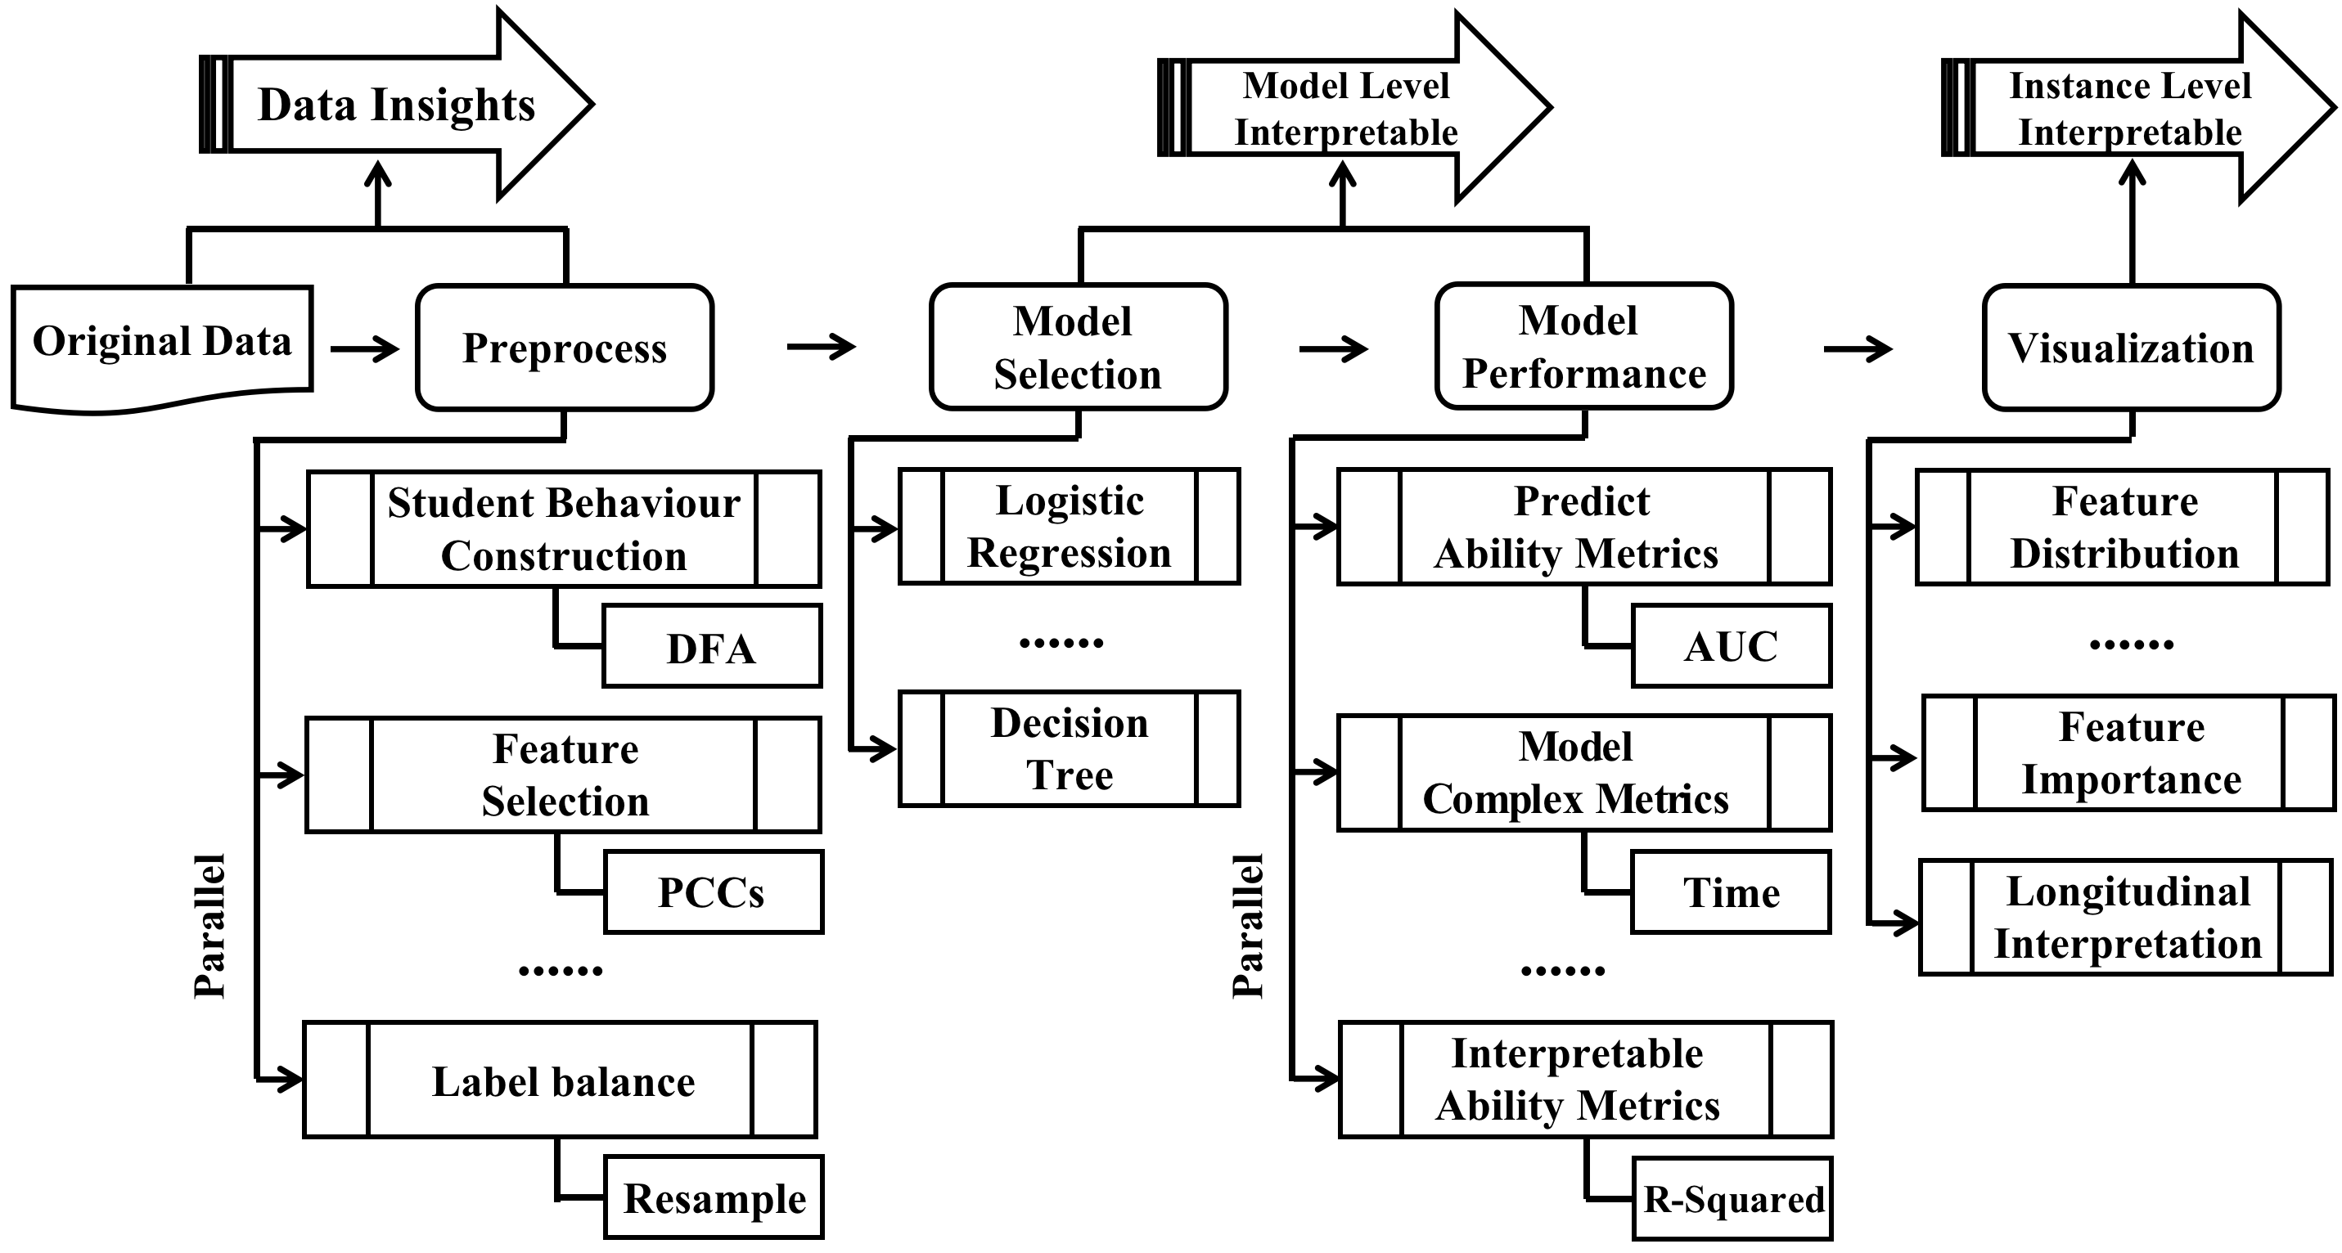
2
Proposed Model

Slide 5
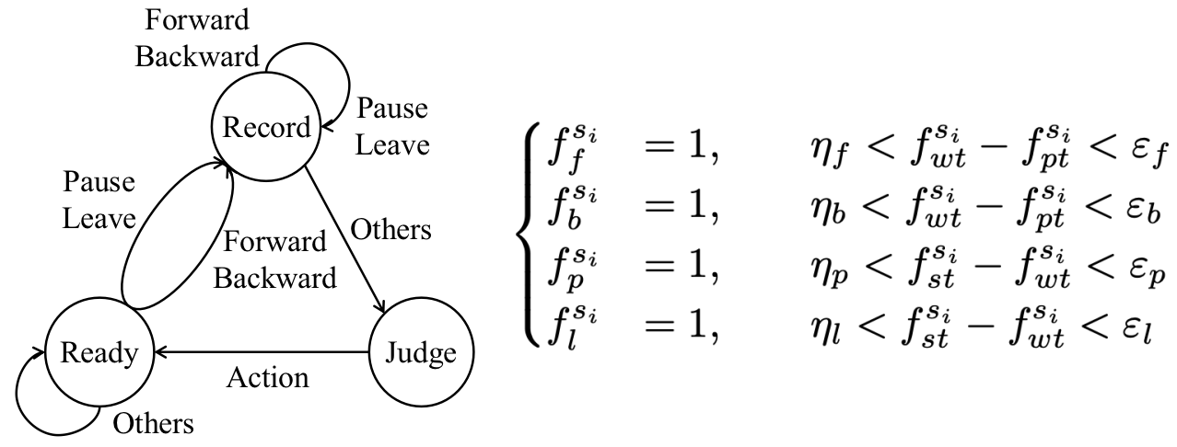
2
Proposed Model
Data Processing and Feature Engineering

Slide 6
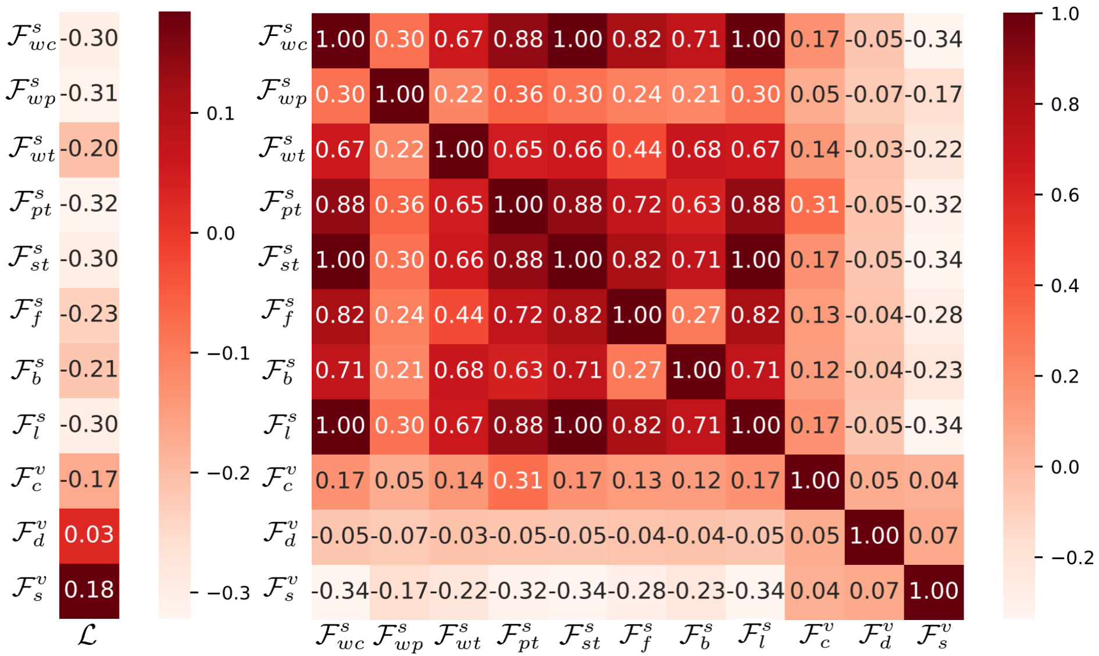
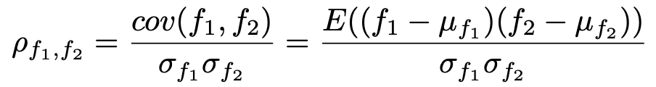
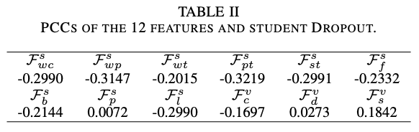
2
Proposed Model
Data Processing and Feature Engineering

Slide 7
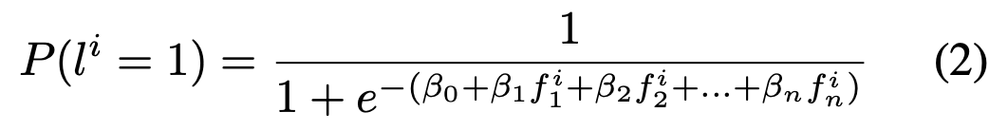
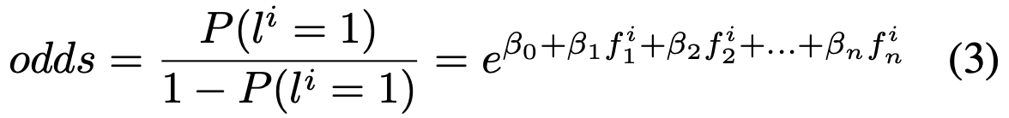
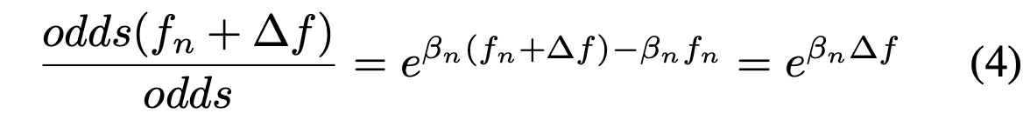
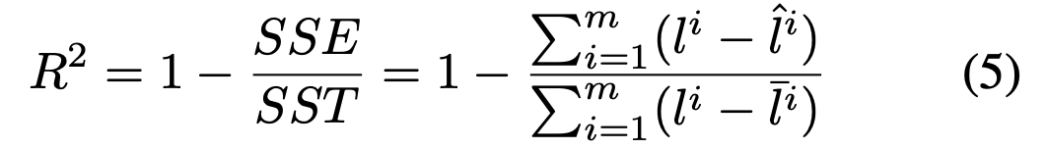
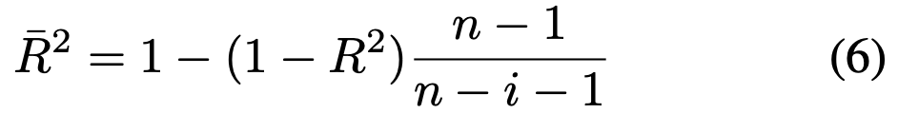
3
Experiments
Logistic Regression Model

Slide 8
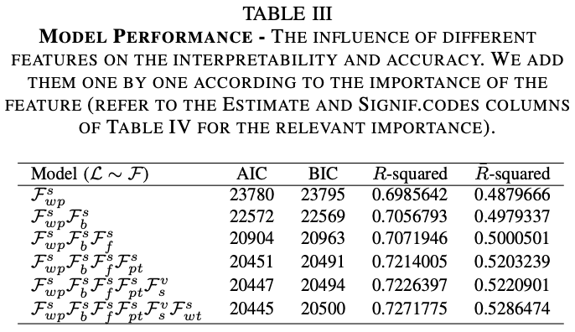
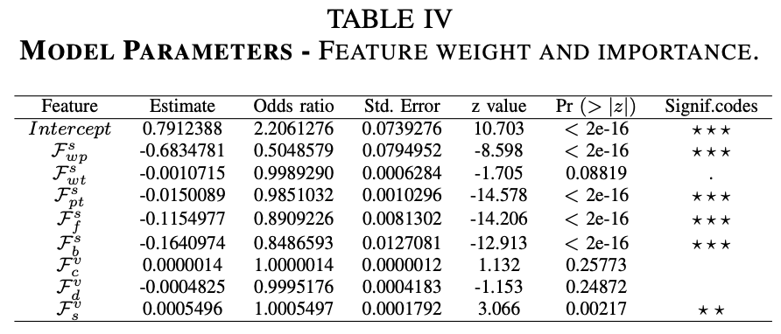
3
Experiments
LR Model Level Interpretation

Slide 9
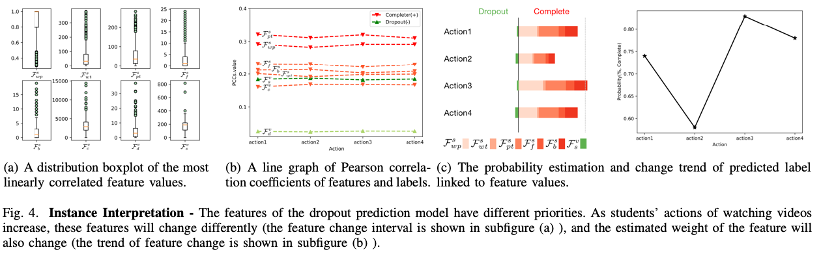
3
Experiments
LR Instance Level Interpretation

Slide 10
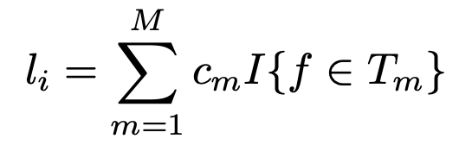
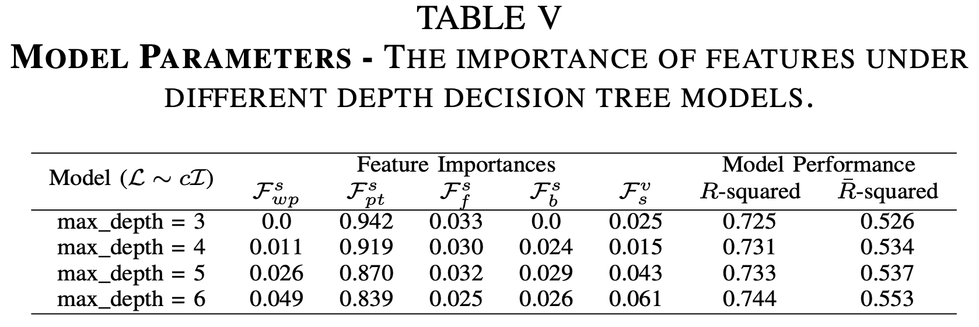
3
Experiments
DT Model Level Interpretation

Slide 11
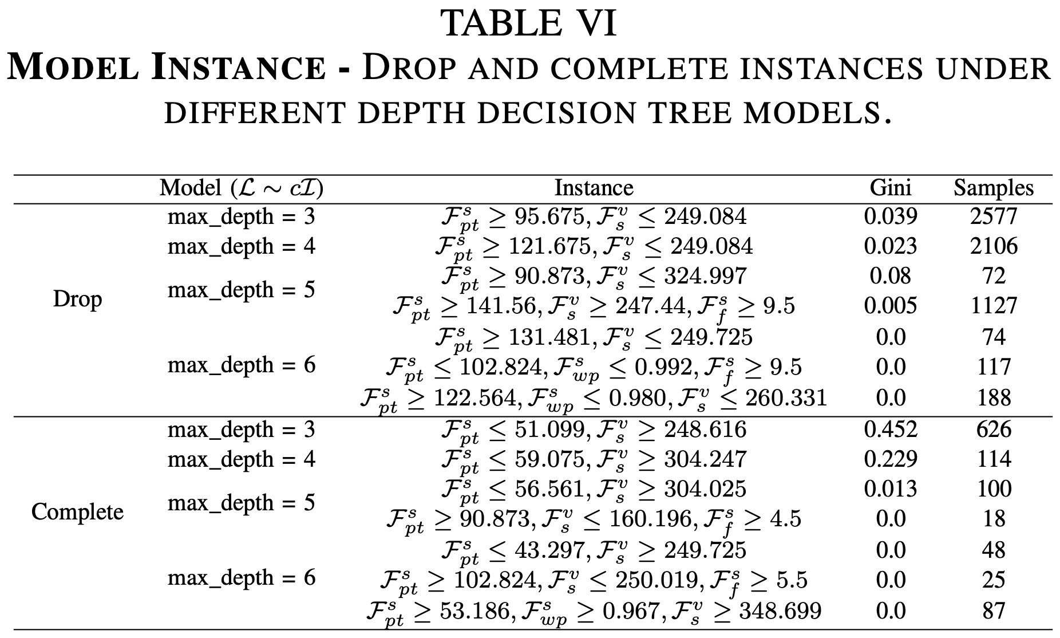
3
Experiments
DT Instance Level Interpretation

Slide 12
4
Conclusion
Our lightweight pipeline begins with interpretable features, we employ a deterministic finite automaton to construct the complete student behaviours and we adopt a direct and effective strategy to extract the course features. We do our utmost to simplify the MOOC dropout problem, grasp the core features through two interpretable models. In the end, the student's dropout behaviour is explained at several levels, which enables instructors and video producers to make the most of online videos for future education.

Slide 13
SEKE2021
Thanks for your listening
Reporter：Deming Sheng

