Slide 1

SEKE2021
Grasping or Forgetting? MAKT: A Dynamic Model via Multi-head Self-Attention for Knowledge Tracing
Deming Sheng¹, Jingling Yuan^{1(✉️)}, Xin Zhang¹
School of Computer Science and Technology, Wuhan University of Technology,Wuhan 430070, China
Emails: yjl@whut.edu.cn, shengdeming@whut.edu.cn

Slide 2
1
Introduction
2
Proposed Model
3
Experiments
4
Conclusion

Slide 3

1
Introduction
We customize a multi-head self-attention layer to model individualization, positional encoding rather than the traditional RNN-based model is utilized to capture sequence information.
We perform extensive experiments on three different datasets and demonstrate that MAKT in addition to showing its robustness and superiorities, supports parallel computing.
We visualize attention weights and student knowledge acquisition tracking, offer intuitive and in-depth insights on the predicted result at both the model and instance level.

Slide 4
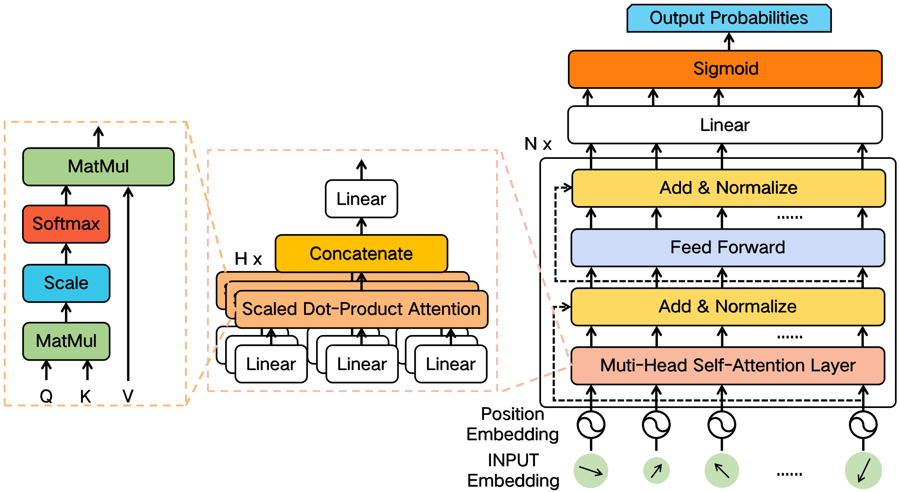
2
Proposed Model
Model of MAKT

Slide 5




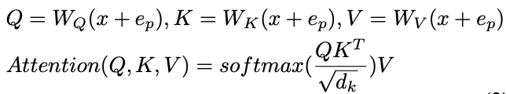
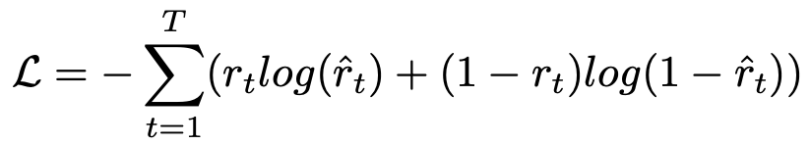


2
Proposed Model
Model of MAKT
Input Embedding
Feed Forward Network
Position Embedding
Objective Function
Self-Attention
Multi-head Attention
Add & Norm

Slide 6
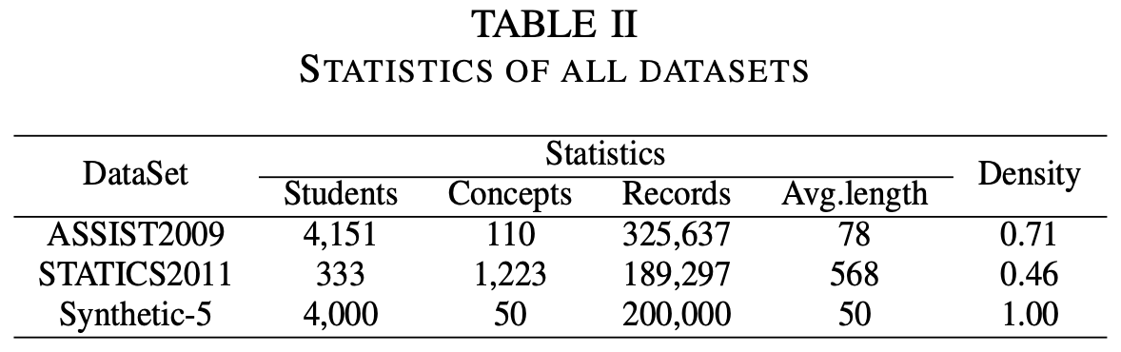
3
Experiments
Statistics of the original dataset
We adopt two real-world public datasets (ASSIST2009 & STATICS2011) and one synthetic dataset (Synthetic-5) to show the effectiveness of MAKT.

Slide 7
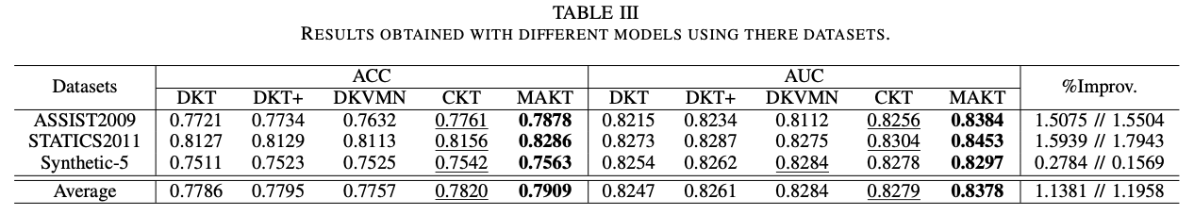
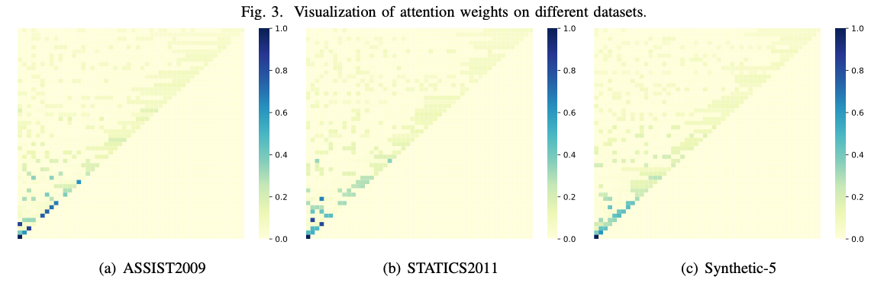
3
Experiments

Slide 8
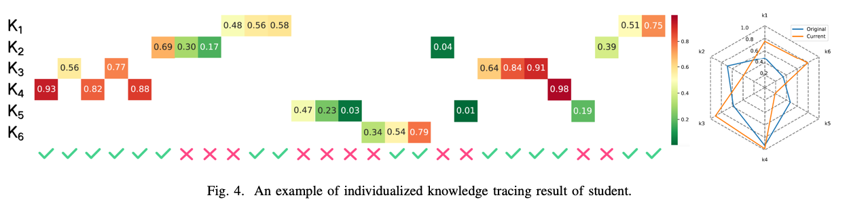
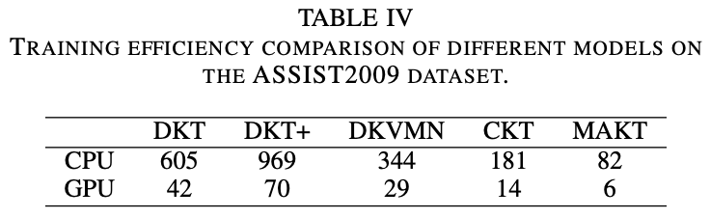
3
Experiments

Slide 9
4
Conclusion
In this paper, we propose a multi-head self-attention based model named MAKT for dynamic knowledge tracing. Specifically, MAKT leverages the historical learning interactions to effectively predict student performance on future exercises and dynamically track the student knowledge state. Simultaneously, MAKT has excellent interpretability and high training efficiency owing to the multi-head self-attention layer, which can offer insights from different levels and support parallel computing. In the end, extensive experimental results demonstrate that MAKT outperforms other baseline models in both ACC and AUC metrics on three different datasets, which indicates the robustness and superiorities of MAKT.

Slide 10
SEKE2021
Thanks for your listening
Reporter：Deming Sheng

