Slide 1

CSCWD2021
An Efficient Long Chinese Text Sentiment Analysis Method Using BERT-Based Models with BiGRU
Deming Sheng¹, Jingling Yuan^{1(✉️)}
School of Computer Science and Technology, Wuhan University of Technology,Wuhan 430070, China
Emails: yjl@whut.edu.cn, shengdeming@whut.edu.cn
Notes:
Thanks for organizing a virtual conference. It's my great honor to have this opportunity to share our work through this video. If you have any questions, you can contact me through the email on the slide. The topic of our paper is “An Efficient Long Chinese Text Sentiment Analysis Method Using BERT-Based Models with BiGRU”.

Slide 2
1
Introduction
2
Proposed Model
3
Experiments
4
Conclusion
Notes:
The outline of my presentation as this, the first part I want to introduce our main contributions, the second part illustrates our proposed method, the following is an analysis of the experiment results of our paper. In the end, a simple conclusion is given.

Slide 3
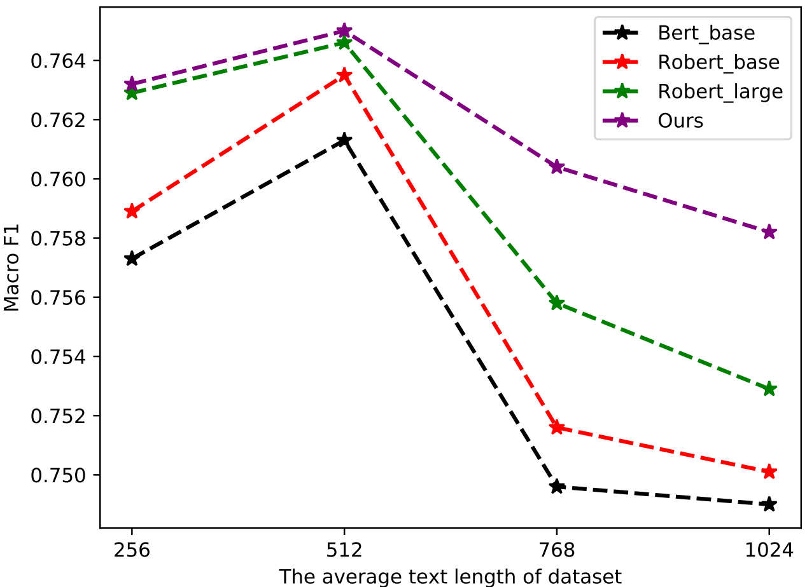
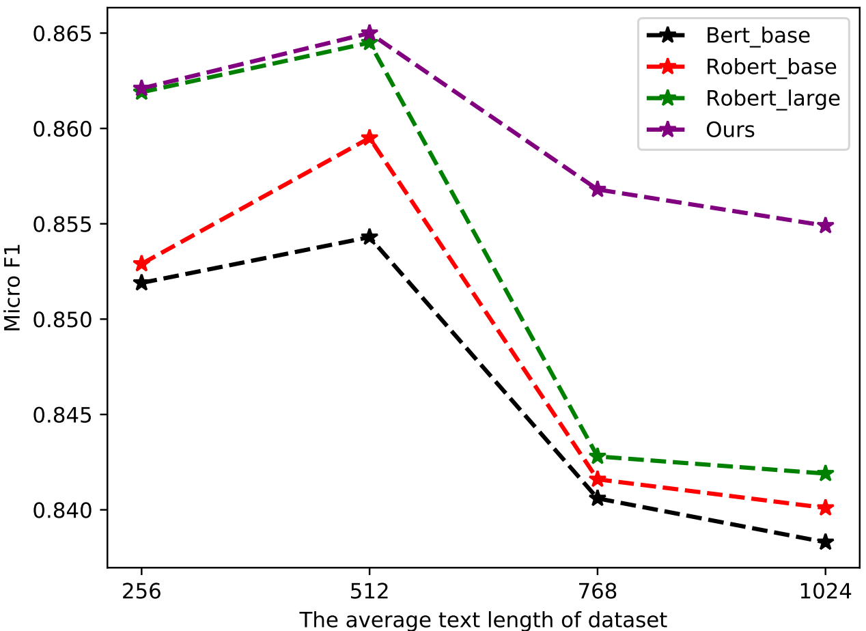
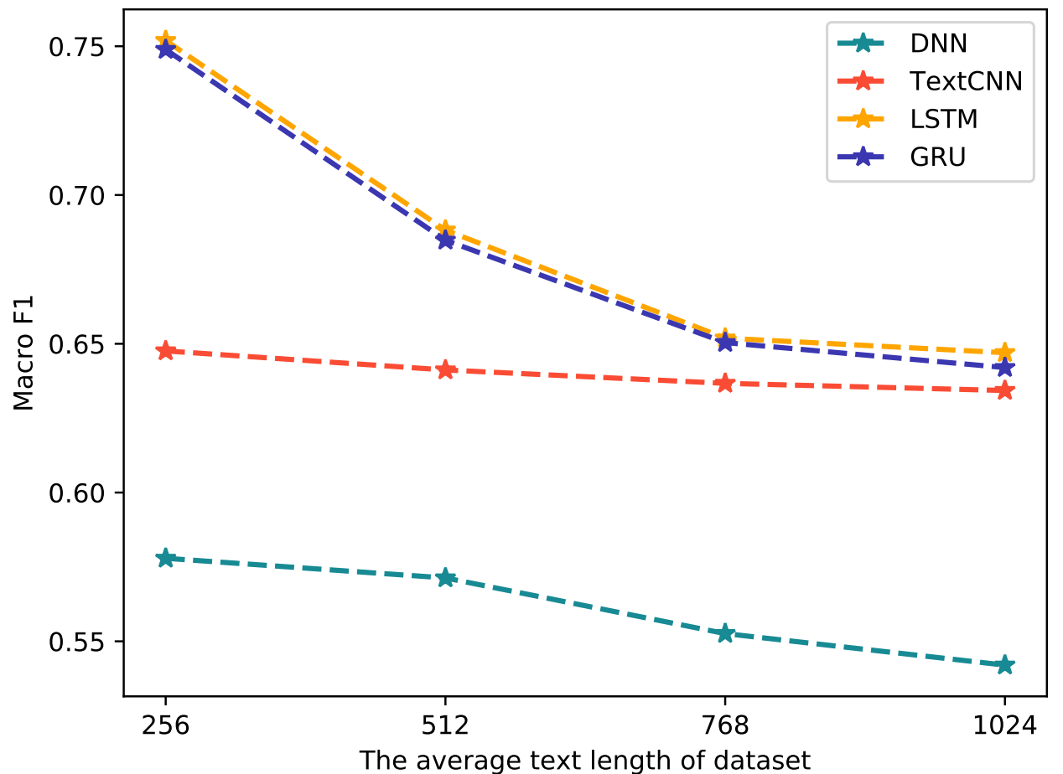
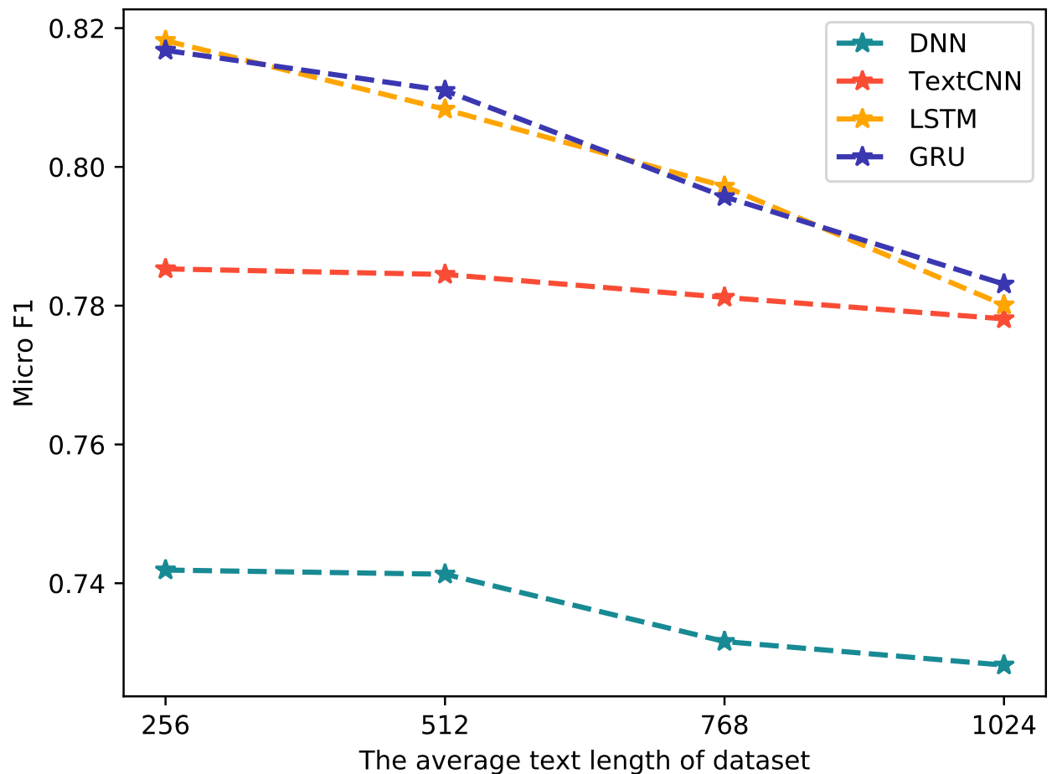
1
Introduction
The performance of different models in long Chinese text sentiment analysis
Our model & SOTA models
Traditional models.
Notes:
Sentiment analysis is an increasingly crucial task in natural language processing (NLP), for it is widely applied in more and more fields, such as opinion mining, dialogue generation, and user portrait construction.
However, recent research still focuses on sentiment analysis of sentences or short texts, which is being disconnected from the growing text.
Traditional sentiment analysis models for short text have achieved great success in recent years.
And more recently, the pre-trained language models , such BERT and RoBERT, have reached state-of-the-art in various natural language processing (NLP) tasks with multiple datasets.
Unfortunately, we can infer from Fig that both traditional and state-of-the-art models suffer a weak performance as the text length increases.

Slide 4
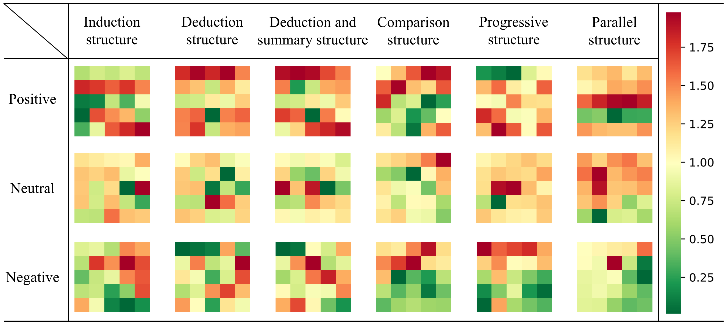
1
Introduction
Chinese article structures
The six most common Chinese article structures.
Each block represents a prediction of a part in the whole article.
Notes:
Long text sentiment analysis faces many difficulties, one of them is the sudden increase in time and resource costs caused by the excessive input mentioned above, and even the phenomenon of gradient disappearance and gradient explosion.
Besides, the most notable of which is how to obtain effective core sentiments without falling into certain local irrelevant sentiments, for long texts often contain multiple sentiments and diverse emphases.
The existing long-sequence processing schemes such as truncation and random sampling can not effectively deal with the complex and changeable structures of the Chinese article in Fig. How to effectively acquire each partial sentiment and learn the relationship between them, that is, learn the structure of articles to combine the sentiment of each part as the core emotional tone is a huge challenge.

Slide 5
1
Introduction
Main contributions
We propose a BERT-based fusion model to better capture the whole long Chinese text sentiment. Our model adopts BERT-based models as base classifiers to obtain each partial sentiment, and leverages a BiGRU network to learn the complex and changeable structures of Chinese articles and further fuses N BERT-based models results, finally utilizes an attention layer to enhance core sentiments of the long Chinese texts. The experimental result shows our method outperforms the traditional and state-of-the-art models.
We devise a new truncation method to gain four types of embeddings for long Chinese text sentiment analysis. By calculating the TFIDF of each word in the whole text, we successfully extract five keywords as a reference for the global sentiment. And then we transfer the attached label into Chinese word as label embedding with the above title embedding, keywords embedding and the truncated sub-content embedding to joint put into BERT-based models.
We adopt three ensemble algorithms to improve the performance of our model. With the enhancement of ensemble algorithms, both Macro and Micro F1 has ameliorated. Meanwhile, we compare the effects of different truncation methods and ensemble algorithms on the experiment.

Slide 6
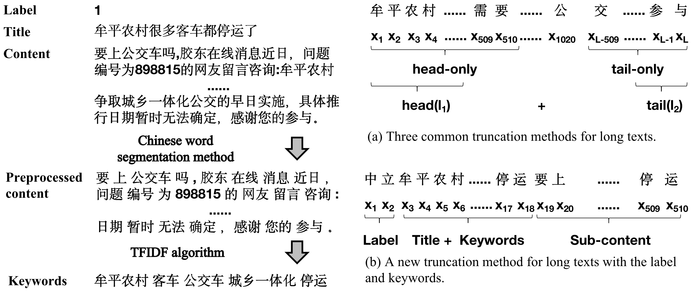
2
Proposed Model
Data preprocessing
Notes:
Since the maximum sequence length of BERT is 512, we need to preprocess the long texts.
As shown in the Fig, for a long text input, there are generally the following three types of truncation methods to adapt BERT fine-tuning:
head-only select the first 510 tokens
tail-only select the last 510 tokens
head+tail: empirically select the first l1 and the last l2 tokens, where l1 + l2 less than or equal to 510.
we adopt the TFIDF algorithm to extract the first five core keywords of Weibo articles as a reference for the global sentiment.
Under the restriction of BERT's 510 tokens, we truncate the long text as shown in the subfig b.

Slide 7
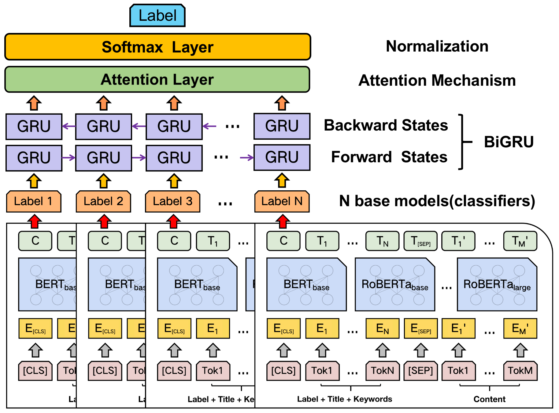
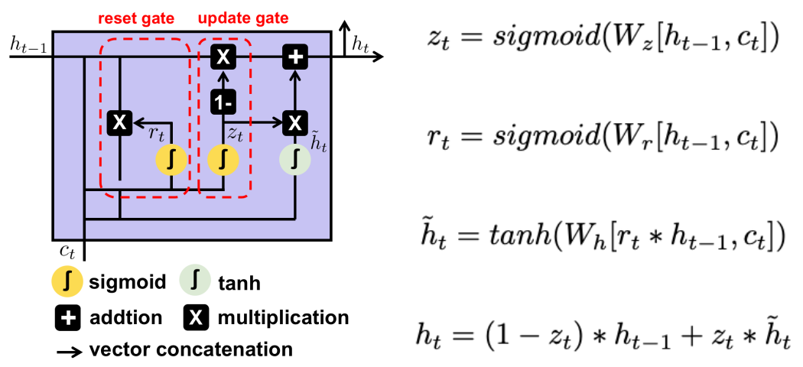
2
Proposed Model
Framework
Notes:
The framework we propose approach is showed in Fig, which mainly consists of three parts.
The first part is base models or base classifiers. In this part, we adopt some BERT-based models to get N preliminary results after preprocessing.
The second part is model fusion. In this part, we utilize a BiGRU network to fuse N base models.
The last part is attention mechanism. In this part, we employ an attention layer to enhance the output of the above BiGRU and a softmax layer to normalize the result.

Slide 8
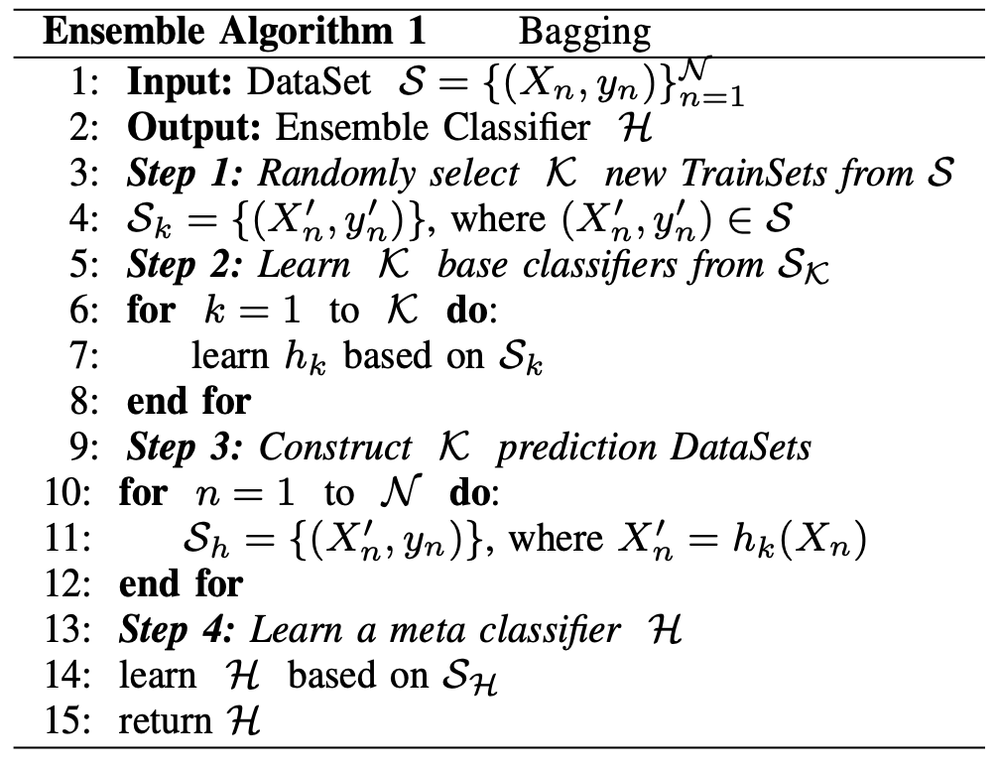
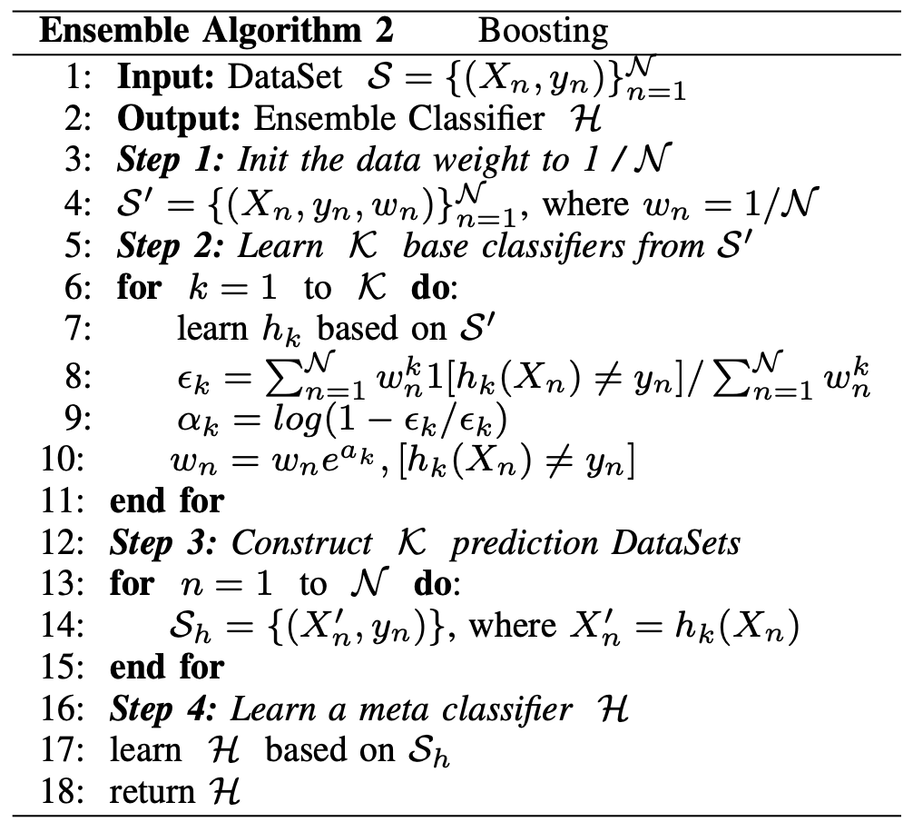
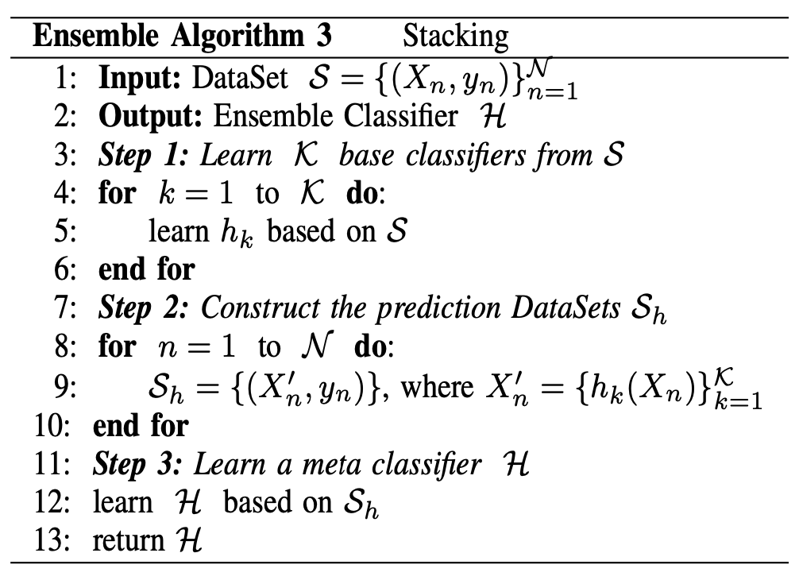
2
Proposed Model
Ensemble Algorithms
Notes:
Ensemble learning has been shown to significantly improve the results of various machine learning tasks by combining several base models.
Ensemble learning can be divided into two groups: homogenous ensemble learning and heterogeneous ensemble learning.
The typical representatives of homogenous ensemble learning are bagging and boosting, while heterogeneous ensemble learning is stacking.

Slide 9
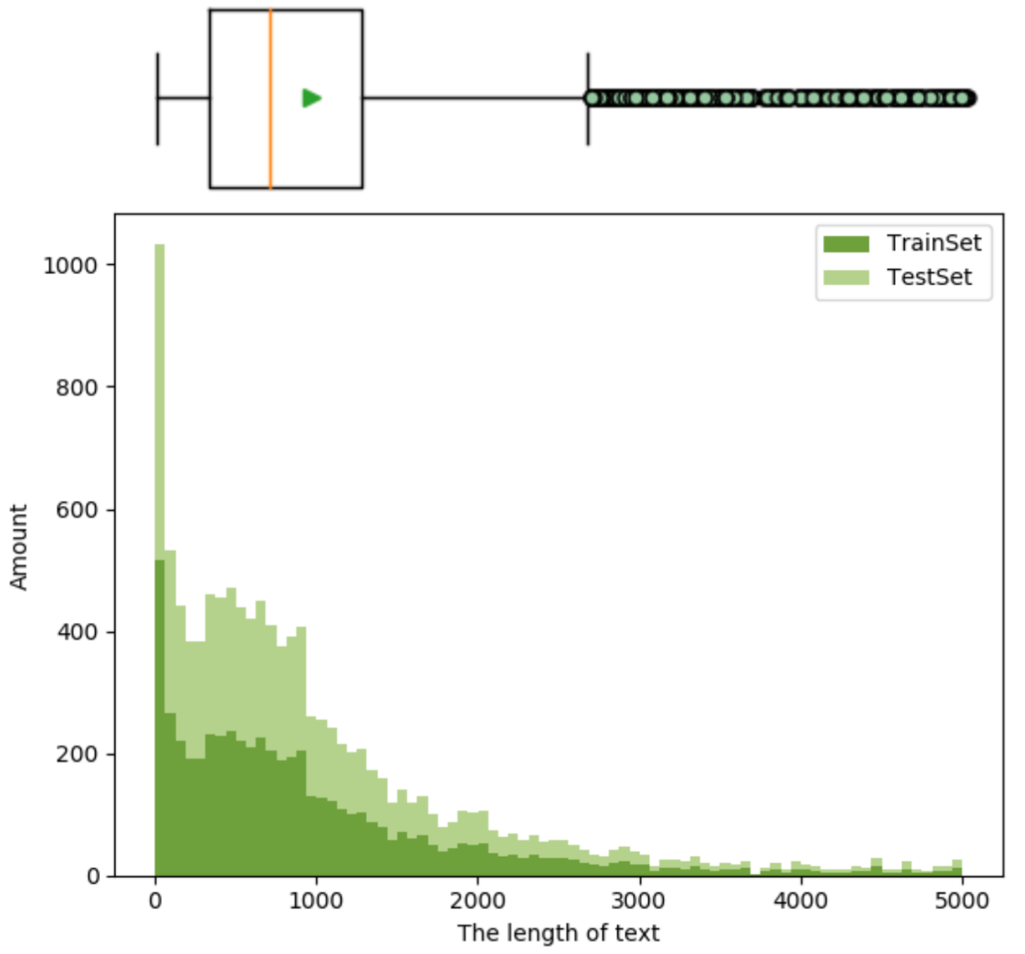
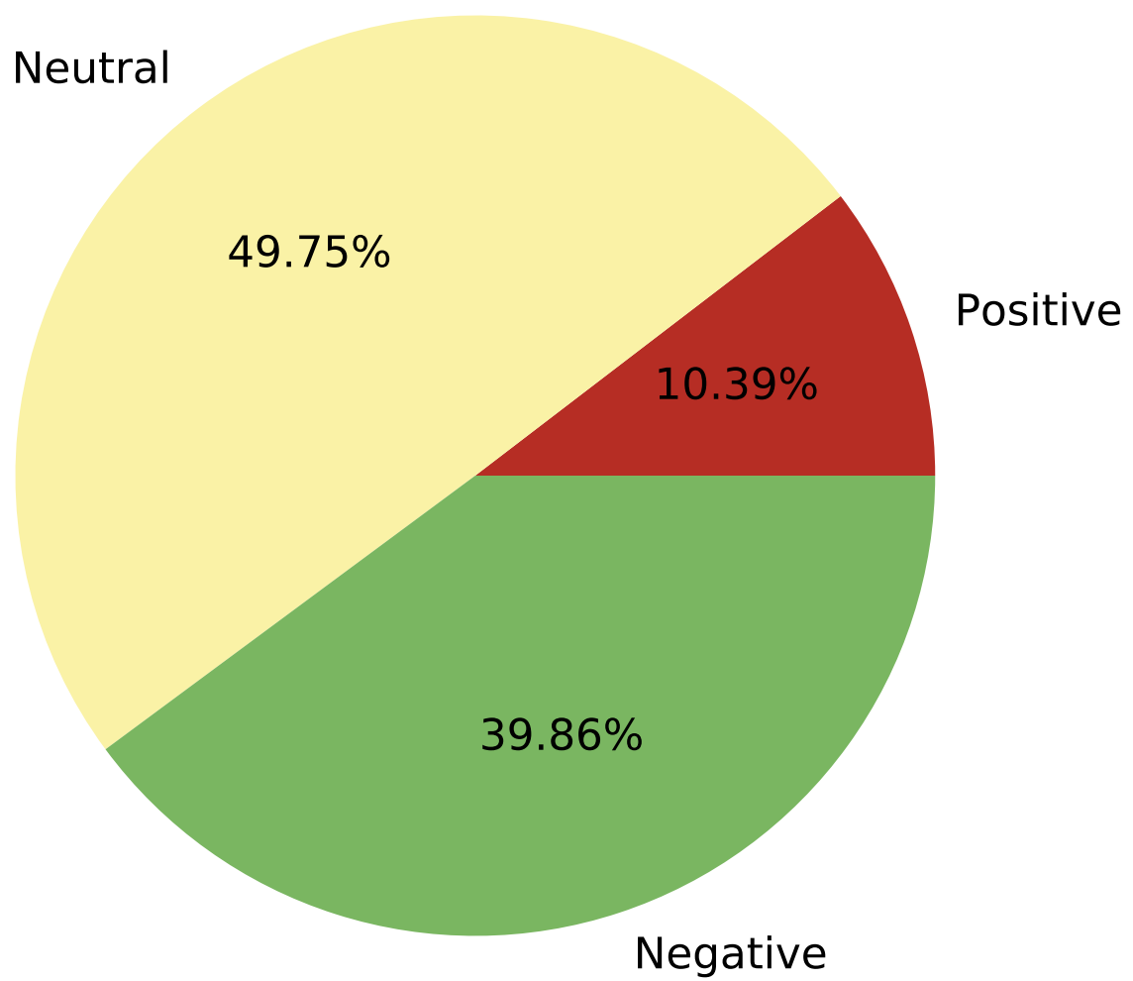

3
Experiments
Statistics of the original dataset
Notes:
Fig.6 shows the statistics of the original dataset, we construct training and testing datasets by randomly spliting the original dataset at a ratio of 8:2.
Notably, almost all the Chinese texts are beyond the maximum token length of BERT-based models.
Moreover, we can figure that the label samples of the dataset are obviously imbalanced, with the most neutral samples and the least positive samples.
Class imbalance is a well documented problem in machine learning, where the presence of imbalance can bias a predictor to output the majority class.
Therefore, here we resample the data to alter the distribution of labels in the dataset.

Slide 10
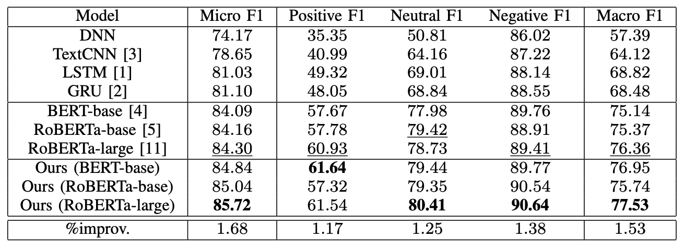
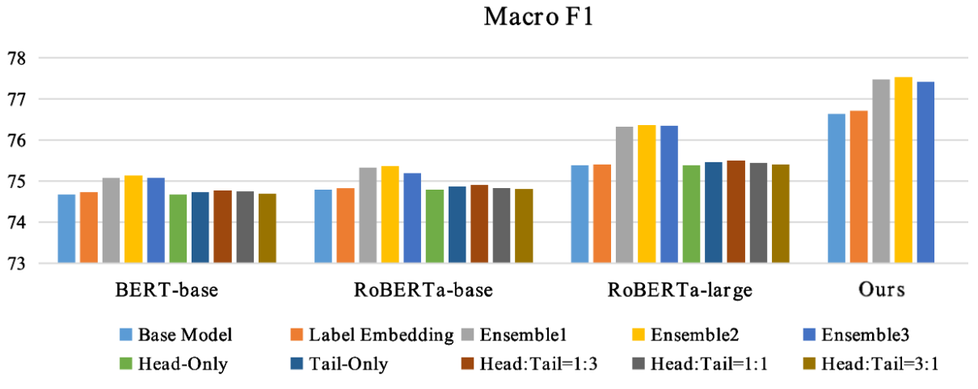
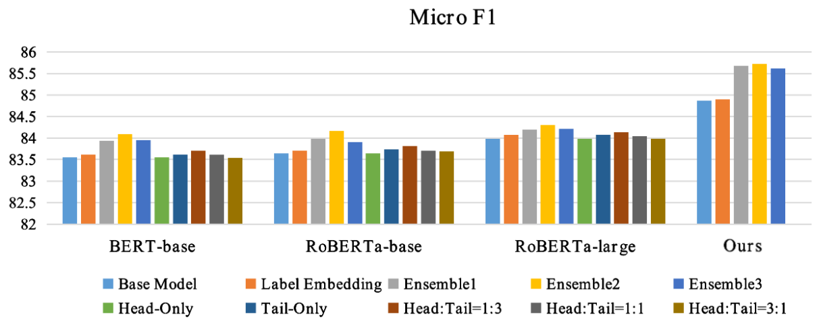
3
Experiments
Overall performance comparison
Notes:
As shown in the fig, we can see that:
Traditional models do not have advantages in sentiment analysis tasks of long Chinese texts, whether in training speed or accuracy.
BERT-based models have smoothly learned the four embeddings extracted by our truncation method and obtained preliminary ordered sub-result vectors.
The BiGRU network can efficiently fusion a series of ordered sub-result vectors to obtain the global sentiments of long Chinese texts.
More importantly, attention mechanism accurately captures core sentiments without falling into certain local irrelevant sentiments.
The truncation method for long texts we proposed is better than other traditional methods.
Ensemble learning does significantly improve the results of long texts sentiment analysis by combining several base models.

Slide 11
4
Conclusion
In this paper, we propose a BERT-based fusion model to solve long Chinese text sentiment. A new truncation method is devised to obtain four embeddings for further training as well as data is resampled to mitigating the imbalanced label. Then, we utilize a BiGRU network to fuse BERT-based models and an attention layer to obtain effective core sentiments of the long Chinese texts. What's more, three ensemble algorithms are adapted to improve the performance of our model. Experimental results show that our model keeps competitive accuracy compared with state-of-the-art methods along with our truncation method outperforms traditional methods.

Slide 12
CSCWD2021
Thanks for your listening
Reporter：Deming Sheng

