Slide 1

KSEM2020
MOOCRec: An Attention Meta-path Based
Model for Top-K Recommendation in MOOC
Deming Sheng¹, Jingling Yuan^{1(✉️)}, Qing Xie¹, and Pei Luo¹
School of Computer Science and Technology, Wuhan University of Technology,Wuhan 430070, China
Emails: yjl@whut.edu.cn, shengdeming@whut.edu.cn
Notes:
Thanks for organizing a virtual conference. It's my great honor to have this opportunity to share our work through this video. If you have any questions, you can contact me through the email on the slide. The topic of our paper is “MOOCRec: An Attention Meta-path Based Model for Top-K Recommendation in MOOC”.

Slide 2
1
Introduction
2
Proposed Model
3
Experiments
4
Conclusion
Notes:
The outline of my presentation as this, the first part I want to introduce our main contributions, the second part illustrates our proposed method, the following is an analysis of the experiment results of our paper. In the end, a simple conclusion is given.

Slide 3

1
Introduction
We collect and collate a MOOC dataset containing course details and user reviews of the course. By calculating the TF-IDF of each word in the whole course information, we successfully extract a Knowledge Points Set. And then we designed different meta-paths in the HINs to capture rich context information for offering abundant course resources.
We propose an attention meta-path recommendation model named MOOCRec to accommodate students dynamics and diverse preferences. MOOCRec lever_x0002_ages both explicit and implicit relationships to better model the preference of students. In addition, after reconstructing HINs and redesigning meta-paths in Movielens, MOOCRec shows the potential for excellent versatility.
We devise a collaborative attention mechanism under MOOC to better un_x0002_derstand what factors affect student preferences effectively. With the en_x0002_hancement of different embedding methods, the performance of MOOCRec has improved and exceeded the traditional model.
Notes:
With the surge of the courses and users on Massive Open Online Courses (MOOC), MOOC has accumulated rich educational data. However, the utilization of MOOC resources is not high enough to satisfy the dynamic and diverse demands of different individuals. Meanwhile, the traditional recommendation model for MOOC dataset underperforms in both precision and recall. To address those issues, we collect and collate a MOOC dataset and then propose an attention meta-path based recommendation model named MOOCRec to jointly learn explicit and implicit relationships between students and courses. By extracting the knowledge points of the whole course information, we successfully construct different heterogeneous information networks(HINs) in MOOC and then we elaborately design multiple meta-paths based context to exploit the heterogeneity of other HINs in MOOC, which enables MOOCRec to offer abundant course resources. In particular, we leverage three attention mechanisms under MOOC to further enhance factors that effectively influence student preferences to improve the precision of our model. What's more, we adopt another classical dataset called Movielens, reconstruct HINs and redesign meta-paths to demonstrate that the extensive availability of MOOCRec.

Slide 4
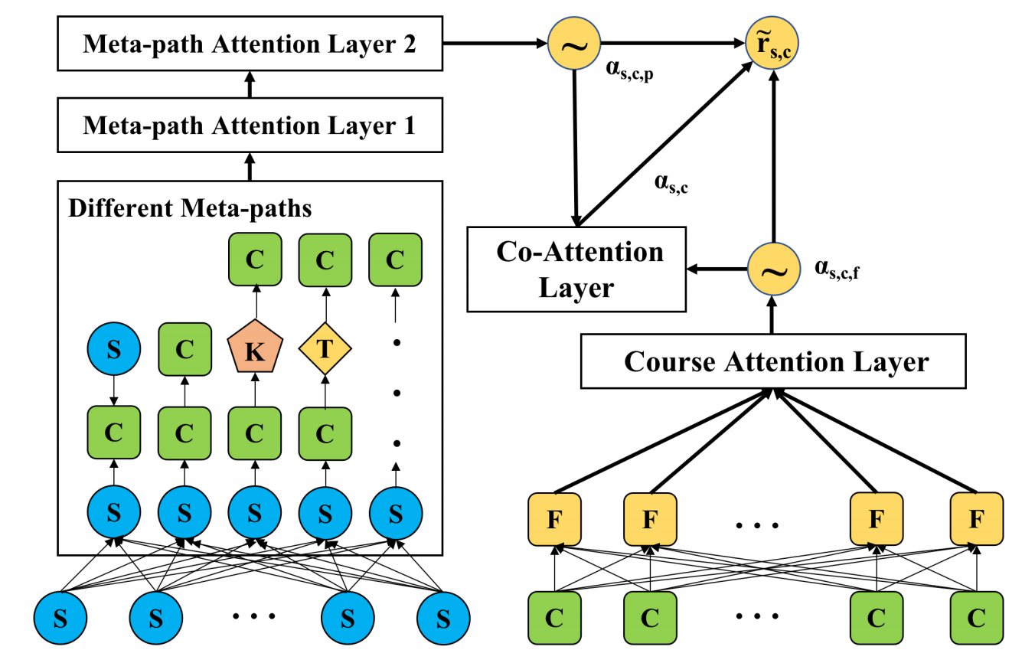
2
Proposed Model
Course Embedding
Meta-path Embedding
Attention Mechanism
Notes:
The framework we propose approach is showed in the figure. This framework includes three parts. The first part is course embedding. In this part, we take the information crawled by MOOC websites and the extracted knowledge points as explicit features. The second part is meta-path embedding. In this part, we devise a series of different meta-paths to capture implicit features, which enables our model to recommend abundant course resources. The last part is the attention mechanism. In the last part, we utilize the attention mechanisms to better model student preference and explore the effects of explicit and implicit features on the final result.

Slide 5
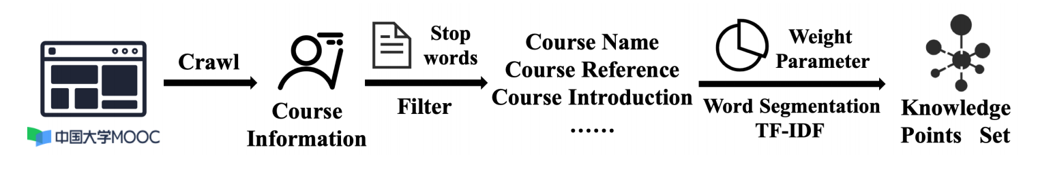
2
Proposed Model
Knowledge Points Extraction
Knowledge points refer to a set of key knowledge of each course. The process of extracting knowledge points is shown in the above figure. We take all the information crawled from the MOOC website as the extraction document of knowledge points. And then we filtered the results of document segmentation, added the weight parameters of each part of the document, calculated the weight of Term Frequency-Inverse Document Frequency(TF-IDF), and finally obtained the ten knowledge points of each course.
Notes:
Knowledge points refer to a set of key knowledge of each course. The process of extracting knowledge points is shown in the above figure. We take all the information crawled from the MOOC website as the extraction document of knowledge points. And then we filtered the results of document segmentation, added the weight parameters of each part of the document, calculated the weight of Term Frequency-Inverse Document Frequency(TF-IDF), and finally obtained the ten knowledge points of each course.

Slide 6
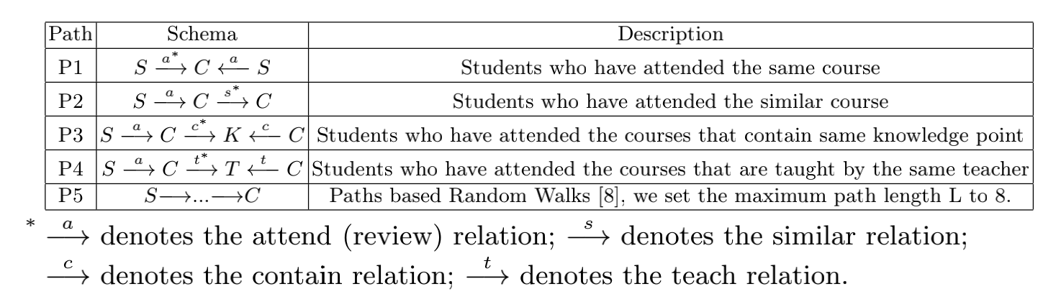
2
Proposed Model
Meta-paths in MOOC HINs
Notes:
As shown in the above table, we have elaborately designed several different meta-paths to mine the implicit connections between students and courses. The essence of a student choosing a course is to choose the knowledge point he needs, the recommendation of his classmates or some teachers he prefers. Therefore, we select four types of nodes: courses, users, knowledge points and teachers, respectively. For Movielens, meta-paths are UMMM, UUUM, UMTM, and UMUM. U represents user, M represents movie and T represents the type of movie.

Slide 7
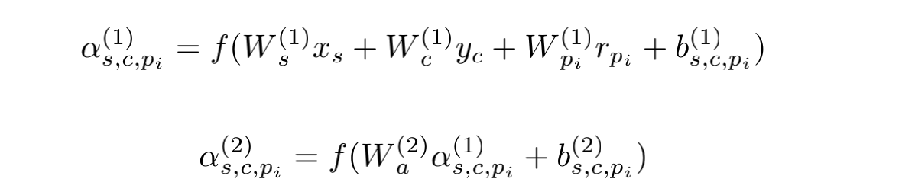
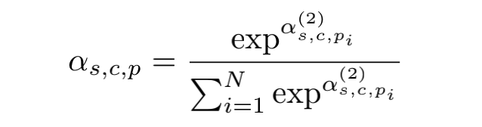
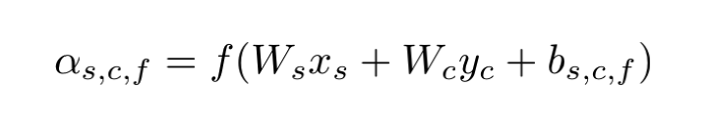

2
Proposed Model
Attention Mechanism
Attention for meta-path
Attention for course
Co-Attention
Notes:
To further enhance the implicit relationships, here we adopt two meta-path attention layers to weight student embedding xs, course embedding yc, and relation embedding rp for a specified meta-path pi in Table1: At last, we utilize the softmax function to normalize the above $\alpha{^{(2)}_{s,c,p}}$
Due to the limitation of MOOC, we cannot collect more information of users, so we choose the characteristic information of the course, including the teachers and ten main knowledge points. Here we adopt a course attention layer to figure out which explicit feature matters most:
With the attention for meta-path and course features, both implicit and explicit features are enhanced. Naturally, we leverage a co-attention layer to capture them jointly:

Slide 8
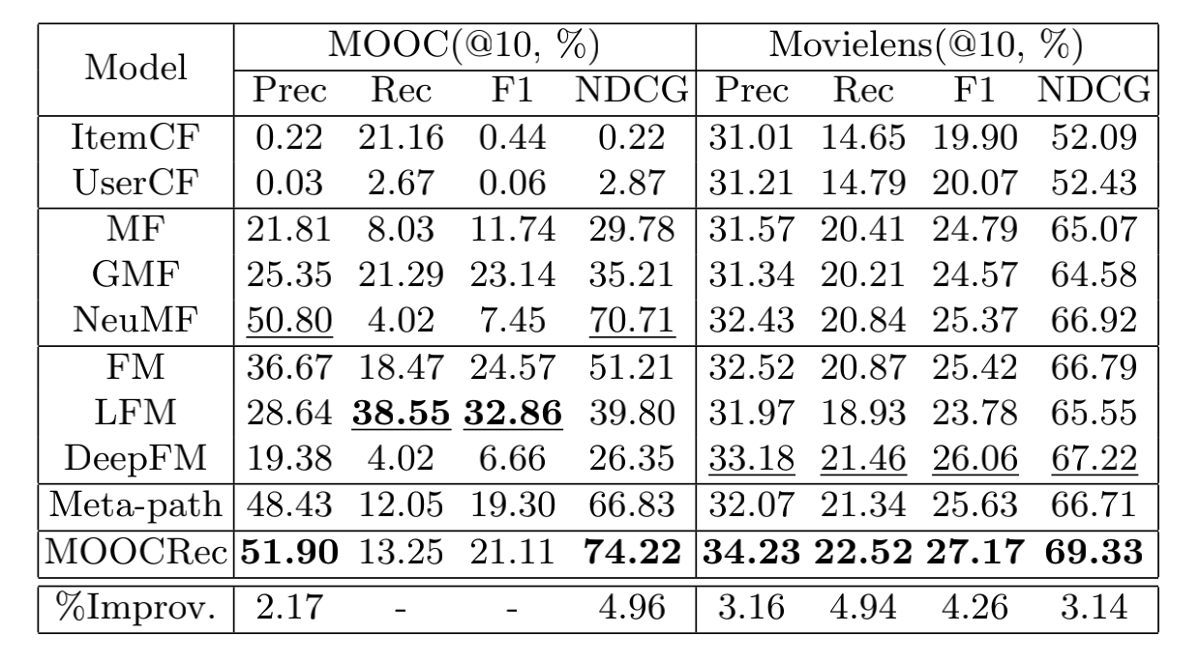
3
Experiments
Notes:
As shown in Table, we collect and collate a MOOC dataset and adopt another classical dataset named Movielens to demonstrate the effectiveness and extensive availability of MOOCRec. To illustrate the effectiveness of our model, we consider four kinds of recommendation methods: CF-based (ItemCF and UserCF), Model-based (MF, GMF and NeuMF), Generic feature-based (FM, LFM and DeepFM), Path-based (Meta-path).
We can see that Meta-path is much better than the methods based on leveraging explicit relationships in cases where there are not many cross-links between users and items. Compared to the Meta-path based method, MOOCRec has successfully integrated the features of the course itself, performing even better with the attention mechanism we designed. We can draw the conclusion that a mutual enhancement way can better model student preference.
We design a series of different meta-paths to try to provide students with a richer variety of courses, but we still found that MOOCRec did not perform well on the recall value. It is worth noting that the Meta-path based model also suffers the same problem of low recall value. We suspect that many students may tend to choose those popular courses with high reputation, and then MOOCRec will focus more on those courses under our attention mechanisms. In the end, the recall rate comes down while improving precision. At the same time, this is also in line with the characteristics of our MOOC dataset: the number of students is much larger than the number of courses, and on average each student only chooses a certain course.

Slide 9
4
Conclusion
We propose an attention meta-path based recommendation model for users' dynamic and diverse preferences. We adopt three attention mechanisms to enhance different embeddings, furthering improving the performance of MOOCRec. Unfortunately, due to the lack of information on MOOC users, we can't further analyze the impact of user information on the MOOC dataset recommendation effect. For future work, we would like to expand our MOOC dataset to collect multiple kinds of contextual information, build a Knowledge Graph and explore how to incorporate knowledge graph into the recommendation on our MOOC dataset. In addition, we also want to explore the performance impact of different embedding methods on recommendation.
Notes:
We propose an attention meta-path based recommendation model for users' dynamic and diverse preferences. We adopt three attention mechanisms to enhance different embeddings, furthering improving the performance of MOOCRec. Unfortunately, due to the lack of information on MOOC users, we can't further analyze the impact of user information on the MOOC dataset recommendation effect. For future work, we would like to expand our MOOC dataset to collect multiple kinds of contextual information, build a Knowledge Graph and explore how to incorporate knowledge graph into the recommendation on our MOOC dataset. In addition, we also want to explore the performance impact of different embedding methods on recommendation.

Slide 10
KSEM2020
Thanks for your listening
Reporter：Deming Sheng

