Slide 1
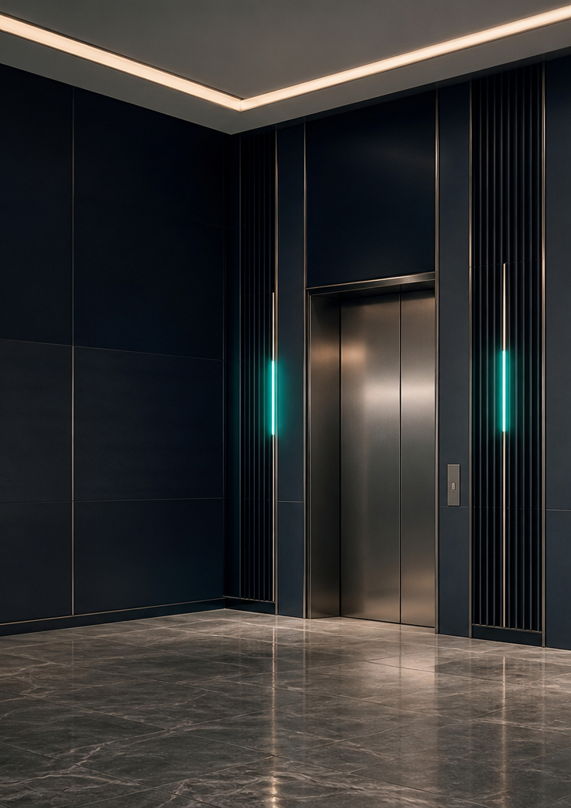

Colour
Palette
Premium Nigerian + European Engineering + Modern Architectural Lifestyle
VALUE. INNOVATION. PRESTIGE.
01 / 05

Slide 2
CORE PALETTE
A disciplined nine-colour system.
Midnight Navy
Deep Navy
Platinum Silver
#061326
RGB 6 / 19 / 38
CMYK 84 / 50 / 0 / 85
#020814
RGB 2 / 8 / 20
CMYK 90 / 60 / 0 / 92
#D8D8D4
RGB 216 / 216 / 212
CMYK 0 / 0 / 2 / 15
Primary brand background
Depth and footer panels
Premium light neutral
Warm Silver
Emerald Accent
Deep Emerald
#C9C7BF
RGB 201 / 199 / 191
CMYK 0 / 1 / 5 / 21
#168A55
RGB 22 / 138 / 85
CMYK 84 / 0 / 38 / 46
#0F5F3C
RGB 15 / 95 / 60
CMYK 84 / 0 / 37 / 63
Supporting neutral
Calls to action and highlights
Dark accent support
Pure White
Graphite
Cool Grey
#FFFFFF
RGB 255 / 255 / 255
CMYK 0 / 0 / 0 / 0
#111418
RGB 17 / 20 / 24
CMYK 29 / 17 / 0 / 91
#A8ADB3
RGB 168 / 173 / 179
CMYK 6 / 3 / 0 / 30
Space and clarity
Body text
Captions and dividers
02 / 05

Slide 3
COLOUR ROLES
A hierarchy, not a rainbow.
60%
Midnight Navy + White
Primary surfaces, major contrast and editorial breathing room.
25%
Silver + Graphite
Neutral structure, body copy, dividers and refined material cues.
10%
Deep Navy
Depth, footers, technical panels and premium layering.
5%
Emerald
Calls to action, highlights, Nigerian reference and selected emphasis.
CMYK values are approximations. Approve a physical proof for production colour.
03 / 05

Slide 4




LOGO COMBINATIONS
Use only approved contrast pairings.
White / platinum logo on Midnight Navy
Navy logo on white
White logo on Emerald
One-colour navy
One-colour black for restricted production
04 / 05

Slide 5
DO / DON'T
Contrast and restraint signal quality.
DO
DON'T
Use navy as the field colour and emerald as a precise accent.
Do not flood layouts with bright green or combine several competing accents.
Strong contrast
Generous whitespace
One clear focal point
Over-saturated fields
Weak hierarchy
Reduced premium perception
Accessibility target: WCAG AA for normal text and AAA where practical for critical safety information.
05 / 05

