Slide 1
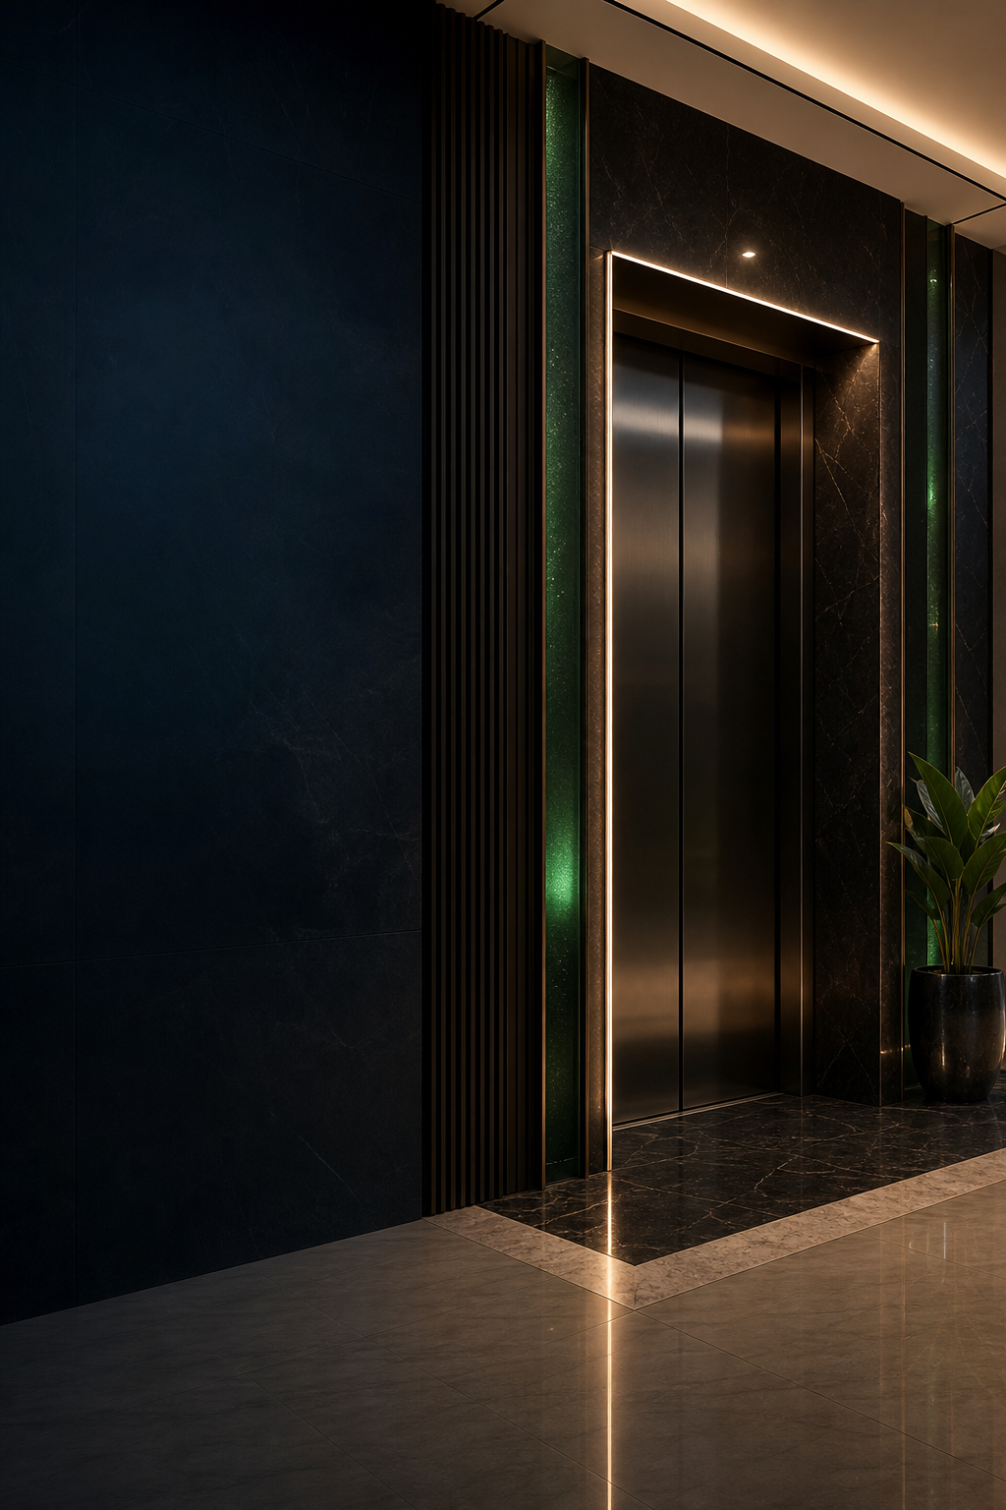

Typography
Guide
Elegant, architectural, readable.
VALUE. INNOVATION. PRESTIGE.
01 / 06

Slide 2

TYPEFACE ROLES
Three complementary voices.
Cormorant Garamond
DISPLAY SERIF
Premium headings, editorial covers and expressive quotations.
Inter
PRIMARY SANS
Body copy, specifications, proposals, quotations and interface text.
MONTSERRAT
GEOMETRIC ACCENT
Short labels, navigation, technical metadata and uppercase details.
CUSTOM LOGOTYPE
Always use supplied artwork.
Never recreate the wordmark.
02 / 06

Slide 3
HIERARCHY
Exact roles create consistent rhythm.
Role
Font / weight
Size
Tracking
Leading
H1 / Cover
Cormorant Garamond Semibold
42–56 pt
0%
0.95–1.05
H2 / Section
Cormorant Garamond Semibold
24–34 pt
0%
1.05–1.15
H3 / Subheading
Inter Semibold
14–18 pt
0%
1.15–1.25
Body
Inter Regular
9.5–11 pt
0%
1.35–1.5
Caption
Inter Regular
8–9 pt
0%
1.25–1.4
Label
Montserrat Semibold
8–11 pt
4–8%
1.1–1.2
Logo wordmark
Supplied artwork only
N/A
N/A
N/A
03 / 06

Slide 4
EXAMPLE LAYOUT
The system in use.
RESIDENTIAL MOBILITY
A lift that belongs
in the architecture.
Designed around the building. Supported for the life of the system.
VIP Lift Nigeria helps homeowners, architects and developers select lift systems that suit the site, the users and the long-term maintenance plan. Our role continues from early discussion through supply, installation, servicing and repair.
REQUEST A SITE REVIEW
Clear advice for homes, offices and public buildings.
Caption: Modern platform-lift integration with clear sightlines and restrained materials.
04 / 06

Slide 5
USAGE NOTES
Consistency is mostly restraint.
Use sentence case for most communication; reserve uppercase for short labels.
Keep body copy left-aligned and avoid over-letterspacing paragraphs.
Use generous line height and short measures for technical readability.
Limit one page or composition to three type families and a small number of weights.
Use Cormorant Garamond for headings, not dense specifications or tables.
Use supplied logo artwork; the custom wordmark is not a typeface.
Fallback system
Fallbacks are for environments where brand fonts cannot be installed. They do not replace the preferred system in master artwork.
Baskerville → display
Avenir Next → body
Arial → compatibility
05 / 06

Slide 6
DO / DON'T
Hierarchy should be visible before it is read.
DO
DON'T
A clear premium
heading
Everything the same size
ALL CAPS SUBHEADING WITH TOO MUCH TRACKING
A concise subheading creates a bridge into readable body copy.
Cramped body copy with limited line spacing makes premium communication harder to read and reduces trust. Decorative styling should never replace hierarchy.
Body copy uses comfortable leading, a practical measure and visible separation from the next content block. Labels remain short.
SMALL LABEL
Avoid too many weights, decorative effects and inconsistent alignment.
06 / 06

