Slide 1
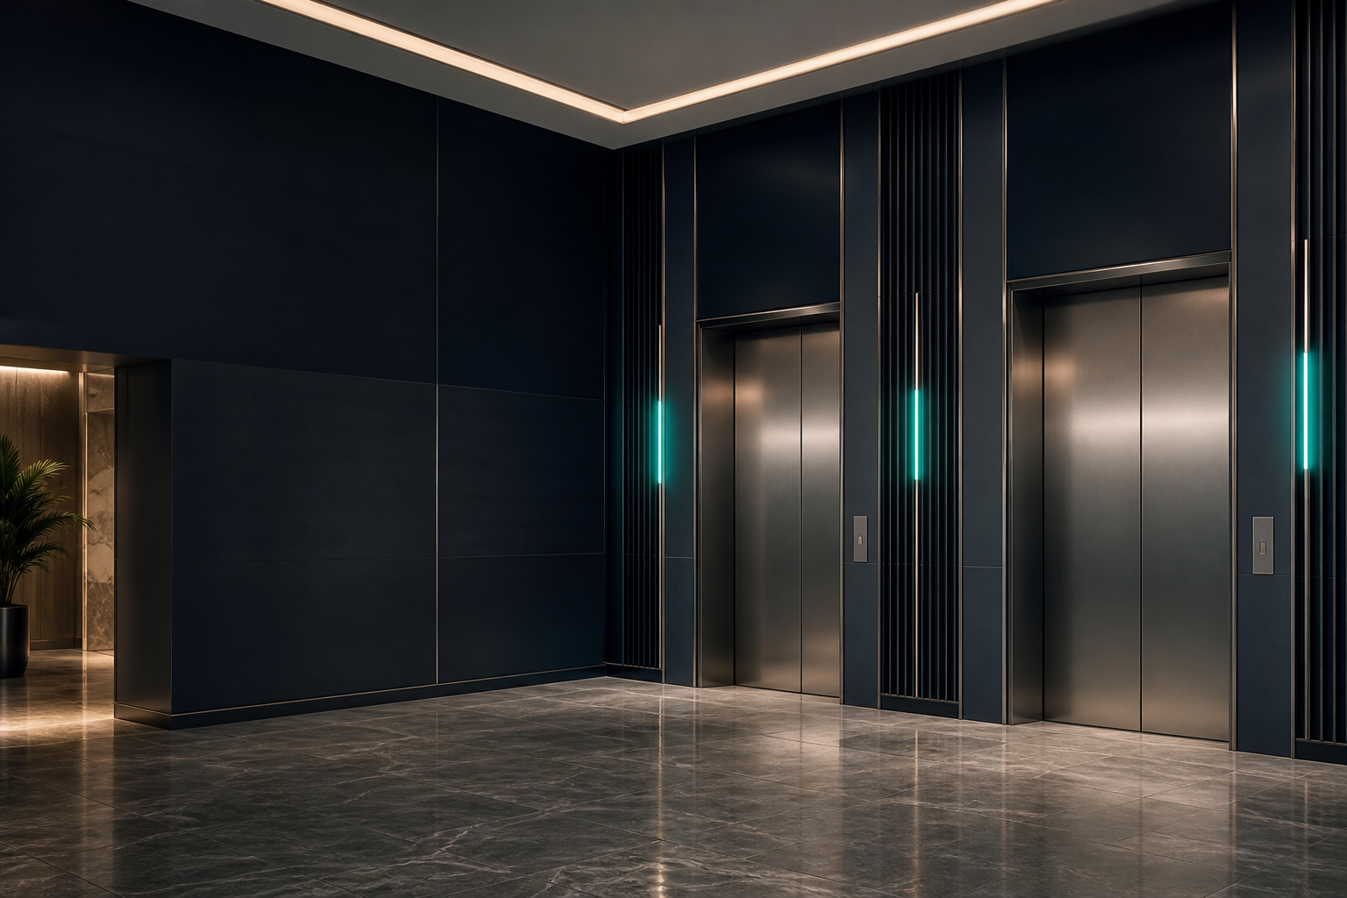

Lift solutions,
locally supported.
Supply • Installation • Repair • Servicing • Maintenance
VALUE. INNOVATION. PRESTIGE.
01 / 08

Slide 2

ABOUT US
International systems. Nigerian expertise.
VIP Lift Nigeria supplies, installs, repairs, services and maintains selected international lift systems for homes, businesses and public buildings.
Early-stage site and requirement review
Product selection and supply coordination
Professional installation and commissioning
Responsive servicing, repairs and maintenance
02 / 08

Slide 3
SERVICES
Support across the lift lifecycle.
01
02
03
04
05
Supply
Installation
Repair
Servicing
Maintenance
Selected systems matched to the building, users and design intent.
Coordinated delivery, installation and commissioning support.
Practical fault response and repair planning.
Routine attention that protects performance and usability.
Structured ongoing support for long-term confidence.
One accountable local partner from first conversation through ongoing care.
03 / 08

Slide 4
LIFT CATEGORIES
A solution for the building and the journey.
01
02
Platform lifts
Traction lifts
Accessible, space-aware solutions for homes and public environments.
Efficient vertical mobility for multi-storey residential and commercial use.
03
04
Home lifts
Commercial lifts
Comfort, accessibility and future-ready living integrated into the architecture.
Durable passenger movement for offices, hotels, retail and public buildings.
04 / 08

Slide 5
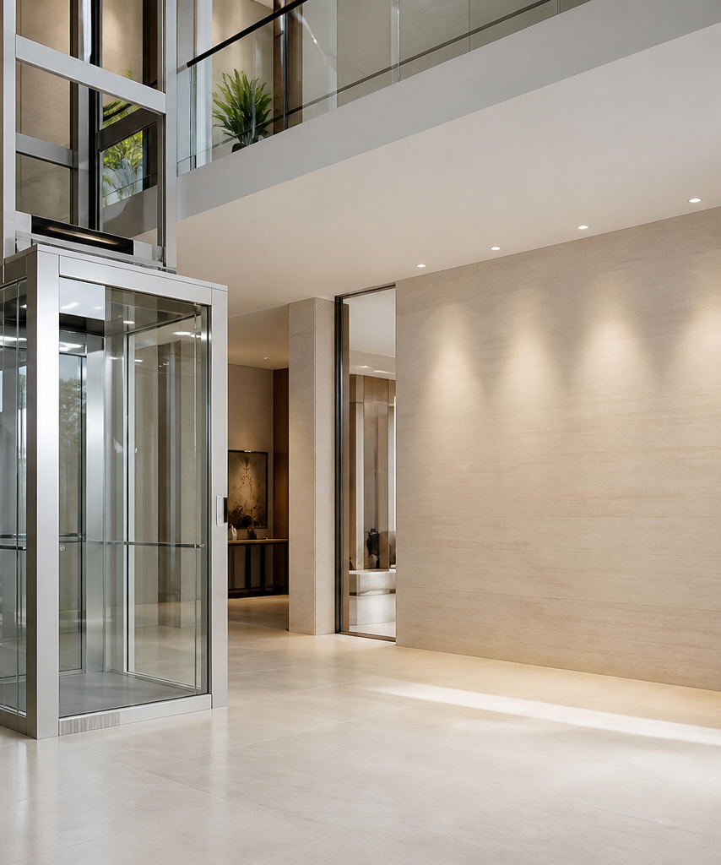
WHERE WE WORK
Designed for everyday Nigerian buildings.
Private homes
Duplexes
Apartments
Hotels
Offices
Shopping environments
Churches
Public buildings
Each project begins with the site, the intended users and the maintenance reality.
05 / 08

Slide 6
OUR APPROACH
From requirement to reliable operation.
01
02
03
04
Review
Recommend
Coordinate
Support
Understand the building, users, access requirements and commercial priorities.
Shape a clear lift brief and suitable system direction.
Align supply, site preparation, installation and commissioning.
Provide servicing, maintenance and repair response after handover.
Clear advice. Precise coordination. Ongoing local support.
06 / 08

Slide 7
SERVICE SUPPORT
The relationship continues after installation.
01
02
Planned maintenance
Responsive servicing
Scheduled checks and practical maintenance planning.
Clear communication when performance needs attention.
03
04
Repair coordination
Lifecycle guidance
Diagnosis, parts planning and repair execution.
Support for responsible operation and future decisions.
Maintenance scope, response times and warranty terms are confirmed per project and contract.
07 / 08

Slide 8
Let’s review your building.
Share the site, intended use and project stage. We will help shape the next practical step.
+234 809 555 0148
hello@viplift.example
www.viplift.example
Sample contact details. Replace before publication.
08 / 08

