Slide 1
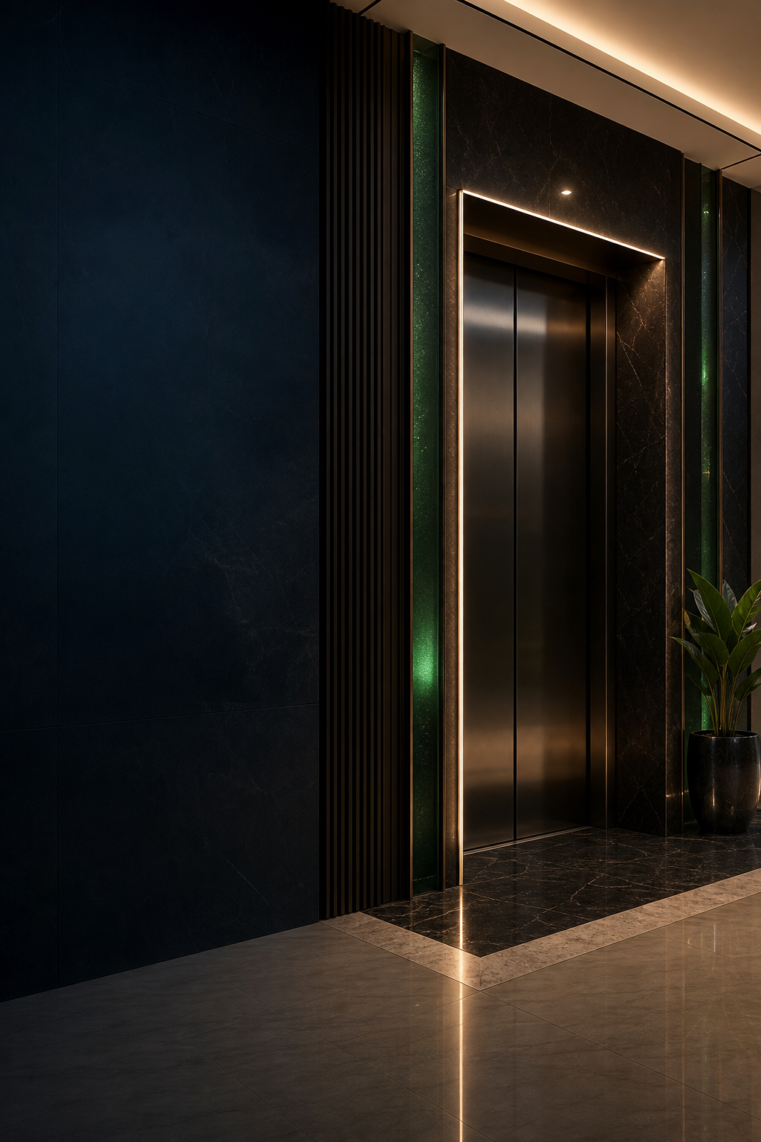

Brand
Guidelines
A premium Nigerian lift-solutions identity shaped by architectural clarity and European engineering discipline.
VALUE. INNOVATION. PRESTIGE.
01 / 16

Slide 2

BRAND OVERVIEW
Built to elevate confidence.
VIP Lift Nigeria is a Nigerian lift-solutions partner that supplies, installs, repairs, services, and maintains selected international lift systems for homes, businesses, and public buildings.
01
02
Premium
Engineering-led
Refined choices, confident restraint and excellent finish.
Clear specifications, precise language and practical expertise.
03
04
Locally supported
Architectural
Service, maintenance and responsive support for Nigerian buildings.
A visual system that complements spaces rather than competing with them.
Homes • Duplexes • Apartments • Hotels • Offices • Public buildings
02 / 16

Slide 3
POSITIONING & VOICE
Calm expertise. Clear service.
POSITIONING
International lift systems,
selected for Nigerian buildings
and supported locally.
Clear
Confident
Use direct language and explain technical details without jargon.
State capability precisely; avoid hype and unsupported superiority claims.
Service-oriented
Premium
Lead with outcomes, maintenance support and practical next steps.
Sound assured and considered, never loud, ornamental or arrogant.
Preferred service line
Lift supply, installation, repair, servicing and maintenance.
03 / 16

Slide 4



LOGO SYSTEM
One identity, several useful lockups.
Primary stacked / with slogan
Horizontal / without slogan
Symbol only
Wordmark only
Use the stacked lockup for covers, premium presentations and formal brand moments.
Use a no-slogan horizontal lockup when the slogan would reproduce too small.
Use symbol-only artwork for profile icons, patterns and restrained supporting marks.
Never type, trace or reconstruct the custom VIP LIFT wordmark.
04 / 16

Slide 5

CLEAR SPACE & SIZE
Give the mark room to work.
X
X
Clear space: at least the height of the symbol stem (X) on every side.
DIGITAL
PRINT
Minimum digital size
Minimum print size
With slogan: 240 px wide
Without slogan: 140 px wide
Symbol only: 32 px square
With slogan: 48 mm wide
Without slogan: 28 mm wide
Symbol only: 8 mm square
When in doubt, use a simpler lockup rather than reducing the slogan below legibility.
05 / 16

Slide 6
INCORRECT USAGE
Protect recognition and credibility.
× Do not stretch or compress
× Do not rotate
× Do not recolour
× Do not add shadows
× Do not outline
× Do not use on busy imagery
× Do not recreate the wordmark
× Do not use low-resolution files
06 / 16

Slide 7
COLOUR PALETTE
Dark depth. Precise light. Restrained green.
Midnight Navy
Deep Navy
Platinum Silver
#061326
#020814
#D8D8D4
Warm Silver
Emerald Accent
Deep Emerald
#C9C7BF
#168A55
#0F5F3C
Pure White
Graphite
Cool Grey
#FFFFFF
#111418
#A8ADB3
Emerald is an accent, not a field colour. Navy and white carry the system.
07 / 16

Slide 8

TYPOGRAPHY
Elegant headings. Uncomplicated reading.
Cormorant Garamond
Display serif for cover titles, major headings and premium editorial moments.
Inter
Primary sans-serif for documents, specifications, tables, digital interfaces and body copy.
MONTSERRAT
Geometric accent for short uppercase labels, navigation and technical details.
The wordmark is supplied artwork.
It is never recreated with a font.
Fallbacks when brand fonts are unavailable: Baskerville, Avenir Next and Arial.
08 / 16

Slide 9

BRAND PATTERNS
Identity-derived, never decorative noise.
Symbol monogram
A measured repeat for covers, proposal backs and dividers.
Diagonal elevation
Upward movement for campaign and social applications.
Architectural shaft
Technical linework for quotations, profiles and specifications.
09 / 16

Slide 10
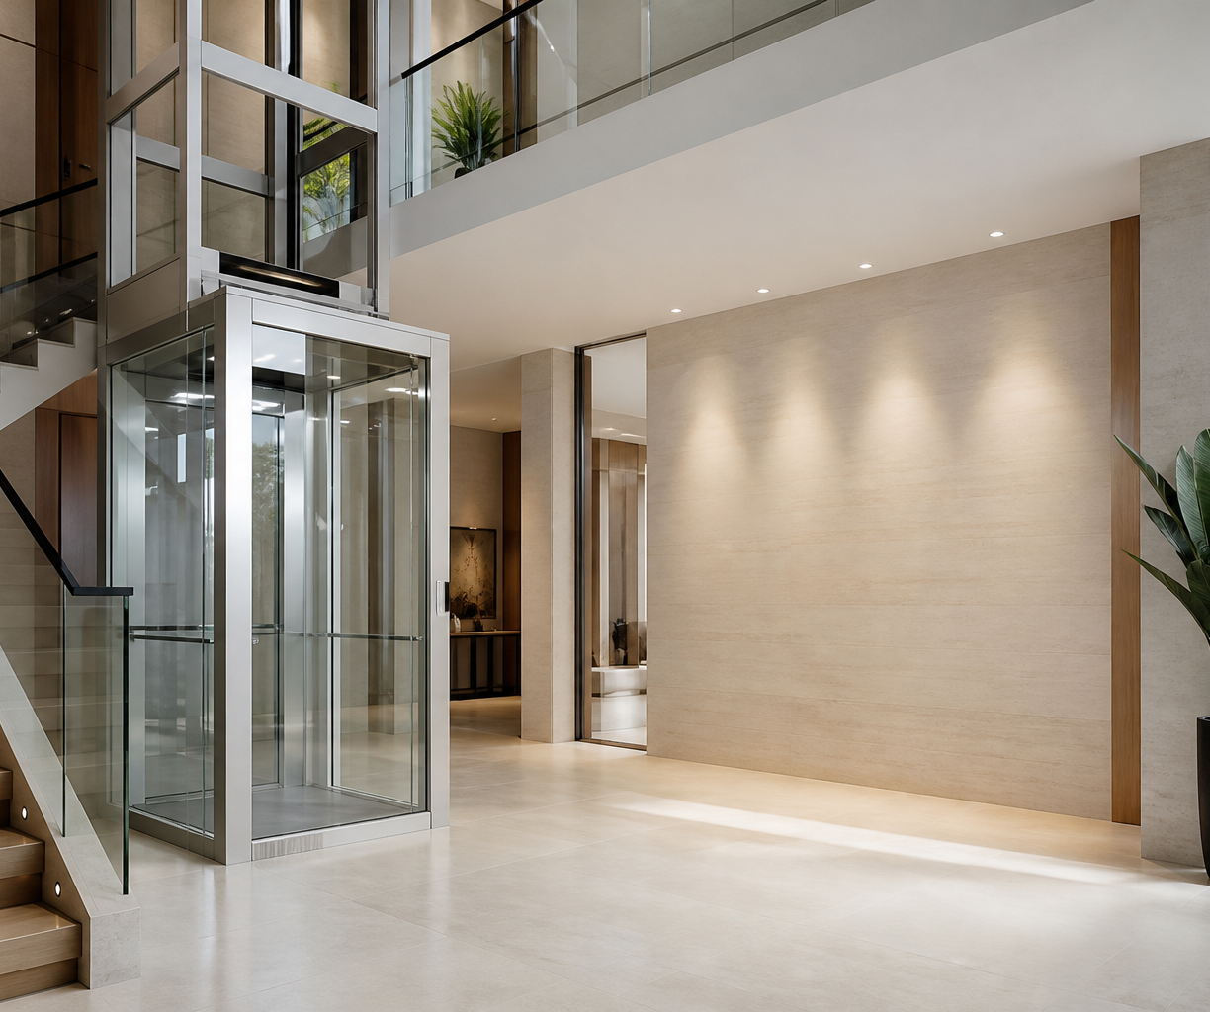
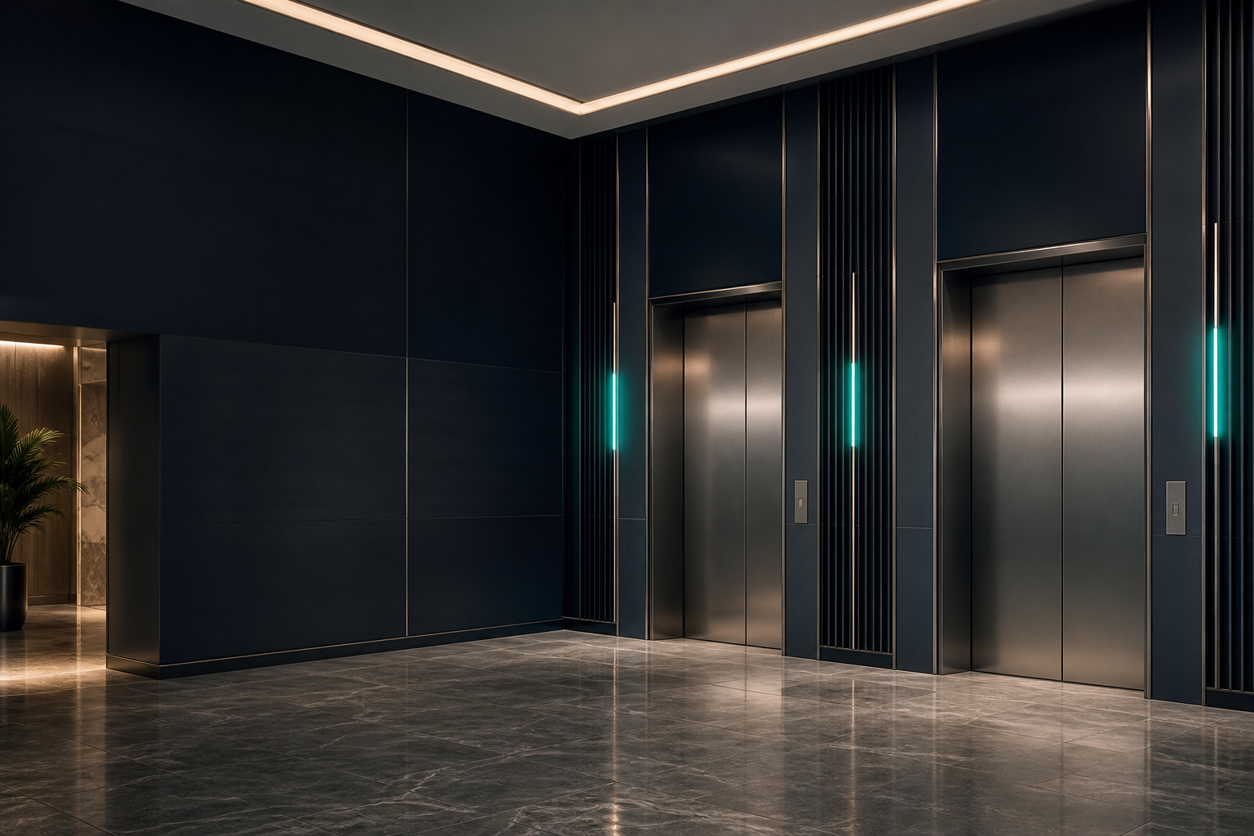
PHOTOGRAPHY
Architecture first. People only with purpose.
Preferred image qualities
Modern Nigerian residential, hospitality and commercial architecture.
Realistic lift integration, honest materials and clean vertical geometry.
Controlled lighting, neutral surfaces and restrained emerald moments.
Negative space that allows official typography and logos to remain clear.
Avoid: synthetic text, invented control panels, fake brand marks, exaggerated chrome and visibly impossible interiors.
10 / 16

Slide 11
TEMPLATES
A coherent system across every touchpoint.
01
02
Business card
Letterhead
Dark and light, front and back
A4 editable Word template
03
04
Quotation
Company profile
Six-page commercial proposal
Eight-page presentation
05
06
Email signature
Social
Compact HTML-friendly design
Square service graphic and profile icon
07
08
Cabin plate
Patterns
Durable, high-contrast signage
Vector and raster background system
Templates use consistent sample details registered under the reserved .example domain. Replace before publication.
11 / 16

Slide 12
SOCIAL & DIGITAL
Recognizable at a glance.
Premium Lift Solutions
for Nigerian Buildings
Profile icon
SUPPLY • INSTALLATION • MAINTENANCE
Keep mobile headlines below 12 words.
Use no-slogan logos when the lockup is small.
Keep calls to action direct: Request a site review.
Use emerald for actions and service emphasis, not full backgrounds.
12 / 16

Slide 13
PRINT USAGE
Quiet precision reproduces as premium.
Paper
Colour
Uncoated premium white or warm-white stock. Avoid highly glossy paper for corporate documents.
Use CMYK builds as production starting points and approve proofs before long runs.
Finishing
Signage
Blind deboss, restrained silver foil or spot varnish may be used selectively.
Prioritize contrast, durability and legibility over decorative surface effects.
Bleed
Logo
Business cards and full-bleed print pieces use 3 mm bleed with a 5 mm safe area.
Prefer supplied SVG or PDF artwork for print. Do not upscale low-resolution PNGs.
13 / 16

Slide 14
EXPORT FORMATS
Choose the right file for the job.
VECTOR
PRINT
SVG
PDF
Preferred for scalable logos, patterns and digital production.
Print-ready guides, proposals, profiles and shareable masters.
DIGITAL
PHOTO
PNG
JPG
Transparent logos and sharp digital graphics.
High-quality photographic previews where transparency is unnecessary.
EDIT
EDIT
PPTX
DOCX
Editable presentation and designed layout masters.
Editable operational documents and client proposals.
For production print, confirm bleed, colour profile, stock and finishing with the selected vendor.
14 / 16

Slide 15
FILE STRUCTURE
Organized for real-world use.
01-Logo
Official supplied marks in PNG, SVG and PDF.
02-Colours
Five-page colour guide and page exports.
03-Typography
Six-page type guide and editable master.
04-Brand-Patterns
Three identity-derived pattern families.
05-Templates
Business, document, profile, email, social and signage masters.
06-Exported-Assets
Consolidated PDF, PNG, JPG and SVG delivery folders.
README.md and brand-kit-manifest.json describe the delivered package and are maintained as the index of record.
15 / 16

Slide 16
Approval & stewardship
Use official artwork. Protect clear space. Keep copy precise. Verify technical and commercial claims before publication.
Brand enquiries
brand@viplift.example • www.viplift.example
Sample contact details are supplied for editing and must be replaced before public use.
16 / 16

