Slide 1

Exploratory Data Analysis
G2M Case Study
Halit Ayberk DEMIR
20.03.23

Slide 2


At this project Pink Cab and Yellow Cab company insights will be investigated;
Difference of the Net Profits in the companies
The firms’ net profit in different cities
Seasonality of the drives
Both cab firms’ reach for unique customers
Their profits in differently populated cities
Their profits related to customers economic status
Their profit trend in 3 years
Introduction

Slide 3
Univariate Analysis

Slide 4

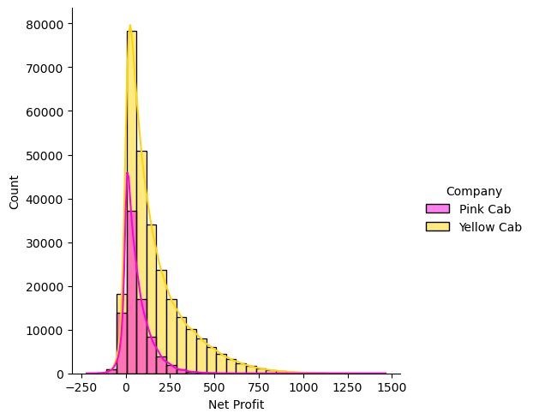
Net Profit Distribution For the 2 Cab Firms.
Mean profit of the Yellow Cab per drive is 160.26$
Mean profit of the Pink Cab per drive is 62,3$
Median profit of the Yellow Cab per drive is 102.0$
Median profit of the Pink Cab per drive is 102.0$
Both of the Data is positively skewed, Pink Cab has lower mean profit then the Yellow Cab firm.

Slide 5
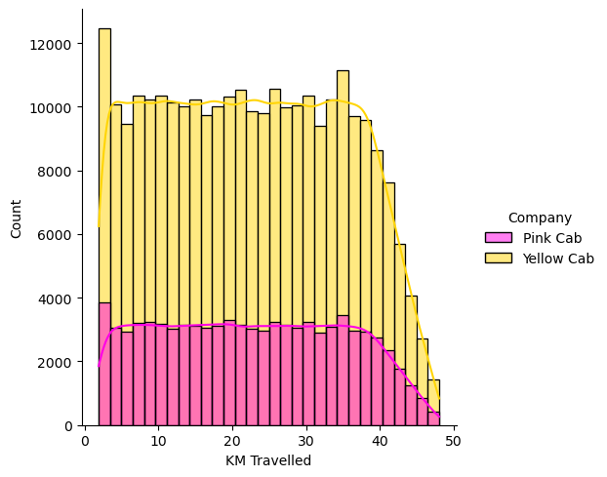
22.55
Distance Travelled Distribution For the 2 Cab Firms.
Mean distance travelled of the Yellow Cab per drive is 22.57km
Mean distance traveled of the Pink Cab per drive is 22.56 km.
Median distance traveled of the Yellow Cab per drive is 22.44 km
Median distance traveled of the Pink Cab per drive is 22.44 km
Pink and Yellow cab has close distance travelled in average, but count of the measures is a lot more in Yellow Cav

Slide 6
Bivariate Analysis

Slide 7
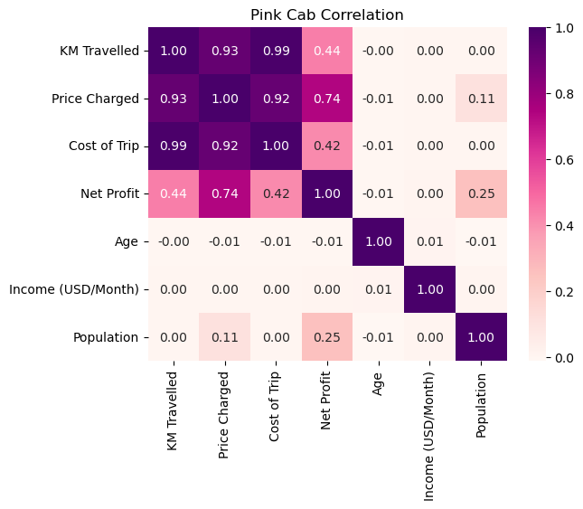
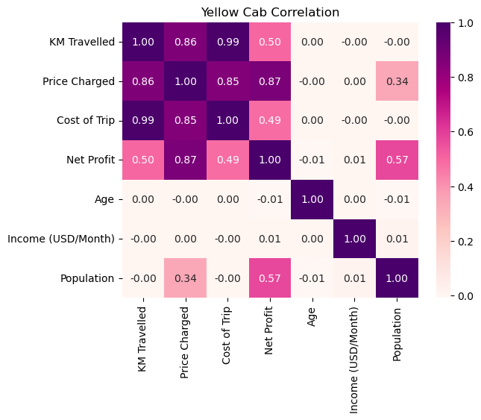
22.55
Correlation Matrices For Both of the Cab Firms.

Slide 8
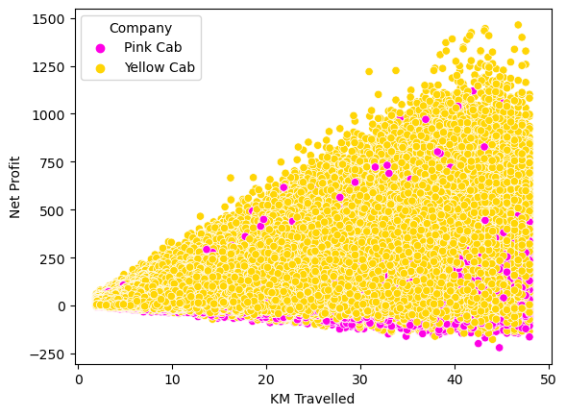
22.55
Distance Travelled and Net Profit Comparison
Km traveled and net profit can be highly correlated.
The correlation can be seen from this scatter graph
Yellow cab’s Net profit correlation with the KM travelled is more than the Pink Cab.

Slide 9
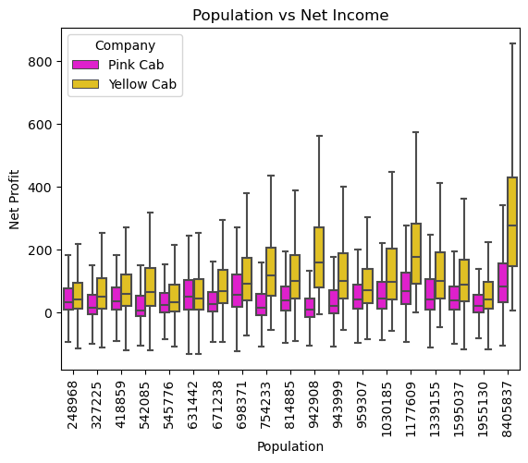
22.55
Net Profit’s Dependency of Population
Also Yellow Cab’s Net profit correlation with the population is 0.57 , whereas Pink Cab’s Net profit has a correlation with the population 0.25
Boxplot shows Yellow Cab gains more net profit in the more populated cities
Pink Cab’s net profit does not increase as much as the population increases.

Slide 10
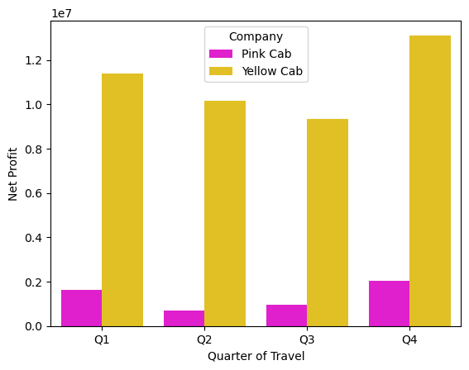
22.55
Sum of Net Profit’s in Different Quarters
Sum of the Net Profit vs quarters.
Net Profit has seasonality.
In winter Net Profits are rising for both Pink and Yellow Cab Company.

Slide 11
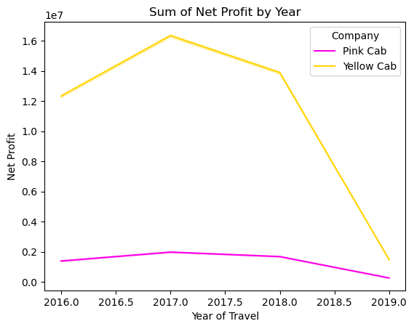
22.55
Distance Travelled Distribution For the 2 Cab Firms.
Decrease in 2019 caused by lack of data.
There is a decrease for the both cab firms in 2018
Sum of Net profit is more than the pink cab firm in all years
More Data is needed to see the trend in years.

Slide 12
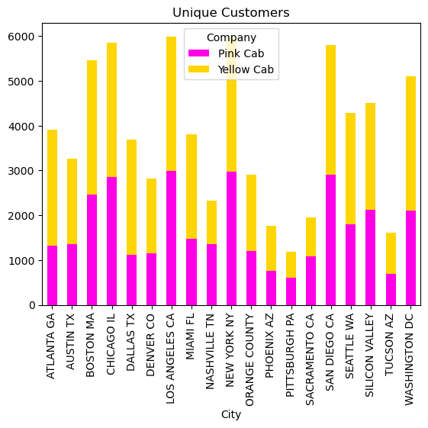
22.55
Unique Customer Reach For Both of the Cab Firms
Both Cab firm’s reach for the unique customers are close but still yellow leading in the reach for the customers
This means that the unique users use yellow cab firm more frequently than the pink cab.

Slide 13
Hypothesis Testing

Slide 14
In hypothesis Testing it is proven that;
Average net profit of the company is higher than the pink cab
Net profit depends on the distance travelled in the cab
Net profit gained and the economic status of the customer is related
The average profits are different between quarters therefore data is seasonal
Hypothesis Testing

Slide 15
Yellow Cab is a smarter choice to invest because;
Average net profit of the company is higher than the pink cab
Has a wider customer reach, and frequency
Yellow cab has net more profit in more populated cities
The average profits are different between quarters therefore data is seasonal
Also for more km travelled yellow cab gains more profit
Conclusion

Slide 16
H. Ayberk DEMIR h.ayberk.demir.34@gmail.com
Thank You For Your Attention!

