Slide 1

Exploratory Data Analysis
HealthCare-DataScience Project
Halit Ayberk DEMIR
LISUM19
15.05.2023

Slide 2
Problem Statement
ABC is a pharmaceutical company and desires to understand the persistency of the drug
per physician description. To solve this issue, ABC company reached an analytics company to
automate this process of identification.

Slide 3
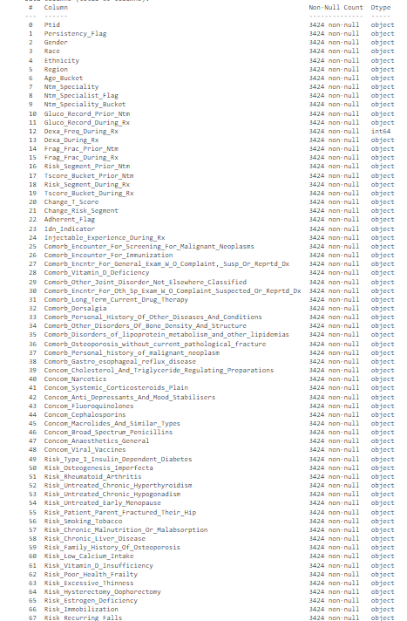
Data Understanding
- Dataset has 68 columns.
- Our dataset has only one numerical
column which is dexa frequency during rx.
-66 Columns are categorical values most of them being simply «Y» or «N»

Slide 4
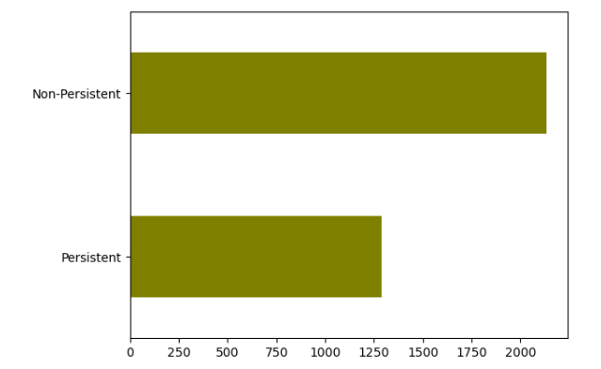
Understanding Important Columns.
Target Feature, Persistent Flag
Uneven Data;
Non Persistent: 2135
Persistent: 1289

Slide 5
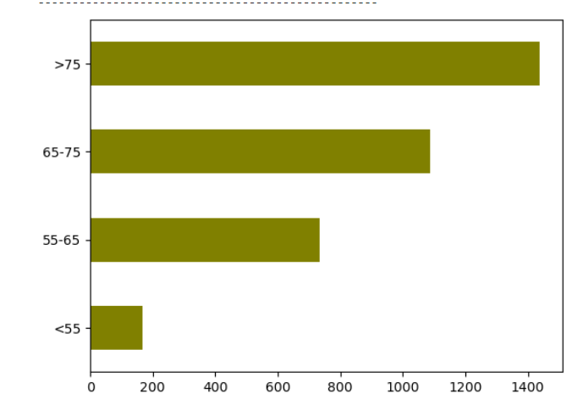
Understanding Important Columns.
Age Bucket;
>75 : 1439
65-75: 1086
55-65: 733
<55: 166

Slide 6
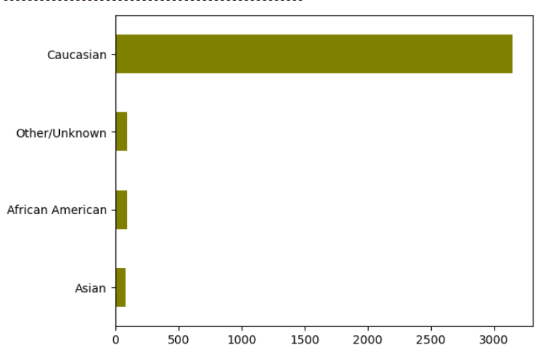
Understanding Important Columns.
Race
Caucasian: 3148,
Other/Unknown: 97,
African American: 95,
Asian: 84,

Slide 7
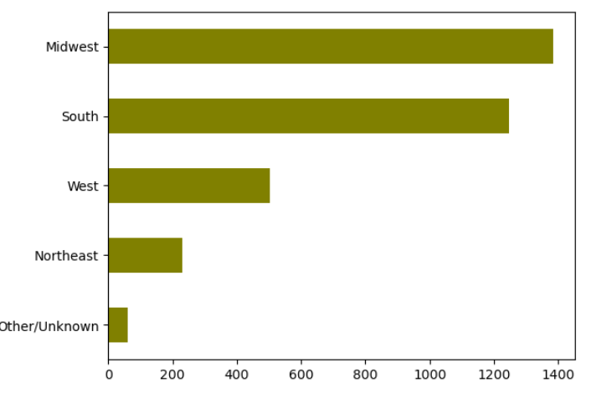
Understanding Important Columns
Region
Midwest: 1383
South: 1247
West: 502
Other/Unkown:60

Slide 8
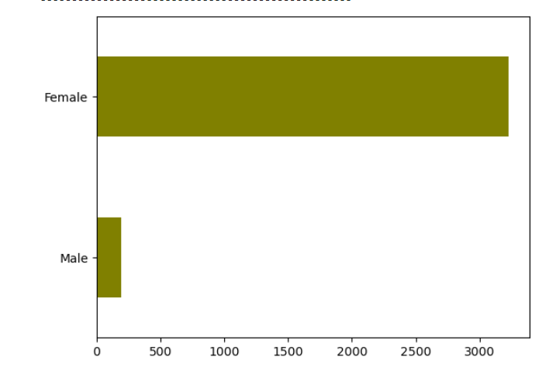
Understanding Important Columns.
Gender
Uneven Dataset
Female Dominating Dataset
Female: 3424
Male: 194

Slide 9
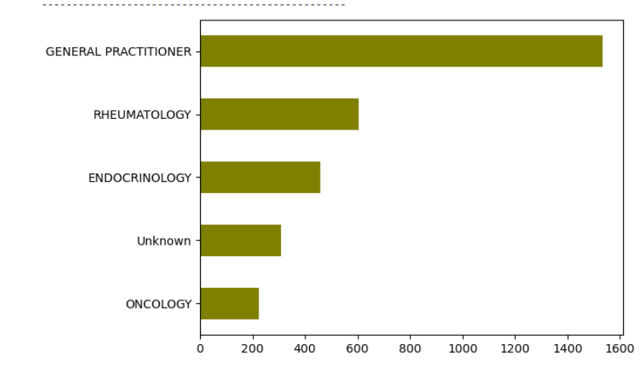
Understanding Important Columns.
Ntm Speciality
36 Unique Values
With Leading;
General Practitioner: 1535
Rheumatology: 604
Endocrinology: 458

Slide 10
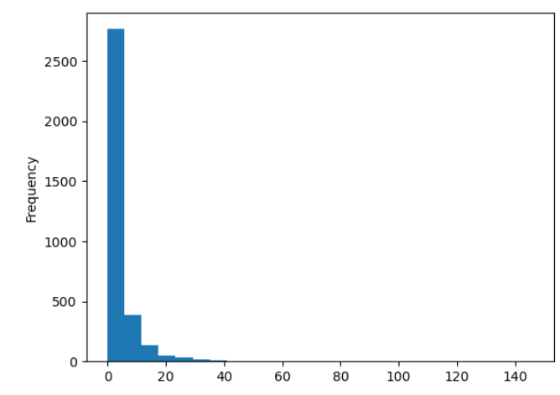
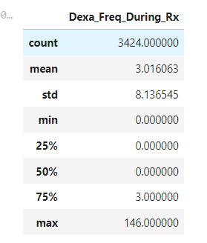
Understanding Important Columns.
Dexa Frequancy During Rx
Only Numerical Column In The Dataset

Slide 11
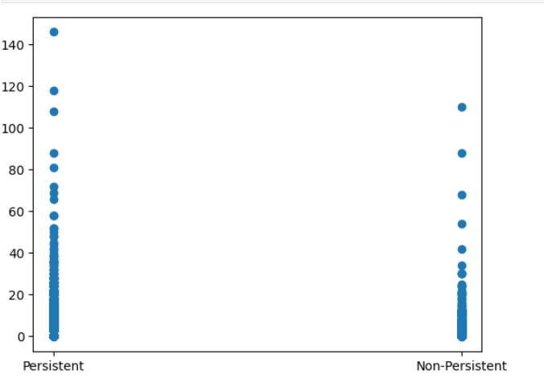
Finding Outliers.
Distribution of Dexa Frequancy During
Rx with target column persistancy flag.
Clearly outliers are visible.
This outliers are dropped.

Slide 12
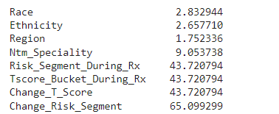
Unknown Values In the Dataset.
Percentage of Unknown Values In the
columns.
If the percentage is higher than 40,
column is dropped.
Else, the unknown data is filled with
the most frequent value

Slide 13
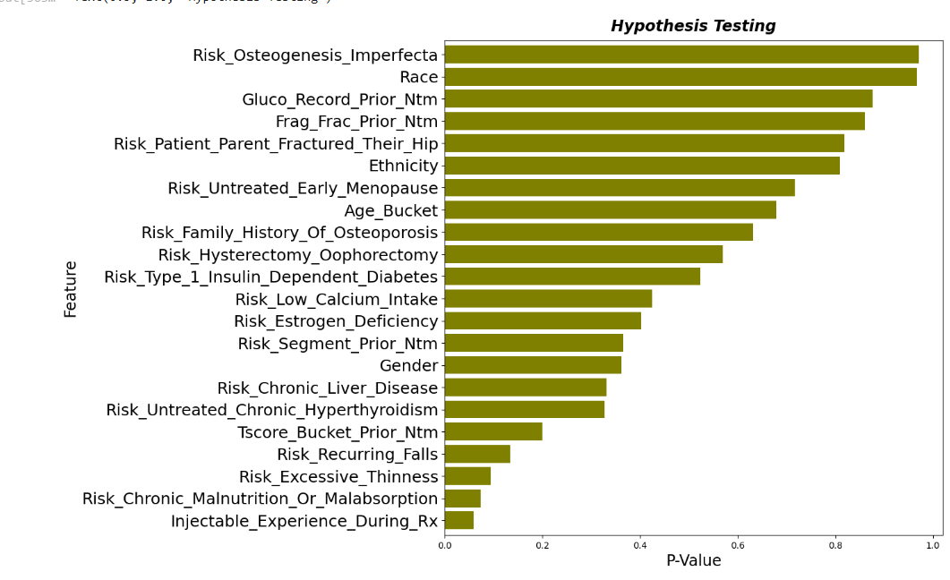
Chi2 Analysis
Reduction of Columns
At the left columns with low assosiation are shown
If P value is higher it has a higher probability of being not assosiated with the target variable

Slide 14
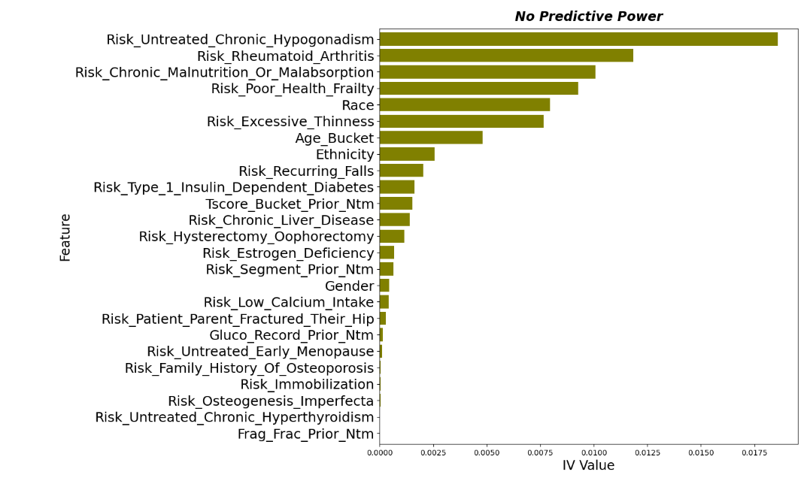
Information Value
IV technique for feature selection
Columns with no predictive power.

Slide 15
Suggested ML Models:
Logistic Regression: WOE/IV
DecisionTree/RandomForest
Gradient Boosting Machines (GBM) / XGBoost / LightGBM
Support Vector Machines (SVM):
Neural Networks

Slide 16

Halit Ayberk DEMIR
Thank You

