Slide 1

Exploratory Data Analysis
HealthCare-DataScience Project
Halit Ayberk DEMIR
LISUM19
30.05.2023

Slide 2
Problem Statement
ABC is a pharmaceutical company and desires to understand the persistency of the drug
per physician description. To solve this issue, ABC company reached an analytics company to
automate this process of identification.

Slide 3
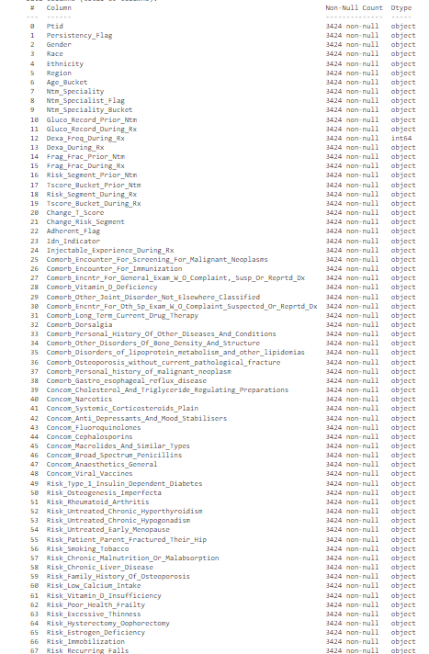
Data Understanding
- Dataset has 68 columns.
- Our dataset has only one numerical
column which is dexa frequency during rx.
-66 Columns are categorical values most of them being simply «Y» or «N»

Slide 4
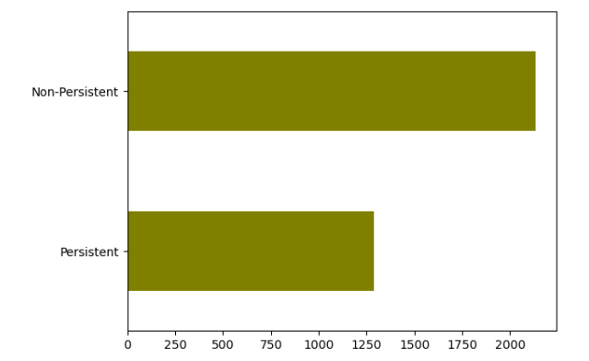
Understanding Important Columns.
Target Feature, Persistent Flag
Uneven Data;
Non Persistent: 2135
Persistent: 1289

Slide 5
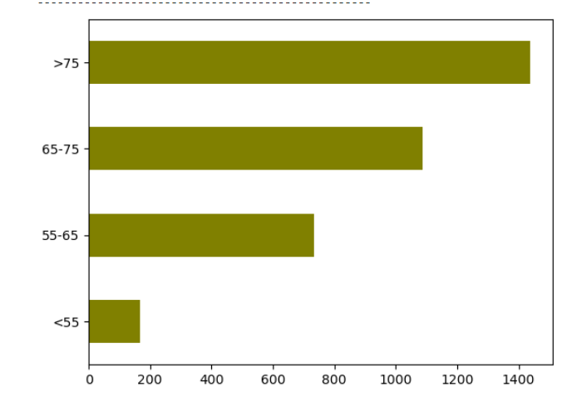
Understanding Important Columns.
Age Bucket;
>75 : 1439
65-75: 1086
55-65: 733
<55: 166

Slide 6
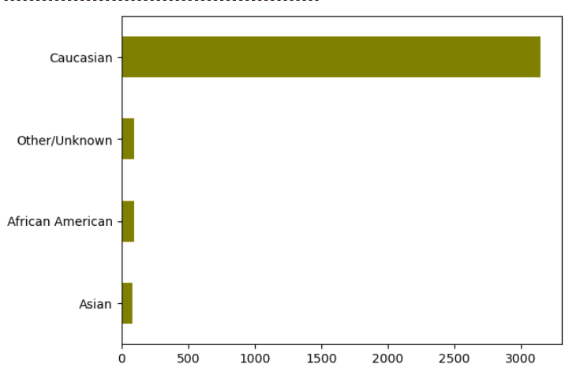
Understanding Important Columns.
Race
Caucasian: 3148,
Other/Unknown: 97,
African American: 95,
Asian: 84,

Slide 7
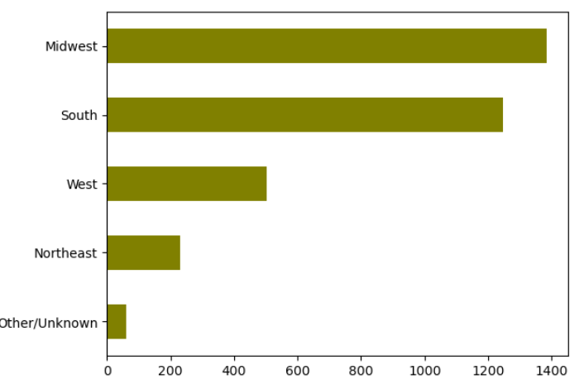
Understanding Important Columns
Region
Midwest: 1383
South: 1247
West: 502
Other/Unkown:60

Slide 8
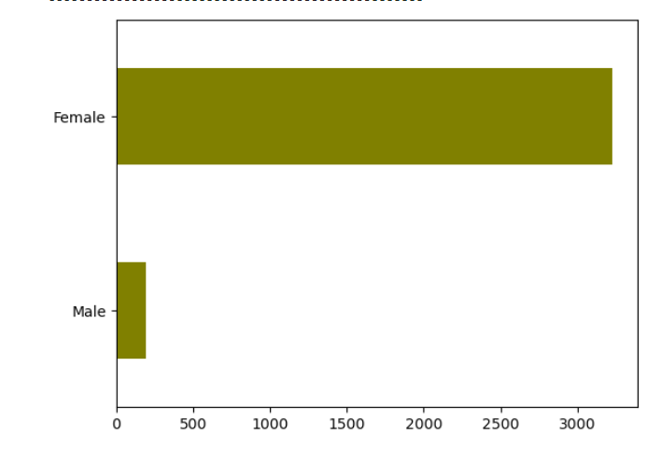
Understanding Important Columns.
Gender
Uneven Dataset
Female Dominating Dataset
Female: 3424
Male: 194

Slide 9
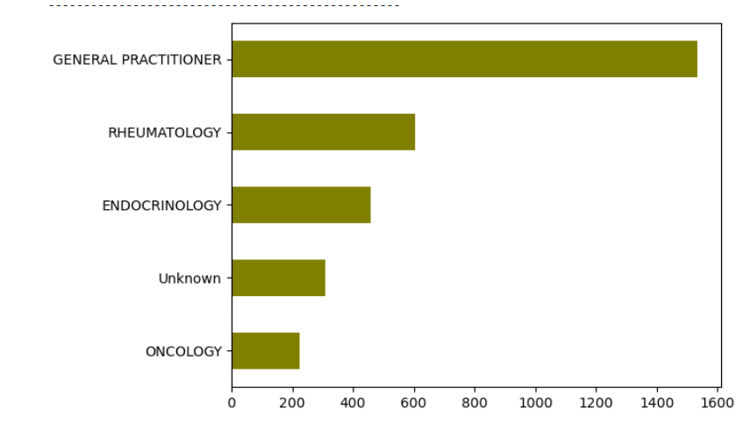
Understanding Important Columns.
Ntm Speciality
36 Unique Values
With Leading;
General Practitioner: 1535
Rheumatology: 604
Endocrinology: 458

Slide 10
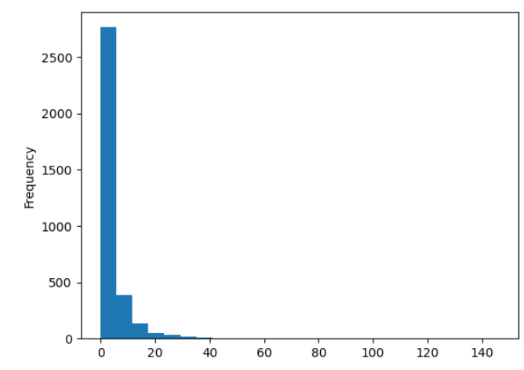
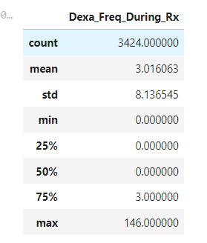
Understanding Important Columns.
Dexa Frequancy During Rx
Only Numerical Column In The Dataset

Slide 11
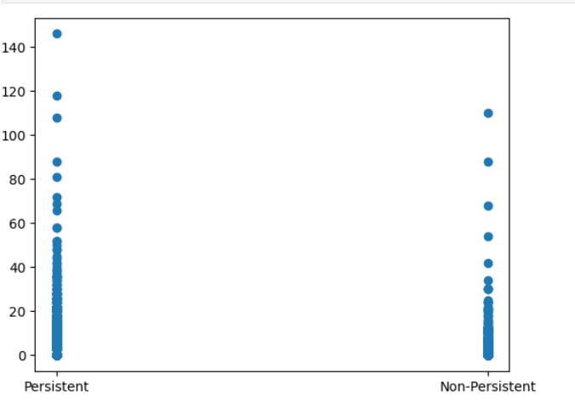
Finding Outliers.
Distribution of Dexa Frequancy During
Rx with target column persistancy flag.
Clearly outliers are visible.
This outliers are dropped.

Slide 12
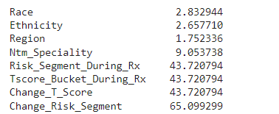
Unknown Values In the Dataset.
Percentage of Unknown Values In the
columns.
If the percentage is higher than 40,
column is dropped.
Else, the unknown data is filled with
the most frequent value

Slide 13
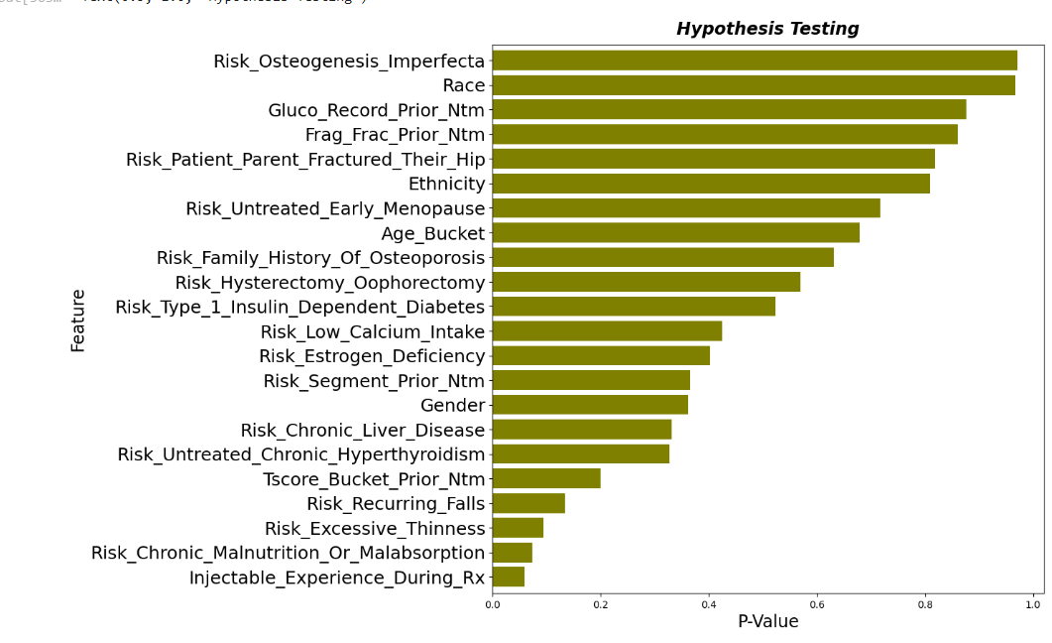
Chi2 Analysis
Reduction of Columns
At the left columns with low assosiation are shown
If P value is higher it has a higher probability of being not assosiated with the target variable

Slide 14
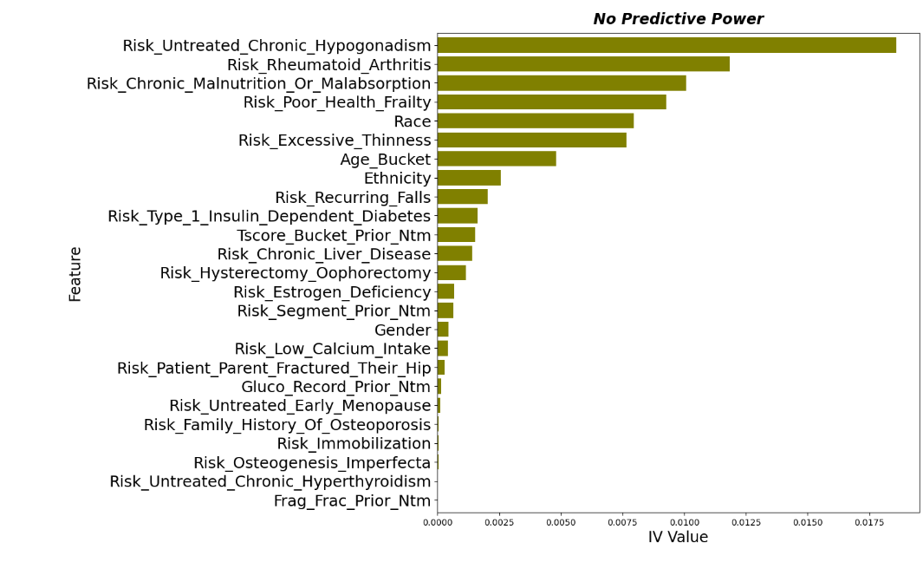
Information Value
IV technique for feature selection
Columns with no predictive power.

Slide 15
Suggested ML Models:
Logistic Regression: WOE/IV
DecisionTree/RandomForest
Gradient Boosting Machines (GBM) / XGBoost / LightGBM
Support Vector Machines (SVM):
Neural Networks

Slide 16
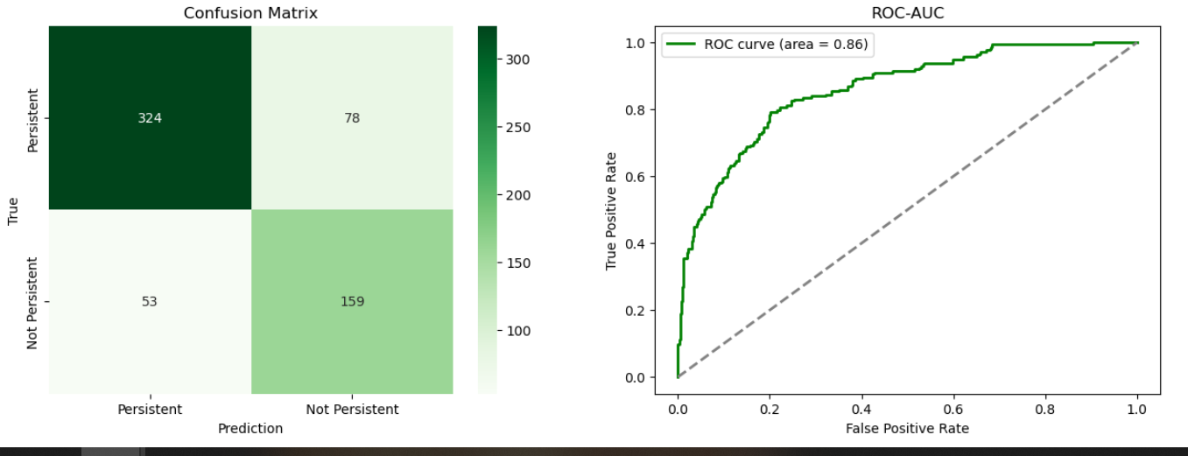
Model 1 Logistic Regression (Base Model)
Accuracy: 0.7866449511400652
Precision: 0.6708860759493671
Recall: 0.75
F1 Score: 0.7082405345211581
AUC-ROC: 0.7779850746268656

Slide 17
Model 1 Logistic Regression (Base Model)
Accuracy: 0.7866449511400652
Precision: 0.6708860759493671
Recall: 0.75
F1 Score: 0.7082405345211581
AUC-ROC: 0.7779850746268656

Slide 18
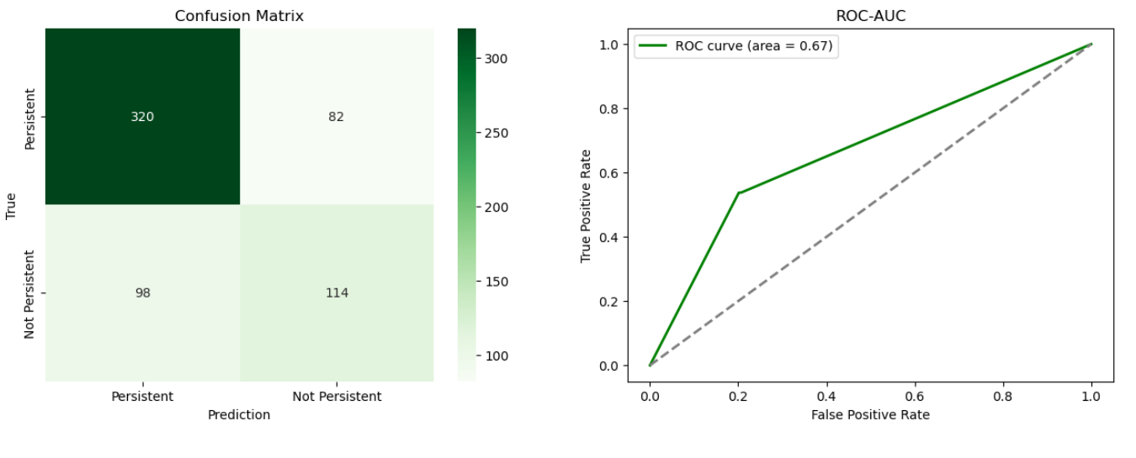
Model 2 Decision Tree.
Accuracy: 0.7068403908794788
Precision: 0.5816326530612245
Recall: 0.5377358490566038
F1 Score: 0.5588235294117646
AUC-ROC: 0.6668778747770582

Slide 19
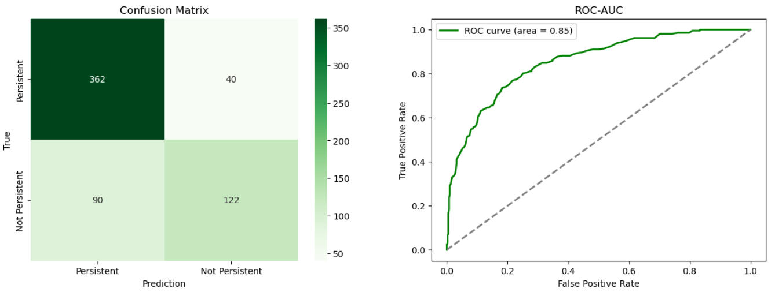
Model 3 Random Forest Classifier
Accuracy: 0.7882736156351792
Precision: 0.7530864197530864
Recall: 0.5754716981132075
F1 Score: 0.6524064171122994
AUC-ROC: 0.7379846052755092

Slide 20
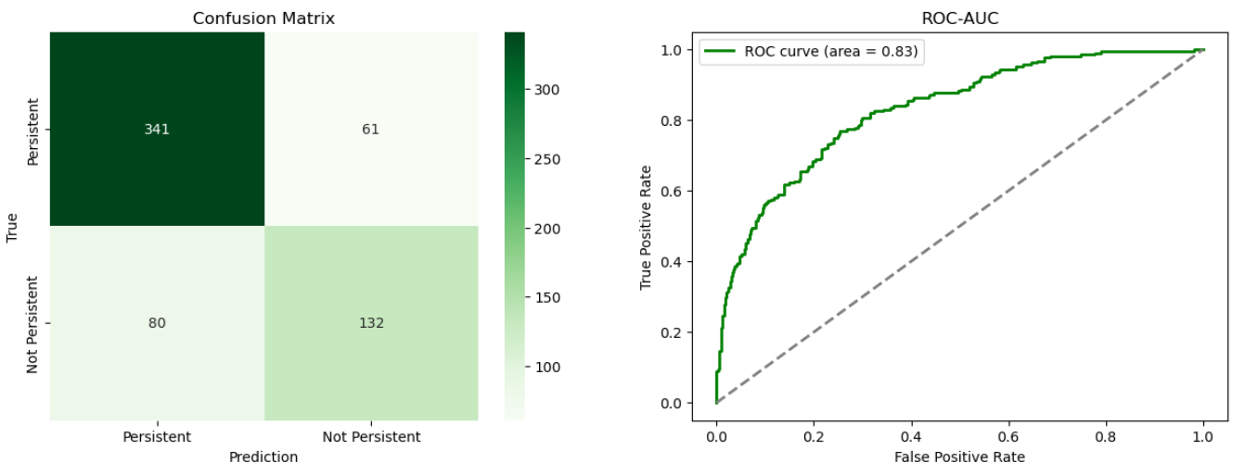
Model 4 Gradient Boosting
Accuracy: 0.7703583061889251
Precision: 0.6839378238341969
Recall: 0.6226415094339622
F1 Score: 0.6518518518518519
AUC-ROC: 0.735450107950812

Slide 21
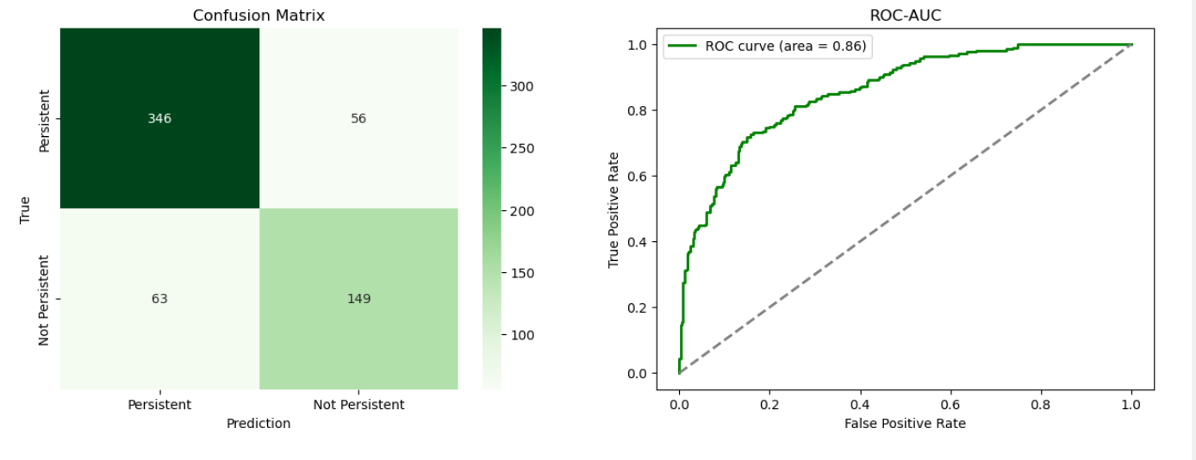
Model 5 Support Vector Machines
Accuracy: 0.8061889250814332
Precision: 0.7268292682926829
Recall: 0.7028301886792453
F1 Score: 0.7146282973621103
AUC-ROC: 0.7817633530460902

Slide 22
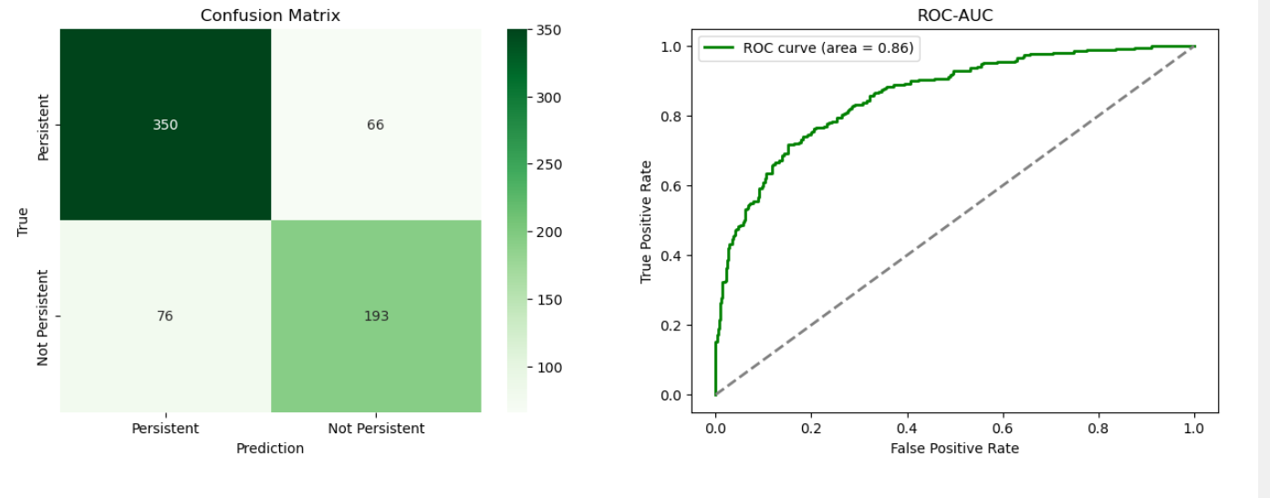
Model 6 Logistic Regression WoE
Accuracy: 0.7927007299270074
Precision: 0.7451737451737451
Recall: 0.7174721189591078
F1 Score: 0.731060606060606
AUC-ROC: 0.7794091364026308

Slide 23
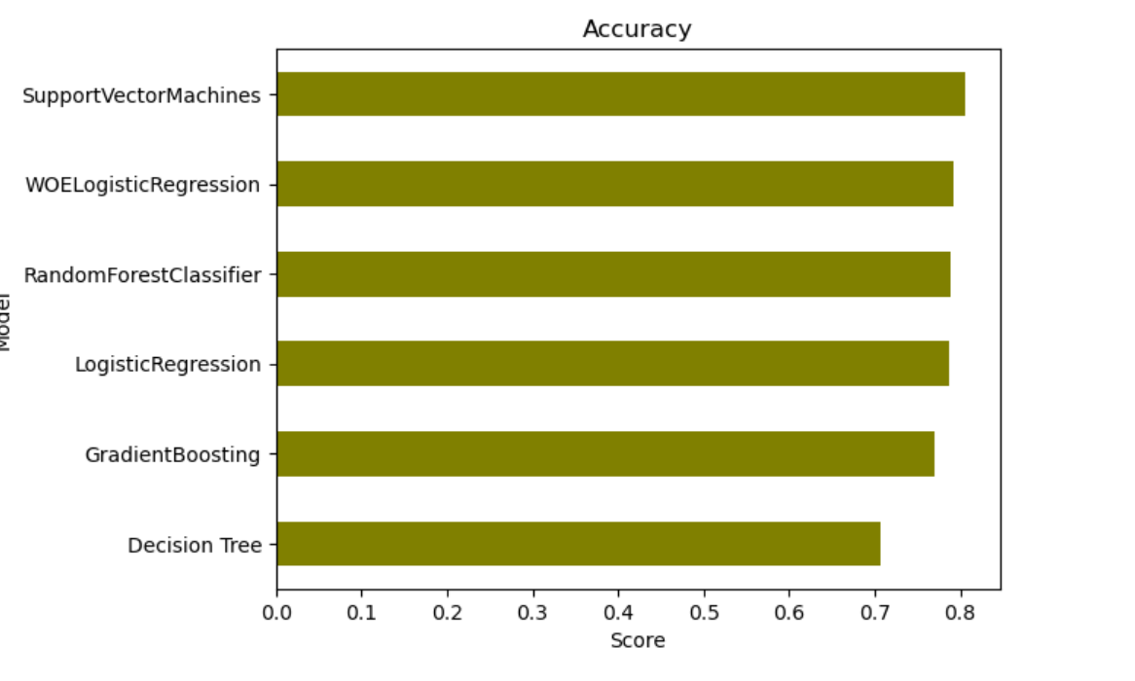
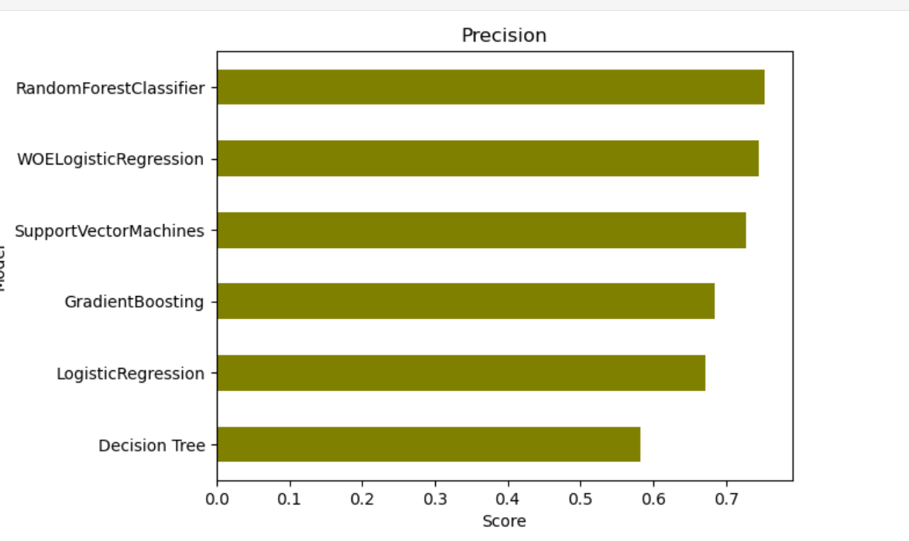
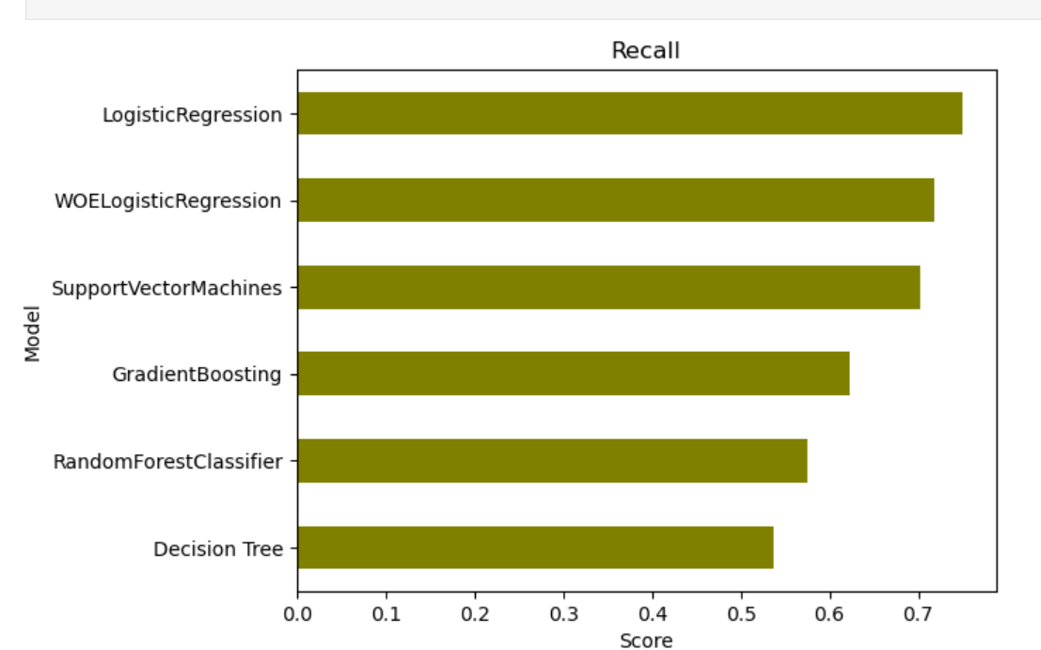
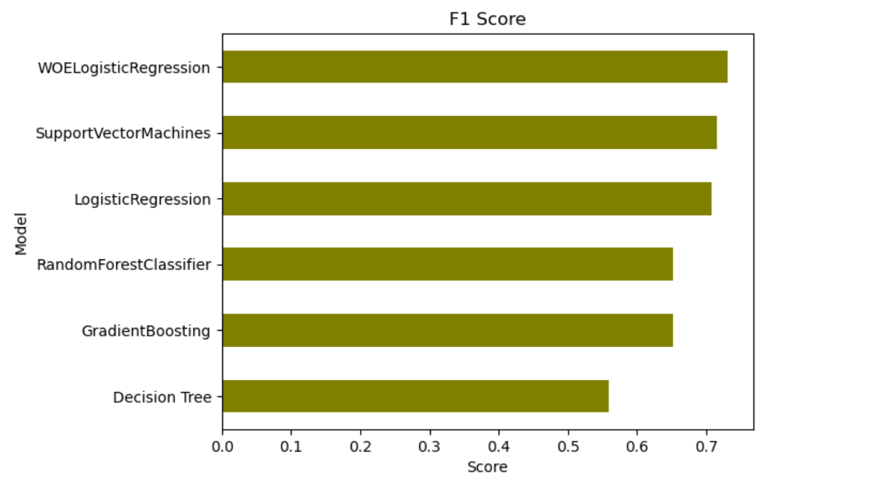
Final Metrics

Slide 24
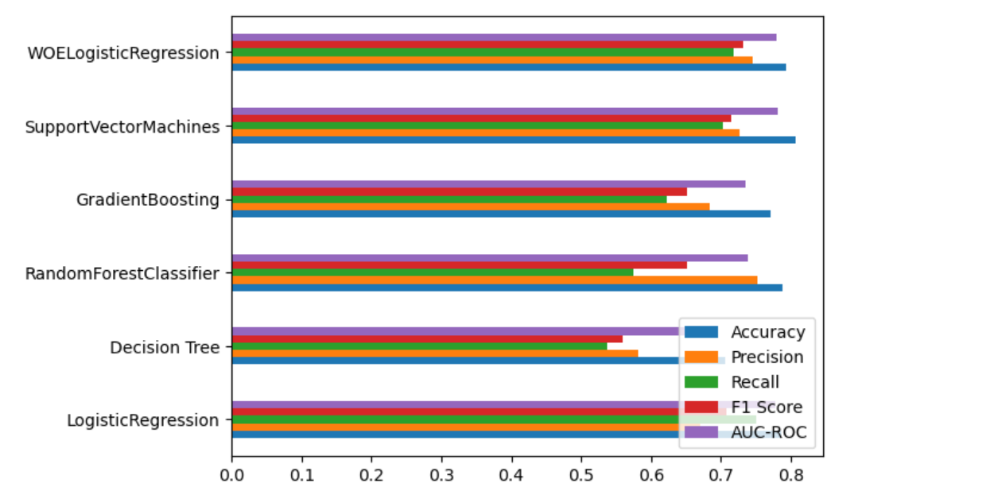
Final Metrics

Slide 25
Selected Model: SVM
Accuracy: 0.8061889250814332
Precision: 0.7268292682926829
Recall: 0.7028301886792453
F1 Score: 0.7146282973621103
AUC-ROC: 0.7817633530460902
*Since It’s high accuracy, high F1 score, and ease of implementation SVM is chosen as model to deploy.*

Slide 26

Halit Ayberk DEMIR
Thank You

