Slide 1

PeriodiC++
Teoman GUVEN
Mehmet Emre CEBECI
Ahmet Kaan DEMIRCI
Mustafa ÖZDEMIR

Slide 2
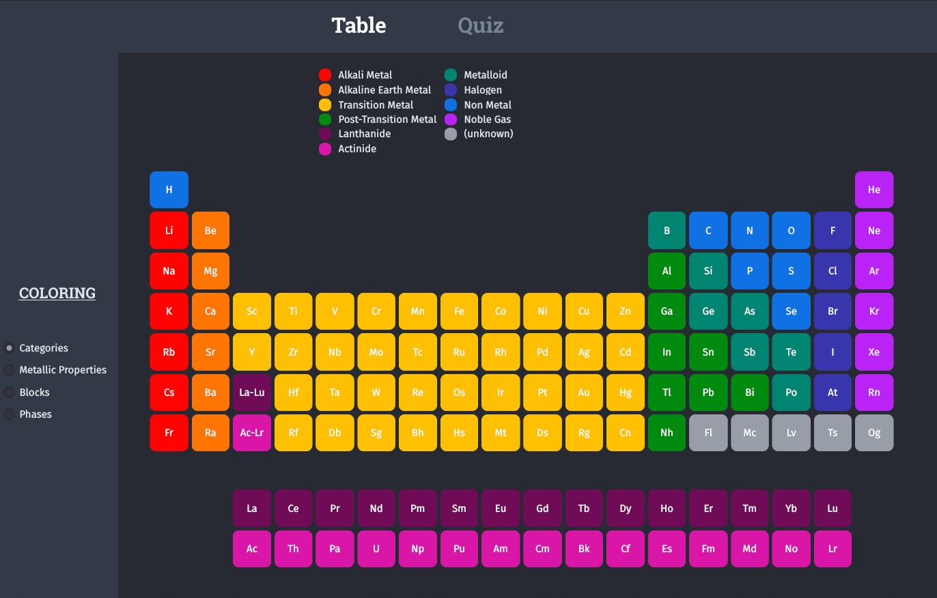
What is PeriodiC++ ?
PeriodiC++ application is a comprehensive periodic table application with several features: A user-friendly interface allows you to learn the elements, explore chemical properties, and take integrated quizzes to master the periodic table. "periodiC++" has two interesting quiz modes: "Levels" and "Challenge Mode" where users can test their knowledge against the clock, earn points and do their best.

Slide 3
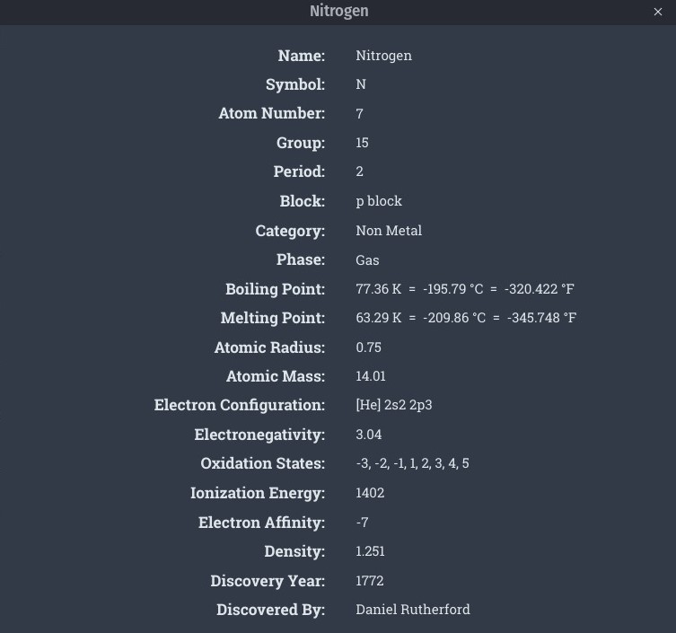
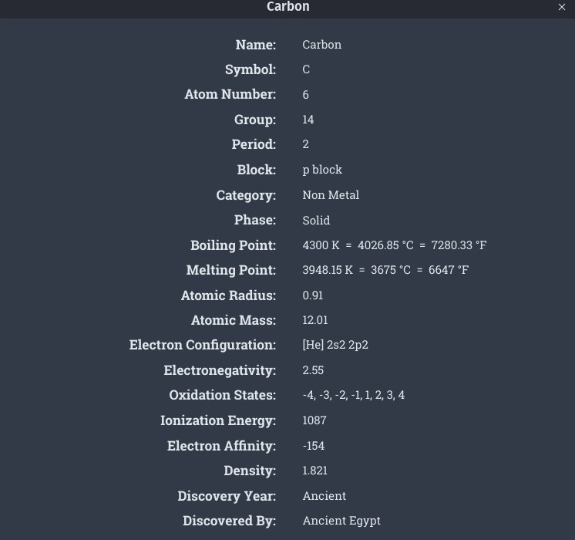
Element Properties
In the periodic table, the properties of the element we click are shown. For example symbol, atom number group, period , category etc.

Slide 4
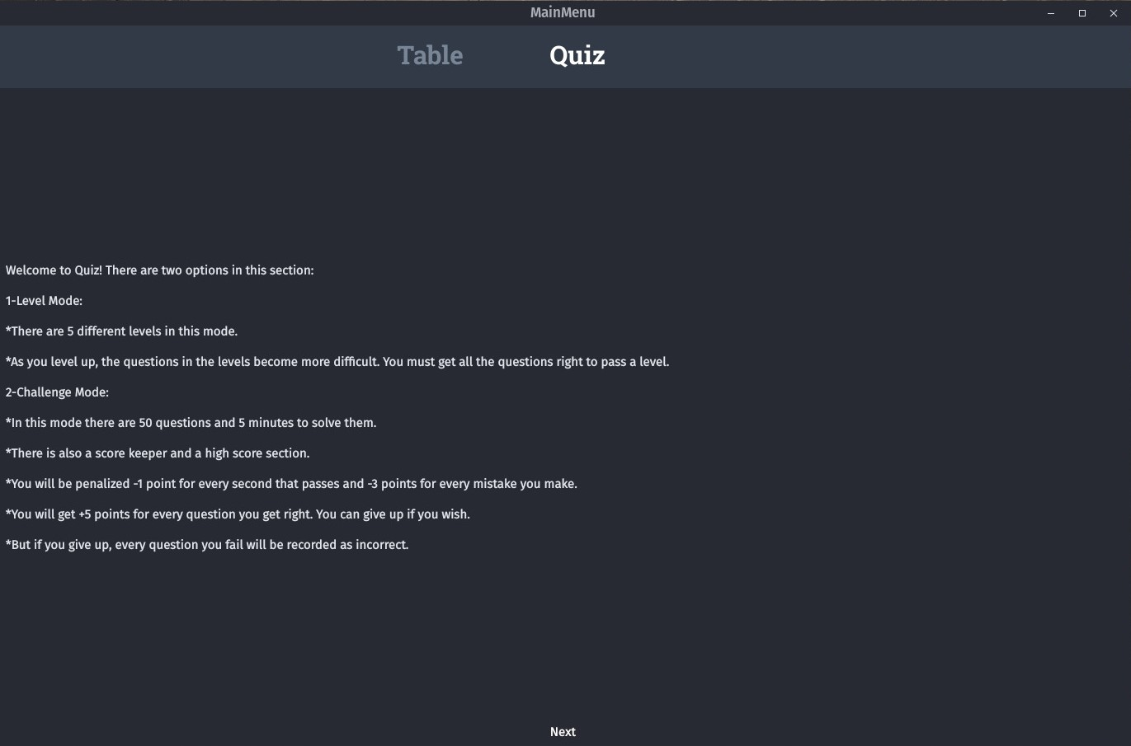
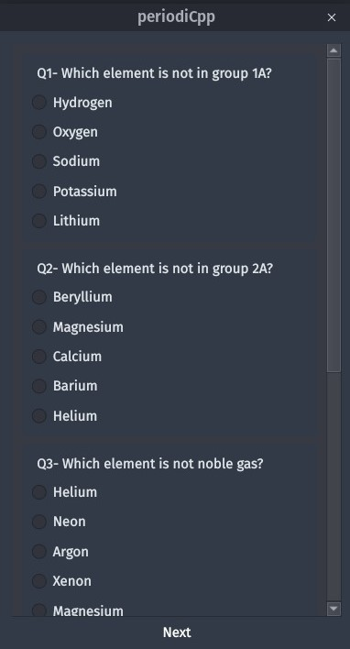
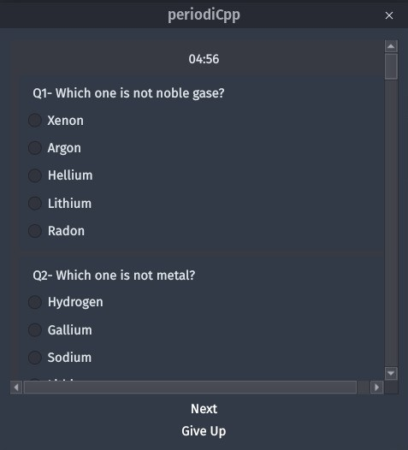
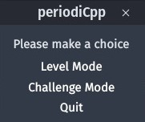

Quiz Section
We designed the quiz section to learn the elements better and make the PeriodiC++ project more fun The quiz section consists of 2 modes. The first mode is Level mode, where the difficulty of the questions increases as the level increases. The second mode is the challenge mode, where you try to know the most questions in the shortest time..

Slide 5
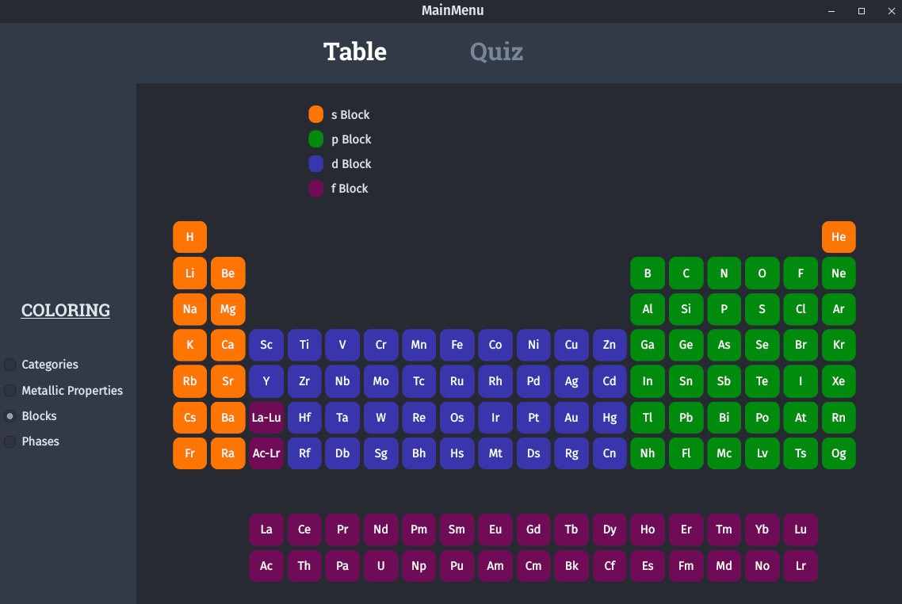
Coloring
We colored the elements in the periodic table according to whether they are nonmetal or metal, their metallic properties, block and phases.

Slide 6
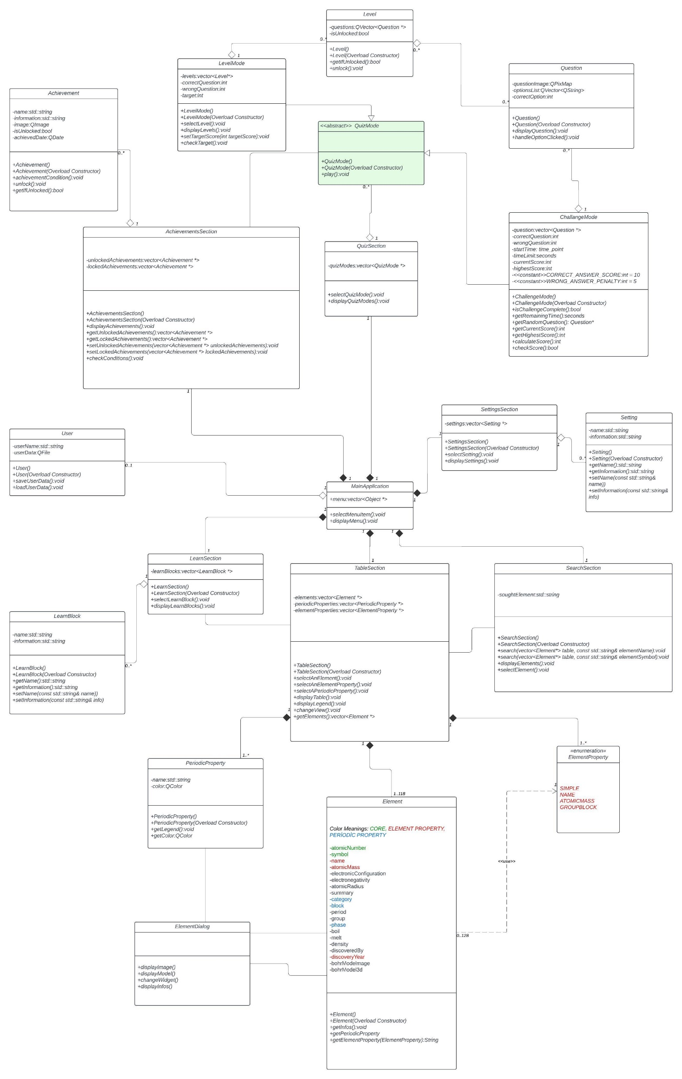
UML
We go to the link below to explain the UML, Classes and the relationships between them of the PeriodiC++ project.
https://lucid.app/lucidchart/0a519ef8-246f-4502-8f22-4ee3e17d20db/edit?invitationId=inv_c6143f45-b8e7-44fc-b32c-8fad8be09fb7&page=HWEp-vi-RSFO#

Slide 7
DEMO SECTION

