Slide 1

MOVIE RECOMMENDER
https://boyslife.org/hobbies-projects/funstuff/18651/100-movies-for-kids/attachment/movies-featured/
YALIM DEMIRKESEN

Slide 2
Content
Problem Statement
Data
Recommendations
Clustering
Ways to Improve

Slide 3

Adam Ellis / Via buzzfeed.com

Slide 4
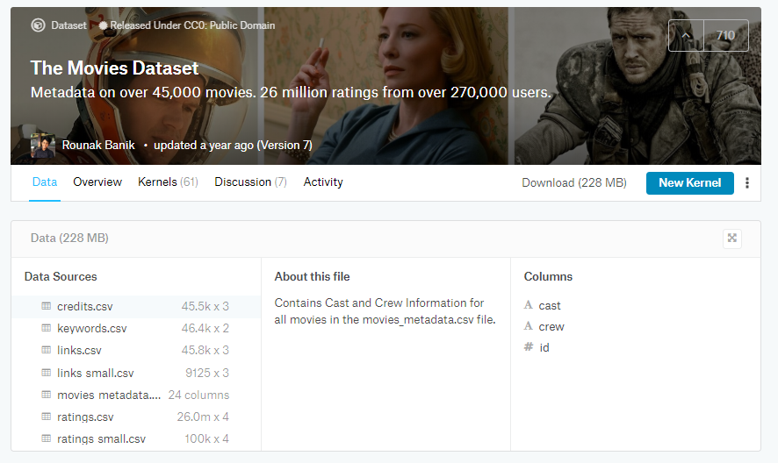

Slide 5
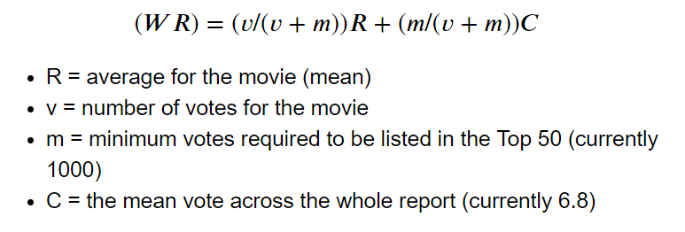
Recommendations - Simplest

Slide 6
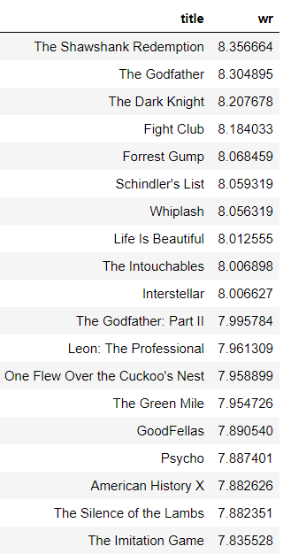
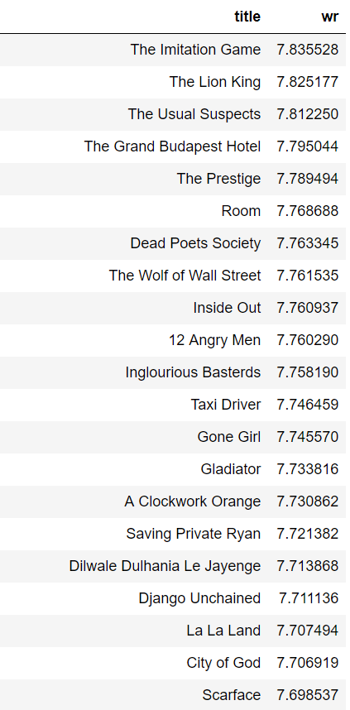

Slide 7
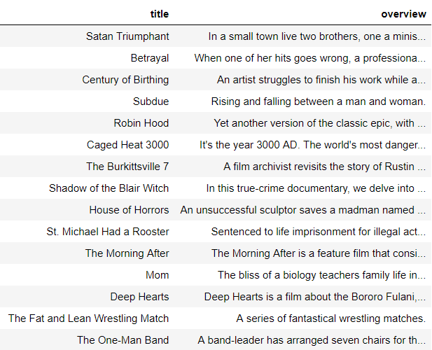
Recommendations – Count Vectorizer

Slide 8
Recommendation – Count Vectorizer
A stranger named Silas flees from a devastating storm and finds refuge with Tom and Gillian on their farm. While struggling with the Storm, Silas seems to be the only one who can help Tom and Gillian to find their son but there are other more dangerous forces out there, that are waiting for the three.
Leon, the top hit man in New York, has earned a rep as an effective "cleaner". But when his next-door neighbors are wiped out by a loose-cannon DEA agent, he becomes the unwilling custodian of 12-year-old Mathilda. Before long, Mathilda's thoughts turn to revenge, and she considers following in Leon's footsteps.
During a time when the city of Los Angeles is terrorized by animal attack style murders, a kindly elderly lady provides a nomad with room and board. It turns out that he is a werewolf and is responsible for the recent killings. He bites the elderly woman, turning her into a hungry werewolf. Now her adult son must try to prevent the both of them from doing any more harm.
When one of her hits goes wrong, a professional assassin ends up with a suitcase full of a million dollars belonging to a mob boss ...
… The tormented minister and his cuckolded brother will die in a strange accident in the chapel and later an infant will be born from the minister's adulterous relationship.

Slide 9
CLUSTERING

Slide 10
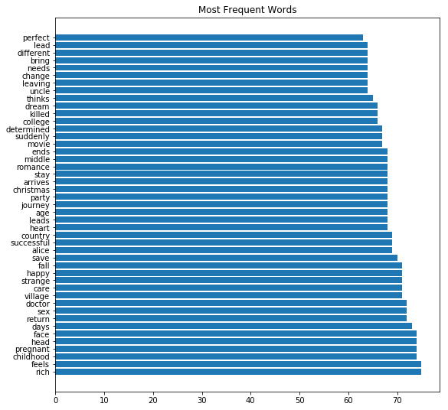
Cluster 1
College
Romance
Journey
Party
Pregnant
Childhood

Slide 11
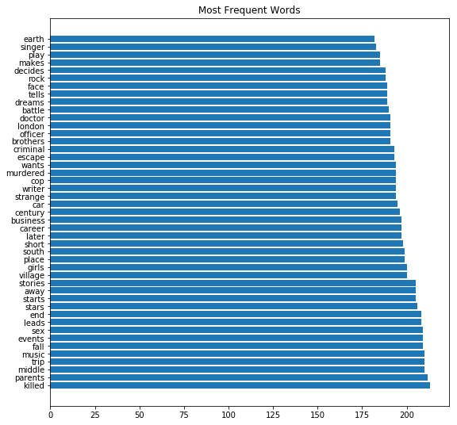
Cluster 2
Rock
Battle
London
Officer
Cop
Criminal
Music
Parents

Slide 12
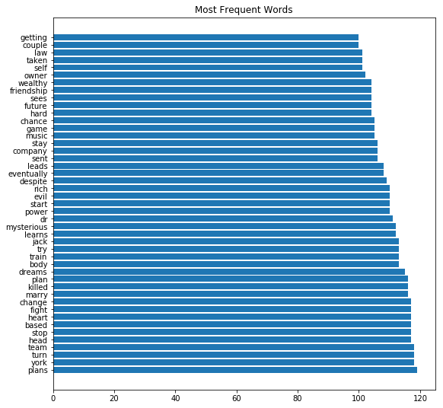
Cluster 3
Law
Friendship
Evil
Mysterious
Marry
Heart
Team

Slide 13
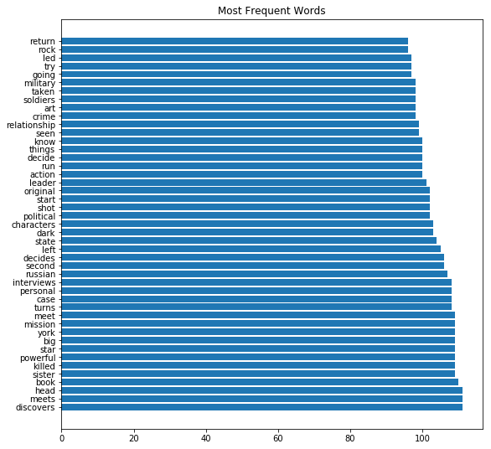
Cluster 4
Military
Soldiers
Relationship
Action
Leader
Political
Russian
Discovers

Slide 14
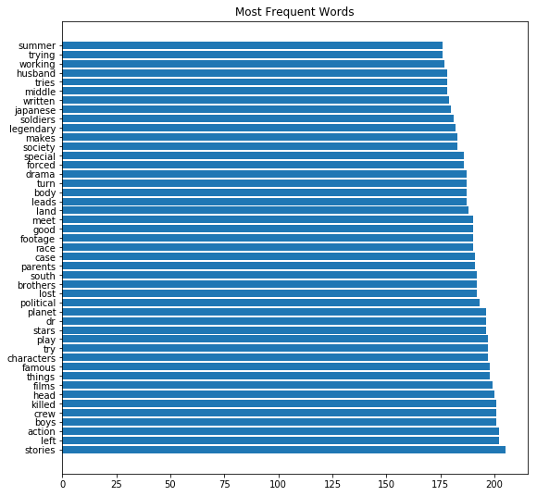
Cluster 5
Summer
Society
Drama
Race
Planet
Action

Slide 15
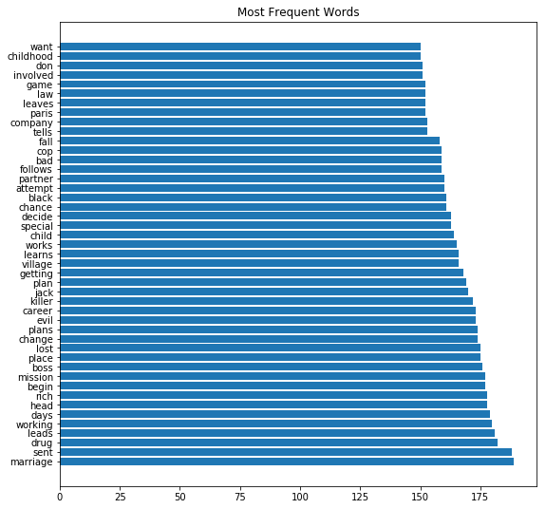
Cluster 6
Game
Company
Cop
Child
Career
Mission
Drug

Slide 16
Ways to Improve
User Based Recommendations
Movie Budgets
Scraping More Movie Data

Slide 17
Thank you!

