Slide 1
Apache Performance Tuning
Part 2: Scaling Out
Sander Temme <sander@temme.net>

Slide 2
Agenda
Introduction
Redundancy in Hardware
Building Out: Separate Tiers
Building Out: Load Balancing
Caching Content
Conclusion

Slide 3
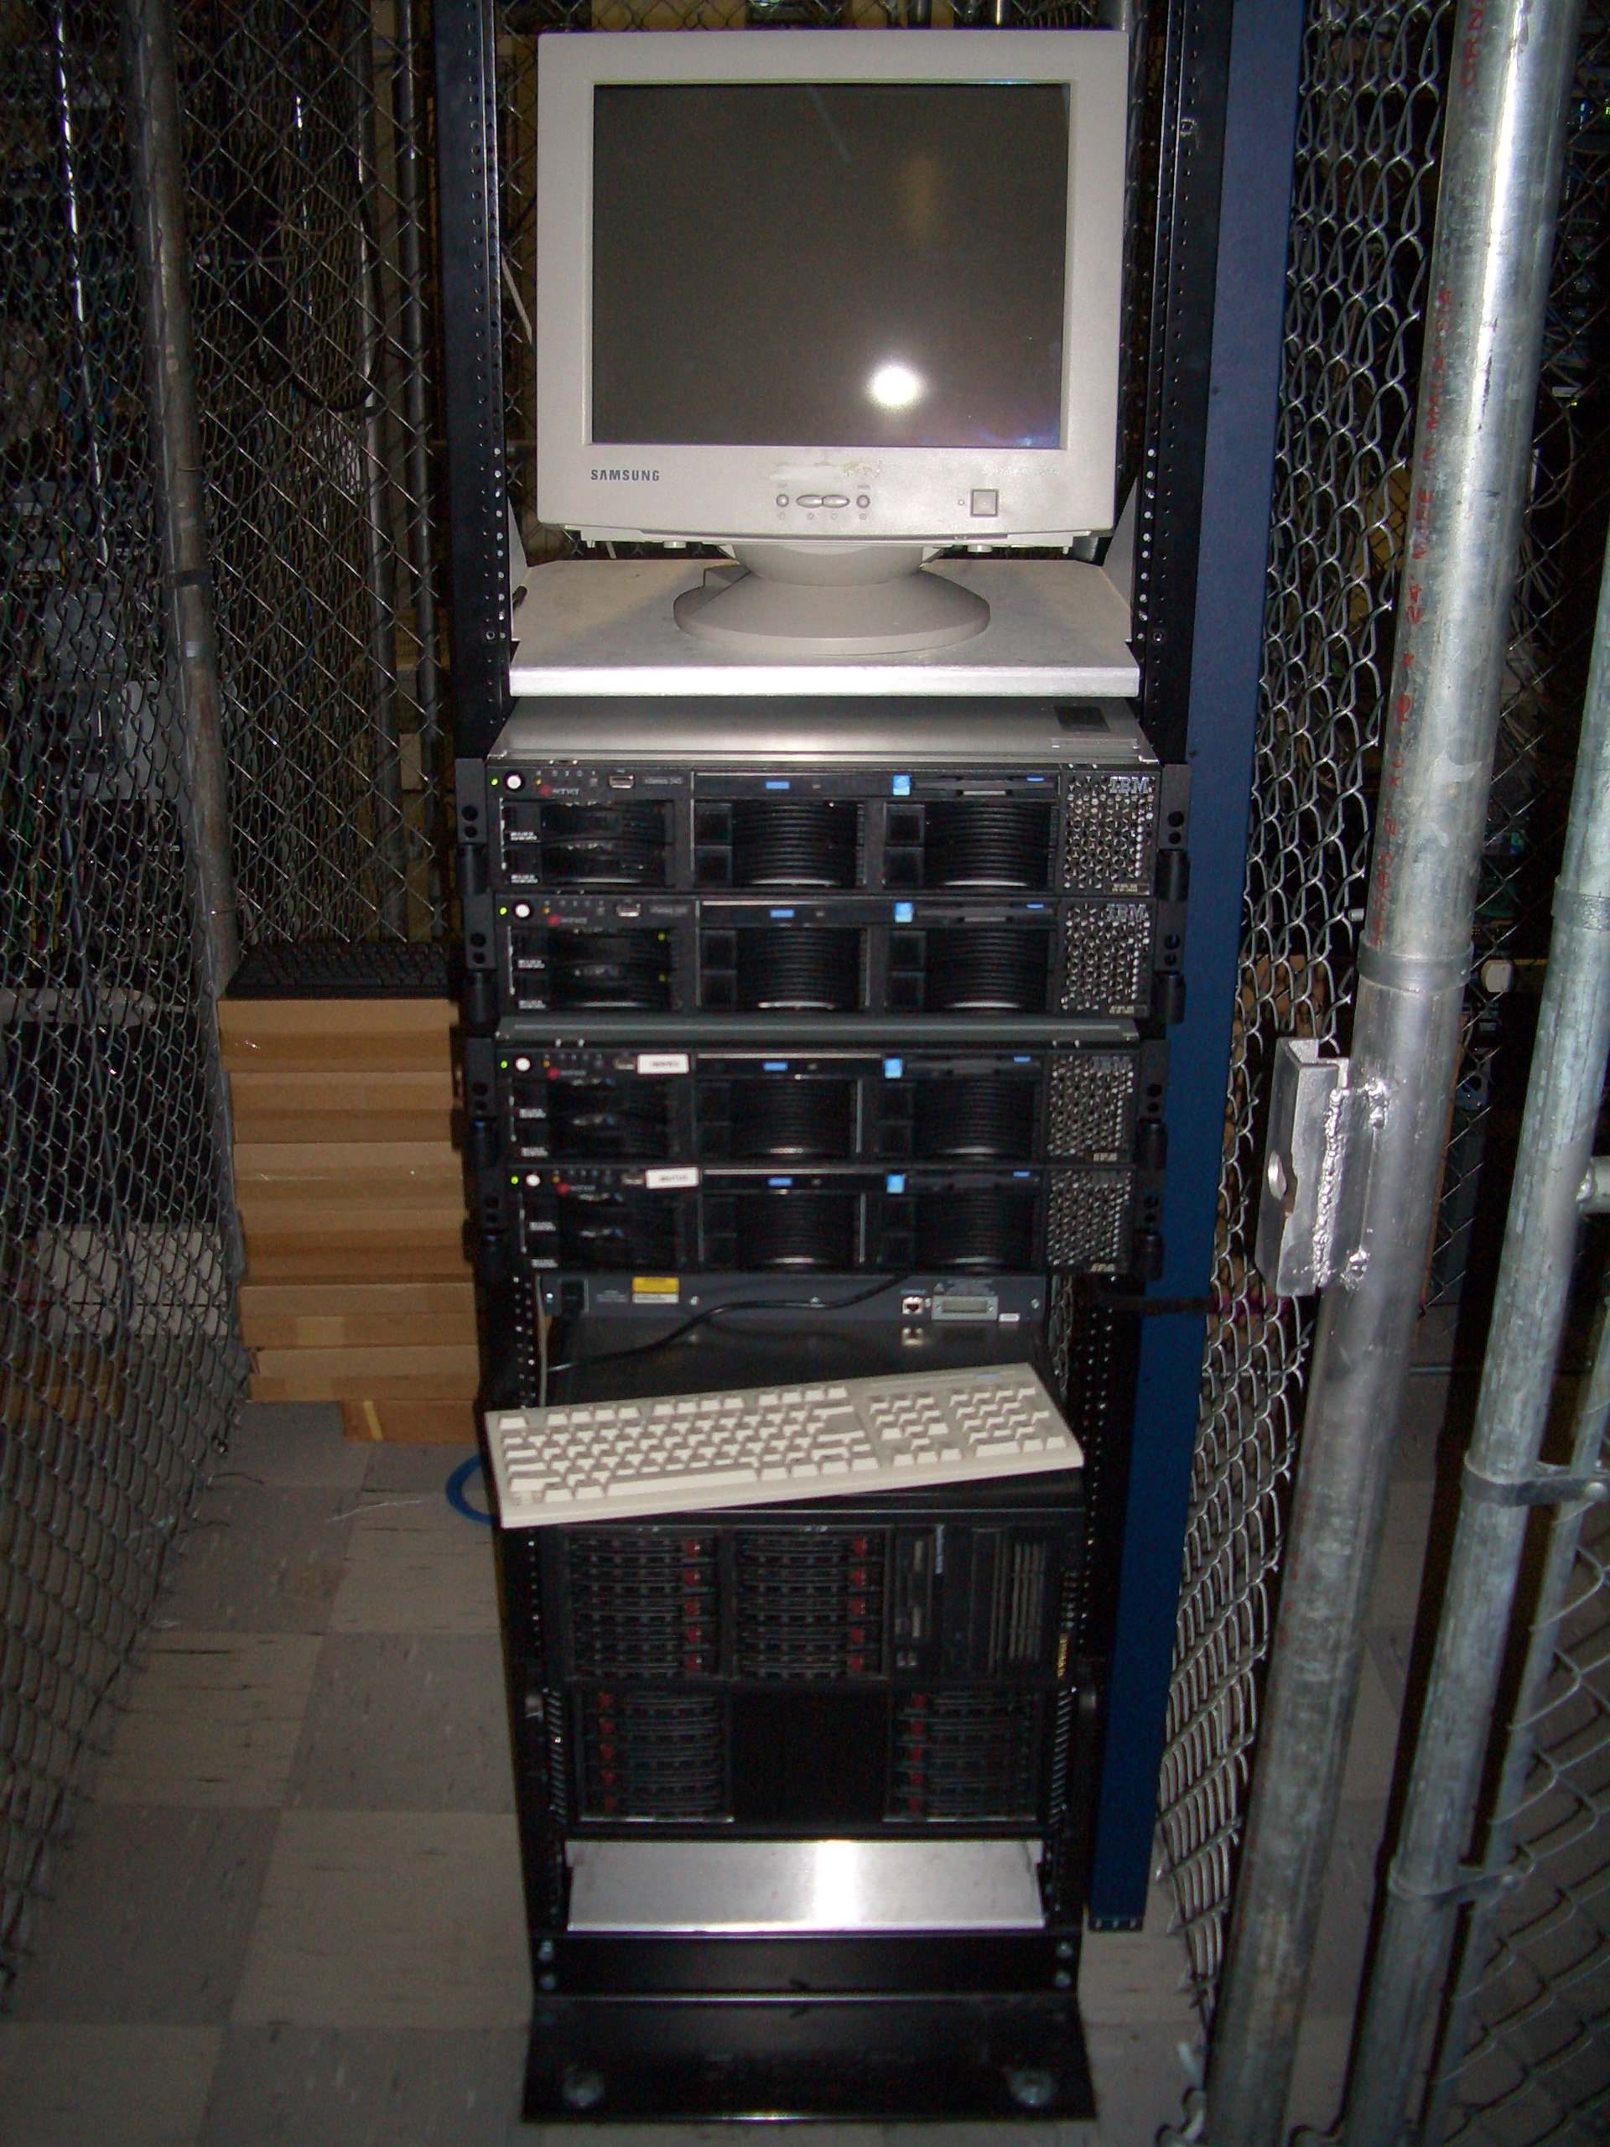
Introduction
Why do This?
Scalability (Oh my gosh, I’m so popular!)
Reliability (We need five nines!)
Why NOT do This?
It costs money

Slide 4

Redundancy in Hardware
Moving Parts Break
Hard Disks
Power Supplies
Hard Disks
Fans
Hard Disks
Buy High Quality Disks
Refurbished, OEM, Brand Name
Which has longer warranty?
Which is more reliable?

Slide 5
Server Configuration
Mirror those Disks
Install the RAID utility
Have it warn you
RAID is no good if you don’t learn of failures!
Redundant Power Supplies
On different circuits

Slide 6
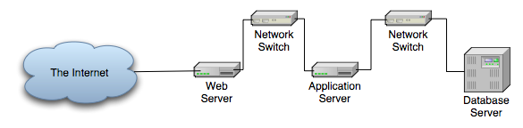
Scaling Vertically

Slide 7
Scaling Vertically
Move Services to Other Hosts
Pros:
Less resource contention
Specialized hardware
Scale out tiers individually
Cons:
Development/Deployment harder
More hosts to manage

Slide 8
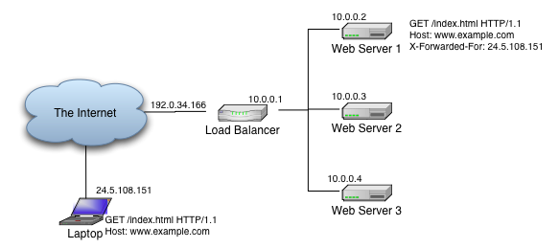
Scaling Horizontally

Slide 9
Scaling Horizontally
Multiple servers per tier
All receive requests
All serve same content
Some arbitration scheme

Slide 10
Load Balancing Schemes
DNS Tricks
Peer Server Pools
Network Load Balancing (Win2k3)
Wackamole
Load Balancing Appliance
Box from F5, Juniper, Cisco, Foundry, …
Linux Virtual Server

Slide 11
DNS Round-Robin
Easy!
Multiple A Records in DNS Zone File
Not Smart:
DNS Lookups are cached
Load on Server
Server Outage

Slide 12
Example Zone File
scalingout.org. 86400 IN SOA ns.scalingout.org. sctemme.scalingout.org. (
2006051401 ; Serial
86400 ; refresh (1 day)
7200 ; retry (2 hours)
8640000 ; expire (10 days)
86400 ) ; minimum (1 day)
scalingout.org. IN NS bagheera.scalingout.org.
gw IN A 10.11.0.1
bagheera IN A 10.11.0.2
; ...
mail IN CNAME bagheera
ns IN CNAME bagheera
www IN A 10.11.0.113
IN A 10.11.0.114
IN A 10.11.0.115

Slide 13
Peer-based: NLB
Windows 2000 Server Enterprise Ed., Windows Server 2003
Up to 32 hosts in cluster
All hosts assume cluster IP, MAC
NLB makes LB decision
Only one host gets to answer TCP handshake
Should be application independent

Slide 14
Peer-based: Wackamole
High Availability Solution
When Host Fails
Other hosts take over its IP addresses
Distribute IP addresses among cluster
Every IP address reliably available
No Load Balancing!
Use with RR DNS (or something)
http://www.backhand.org/wackamole/

Slide 15



Load Balancing Device
Client
Internet

Slide 16
Load Balancing
One Load Balancer
Many Web Servers
Choice of Balancing Schemes
Round-robin, Least Used, …
Reliability
Heartbeats, unavailable servers don’t receive requests
Feature War

Slide 17

Linux Virtual Server
Free, Open Source, etc.
IP Virtual Server module in kernel
Lots of auxiliary modules
Like a box of Legos
May come with Your Distribution
Do It Yourself
http://www.linuxvirtualserver.org/

Slide 18
Example: mod_proxy_balancer
New in Apache HTTP Server 2.2
Part of mod_proxy
Two Load Balancing Methods
By number of requests
By number of bytes
Detects failed backends

Slide 19
Apache Configuration
Listen 80
LogLevel debug
TransferLog logs/access_log
LoadModule proxy_module modules/mod_proxy.so
LoadModule proxy_http_module modules/mod_proxy_http.so
LoadModule proxy_balancer_module modules/mod_proxy_balancer.so
ProxyPass / balancer://mycluster/
ProxyPassReverse / http://1.2.3.4:80
ProxyPassReverse / http://1.2.3.5:80
<Proxy balancer://mycluster>
BalancerMember http://1.2.3.4:80
BalancerMember http://1.2.3.5:80
</Proxy>

Slide 20
Example: Tomcat, mod_jk
Apache + mod_jk
Multiple Tomcat servers
Balancer Worker

Slide 21
Apache Configuration
LoadModule jk_module /Volumes/Files/asf/httpd-r415210w/modules/mod_jk.so
JKMount /servlets-examples/* loadbalancer
JKMount /*.jsp loadbalancer
JkMount /jkmanager/* jkstatus
JKLogFile logs/jk_log
JKLogLevel debug
JKWorkerProperty worker.list=loadbalancer,jkstatus
JKWorkerProperty worker.tc1.port=15109
JKWorkerProperty worker.tc1.host=localhost
JKWorkerProperty worker.tc1.type=ajp13
JKWorkerProperty worker.tc1.lbfactor=1
JKWorkerProperty worker.tc2.port=15209
JKWorkerProperty worker.tc2.host=localhost
JKWorkerProperty worker.tc2.type=ajp13
JKWorkerProperty worker.tc2.lbfactor=1
JKWorkerProperty worker.tc3.port=15309
JKWorkerProperty worker.tc3.host=localhost
JKWorkerProperty worker.tc3.type=ajp13
JKWorkerProperty worker.tc3.lbfactor=1
JKWorkerProperty worker.loadbalancer.type=lb
JKWorkerProperty worker.loadbalancer.balance_workers=tc1, tc2, tc3
JKWorkerProperty worker.jkstatus.type=status

Slide 22
Tomcat Configuration
Put same content on all Tomcats
Edit conf/server.xml:
jvmRoute must match jk worker name!
<Engine name="Catalina" defaultHost="localhost" jvmRoute="tc1">

Slide 23
Problem: Session State
HTTP is Stateless
Apps use Sessions
Cookies
URL Encoding
Session created on single server
Broken by Load Balancing
PHP: sessions stored on disk

Slide 24
Solutions: Session State
“Sticky” routing on Load Balancer
Store State in DB
Put benign State in Cookie
But don’t trust the client too much
Replicate Sessions on Back-end

Slide 25
Tomcat Session Replication
Share HttpSession objects across instances
One instance dies, session lives on
Apache will route requests to other instance
Uses IP Multicast

Slide 26
Session Replication Config
Uncomment <Cluster> element in server.xml
Put empty <distributable /> element in <web-app> element in web.xml

Slide 27
Caching Content
Dynamic Content is Expensive
Static Content Relatively Cheap
Several Approaches:
Dynamic caching
Pre-rendering popular pages (index.rss…)

Slide 28
mod_cache Configuration
<IfModule mod_cache.c>
<IfModule mod_disk_cache.c>
CacheRoot /raid1/cacheroot
CacheEnable disk /
# A page modified 100 min. ago will expire in 10 min.
CacheLastModifiedFactor .1
# Always check again after 6 hours
CacheMaxExpire 21600
</IfModule>
</IfModule>

Slide 29
Make Popular Pages Static
RSS Feeds
Popular catalog queries
… (Check your access log)

Slide 30
Static Page Substitution
<Directory "/home/sctemme/inst/blog/httpd/htdocs">
Options +Indexes
Order allow,deny
Allow from all
RewriteEngine on
RewriteCond %{REQUEST_FILENAME} !-f
RewriteCond %{REQUEST_FILENAME} !-d
RewriteRule ^(.*)$ /cgi-bin/blosxom.cgi/$1 [L,QSA]
</Directory>

Slide 31
Tuning the Database Tier
Not my area (sorry)
Give Money to Oracle Consultants
(or MySQL) (or …)
Tip: Separate Read and Write Operations
Replicate from Write db to Read db
Read db data slightly stale
Does it matter?

Slide 32


Putting it All Together
Read-only
Internet
Client
Write-only

Slide 33
Monitoring the Farm
Monitor for outages
More boxes, more failure
HA can mask failures
Monitor for performance
Utilization
Trends

Slide 34
Monitoring Solutions
Nagios
Check services, hosts for outage
Highly configurable, extendable
Worth your time investment
Ganglia
Monitor for performance
See Brad Nicholes’s session

Slide 35
Monitoring Caveats
Takes Time, Effort
Highly flexible products
You can’t fix it
If you don’t know it’s broken
You can’t tune it
If you don’t know the bottlenecks

Slide 36
Conference Roadmap
Monitoring 2.0 - Zenoss, the next level of IT management (Training)
Apache Performance Tuning Part 1: Scaling Up
Load-balancing with Apache HTTPD 2.2 and later
Scaling the download infrastructure with your success
Break My Site

Slide 37
Current Version
http://people.apache.org/~sctemme/ApconEU2008/

Slide 38
Thank You

