Slide 1




Notes:
Welcome
Name, Position, Teaching
Thanks to Computer Science Club
Topic of Discussion
General Outline of Demo

Slide 2


SYSTEM SPECS
Notes:
Bruce Introduction
OS =

Slide 3
Head Node
Server: PowerEdge R740XD
CPU: Dual Intel Xeon Gold 6126 2.6G, 12C/24T, 10.4GT/s , 19.25M Cache, Turbo, HT (125W) DDR4-2666
Memory: 96GB DDR4 2666MHz DRAM
Hardrdrives:
  OS: 2 x 240GB SSD SATA 6Gbps 512e 2.5in Flex Bay Drives in Raid 1 (mirrored) for a total of 240GB of storage
  Storage: 12 x 4TB 7.2K RPM NLSAS 12Gpbs 512n 3.5in Hot-plug Hard Drives in RAID 6 (double parity) for a total of 40TB of storage. This RAID configuration gives 10x read speed, but no write speed gain.
SYSTEM SPECS
Notes:
Head node is a Dell PowerEdge R74
Two Intel Xeon Gold 6216 Proceesors running at 2.6G
86 GB of DDR4 RAM running 2666MHz
Two Hard drive partions - the OS and Storage
OS - 2 x 240GB SSD Sata Drives running in Raid 1 mirrored for redundancy
Storage 12 x 4TB drives, physical disk run running at 7.2K RPMs. They are Hot-pluggable drives running RAID 6. Which is double parity. This gives us 40TB of storage with 10x read speed. but no gain in write speed.

Slide 4
Compute Node
Server: PowerEdge R440
CPU: Dual Intel Xeon Gold 6126 2.6G, 12C/24T, 10.4GT/s , 19.25M Cache, Turbo, HT (125W) DDR4-2666
Memory: 96GB DDR4 2666MHz DRAM
Had drives:
  OS: 1 x 200GB SSD SATA Boot 6Gbps 512n 2.5in Hot-plug Drive, 1 DWPD, 219 TBW
  Storage: None
SYSTEM SPECS

Slide 5
Spec Summary
Servers: 8 nodes
  1 Head node
  7 Computer nodes
CPU: 16
  2 CPU per node
Cores: 192
  12 cores per CPU
Memory: 768GB DDR4 2666MHz DRAM
  96GB per node
Storage: 40TB
  Only on Head node
SYSTEM SPECS
Notes:
Add Picture of Bruce Here

Slide 6



Accessing Bruce

Slide 7


Who?

Slide 8
All UCA:
Faculty
Staff
Who Can Access Bruce?
Students

Slide 9


How?

Slide 10
Requires an account
Remote Access only
Accessed through the secure protocol SSH
Provides a text-based interface
All commands typed locally and executed on the remote server
NOTE: Campus Access ONLY!
How to access Bruce?
Examples:
ssh [username]@161.31.5.50
Notes:
As stated before, you will first need an account.

Slide 11
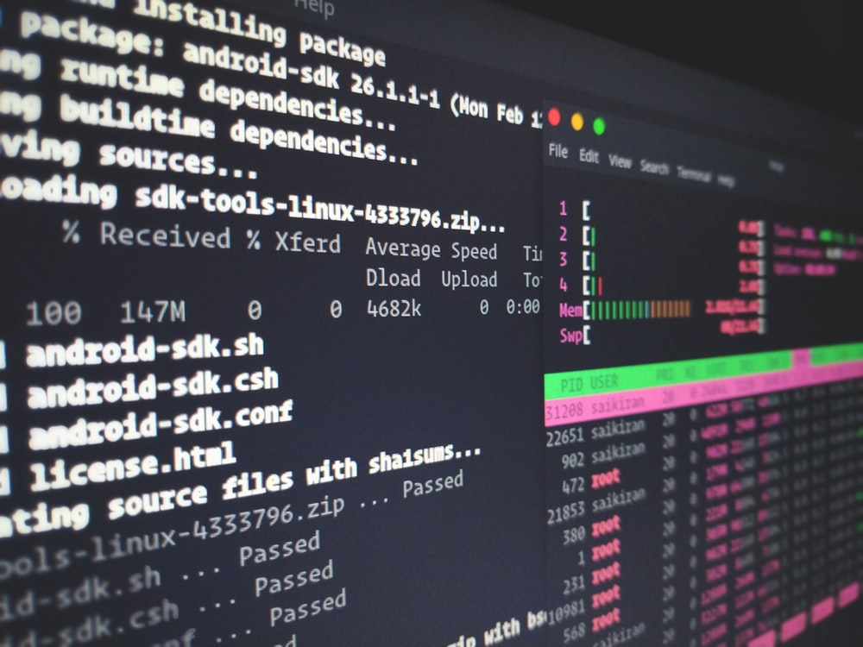

Bruce Basics

Slide 12
Working on Bruce
Bruce Basics
ssh[username]@161.31.5.50
By default, you will be taken to your home directory
A comprehensive list, including examples
https://dev.to/awwsmm/101-bash-commands-and-tips-for-beginners-to-experts-30je#pwd-ls-cd
Notes:
No one else has write privileges to your home directory
Your free to install any software you want to your home directory
You should have a handout with several basic Linux commands that can get you started in Linux.
This isn’t an official documentation, but actually a blog post but it is done really well with great examples in plain English that is easy to understand.
You can not install any software globally, that is only done by the administrator

Slide 13
Transferring Files
FTP Clients
Filezilla
  Download: https://filezilla-project.org/
WinSCP
  Download: https://winscp.net/eng/index.php
Bruce Basics
SCP
scp [local_file] [username@]server_IP:[remote_file] [destination]
Examples
Copying local to remote.
  $ scp myfile.txt jcorkran@161.31.5.50: ~
Copying remote to local.
  $ scp jcorkran@161.31.5.50:~/documents/myfile.txt .
Notes:
2 Types GUI based utilites and then a command lines utility. Obvisouly there are other methods out there.
On the GUI side we have Filezilla and Winscp
On the CMD Line side we have SCP.

Slide 14
Submitting Jobs - Slurm
Slurm: Jobs Scheduler
A workload management system
  Monitors jobs
  Modifies jobs
  Deletes jobs
Settings
  Job script being processed
  Number of processors allocated
  Resource usage
  Application-specific variables
  and more…
Bruce Basics
Notes:
So to get a better understanding of Slurm I would to first talk about why we need Slurm.
So when we ssh in Bruce we are always working on the Head node.
All code we run is actually taking up resources on the Head node.
So if everyone just runs their own code without using Slurm, then we only have 2 CPUs and 96GB of RAM to share.
Hence the need for Slurm.
So Slurm knows all about the resources available for all 7 nodes.
Slurm will schedule all jobs and allocate the open resources accordingly
Slurm uses the FIFO system, First in First out. So no complicated algorithm to sort out an estimation of how long the job will take versus other submissions.
Its just First come First served, and if there isn’t enough resources available your job will sit in the queue and wait for its turn.
So if we ever start utilizing the resources of Bruce you may not get your results back as soon as you would like.
Slurm is just a bash script that you can add special syntax to that the SBATCH commnd can understand what you want. So basically you code in all the parameters you would like for Slurm to know about.

Slide 15
Running Jobs - sbatch
sbatch - command
To submit a job to slurm, we use the sbatch command
Bruce Basics
#!/bin/bash
#SBATCH --job-name=hello <- The name you want the job to have
#SBATCH --output=sample-%j.out <- The filename for the jobs output (stdout)
#SBATCH --error=sample-%j.err <- The filename for the jobs error output (stderr)
#SBATCH --partition=defq <- The name of the default queue is defq
srun <script_name> # used for script submission
NOTE: This is by no means an exhaustive overview of the capabilities and commands available in SBATCH. This is just a very small sample of what is possible
Notes:
Note the shebang at the top.
Then we have the specific parameters for sbatch

Slide 16
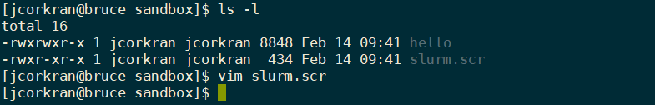
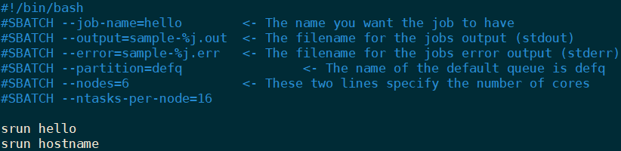
Running Jobs - sbatch
Bruce Basics

Slide 17


$ ls
slurm.scr hello_world
$ sbatch slurm.src
Submitted batch job 36
$ echo “Lets get coding”
Lets get coding
Live Examples

Slide 18
Demonstration
Submit sbatch job
  Creates over 3700 files
  Displays
    Shortest
      filenames
      count
    Longest
      filename
      count
    Count - files processed
Group Project
Submit sbatch job
  Hello World
  Incremented count
$ ls
slurm.scr hello_world
$ sbatch slurm.src
Submitted batch job 36
$ echo “Lets get coding”
Lets get coding
Live Examples

Slide 19

Documentation

Slide 20
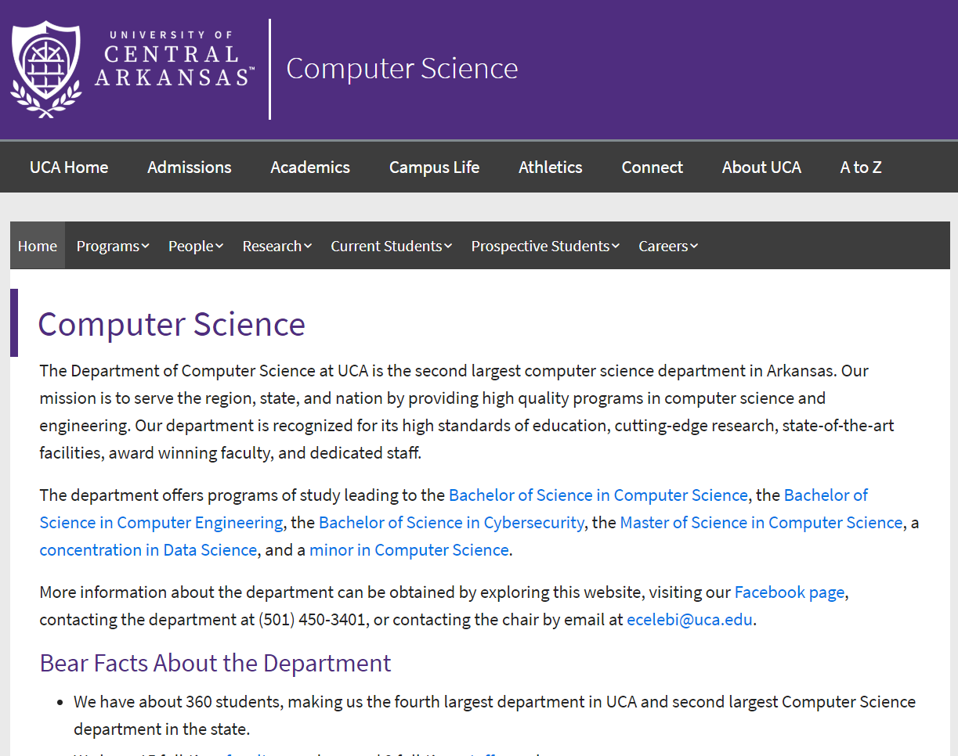
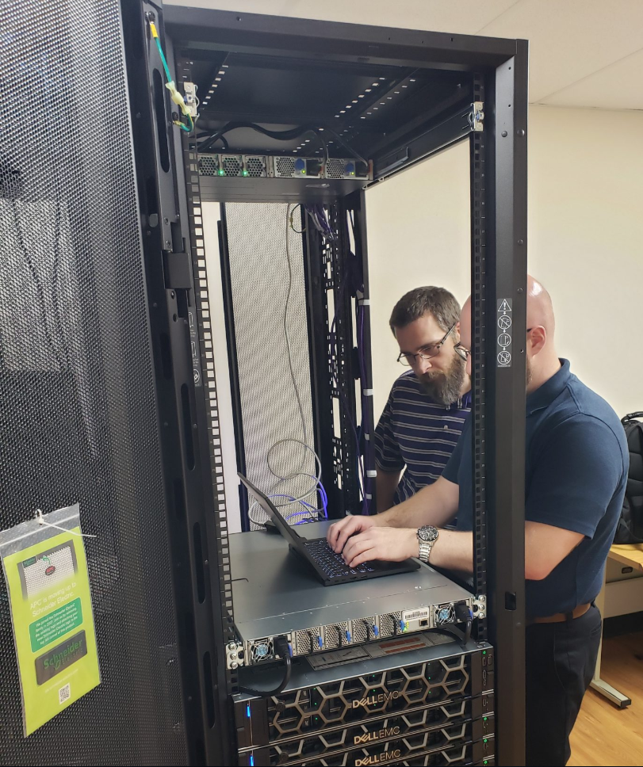
Documentation

Slide 21
Computer Science Website
https://uca.edu/computerscience/supercomputer/
Documentation

