Slide 1
ENVIRONMENTAL HEALTH RESEARCH · PHASE 1 FEASIBILITY REPORT
PFAS Drinking-Water Exposure &
Obesity-Related Health Outcomes
A community-level feasibility study across Texas ZIP Code Tabulation Areas (ZCTAs)
EPA UCMR 5 · CDC PLACES · US Census ACS — public data, fully reproducible pipeline
Prepared by Yuqing · Phase 1 Review · September 2026

Slide 2




THE RESEARCH QUESTION
Linking Environmental PFAS Exposure
to Community Health
Obesity
adult prevalence, %
How are community-level PFAS exposures associated with obesity-related health outcomes — and how do these relationships vary across geography and socioeconomic context?
Diabetes
diagnosed, adult prevalence
Hypertension
Testbed geography: Texas, with specific attention to Bexar County / San Antonio
high blood pressure prevalence
PFAS FEASIBILITY · PHASE 1
2 / 15

Slide 3






PHASE 1 SCOPE
A Feasibility Package — Not Yet a Causal Analysis
Six deliverables, assembled entirely from public data:
A. Data Inventory
B. Integrated Dataset
C. Linkage Summary
5 public sources, all key-free
1,989 TX ZCTAs linked end-to-end
full integration funnel documented
D. Preliminary Maps
E. Exploratory Analysis
F. Methodological Memo
exposure + 3 outcomes + SES
correlations, Moran's I, LISA
limitations & recommended next steps
PFAS FEASIBILITY · PHASE 1
3 / 15

Slide 4



DATA & METHODS
Five Public Sources, Zero API Keys
→
→
→
→
EPA UCMR 5
EPA SDWIS
ZIP → ZCTA crosswalk
CDC PLACES
US Census ACS
PFAS in drinking water — 29 compounds
population served, source type
geographic linkage
obesity / diabetes / hypertension
socioeconomic & demographic covariates
Reproducible pipeline — 14 R scripts, one command: Rscript scripts/run_all.R (~1 minute)
PFAS FEASIBILITY · PHASE 1
4 / 15

Slide 5
SAMPLE FEASIBILITY
Texas Provides a Workable Analytic Sample
1,154
622
1,436
95.2%
1,223
→
→
→
→
TX public
water systems
with a PFAS
detection
ZIP codes
served
matched
to a ZCTA
ZCTAs — primary
analytic sample
95.7%
of Texas' ZCTA population is covered by the primary analytic sample — ample for global and spatial statistical modelling.
Caveat: the sample is limited to monitored ZCTAs (geographically gappy), and only 19 ZCTAs show a regulatory exceedance — limited exposure contrast within one state.
PFAS FEASIBILITY · PHASE 1
5 / 15

Slide 6
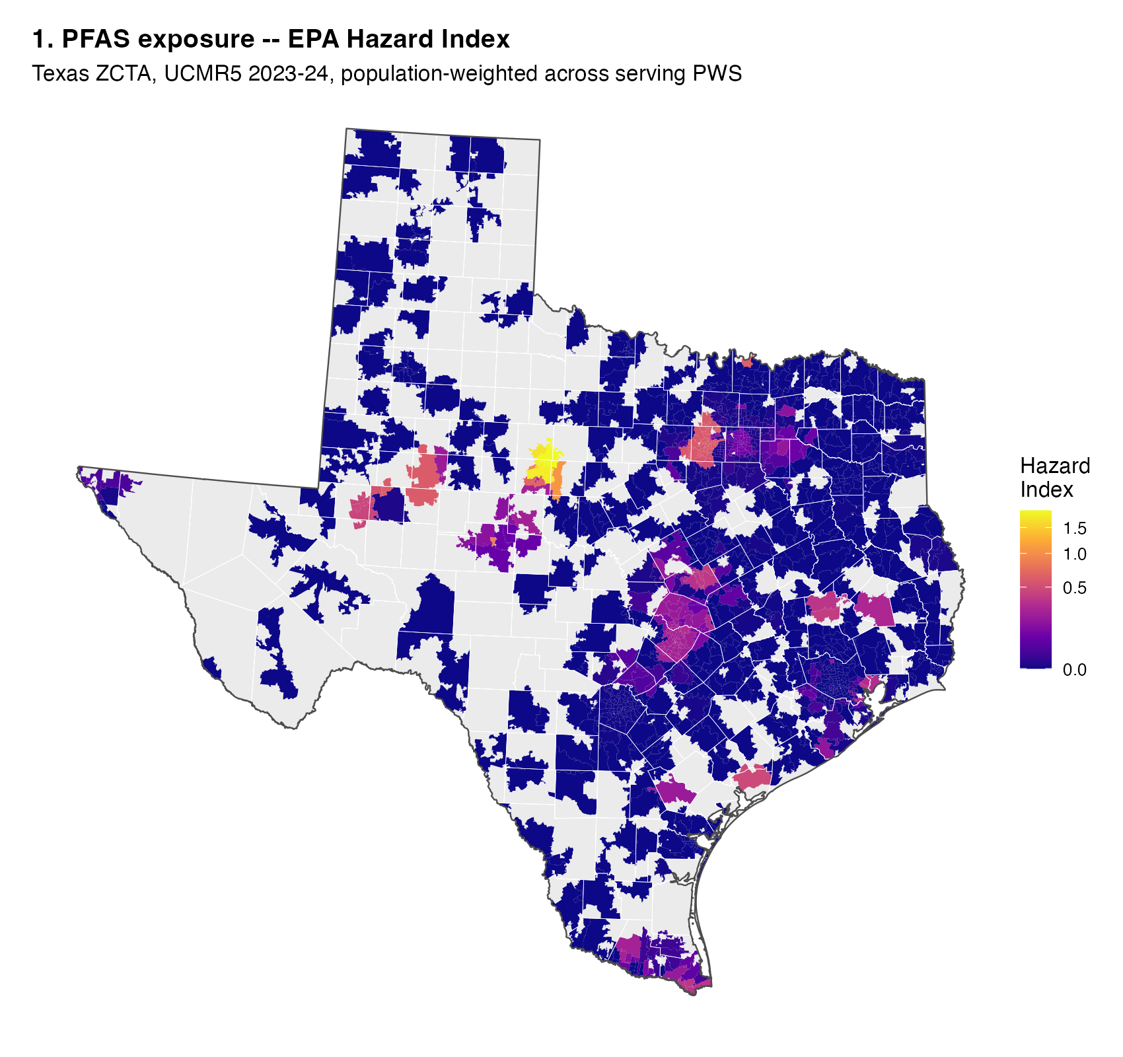
PRELIMINARY MAPS
Where Is PFAS Detected Across Texas?
EPA Hazard Index (2024), population-weighted across every water system serving a ZCTA
Detected in 622 of 1,154 Texas systems; only 19 exceed a regulatory threshold
Highest values cluster in DFW, Midland–Odessa, and the Houston–Austin–San Antonio corridor
Most of rural Texas is unmonitored under UCMR 5 (shown in grey)
PFAS FEASIBILITY · PHASE 1
6 / 15

Slide 7
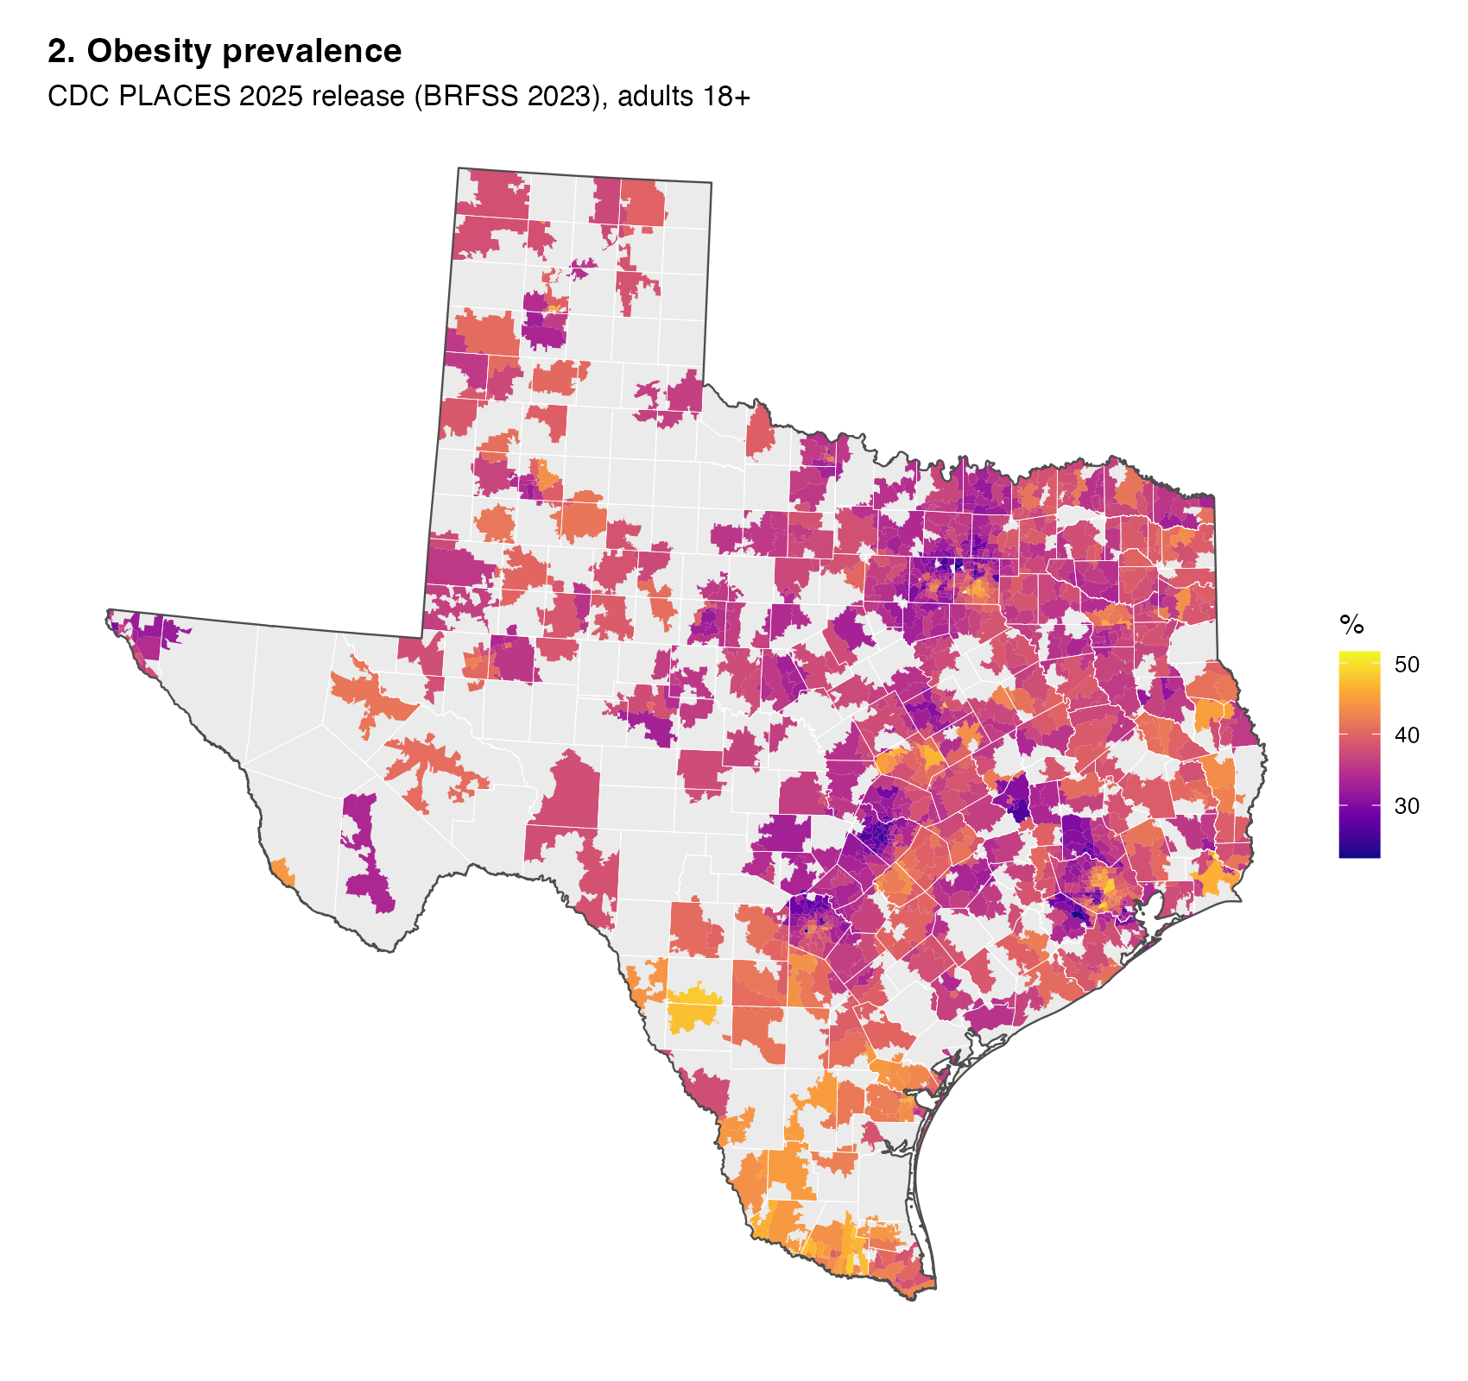
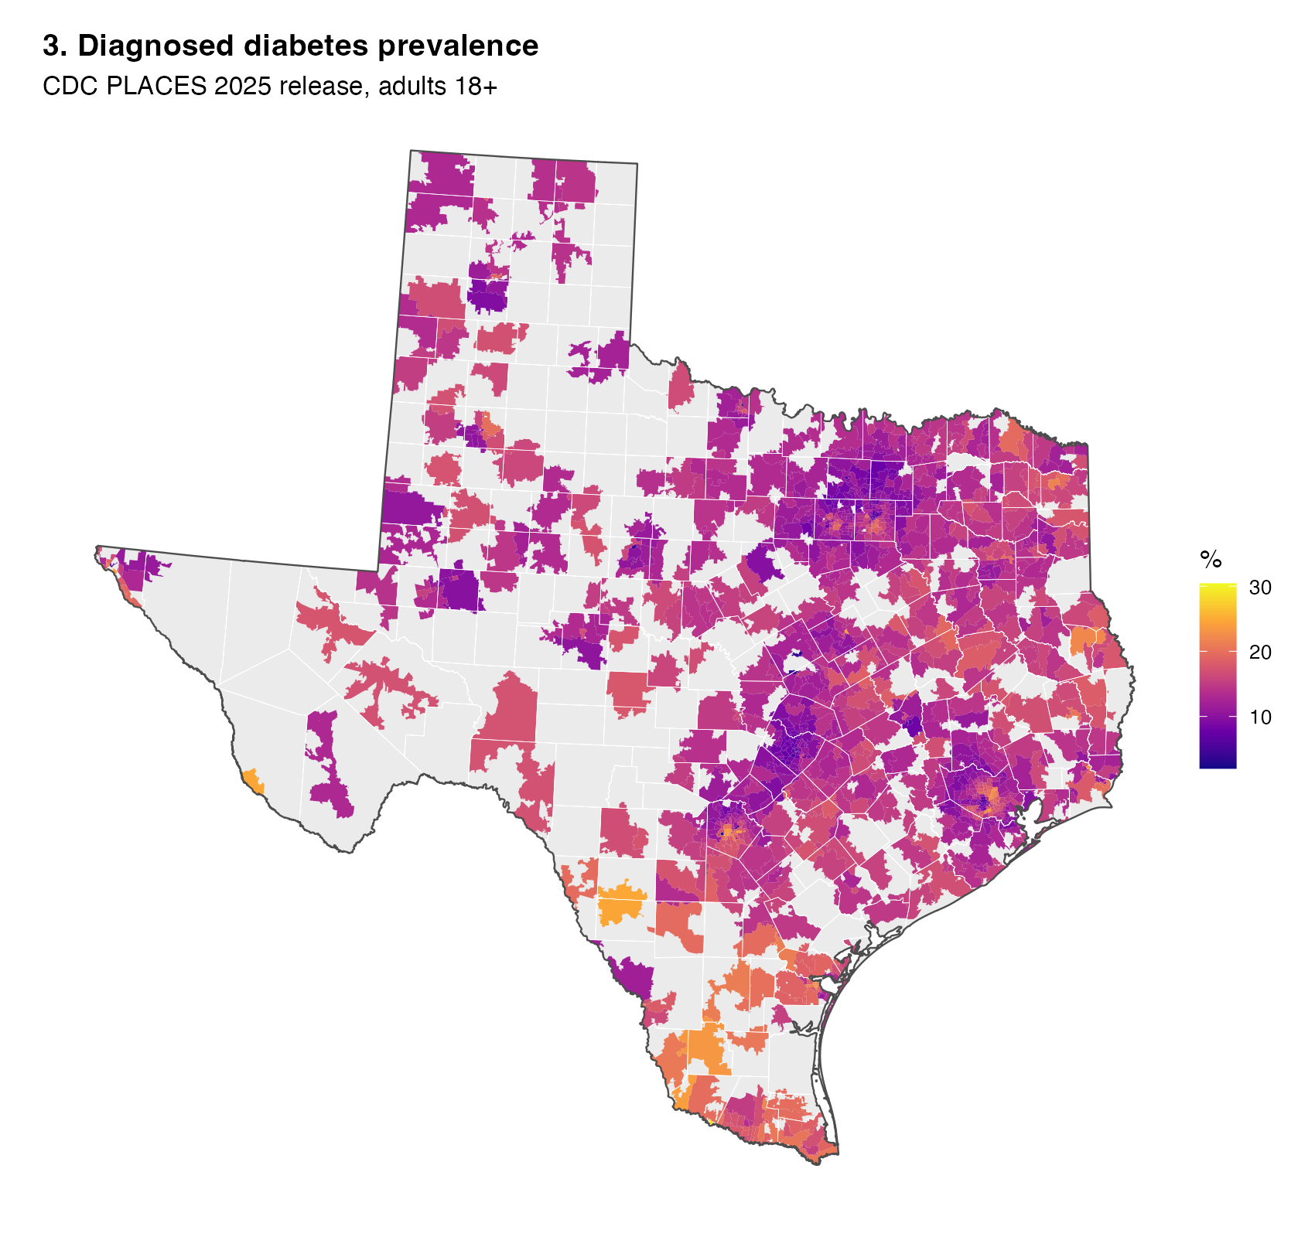
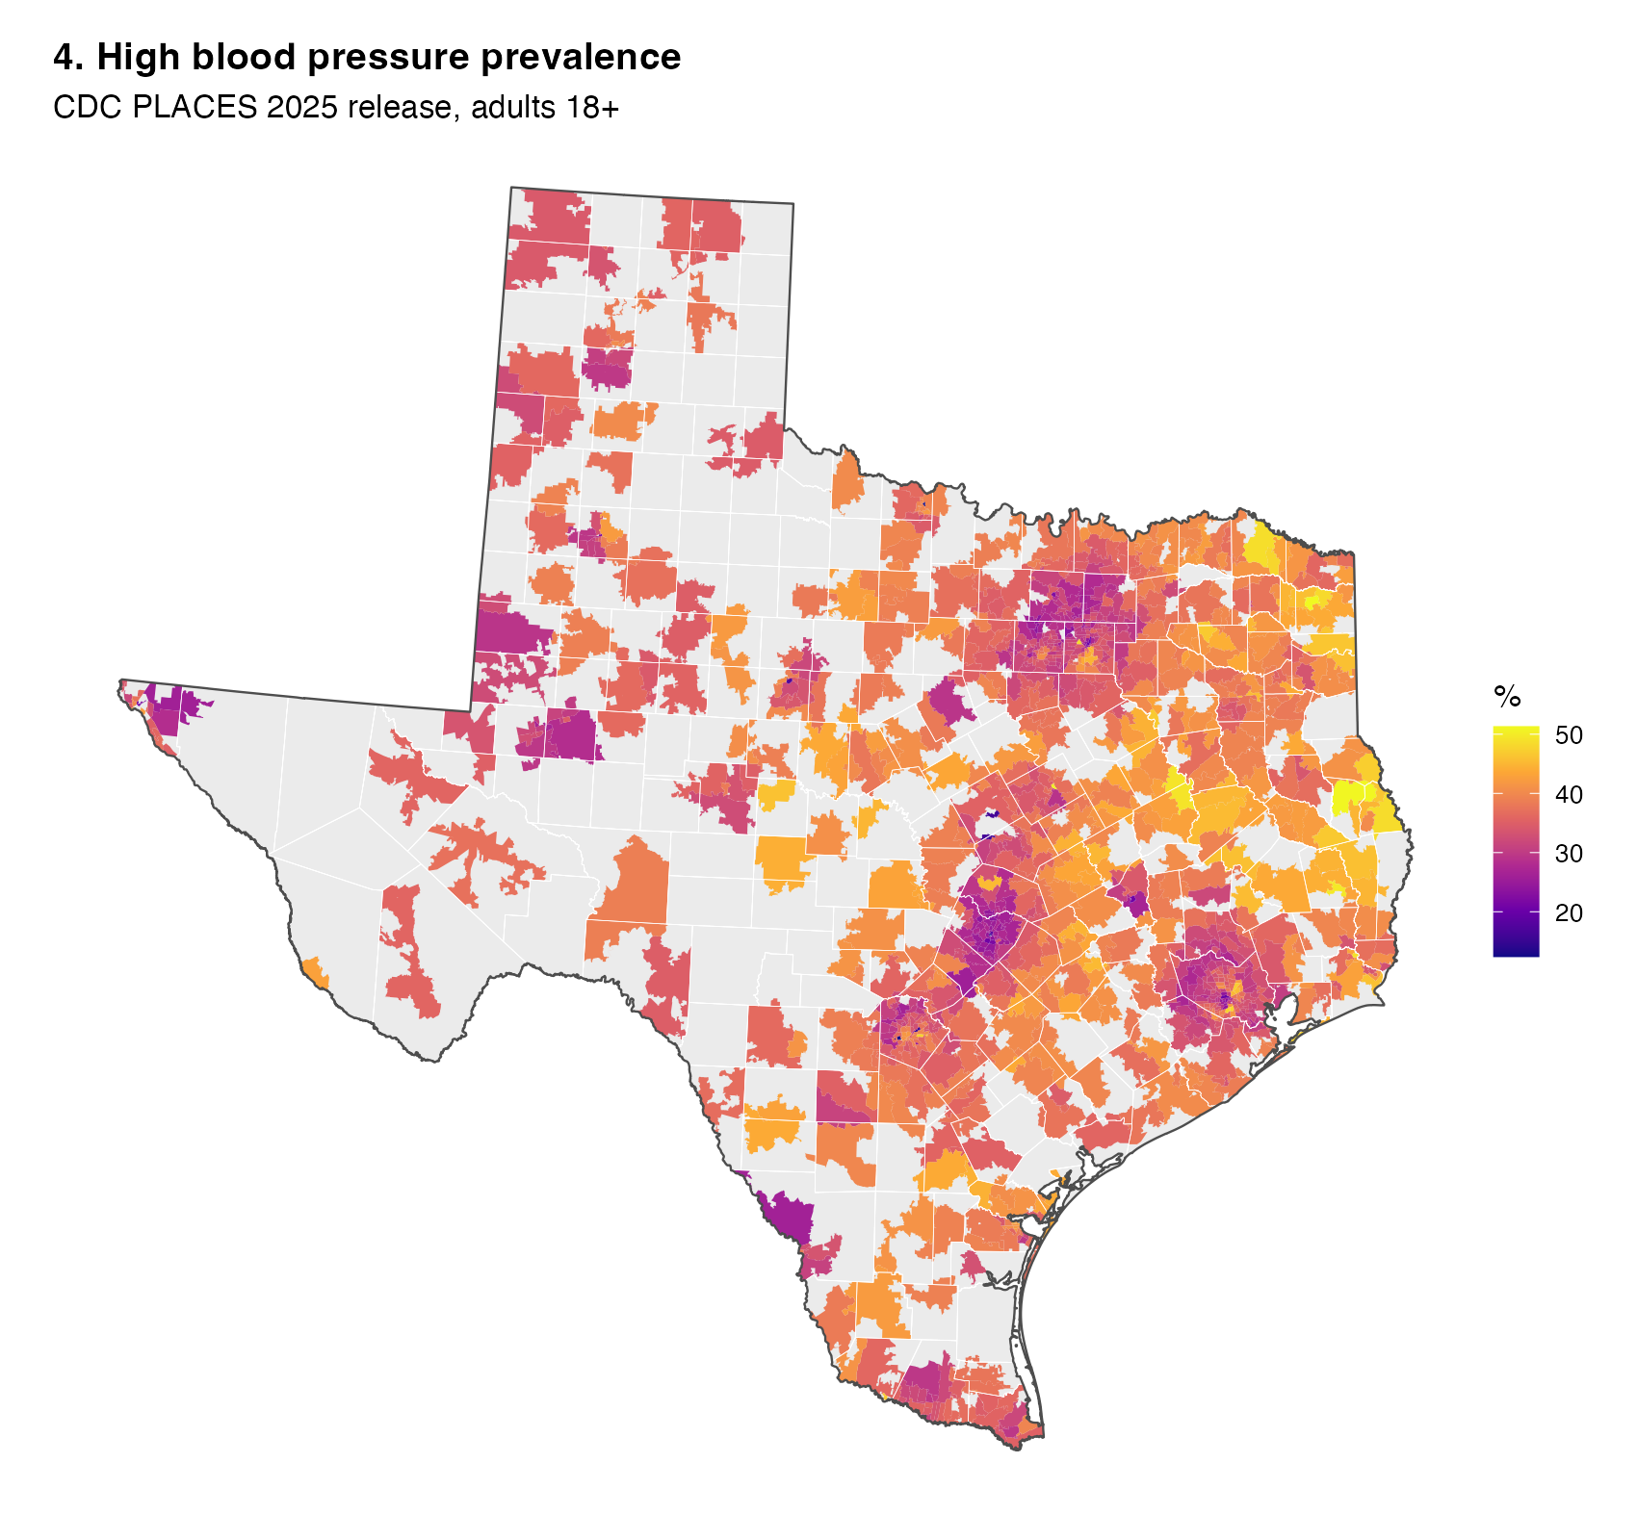
PRELIMINARY MAPS
Three Health Outcomes, Three Spatial Patterns
Obesity
Diabetes
Hypertension
CDC PLACES 2025 release — model-based crude prevalence, ZCTA level
PFAS FEASIBILITY · PHASE 1
7 / 15

Slide 8
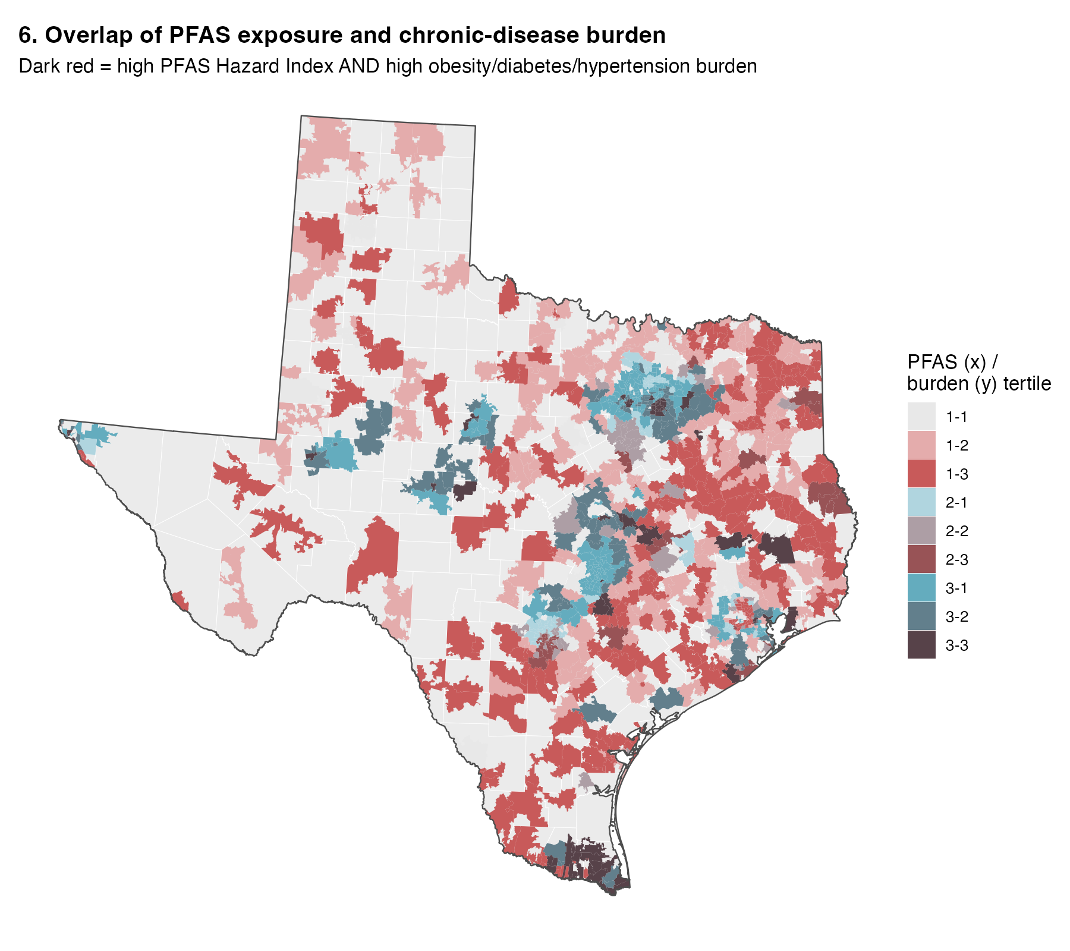
KEY FINDING
Exposure and Disease Hot-Spots
Rarely Coincide
105
PFAS “High-High” hot-spot ZCTAs
3
also an obesity hot-spot
0
also a diabetes hot-spot
0
also a hypertension hot-spot
Both PFAS exposure and chronic-disease burden are strongly spatially clustered (Moran's I 0.5–0.8) — but in different places. No ZCTA is simultaneously a PFAS, disease, and SES-vulnerability hot-spot.
PFAS FEASIBILITY · PHASE 1
8 / 15

Slide 9
KEY FINDING
Correlation Is Strongest for Hypertension — Then Mostly Disappears
Unadjusted correlation is inverse (higher PFAS → lower prevalence) and increases in magnitude from obesity to hypertension — the pattern the advisor noticed.
After adjustment, all three associations collapse toward zero — explained mostly by urbanicity and socioeconomic status, not a protective effect of PFAS.
PFAS FEASIBILITY · PHASE 1
9 / 15

Slide 10


MODELLING FEASIBILITY
What's Ready — and What's Still Fragile
Texas sample for spatial modelling
FEASIBLE (size)
GAPPY (support)
1,223 ZCTAs / 95.7% of population — ample size, but limited to monitored ZCTAs; queen-contiguity fragments into ~28 sub-graphs.
Propensity-score matching
FEASIBLE BUT FRAGILE
Common support ~81%; baseline imbalance large (max SMD 0.87); weighting leaves 0.47 — only 1:1 caliper matching fully balances covariates.
GWR / MGWR
MGWR ONLY
NOT GLOBAL GWR
Naive GWR bandwidth (~14 neighbours) over-fits: local coefficients range from −176 to +251 — spatial-error models are the workhorse instead.
PFAS FEASIBILITY · PHASE 1
10 / 15

Slide 11
ADVISOR FEEDBACK
Two Questions From the Review
Drinking water is only one source of exposure. Do we have PFAS information in air and soil that can be processed similarly — for a more accurate exposure estimate?
→ Next-Phase Direction 1
It's understandable that PFAS shows weak correlation with obesity — too many contributing factors. The hypertension correlation is more interesting. Should we look at more direct health indicators or biomarkers?
→ Already visible in Phase 1 data (previous slide); motivates the planned individual-level biomarker study
PFAS FEASIBILITY · PHASE 1
11 / 15

Slide 12



NEXT-PHASE DIRECTION 1
From a Concentration to a PFAS Exposure System
Move beyond drinking-water concentration alone — integrate every available environmental medium into one community-level exposure measure.
Community-level PFAS exposure index
+
+
+
→
Water
Soil
Air / emissions
Industrial facilities
in place — Phase 1
to integrate
to integrate
to integrate
Source attribution
Beyond mapping where exposure is high, examine what explains the pattern: industrial facilities, AFFF-related sites (airports, military bases, fire-training areas), wastewater / biosolids application, and other point sources.
PFAS FEASIBILITY · PHASE 1
12 / 15

Slide 13



NEXT-PHASE DIRECTION 2
Where Does PFAS Exposure Matter More?
Effect modification & interaction effects — identify populations or places where the health implications of PFAS exposure are stronger or weaker.
× Socioeconomic vulnerability
Does the health association strengthen in lower-income or higher-poverty communities?
× Age structure
Older populations may show different sensitivity to chronic, low-level exposure.
× Urbanicity
Urban vs. rural water systems differ in source type, monitoring density, and confounding structure.
Complements the advisor's biomarker question: interaction effects can be tested more directly once individual-level blood pressure, cholesterol, and biomarker data (Phase 4) are available.
PFAS FEASIBILITY · PHASE 1
13 / 15

Slide 14

PROPOSED PATH FORWARD
From Feasibility to a Community Exposure–Health Model
P2
P3
P4
PHASE 1 — DONE
PHASE 2
PHASE 3
PHASE 4
Data Feasibility
Broader Exposure System
Spatial Bayesian Modelling
Individual Biomarker Study
Texas testbed — integrated pipeline, linkage, descriptives
water + soil + air/emissions + industrial facilities; source attribution; effect modification; expanded geography
confounding-sensitivity analysis; identification diagnostics
serum PFAS/MNPs, BMI, A1c, blood pressure, diet
PFAS FEASIBILITY · PHASE 1
14 / 15

Slide 15
Thank You
Questions & Discussion
PFAS Drinking-Water Exposure & Obesity-Related Health Outcomes — Phase 1 Feasibility Report
Yuqing · demiyyq@gmail.com

