Slide 1
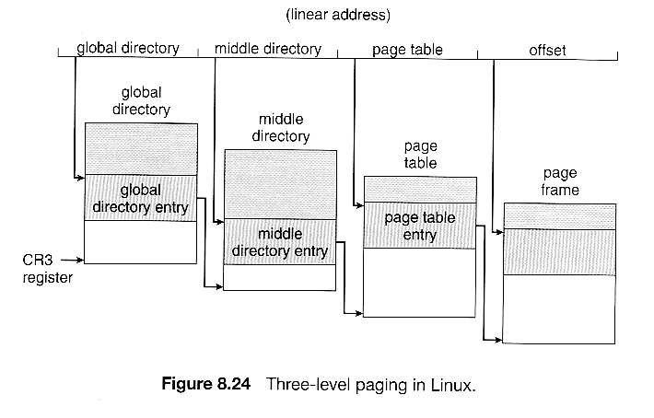
PGDX
PMDX
PTX
Offset
Virtual Address
Notes:
AMD introduced the 3-level page table with x86_64 but only supported 39 bits of VA(512GB)
VA is split into PDGX, PMDX, PTX(9 bits each) and offset(12 bits)

