Slide 1
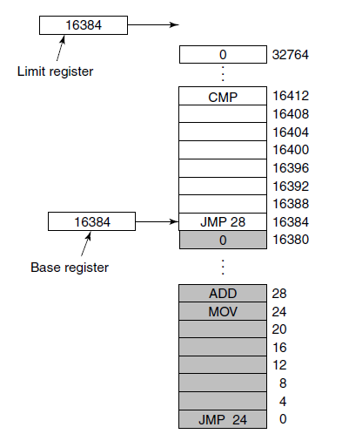
Base and Limit Registers
Base and limit registers can be used to give each process a separate address space.

