Slide 1
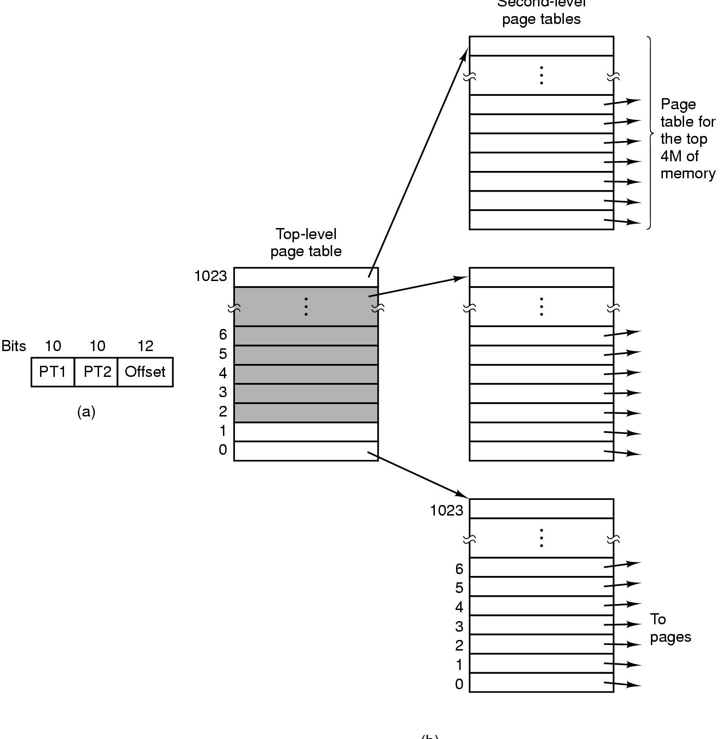
32 bit virtual address
PT1: Top-level index, 10 bits
PT2: Second-level index, 10 bits
Offset: 12 bits
Page size: 4KB
Second-level maps 4MB (1024 entries of 4KB)
Top-level maps 4GB (1024 entries of 4MB)

