Slide 1
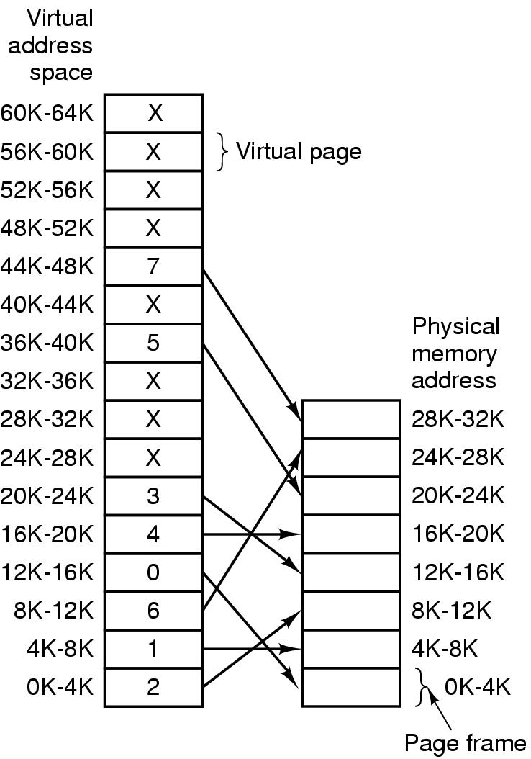
Virtual memory: 64KB
Physical memory: 32KB
Page size: 4KB
# Virtual memory pages: 16
# Page Frames: 8

