Slide 1
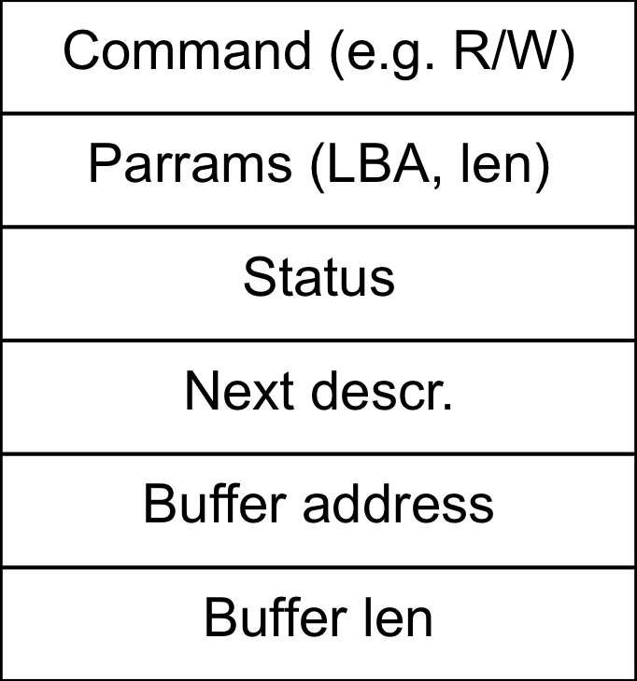
Command (e.g. R/W)
Params (LBA, len)
Status
Next descr.
Buffer address
Buffer len
data buffer
data buffer
data buffer

