Slide 1
Abstract Mashups for Enterprise Java
Ed Burn
Hazem Saleh

Slide 2
Overview
What is Mashability.
How does mashability influence the success of a venture for both the public and enterprise.
Enterprise mashup case study.
Mashups development current challenges.
Mashup application Idea.
What is Mashups4JSF.
Building the mashup application using Mashups4JSF.
Conclusion.

Slide 3
Mashups Development current challenges
There is no unified model agreed by all the mashup service providers for mashup service creation and consumption.
Different representation of mashup services
  SOAP.
  REST.
Different formats of mashup services
  ATOM.
  RSS.
  JSON.
  Others.

Slide 4

Mashups Development current challenges
Intensive JavaScript.
Atom Feed Parsing.
RSS Feed Parsing.
JSON Parsing.
Other formats Parsing.

Slide 5

Mashups Development current challenges
Study low level APIs of the Mashup service provider.
Write a great deal of integration code.

Slide 6
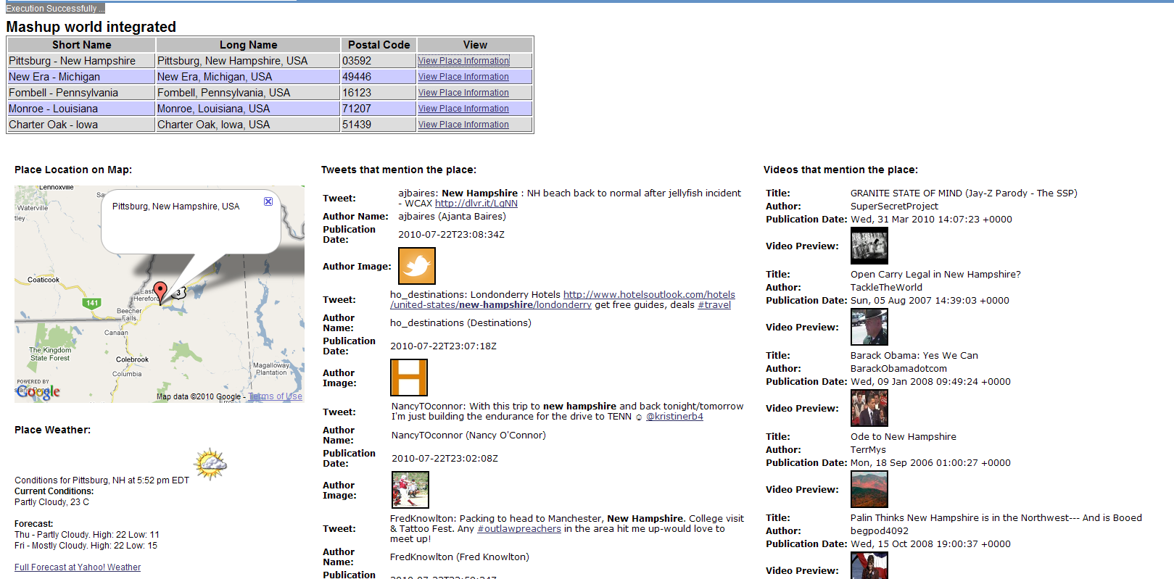
Mashup Application Idea

Slide 7
Mashup Application Idea
// YouTube API Example (RSS Format ==> Using JDOM Library for parsing).
String query = "JavaOne";
try {
URL feedUrl = new URL("http://gdata.youtube.com/feeds/api/videos?alt=rss&v=2&max-results=5&q=" + query);
SAXBuilder builder = new SAXBuilder();
Document document = builder.build(feedUrl);
Element rootElement = document.getRootElement();
List children = rootElement.getChild("channel").getChildren("item");
for (int i = 0; i < children.size(); ++i) {
Element element = (Element) children.get(i);
System.out.println((i + 1) + "- ");
System.out.println(element.getChild("title").getText());
System.out.println(element.getChild("link").getText());
// Get other attributes here (Eliminated for simplification) ...
}
} catch (Exception e) {
// Exception Handling ...
e.printStackTrace();
}

Slide 8
Mashup Application Idea
// Twitter API Example (JSON ==> Using JSON Java Library for parsing).
String query = "JavaOne";
try {
query = URLEncoder.encode(query, "UTF-8");
URL url = new URL("http://search.twitter.com/search.json?q=" + query);
URLConnection connection = url.openConnection();
String line;
StringBuilder builder = new StringBuilder();
BufferedReader reader = new BufferedReader(new InputStreamReader(connection.getInputStream()));
while ((line = reader.readLine()) != null) {
builder.append(line);
}
String response = builder.toString();
JSONObject json = new JSONObject(response);
JSONArray jsonArray = json.getJSONArray("results");
for (int i = 0; i < jsonArray.length(); ++i) {
System.out.print((i + 1) + "- ");
JSONObject j = jsonArray.getJSONObject(i);
System.out.println(j.getString("text"));
// Get other attributes here (Eliminated for simplification) ...
}
} catch (Exception e) {
// Exception Handling ...
e.printStackTrace();
}

Slide 9
Mashup Application Idea
<script type="text/javascript">
// Google Maps code ...
if (GBrowserIsCompatible()) {
var address = "NY, USA";
var map = new GMap2(document.getElementById("map"));
map.setCenter(new GLatLng(24, 15), 13);
var geocoder = new GClientGeocoder();
geocoder.getLatLng(address,
function(location) {
if (!location) {
alert(location + " not found");
} else {
map.setCenter(location, 13);
var marker = new GMarker(location);
marker.openInfoWindow(address);
map.addOverlay(marker);
}
}
);
//add the map control.
var mapControlPosition = new GControlPosition(G_ANCHOR_BOTTOM_RIGHT, new GSize(10, 10));
map.addControl(new GLargeMapControl(), mapControlPosition);
}
</script>

Slide 10
What is Mashups4JSF
One of the possible way for simplifying mashup development in the Java World.
Provides a set of APIs that wraps the low level information of Mashup services.
Provides a set of JSF components that allows the JSF developer to construct rich and customized mashups inside the web page.
The project is still undergoing incubation.

Slide 11
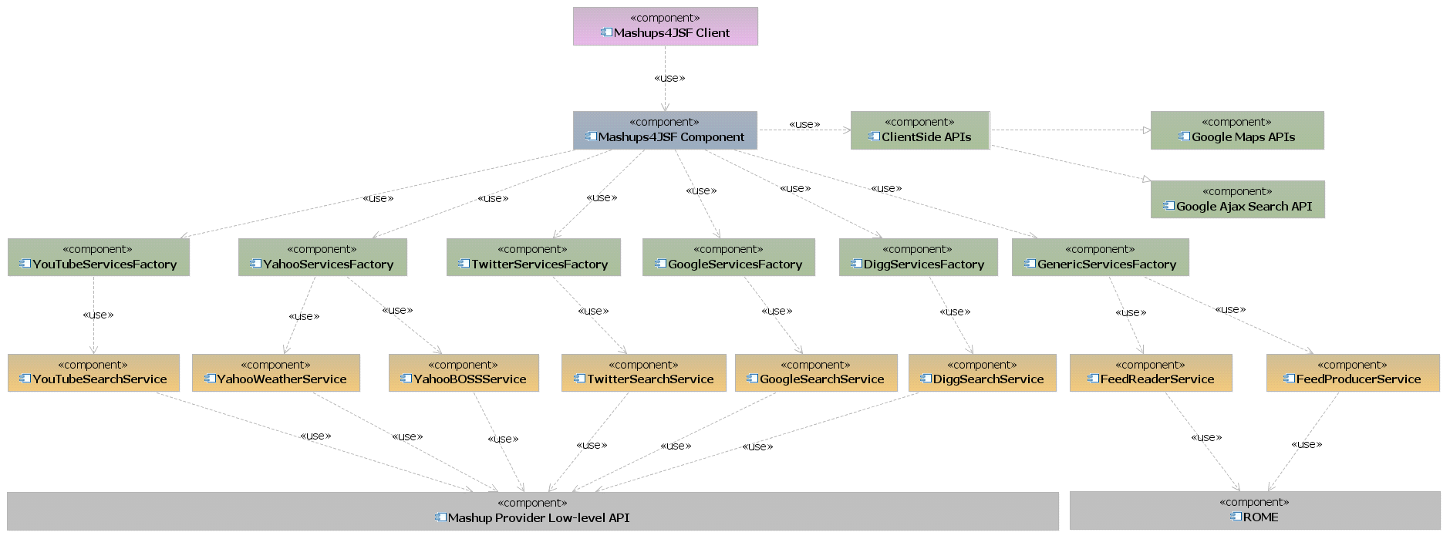
What is Mashups4JSF

Slide 12
Building the mashup application using Mashups4JSF
JSF Components:
  <m:map />.
  <mashup:yahooWeather />.
  <mashup:twitterSearchList />.
  <mashup:youTubeVideoList />.
Let's build the demo from scratch.

Slide 13
Conclusion
Mashups are important.
Having a mashup meta-model gives developers a lot of power.
Key ingredients for a mashup meta-model:
  Mashup integration happens on the server.
  There is a declarative syntax for describing the mashup:
    This syntax includes a suitably powerful component abstraction model.
  There is a powerful programming language that works closely with the declarative syntax.
  Hide the lower level APIs offered by the mashup service providers.

