Slide 1
Abstract Mashups
for Enterprise Java
Ed Burns
Hazem Saleh

Slide 2
AGENDA
1
What is Mashability.
2
How does mashability influence the success of a venture for both the public and enterprise.
3
Enterprise mashup case study.
4
Mashups development current challenges.
5
Mashup application Idea.
6
What is Mashups4JSF.
7
Building the mashup application using Mashups4JSF.
8
Conclusion

Slide 3
AGENDA
1
What is Mashability.
2
How does mashability influence the success of a venture for both the public and enterprise.
3
Enterprise mashup case study.
4
Mashups development current challenges.
5
Mashup application Idea.
6
What is Mashups4JSF.
7
Building the mashup application using Mashups4JSF.
8
Conclusion

Slide 4
AGENDA
1
What is Mashability.
2
How does mashability influence the success of a venture for both the public and enterprise.
3
Enterprise mashup case study.
4
Mashups development current challenges.
5
Mashup application Idea.
6
What is Mashups4JSF.
7
Building the mashup application using Mashups4JSF.
8
Conclusion

Slide 5
AGENDA
1
What is Mashability.
2
How does mashability influence the success of a venture for both the public and enterprise.
3
Enterprise mashup case study.
4
Mashups development current challenges.
5
Mashup application Idea.
6
What is Mashups4JSF.
7
Building the mashup application using Mashups4JSF.
8
Conclusion

Slide 6
AGENDA
1
What is Mashability.
2
How does mashability influence the success of a venture for both the public and enterprise.
3
Enterprise mashup case study.
4
Mashups development current challenges.
5
Mashup application Idea.
6
What is Mashups4JSF.
7
Building the mashup application using Mashups4JSF.
8
Conclusion

Slide 7
Mashups Development current challenges
There is no unified model agreed by all the mashup service providers for mashup service creation and consumption.
Different representation of mashup services
SOAP
REST
Different representation of mashup services
ATOM
RSS
JSON
Others

Slide 8

Mashups Development current challenges
Intensive JavaScript.
Atom Feed Parsing.
RSS Feed Parsing.
JSON Parsing.
Other formats Parsing.

Slide 9

Mashups Development current challenges
Study low level APIs of the Mashup service provider.
Write a great deal of integration code.

Slide 10
AGENDA
1
What is Mashability.
2
How does mashability influence the success of a venture for both the public and enterprise.
3
Enterprise mashup case study.
4
Mashups development current challenges.
5
Mashup application Idea.
6
What is Mashups4JSF.
7
Building the mashup application using Mashups4JSF.
8
Conclusion

Slide 11
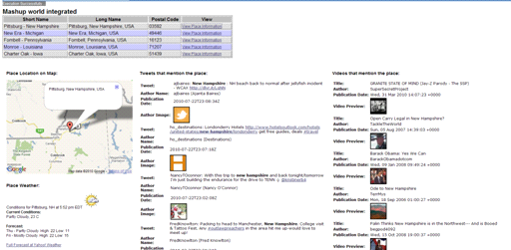
Mashup Application Idea

Slide 12
Mashup Application Idea
// YouTube API Example (RSS Format ==> Using JDOM Library for parsing).
String query = "JavaOne";
try {
URL feedUrl = new URL("http://gdata.youtube.com/feeds/api/videos?alt=rss&v=2&max-
results=5&q=" + query);
SAXBuilder builder = new SAXBuilder();
Document document = builder.build(feedUrl);
Element rootElement = document.getRootElement();
List children = rootElement.getChild("channel").getChildren("item");
for (int i = 0; i < children.size(); ++i) {
Element element = (Element) children.get(i);
System.out.println((i + 1) + "- ");
System.out.println(element.getChild("title").getText());
System.out.println(element.getChild("link").getText());
// Get other attributes here (Eliminated for simplification) ...
}
} catch (Exception e) {
// Exception Handling ...
e.printStackTrace();
}

Slide 13
Mashup Application Idea
// Twitter API Example (JSON ==> Using JSON Java Library for parsing).
String query = "JavaOne";
try {
query = URLEncoder.encode(query, "UTF-8");
URL url = new URL("http://search.twitter.com/search.json?q=" + query);
URLConnection connection = url.openConnection();
String line;
StringBuilder builder = new StringBuilder();
BufferedReader reader = new BufferedReader(new
InputStreamReader(connection.getInputStream()));
while ((line = reader.readLine()) != null) {
builder.append(line);
}
String response = builder.toString();
JSONObject json = new JSONObject(response);
JSONArray jsonArray = json.getJSONArray("results");
for (int i = 0; i < jsonArray.length(); ++i) {
System.out.print((i + 1) + "- ");
JSONObject j = jsonArray.getJSONObject(i);
System.out.println(j.getString("text"));
// Get other attributes here (Eliminated for simplification) ...
}
} catch (Exception e) {
// Exception Handling ...
e.printStackTrace();
}

Slide 14
Mashup Application Idea
<script type="text/javascript">
// Google Maps code ...
if (GBrowserIsCompatible()) {
var address = "NY, USA";
var map = new GMap2(document.getElementById("map"));
map.setCenter(new GLatLng(24, 15), 13);
var geocoder = new GClientGeocoder();
geocoder.getLatLng(address,
    function(location) {
    if (!location) {
    alert(location + " not found");
    } else {
    map.setCenter(location, 13);
    var marker = new GMarker(location);
    marker.openInfoWindow(address);
    map.addOverlay(marker);
    }
    }
);
//add the map control.
var mapControlPosition = new GControlPosition(G_ANCHOR_BOTTOM_RIGHT, new GSize(10,
10));
map.addControl(new GLargeMapControl(), mapControlPosition);
}
</script>

Slide 15
AGENDA
1
What is Mashability.
2
How does mashability influence the success of a venture for both the public and enterprise.
3
Enterprise mashup case study.
4
Mashups development current challenges.
5
Mashup application Idea.
6
What is Mashups4JSF.
7
Building the mashup application using Mashups4JSF.
8
Conclusion

Slide 16
What is Mashups4JSF
Simplify
JSF Components
Feed Annotation
API Wrapers
One of the possible ways for simplifying mashup development in the Java World
Provides a set of APIs that wraps the low level information of Mashup services.
Provides the @Feed annotation for exporting application data as mashup feeds.
Provides a set of JSF components that allows the JSF developer to construct rich and customized mashups inside the web page.

Slide 17
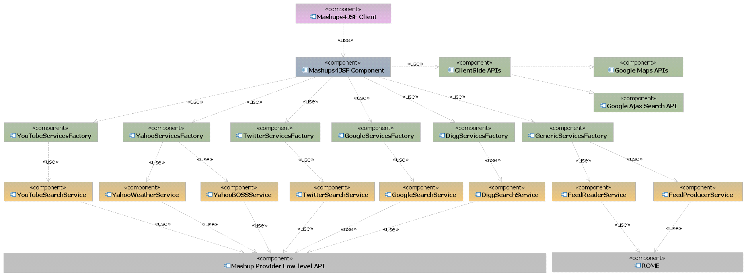
What is Mashups4JSF

Slide 18
AGENDA
1
What is Mashability.
2
How does mashability influence the success of a venture for both the public and enterprise.
3
Enterprise mashup case study.
4
Mashups development current challenges.
5
Mashup application Idea.
6
What is Mashups4JSF.
7
Building the mashup application using Mashups4JSF.
8
Conclusion

Slide 19
Building the mashup application using Mashups4JSF.
<m:map />
<mashup:
twitterSearchList />
<mashup:
youTubeVideoList />
<mashup:
yahooWeather />

Slide 20
AGENDA
1
What is Mashability.
2
How does mashability influence the success of a venture for both the public and enterprise.
3
Enterprise mashup case study.
4
Mashups development current challenges.
5
Mashup application Idea.
6
What is Mashups4JSF.
7
Building the mashup application using Mashups4JSF.
8
Conclusion

Slide 21
Conclusion
  Mashups are important.
  Having a mashup meta-model gives developers a lot of power.
  Key ingredients for a mashup meta-model:
  Mashup integration happens on the server.
  There is a declarative syntax for describing the mashup:
  This syntax includes a suitably powerful component abstraction model.
  There is a powerful programming language that works closely with the declarative syntax.
  Hide the lower level APIs offered by the mashup service providers.

